Slide 1
Multiple Objectives & Simple Multi-attribute Rating Technique (SMART)
“It should be emphasized that the main role of our analysis is to enable the decision maker to gain an increased understanding of his or her decision problem.”
- Goodwin and Wright

Slide 2
Logistics
We are going to be in this lab (103c) every Monday now
I do not receive emails back from Cicada – last week many of you emailed me asking for your assignments and I never got the email.

Slide 3
Today’s Goals
What terminology is important?
What is an example of a multi-objective problem using SMART?

Slide 4
What is SMART?
Simple Multi-Attribute Rating Technique
Allows for multiple objectives to be weighted according to decision maker preferences.
 | Cost | Design | Speed | Reliability
Honda | 10000 | B | A | D
Chevy | 5000 | B | D | B
Toyota | 7500 | C | C | A
Which of the above should we choose?

Slide 5
Terminology
Objective (Book Definition) – “Indication of the preferred direction of movement”.
Objective (Better Definition) – The goal(s) of your project.

Slide 6
Example Objectives
“Minimize the total costs”
“Minimize the distance between homes and fire stations”
“Maximize the exposure of a television advertisement”

Slide 7
Terminology
Attribute – Something used to measure progress towards an objective.
Proxy Attribute – An indirect measurement of progress towards an objective.

Slide 8
Example Attributes
Objective: “Minimize the total costs”
Attribute: Total dollars spent on the project.
Objective: “Minimize the distance between homes and fire stations”
Attribute: Distance in meters between homes.
Objective:
“Maximize the exposure of a television advertisement”
(Proxy) Attribute:
Number of people surveyed who recall advertisement.

Slide 9
Terminology
Utility – The total worth of a course of action under risk and uncertainty (because you ALWAYS have risk and uncertainty!!!)

Slide 10
Today’s Goals
What terminology is important?
What is an example of a multi-objective problem using SMART?

Slide 11
What is SMART?
8 Stages of SMART:
Identify Decision Maker
Identify Alternative Courses of Action
Identify Relevant Attributes
Assign values to measure performance of the alternatives on that attribute
Determine a weight for each attribute
Take a weighted average of the values for each alternative
Make a provisional decision
Perform sensitivity analysis

Slide 12
SMART Example: Which Office to Buy?
Location of office Annual rent ($)
Addison Square 30 000
Bilton Village 15 000
Corlisle Walk 5 000
Denver Street 12 000
Elton Street 30 000
Filton Village 15 000
Gorton Square 10 000

Slide 13
SMART Example: Which Office to Buy?
Identify Decision Maker – Us!
Identify Alternative Courses of Action – Different buildings we could buy are already identified.
Identify Relevant Attributes – What are the buildings like? All we know about them is price right now.

Slide 14
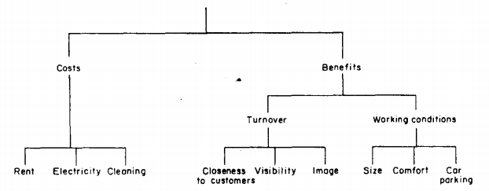
SMART: (3) Identify Relevant Attributes
Using a Value Tree:
Different from a decision tree: focuses on attributes of a decision.

Slide 15
SMART: (3) Using a Value Tree
A Value Tree Should Have Five(ish) Charachteristics:
Complete: All relevant attributes included.
Operational: Need to be able to quantify “leaf” nodes.
Decomposable / No Redundancy: Attributes must not overlap.
Minimum size: Larger trees can become impossible to interpret.

Slide 16
Today’s Goals
SMART
(If Time) Discuss AHP

Slide 17
Logistics
Optional Reading Assignment:
Will be online by the end of the week, I promise!
Due the Monday after Spring Break
Will take the average of this grade and your first reading assignment grade to replace your first grade.
Next Week: AAG
Dan will be out of town Tuesday-Sunday (Feb 26)
Nick will be out of town Thursday-Sunday (Feb 26)
Problem set 1 due Monday Feb 27, Presentations Mon Feb 27 and Wed Feb 29.
Next Wednesday: BP310 Computer Lab

Slide 18
Office | Rent | Electric | Cleaning | Closeness | Visibility | Image | Size | Comfort | Car Parking
Addison Square | 30,000
Bilton Village | 15,000
Corlisle Walk | 5,000
Denver Street | 12,000
Elton Street | 30,000
Filton Village | 15,000
Gorton Square | 10,000

Slide 19
Stop Here Monday

Slide 20
SMART Example: Which Office to Buy?
Identify Decision Maker – Us!
Identify Alternative Courses of Action – Different buildings we could buy are already identified.
Identify Relevant Attributes – Value Tree.
Assign values to measure performance of the alternatives on that attribute

Slide 21
SMART: (4) Assigning Values
You can measure many attributes directly, e.g. Costs, Size (sq. feet), Distance to Customers (miles), Car Parking (# of Spaces), Visibility (number of cars/hour)
Office | Rent | Electric | Cleaning | Distance to Customers | Visibility | Image | Size | Comfort | Car Parking
Addison Square | 30,000 | 2,000 | 3,000 | 0 | 60 |  | 1000 |  | 90
Bilton Village | 15,000 | 800 | 2,000 | 4 | 80 |  | 550 |  | 30
Corlisle Walk | 5,000 | 700 | 1,000 | 1 | 70 |  | 400 |  | 100
Denver Street | 12,000 | 1,100 | 1,000 | 1.2 | 50 |  | 800 |  | 90
Elton Street | 30,000 | 2,300 | 2,500 | 2 | 60 |  | 1500 |  | 70
Filton Village | 15,000 | 2,600 | 1,000 | 8 | 0 |  | 400 |  | 0
Gorton Square | 10,000 | 900 | 1,100 | 1.3 | 100 |  | 700 |  | 80

Slide 22
SMART: (4) Assigning Values
What about things like “Image”, or “Comfort”, though?
Office | Rent | Electric | Cleaning | Distance to Customers | Visibility | Image | Size | Comfort | Car Parking
Addison Square | 30,000 | 2,000 | 3,000 | 0 | 60 |  | 1000 |  | 90
Bilton Village | 15,000 | 800 | 2,000 | 4 | 80 |  | 550 |  | 30
Corlisle Walk | 5,000 | 700 | 1,000 | 1 | 70 |  | 400 |  | 100
Denver Street | 12,000 | 1,100 | 1,000 | 1.2 | 50 |  | 800 |  | 90
Elton Street | 30,000 | 2,300 | 2,500 | 2 | 60 |  | 1500 |  | 70
Filton Village | 15,000 | 2,600 | 1,000 | 8 | 0 |  | 400 |  | 0
Gorton Square | 10,000 | 900 | 1,100 | 1.3 | 100 |  | 700 |  | 80

Slide 23
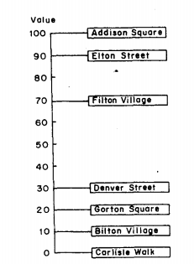
SMART: (4) Assigning Values
What about things like “Image”, or “Comfort”, though?
Rank the alternatives
Establish how big an improvement each is relative to the worst performing (e.g., the improvement from Corlisle to Filton is 7x the improvement from Corlisle to Bilton).
Check for internal consistency: is the improvement from Corlisle to Gorton comprable to Bilton to Denver?

Slide 24
SMART: (4) Assigning Values
What about things like “Image”, or “Comfort”, though?
Office | Rent | Electric | Cleaning | Distance to Customers | Visibility | Image | Size | Comfort | Car Parking
Addison Square | 30,000 | 2,000 | 3,000 | 0 | 60 | 100 | 1000 | 0 | 90
Bilton Village | 15,000 | 800 | 2,000 | 4 | 80 | 10 | 550 | 100 | 30
Corlisle Walk | 5,000 | 700 | 1,000 | 1 | 70 | 0 | 400 | 10 | 100
Denver Street | 12,000 | 1,100 | 1,000 | 1.2 | 50 | 30 | 800 | 30 | 90
Elton Street | 30,000 | 2,300 | 2,500 | 2 | 60 | 90 | 1500 | 60 | 70
Filton Village | 15,000 | 2,600 | 1,000 | 8 | 0 | 70 | 400 | 80 | 0
Gorton Square | 10,000 | 900 | 1,100 | 1.3 | 100 | 20 | 700 | 50 | 80

Slide 25
SMART: (4) Assigning Values
BUT! The improvement in an office for a 1 sq. ft. increase is better for smaller sizes than larger (at some point, additional size is irrelevant).
Office | Rent | Electric | Cleaning | Distance to Customers | Visibility | Image | Size | Comfort | Car Parking
Addison Square | 30,000 | 2,000 | 3,000 | 0 | 60 | 100 | 1000 | 0 | 90
Bilton Village | 15,000 | 800 | 2,000 | 4 | 80 | 10 | 550 | 100 | 30
Corlisle Walk | 5,000 | 700 | 1,000 | 1 | 70 | 0 | 400 | 10 | 100
Denver Street | 12,000 | 1,100 | 1,000 | 1.2 | 50 | 30 | 800 | 30 | 90
Elton Street | 30,000 | 2,300 | 2,500 | 2 | 60 | 90 | 1500 | 60 | 70
Filton Village | 15,000 | 2,600 | 1,000 | 8 | 0 | 70 | 400 | 80 | 0
Gorton Square | 10,000 | 900 | 1,100 | 1.3 | 100 | 20 | 700 | 50 | 80

Slide 26
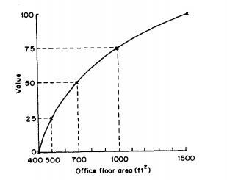
SMART: (4) Assigning Values
BUT! The improvement in an office for a 1 sq. ft. increase is better for smaller sizes than larger (at some point, additional size is irrelevant).
Identify a subjective “turning” point between smallest area (400 sq. ft.) and the largest area (1500 sq. ft). At which point is an increase less valuable?
Establish “quarter points” in between this turning point and the largest and smallest values.
Plot these points out to create the value function
Office | Size
Addison Square | 1000
Bilton Village | 550
Corlisle Walk | 400
Denver Street | 800
Elton Street | 1500
Filton Village | 400
Gorton Square | 700
Turning Point | Value
400 | 0
500 | 25
700 | 50
1000 | 75
1500 | 100

Slide 27
SMART: (4) Assigning Values
By following the value functions, we can revise these two columns of data to reflect preferences.
Office | Rent | Electric | Cleaning | Distance to Customers | Visibility | Image | Size | Comfort | Car Parking
Addison Square | 30,000 | 2,000 | 3,000 | 100 | 60 | 100 | 75 | 0 | 90
Bilton Village | 15,000 | 800 | 2,000 | 20 | 80 | 10 | 30 | 100 | 30
Corlisle Walk | 5,000 | 700 | 1,000 | 80 | 70 | 0 | 0 | 10 | 100
Denver Street | 12,000 | 1,100 | 1,000 | 70 | 50 | 30 | 55 | 30 | 90
Elton Street | 30,000 | 2,300 | 2,500 | 40 | 60 | 90 | 100 | 60 | 70
Filton Village | 15,000 | 2,600 | 1,000 | 0 | 0 | 70 | 0 | 80 | 0
Gorton Square | 10,000 | 900 | 1,100 | 60 | 100 | 20 | 50 | 50 | 80

Slide 28
What is SMART?
8 Stages of SMART:
Identify Decision Maker
Identify Alternative Courses of Action
Identify Relevant Attributes
Assign values to measure performance of the alternatives on that attribute
Determine a weight for each attribute
Take a weighted average of the values for each alternative
Make a provisional decision
Perform sensitivity analysis

Slide 29
SMART: (5) Assigning Weights
Total Costs are simple to calculate (you just sum!), but total benefits are more challenging: how do we weight “Visibility” vs. “Size”? Which is more important?
Office | Rent | Electric | Cleaning | Distance to Customers | Visibility | Image | Size | Comfort | Car Parking
Addison Square | 30,000 | 2,000 | 3,000 | 100 | 60 | 100 | 75 | 0 | 90
Bilton Village | 15,000 | 800 | 2,000 | 20 | 80 | 10 | 30 | 100 | 30
Corlisle Walk | 5,000 | 700 | 1,000 | 80 | 70 | 0 | 0 | 10 | 100
Denver Street | 12,000 | 1,100 | 1,000 | 70 | 50 | 30 | 55 | 30 | 90
Elton Street | 30,000 | 2,300 | 2,500 | 40 | 60 | 90 | 100 | 60 | 70
Filton Village | 15,000 | 2,600 | 1,000 | 0 | 0 | 70 | 0 | 80 | 0
Gorton Square | 10,000 | 900 | 1,100 | 60 | 100 | 20 | 50 | 50 | 80
Costs
Benefits

Slide 30
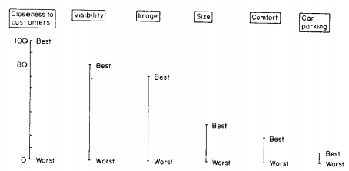
SMART: (5) Assigning Weights
“Swing” Weighting provides a method to establish weights:
Rank each attribute.
On a scale from 0-100, establish how important a swing from the worst to the best would be in the highest ranking attribute.
Determine what the relative swing would be for each other attribute.

Slide 31
For example...
SMART: (5) Assigning Weights
A swing from the worst ‘image’ to the best ‘image’ is considered to be 70% as important as a swing from the worst to the best location for ‘closeness to customers’
...so ‘image’ is assigned a weight of 70.

Slide 32
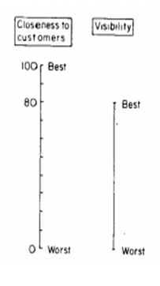
SMART: (5) Assigning Weights
Office | Distance to Customers | Visibility | Image | Size | Comfort | Car Parking
Weights | 100 | 80 | 70 | 30 | 20 | 10
Addison Square | 100 | 60 | 100 | 75 | 0 | 90
Bilton Village | 20 | 80 | 10 | 30 | 100 | 30
Corlisle Walk | 80 | 70 | 0 | 0 | 10 | 100
Denver Street | 70 | 50 | 30 | 55 | 30 | 90
Elton Street | 40 | 60 | 90 | 100 | 60 | 70
Filton Village | 0 | 0 | 70 | 0 | 80 | 0
Gorton Square | 60 | 100 | 20 | 50 | 50 | 80

Slide 33
Normalizing weights
SMART: (5) Assigning Weights
Normalized
weights
Attribute Original weights (rounded)
Closeness to customers 100 32
Visibility 80 26
Image 70 23
Size 30 10
Comfort 20 6
Car-parking facilities 10 3
310 100

Slide 34
SMART: (5) Assigning Weights
Office | Distance to Customers | Visibility | Image | Size | Comfort | Car Parking
Weights | 32 | 26 | 23 | 10 | 6 | 3
Addison Square | 100 | 60 | 100 | 75 | 0 | 90
Bilton Village | 20 | 80 | 10 | 30 | 100 | 30
Corlisle Walk | 80 | 70 | 0 | 0 | 10 | 100
Denver Street | 70 | 50 | 30 | 55 | 30 | 90
Elton Street | 40 | 60 | 90 | 100 | 60 | 70
Filton Village | 0 | 0 | 70 | 0 | 80 | 0
Gorton Square | 60 | 100 | 20 | 50 | 50 | 80
Normalized Weights

Slide 35
What is SMART?
8 Stages of SMART:
Identify Decision Maker
Identify Alternative Courses of Action
Identify Relevant Attributes
Assign values to measure performance of the alternatives on that attribute
Determine a weight for each attribute
Take a weighted average of the values for each alternative
Make a provisional decision
Perform sensitivity analysis

Slide 36
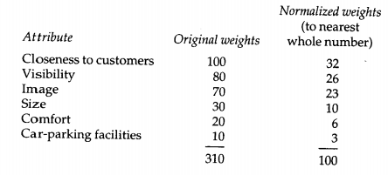
SMART: (6) Applying Weights
Finally, we apply the weights by multiplying and then summing to get a measurement of total benefits for each office.
Office | Distance to Customers | Visibility | Image | Size | Comfort | Car Parking
Normalized Weights | 32 | 26 | 23 | 10 | 6 | 3
 | * | * | * | * | * | *
Addison Square | 100 | 60 | 100 | 75 | 0 | 90
 | = | = | = | = | = | =
Value * Weight | 3200 | 1560 | 2300 | 750 | 0 | 270
Total Benefits for Addison Square: 8,080

Slide 37
SMART: (6) Applying Weights
Office | Distance to Customers | Visibility | Image | Size | Comfort | Car Parking | Aggregate Benefits
Weights | 32 | 26 | 23 | 10 | 6 | 3
Addison Square | 100 | 60 | 100 | 75 | 0 | 90 | 8,080
Bilton Village | 20 | 80 | 10 | 30 | 100 | 30 | 3,940
Corlisle Walk | 80 | 70 | 0 | 0 | 10 | 100 | 4,740
Denver Street | 70 | 50 | 30 | 55 | 30 | 90 | 5,230
Elton Street | 40 | 60 | 90 | 100 | 60 | 70 | 6,480
Filton Village | 0 | 0 | 70 | 0 | 80 | 0 | 2,090
Gorton Square | 60 | 100 | 20 | 50 | 50 | 80 | 6,020

Slide 38
What is SMART?
8 Stages of SMART:
Identify Decision Maker
Identify Alternative Courses of Action
Identify Relevant Attributes
Assign values to measure performance of the alternatives on that attribute
Determine a weight for each attribute
Take a weighted average of the values for each alternative
Make a provisional decision
Perform sensitivity analysis

Slide 39
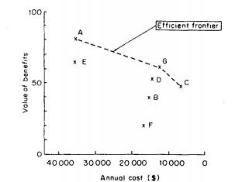
SMART: (7) Provincial Decision
Office | Aggregate Benefits | Aggregate Costs
Addison Square | 8080 | 35000
Bilton Village | 3940 | 17800
Corlisle Walk | 4740 | 6700
Denver Street | 5230 | 14100
Elton Street | 6480 | 34800
Filton Village | 2090 | 18600
Gorton Square | 6020 | 12000

Slide 40
SMART: (7) Provincial Decision
Addison, Gorton, and Corlisle represent “non-dominated” choices.
All other choices are dominated, or bested in both costs and benefits by
another choice.
Office | Aggregate Benefits | Aggregate Costs | Cost : Benefit
Addison Square | 8080 | 35000 | 4.3
Corlisle Walk | 4740 | 6700 | .7
Gorton Square | 6020 | 12000 | 1.99

Slide 41
What is SMART?
8 Stages of SMART:
Identify Decision Maker
Identify Alternative Courses of Action
Identify Relevant Attributes
Assign values to measure performance of the alternatives on that attribute
Determine a weight for each attribute
Take a weighted average of the values for each alternative
Make a provisional decision
Perform sensitivity analysis

Slide 42
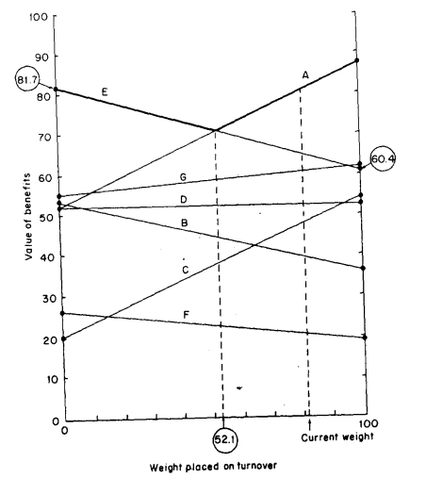
SMART: (8) Sensitivity Analysis
Identical to how we might perform analyze sensitivity for a cost : benefit analysis.
We will explore this in lab on Monday.
Needlessly Complicated Figure 2.7!

Slide 43
SMART: Summary
8 Stages of SMART:
Identify Decision Maker
Identify Alternative Courses of Action
Identify Relevant Attributes
Assign values to measure performance of the alternatives on that attribute
Determine a weight for each attribute
Take a weighted average of the values for each alternative
Make a provisional decision
Perform sensitivity analysis

Slide 44
Assumptions of SMART
Decidability: We assume the decision maker has preferences.
Transitivity: The decision makers preferences are consistent (e.g., A > B, C > B, Thus C > A).
Summation: The interval between A and B is smaller than the interval between A and C in terms of preferences.
Solvability: Preferences can be determined (this may not always be true).
Finite upper and lower bounds of value: For example, to use methods like this the EPA *must* have a value of human life less than infinity.

Slide 45
The Analytical Hierarchy Process (AHP)
“The analytical hierarchy process (AHP) offers an alternative approach to SMART when a decision maker is faced with a problem involving multiple objectives”
- Goodwin and Wright

Slide 46
Today’s Goals
What is AHP?
What are some strengths / weaknesses of AHP?

Slide 47
What is AHP?
Analytical Hierarchy Process
Allows for multiple objectives to be weighted according to decision maker preferences, using pairwise comparisons.
Car | Maintenance | Mileage | Cost
Toyota | A | 100,000 | 10,000
Honda | A | 50,000 | 8,000
Chevy | D | 10,000 | 10,000
Which car to pick?

Slide 48
What is AHP?
The basic idea: comparing two things at once is easier than ranking many things on a scale.

Slide 49
What is AHP?
5 Steps:
Set up a “decision hierarchy” (nearly identical to a Value Tree).
Make pairwise comparisons of attributes and alternatives
Transform pairwise comparisons into weights, check consistency
Use weights to obtain scores and make a provisional decision
Sensitivity analysis (surprise!)

Slide 50
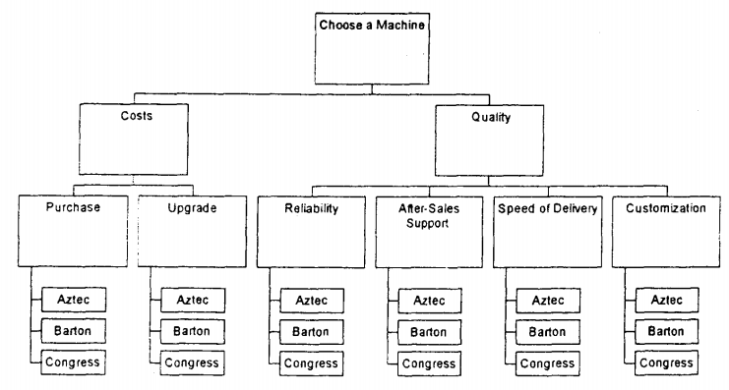
Step (1): Set Up Decision Hierarchy

Slide 51
Step (2): Make Pairwise Comparisons
Start from the top: Are Costs or Quality more important? Are they weakly, strongly, very strongly, or extremely more important?

Slide 52
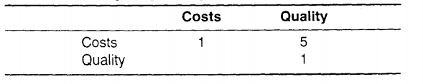
Step (2): Make Pairwise Comparisons
At each level of analysis, make a table that looks like this:
A “5” would indicate that Costs are 5 times more important than Quality.
“1”s are always on the diagonals: Costs are equally important to Costs!

Slide 53
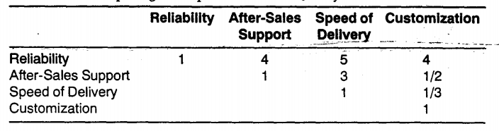
Step (2): Make Pairwise Comparisons
QUIZ:
How important is Customization relative to Speed of Delivery?

Slide 54
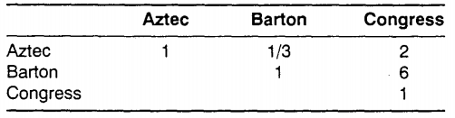
Step (2): Make Pairwise Comparisons
In terms of price, the decision maker strongly prefers “Barton” over “Congress” machine types.

Slide 55
What is AHP?
5 Steps:
Set up a “decision hierarchy” (nearly identical to a Value Tree).
Make pairwise comparisons of attributes and alternatives
Transform pairwise comparisons into weights, check consistency
Use weights to obtain scores and make a provisional decision
Sensitivity analysis (surprise!)

Slide 56
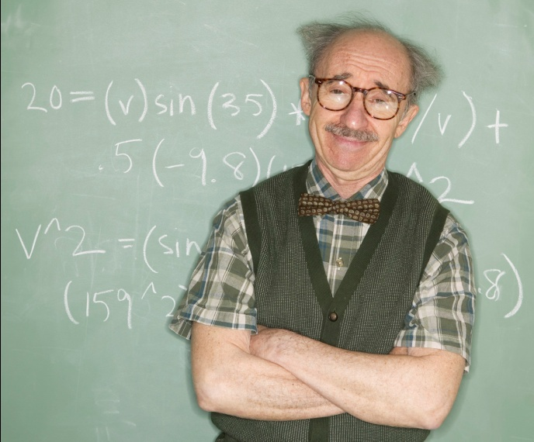
Step (3): Create Weights
MATH!
Weights

Slide 57
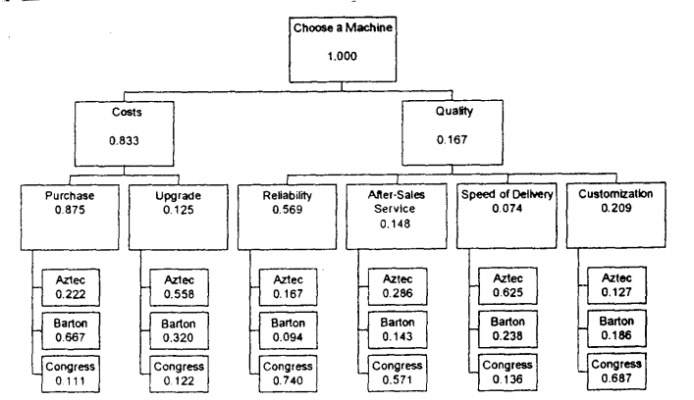
Step (3): Create Weights

Slide 58
Step (3): Examine Inconsistency
Transitivity: The decision makers preferences are consistent (e.g., A > B, C > B, Thus C > A).
Summation: If B is 3 times more important than A, and C is 2 times more important than B, C should be 6 times more important than A.

Slide 59
Step (3): Examine Inconsistency
“Inconsistency” Index: 0 indicates perfect consistency in choices; “rule of thumb” that values > 0.1 are worrisome.
More important that you understand inconsistency and how it might influence results. Correcting inconsistency may not be that important!

Slide 60
What is AHP?
5 Steps:
Set up a “decision hierarchy” (nearly identical to a Value Tree).
Make pairwise comparisons of attributes and alternatives
Transform pairwise comparisons into weights, check consistency
Use weights to obtain scores and make a provisional decision
Sensitivity analysis (surprise!)

Slide 61
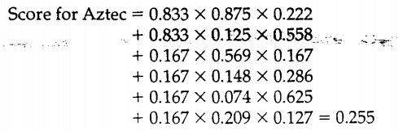
Step (4): Obtain Scores

Slide 62
Step (4): Obtain Scores

Slide 63
Step (4): Obtain Scores

Slide 64
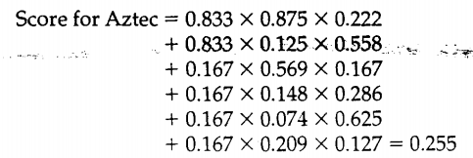

Step (4): Make Provisional Decision
Repeat for all alternatives

Slide 65
Step (5): Sensitivity Analysis
The same as Cost/Benefit Analysis or SMART: Introduce uncertainty into each measurement.

Slide 66
Today’s Goals
What is AHP?
What are some strengths / weaknesses of AHP?

Slide 67
Strengths of AHP
Formal structuring of the problem: The value tree itself aid in decision making.
Simplicity of pairwise comparisons
You can check the consistency of preferences

Slide 68
Weaknesses of AHP
Subjectivity in Preferences: You have to translate comments such as “This is MUCH more important than that” on to a numerical scale.
Inconsistency due to scale: AHP limits something to being 9 times as important as something else. This can cause inconsistency.
New alternatives can cause the entire process to need to be redone.
Number of comparisons can be large

