Slide 1
Steps
Step 1: Characterize Goals
Step 2: Collect Data
Step 3: Survey
Step 4: Integrate Information
Step 5: Forecast
Step 6: Analysis
Step 7: Option Analysis
Step 8: Post-decision Assessment

Slide 2

The problem
USACE (United States Army Corps of Engineers) has thousands of projects throughout the country
Only some of them can be improved
These improvements must be chosen in light of uncertainty in the future!

Slide 3
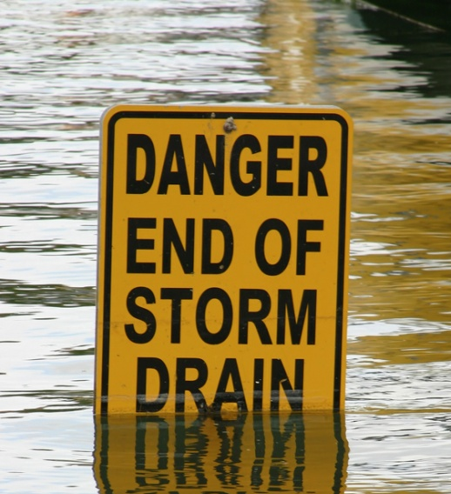
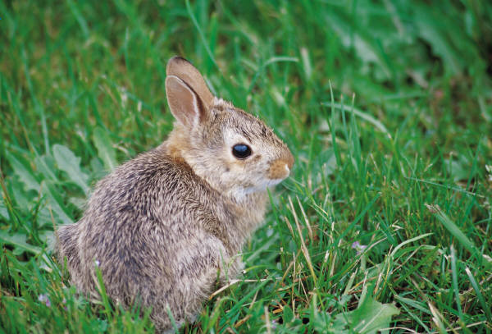
Step 1: Characterize Goals
This (real world) example will focus on just two groups in USACE, flood risk and ecosystem restoration.
Flood risk seeks to spend money on projects which MINIMIZE the risk of potential flooding events.
Ecosystem Restoration seeks to spend money on projects which MAXIMIZES environmental carrying capacity.

Slide 4

Step 2: Collect Data
During this step, we collected environmental data (“indicators”) that gave us information on Flood Risk and Ecosystem Restoration:
  How many people live in different flood plains?
    We could target spending at areas with higher flood plain populations.
  What species are at risk in different areas?
    We could target spending at
    areas with higher risk.

Slide 5
Step 3: Survey
Identify impacts or additional risk factors that may not be directly related to the task at hand (e.g., legal restrictions on funding; economic information)
  Participation in flood insurance programs (how much would the occurrence of a flood impact a community?)
  The level of protection already granted to some areas (no need to fund
  already well protected species)

Slide 6

Step 4: Integrate Information
All of this information was combined using a variety of database technologies (Both GIS and Tabular).
While easy to describe, this step is frequently the most time consuming in a project.

Slide 7


Step 5: Forecast
For each indicator that was collected, how that indicator would change over time was projected for a variety of scenarios.
Scenario – A set of assumptions about the future. E.g., the Special Report on Emissions Scenarios (SRES).
In our case: how many people do we expect to move in to flood plains?

Slide 8
Step 6: Analysis
At this stage, each area had information on flood risk and ecosystem restoration
  But how to combine these indicators into actionable information?
  Methods:
    Analytical Hierarchy Process for Weighting – how important are things relative to each other?
    Aggregation techniques (Data Envelopement Analysis / Ordered Weighted Ordered Aggregation)

Slide 9

Step 7: Option Analysis
Once the relative importance of each area is known, investments can be made.
  However, many different investment options (e.g., do we build a damn or a levy?)
  Tools such as AHP, Cost-benefit analysis, and game theory can help to select the best options.

Slide 10
Step 8: Post-decision Assessment
After the decision is made and implemented, funding to assess how accurate the decision making process was can be helpful in anticipating uncertainty in future projects.
A sensitivity analysis is also generally warranted at this step.

Slide 11
Summary
Step 1: Characterize Goals
Step 2: Collect Data
Step 3: Survey
Step 4: Integrate Information
Step 5: Forecast
Step 6: Analysis
Step 7: Option Analysis
Step 8: Post-decision Assessment

Slide 12
For Next Week
Mondays Reading is on Cicada
    Making Decisions about Environmental Policy by Michael E. Kraft
Reading assignment is online, but not due until the following Monday (Mon, Jan 30).
No Lab next Monday (first Lab will be on Jan 30).

