Slide 1
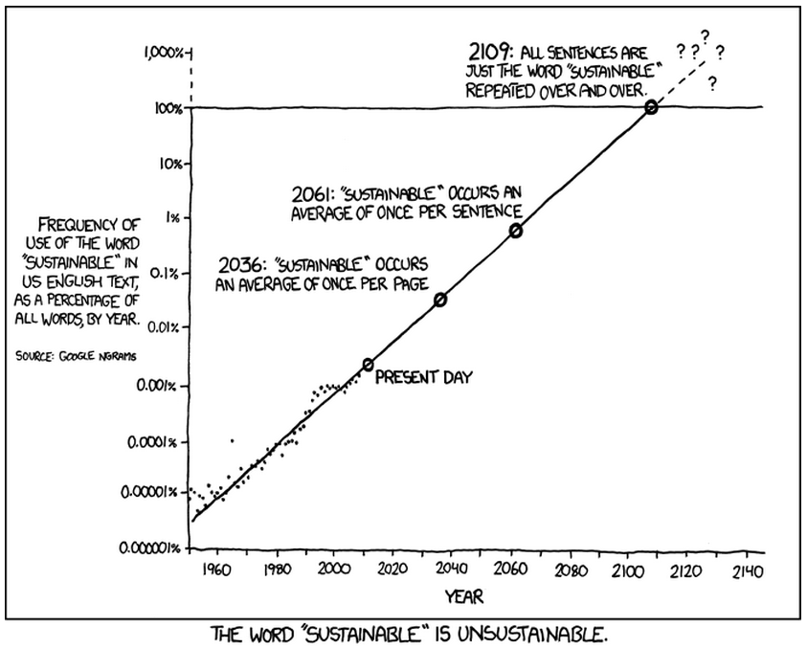
EN 261: Part Two
Welcome back from spring break!
xkcd.com/1007/

Slide 2
Recap
Cost/Benefit Analysis
Decision Trees
Discounting
SMART
Sensitivity / Uncertainty Analysis

Slide 3
What’s Next? (7 more weeks!)
Spatial Interpolation of Environmental Variables (Today)
Aggregation Techniques for Risk Assessment
GIS & Decision Making
AHP
LISA Analysis
Optimization Modeling
Two guest speakers:
Chi Ho Sham, Vice President, The Cadmus Group
Sam Ratick, Professor, Clark University (Formerly Operations Research Analyst, EPA)

Slide 4
Common Feedback from Jan/Feb
Want to see more of the “under the hood” stuff – how would you arrive at the values /data that are given in the assignments?
Assignments can sometimes be very hard to do in groups, logistically and otherwise.

Slide 5
Logistics
Reading Assignment 4 is due Mon Mar 19th.
Problem Set 2 will be given out this Wednesday, due Wednesday, Mar 28.
Both assignments are individual: everyone must turn their own assignment in.

Slide 6
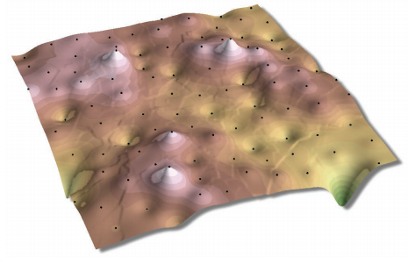
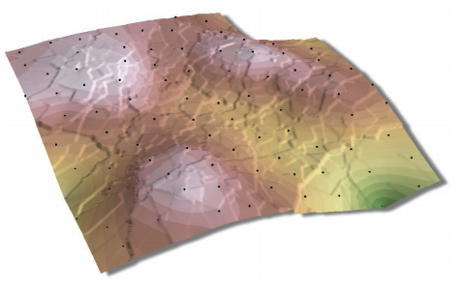
Spatial Interpolation

Slide 7
Today’s Goals
What is spatial interpolation?
What are some examples of spatial interpolation?
What are a few different types of interpolation?
What else do I need to know?

Slide 8
Spatial Interpolation
 | 8 |  | 8
 |  |  |  | 12
 |  | 12
# | Sample
# | Estimation

Slide 9
Spatial Autocorrelation
Things closer together are more similar than those farther apart.
1 | 0 | 1 |  | 3
1 | 1 | 1 | 3 | 4
3 | 2 | 2 | 4
4 | 3 |  | 5 | 6
5 | 4 | 5 | 6 | 7
The red and purple cells are more likely to be similar than the red and blue cells.

Slide 10
Today’s Goals
What is spatial interpolation?
What are some examples of spatial interpolation?
What are a few different types of interpolation?
What else do I need to know?

Slide 11
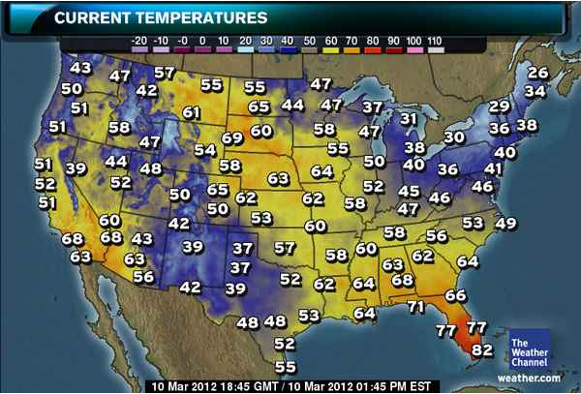
Day-to-day examples

Slide 12
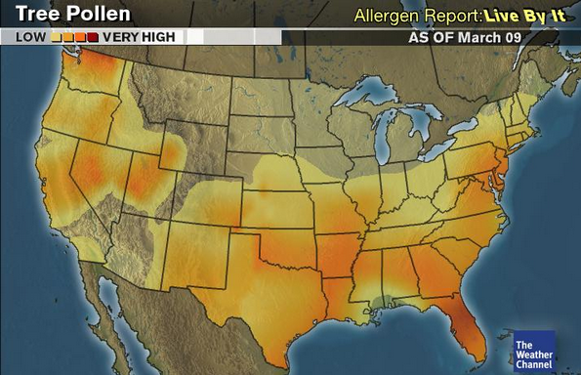

Slide 13
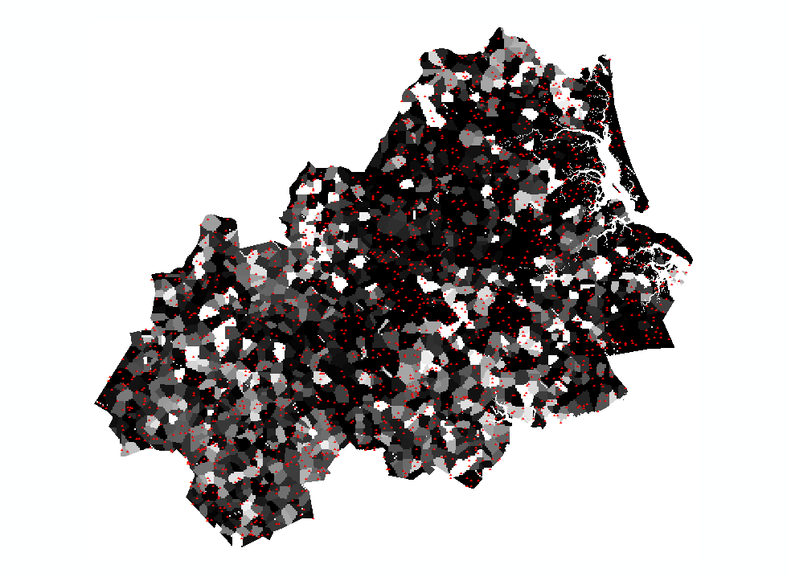

Environmental Examples
Estimates of Potential Nitrogen Runoff using Polygonal Interpolation
Sample Cell

Slide 14
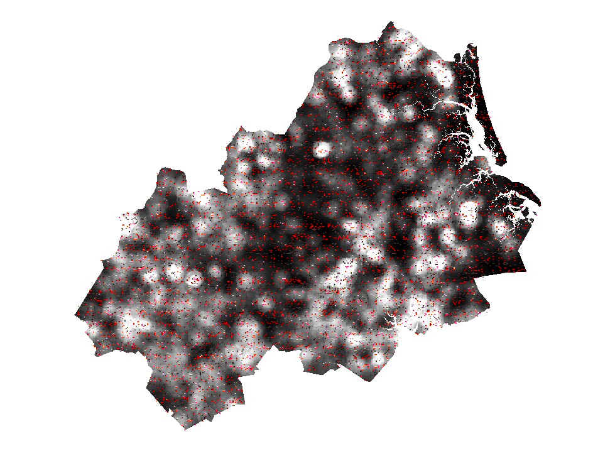
Environmental Examples
Estimates of Potential Nitrogen Runoff using IDW
Sample Cell
Sample Cell

Slide 15
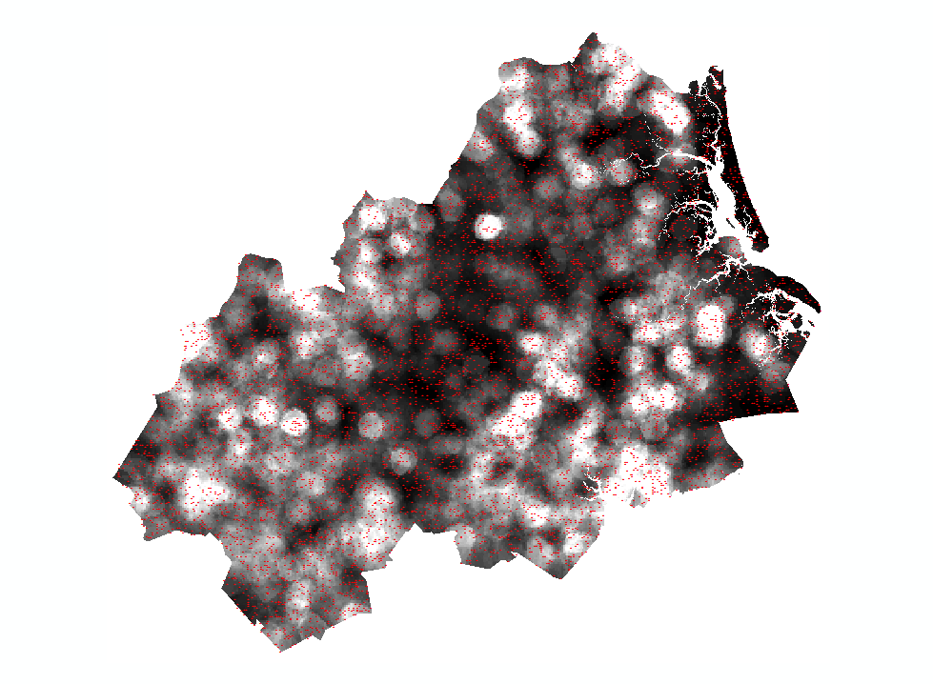
Environmental Examples
Estimates of Potential Nitrogen Runoff using Ordinary Kriging
Sample Cell

Slide 16
Today’s Goals
What is spatial interpolation?
What are some examples of spatial interpolation?
What are a few different types of interpolation?
What else do I need to know?

Slide 17
Types of Spatial Interpolation
Polygonal
Inverse Distance Weighting
Kriging
Splining
Regression Kriging
Co-Kriging
Natural Neighbor
….. and more!

Slide 18
Types of Spatial Interpolation
Polygonal
Inverse Distance Weighting
Kriging
TIN
Splining
Regression Kriging
Co-Kriging
Natural Neighbor
….. and more!

Slide 19
Polygonal Interpolation
Simple. Ideal when you suspect neighbors are extremely similar.
Each un-sampled cells is given the value of the closest sample.
 | 8 |  | 8
 |  |  |  | 12
 |  | 12
# | Sample
# | Estimation

Slide 20
 | 8 |  | 8
 | 12 |  |  | 12
 |  | 12
Process:
Identify the closest cell to the unknown point you are interested in estimating.
Assign that value to the unknown point.

Slide 21
Inverse Distance Weighting
More complex than Polygonal. A good choice if you know, theoretically, how quickly things become less similar (e.g., elevation tends to drop off at predictable rates in many places).
Each unknown point is given a value according to a WLC of other known points.
8 | 8 | 8 | 8 | 8
8 | 9 | 9 | 10 | 11
10 | 10 | 11 | 11 | 12
11 | 12 | 12 | 12 | 12
12 | 12 | 12 | 12 | 12

Slide 22
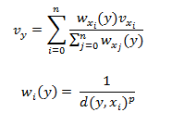
Inverse Distance Weighting
You don’t need to memorize these equations! But it will be helpful to know how it works for interpretation of your results.
Essentially, each unknown point has a value assigned to it based on the value of each known point, and the distance between the unknown point you want to estimate and all known points. The weight assigned to each known point is calculated in equation 2.

Slide 23
Process:
Calculate the distance between the point you want to estimate and all known points.
Determine the weight for each point by applying the equation: “1/d^p”
Multiply the weights by each value.
Divide this sum by the sum of weights.
 | 8 |  | 8
 | ? |  |  | 12
 |  | 12

Slide 24
Distances from unknown cell
Process:
Calculate the distance between the point you want to estimate and all known points.
 | 2 |  | 2.8
 | ? |  |  | 3
 |  | 1.4

Slide 25
Distances from unknown cell
Process:
Calculate the distance between the point you want to estimate and all known points.
Determine the weight for each point by applying the equation: “1/d^2”
The yellow cell is 2 units away from the unknown red cell. Thus, its weight is (1/[2^2]), or 0.25.
 | .25 |  | .13
 | ? |  |  | .11
 |  | .51

Slide 26
Distances from unknown cell
Process:
Calculate the distance between the point you want to estimate and all known points.
Determine the weight for each point by applying the equation: “1/d^2”
Multiply the weights by each value.
The original value in the yellow cell was 8. We multiply that by the distance weight, .25. 8*0.25 = 2.
 | 2 |  | 1.0
 | ? |  |  | 1.3
 |  | 6.1

Slide 27
Calculate the distance between the point you want to estimate and all known points.
Determine the weight for each point by applying the equation: “1/d^p”
Multiply the weights by each value.
Divide this sum by the sum of weights.
Distances from unknown cell
 | 2 |  | 1.0
 | ? |  |  | 1.3
 |  | 6.1
Numerator: 2 + 1.0 + 6.1 + 1.3 = 10.4
Denominator: .25 + .51 + .13 + .11 = 1.0
Final Estimate: 10.4 / 1.0 = 10.4!

Slide 28
Ordinary Kriging
Very complex. Useful when you have no theoretical knowledge of spatial autocorrelation, as this method uses your sample to estimate autocorrelation.
Also creates a WLC
8 | 8 | 8 | 8 | 8
8 | 9 | 8 | 9 | 9
9 | 9 | 9 | 12 | 12
11 | 12 | 12 | 12 | 12
12 | 12 | 12 | 12 | 12
# | Sample
# | Estimation

Slide 29

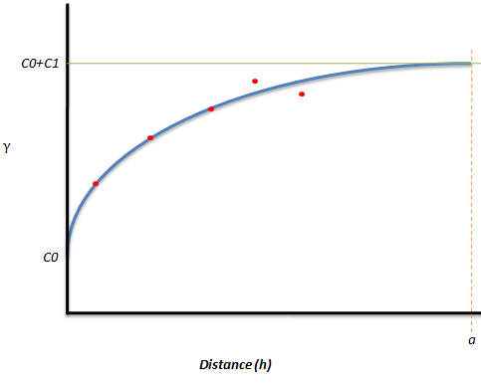

Kriging
A two step process. First, spatial autocorrelation is estimated from known points following the first equation.
Second, the weights from each known point to each unknown point are solved for on the basis of the autocorrelation you measure in the first step.

Slide 30
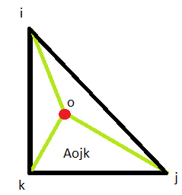
Triangulated Irregular Networks (TIN) AKA Delaunay Triangles
A refined version of the Polygonal technique. Useful when you know neighbors tend to be more similar.
Creates values based on the three closest known point to any unknown point.

Slide 31
Today’s Goals
What is spatial interpolation?
What are some examples of spatial interpolation?
What are a few different types of interpolation?
What else do I need to know?

Slide 32
Limitations
Spatial Interpolation only makes sense when there are spatial patterns in the data.
They are only valid within a single study domain (e.g., if you had weather stations in Alabama, you could not use them to interpolate weather data in Georgia).
Estimates are stronger when spatial autocorrelation is more prevalent.

Slide 33
Validation
Two types of validation are common:
Cross-validation: re-estimate the results over and over again by dropping one point out of the analysis and predicting what its value is. Error is estimated on the basis of all of these validations.
Calibration/Validation: Intentionally use a portion of your data for calibrating only, and a portion of your data for validation only.

Slide 34
Reading Assignment 4
You will be using multiple interpolative methods to predict precipitation in the Plum Island Ecosystems, an area just north of Boston, MA.
You will compare the results of each method, and write why you think those differences occur.
This is NOT a group assignment: everyone must turn in their own!

