Slide 1
FOXSI flare HPD measurements version 3
Sept 2013

Slide 3
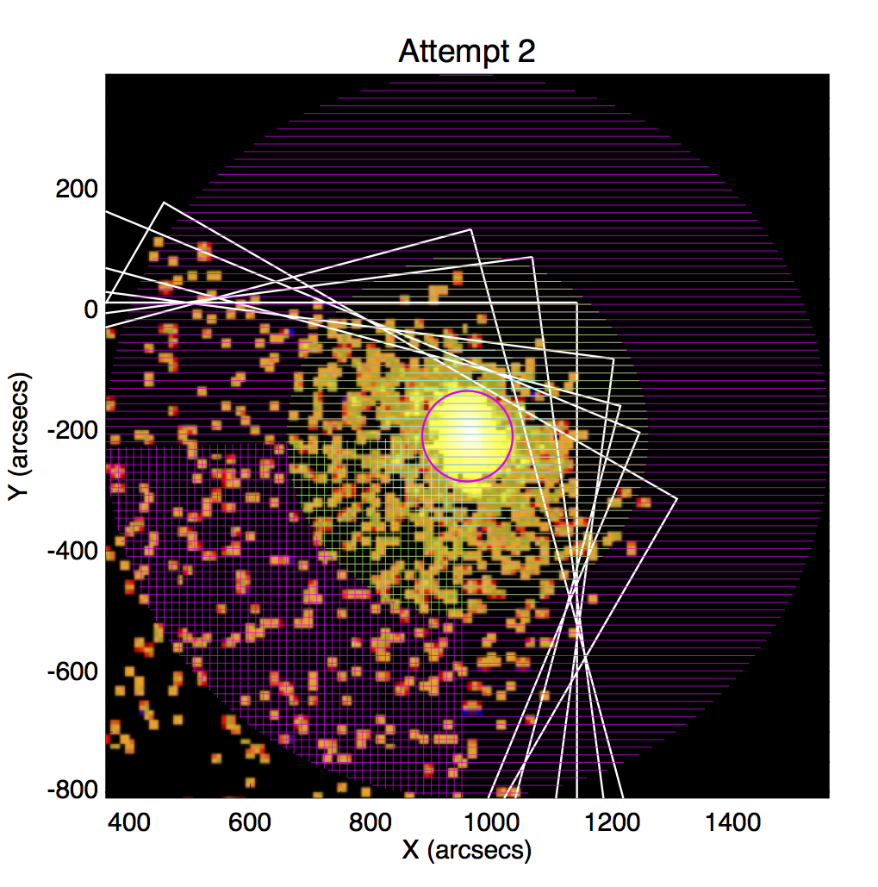
Geometry for HPD

Slide 4
Results: HPD ~50”-~75”

Slide 5
Next steps:
Subtract background from measurement
Not done yet; should be small effect.
Figure out effect of finite source size on HPD (next slides)

Slide 6
Simulations of finite source size
Data from postflight calibration of X5.
Simulation: convolve with source 20” FWHM.
Effect on HPD is small.

Slide 7
Next next steps
Do the flare image deconvolution.
Maximum likelihood procedure in IDL.
The deconvolved source can be more directly compared with the RHESSI source.
What do we use for a PSF?
Measured postflight PSF? Need to smooth…
Simulated PSF? Less noisy but lacks actual imperfect detail.

