Slide 1
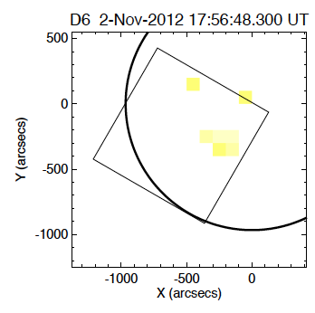
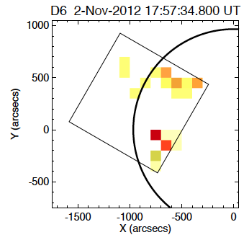
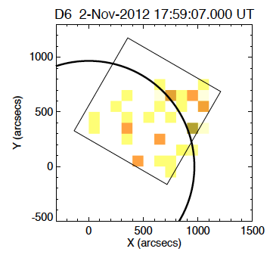
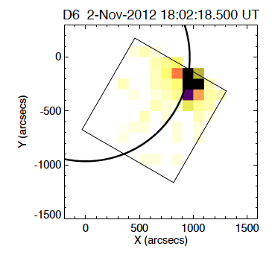
Detector 6 data
First target
Second target
Third target
Last target
Approximate “background” area

Slide 2
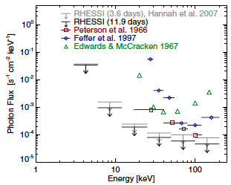
From Hannah et al. 2010
Things to keep in mind:
No correction done for blanketing → underestimation
No correction done for disk area → underestimation
Spectra (& instrument response) are for one detector only.
Target 1 may include single-bounce photons
Target 2 may include single-bounce photons
Target 3 may include wings
Target 4+6 may include wings
Target 4+6 spectrum is from “background” area away from flare, scaled up to match detector area. Didn’t do livetime correction (→ underestimation)

