Slide 1
FOXSI-1 Data and Analysis Update
October 2013

Slide 2
Topics
Coregistration and alignment
Flare imaging
Blanketing absorption characterization
Quiet Sun work
QS photon estimates
Spatial analysis
Active region work
Update from Ishikawa
FOXSI simulations of low vs high freq heating

Slide 3
Public Service Announcement
Don’t be afraid to work with the data!
Once the FOXSI directories are installed, looking at a FOXSI image can be as easy as:
@foxsi-setup-script
; choose a target (example: flare)
get_target_data, 4, d0,d1,d2,d3,d4,d5,d6, /good
; make an image for detector 6
img=foxsi_image_solar( d6, 6, psize=10, thr_n=4., /xycor)
; map and plot it.
plot_map, make_map( img, dx=10, dy=10 ), cen=flare, fov=2

Slide 4
Coregistration and alignment
Translational alignment
Align flare centroids with RHESSI centroid
Done, and implemented as keyword in imaging functions: /xycor
Rotational alignment – methods:
Align flare orientation with RHESSI (best so far)
Use flare off-pointing tracks (started but not finished)
Examine c-stat for deconvolution for various rotation angles of the source about its centroid.
Overall detector (coarse) geometry has been checked using flight data (flare) and postflight alignment images.

Slide 5
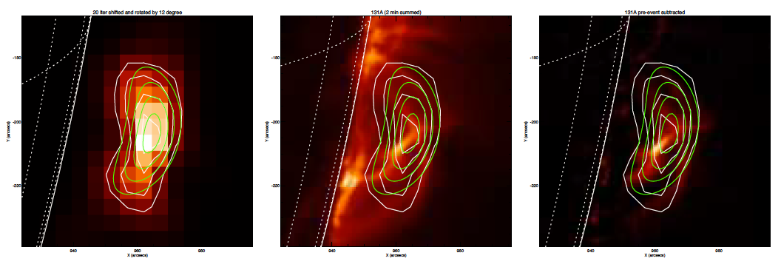
Flare imaging
Max_likelihood deconvolution has been fairly successful:
Background: FOXSI D6
White: FOXSI D6
Green: RHESSI (method?)
Background: AIA 131A
Background: AIA 131A with preflare subtraction

Slide 6
Flare imaging
…though D6 results are by far the best!
D0
D1
D2
D3
D4
D5
D6

Slide 7
Flare imaging
Det | N photons
0 | 558
1 | 198
2 | 953
3 | 267
4 | 1750
5 | 1841
6 | 2006

Slide 8
Flare imaging
To do:
Try FOXSI CLEAN method (started)
Try other PSFs:
Estimate off-axis angle (and direction!) for each optic using alignment images.
Run the deconvolution with PSF closer to those estimates, if we have them.
OR, deconvolve for many simulated PSFs and look for a min C-stat.

Slide 9
Blanketing absorption characterization
All detectors have some extra blanketing in front of them.
“Puff test” showed that inflated blankets can essentially fill the tube fairly easily.
D6 (the best count rate and image) is in the center; it’s possible there could have been a small blanketing gap in front of it.

Slide 10
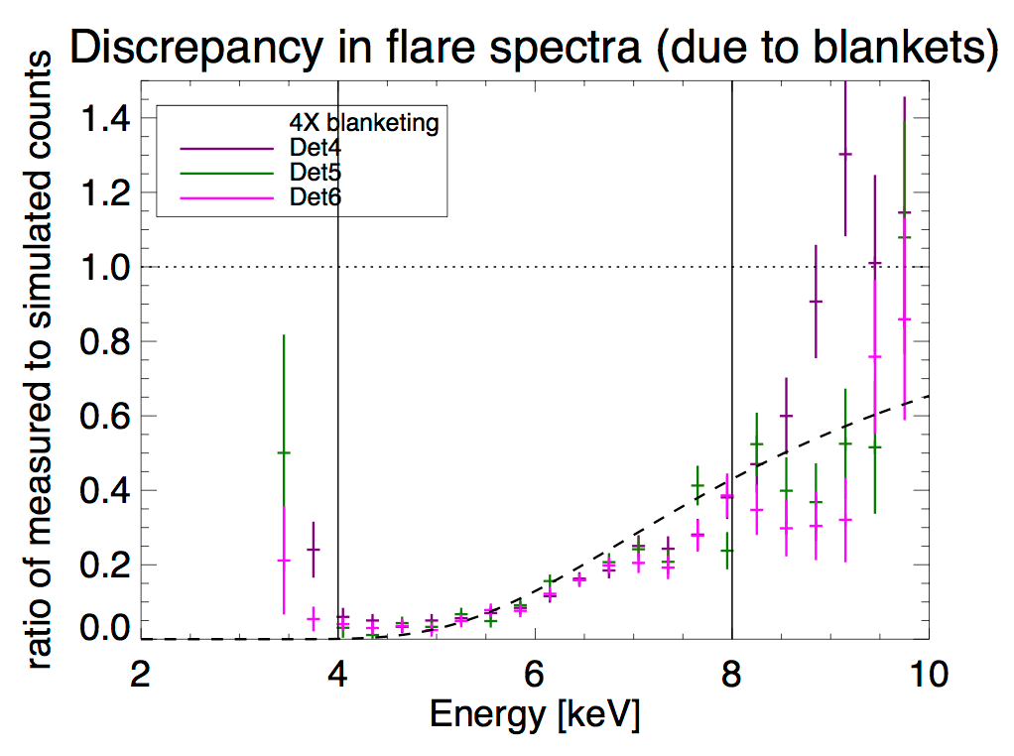
Blanketing absorption characterization
Most recent results: (From March!)

Slide 11
Blanketing absorption characterization
To do:
Try redoing RHESSI spectra with some variations, like reducing the blanket absorption in the DRM. See if we find a better fit. **Started, but suspended for technical troubles.

Slide 12
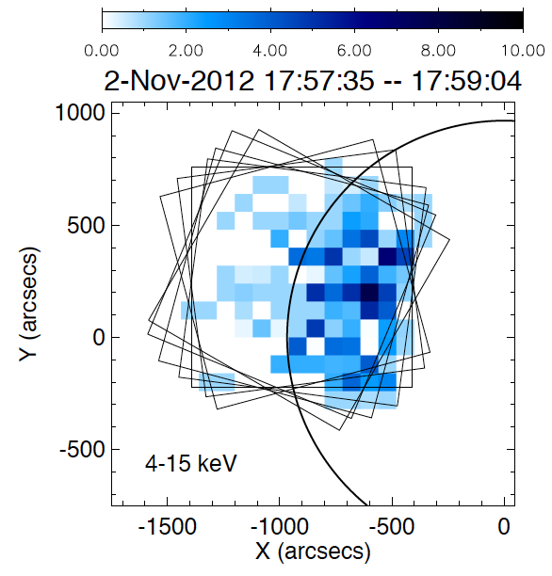
Quiet Sun work
2nd target shows greater flux on-disk than off.

Slide 13
Quiet Sun work
To do:
Investigate single-bounce photons
probably requires ray tracing
Calculate quiet-Sun HXR flux assuming our counts are real.
First, very rough, estimate done (see next slide). More refined calculation should be done.
Probably should first exclude counts in the vicinity of the AR.
Comparison of quiet Sun counts with AIA and XRT.
Not started, except for a quick by-eye comparison.

Slide 14
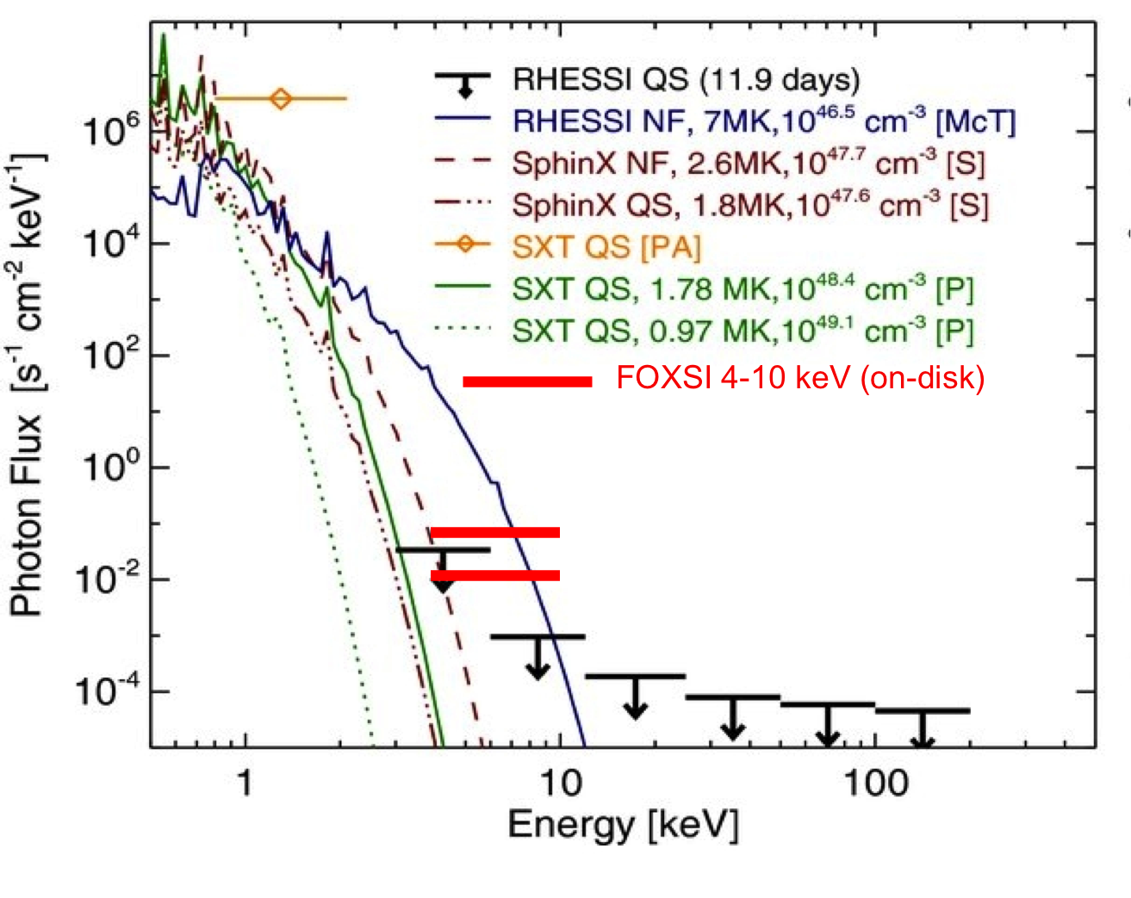
Quiet Sun work

Slide 15
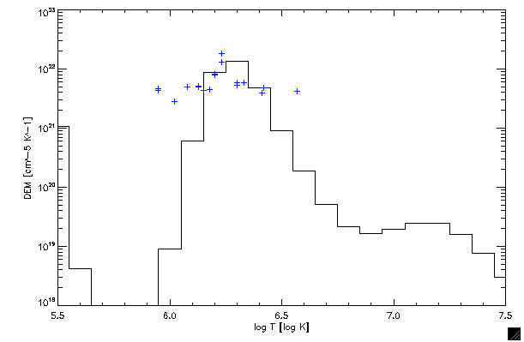
Active region temperatures
DEMs produced for AR in first target using EIS and XRT data.
FOXSI sensitivity curves (not shown) will constrain the high-temperature part.
This analysis is nearing completion.

Slide 16
Simulations of AR heating
Winebarger and Warren are simulating low- vs high-frequency heating of active regions.
They produce DEMs for these two cases and simulate observations from MAGIXS to see if it can differentiate between them.
At their request, FOXSI simulations have also been produced.

Slide 17
Simulations of AR heating -- FOXSI
LOG SCALE
LINEAR SCALE
HIGH FREQ
LOW FREQ

