Slide 1
FOXSI-2 microflare imaging spectroscopy -- UPDATED
Lindsay
2015 April 1

Slide 2
Last target
Detector 6 in different energy bands
OLD

Slide 3
Detector 6 images of final target
Smoothed images
Smoothed over 2 strips.
Significant source location / shape change with energy.
OLD
Notes:
What was time integration? Need to check…

Slide 4
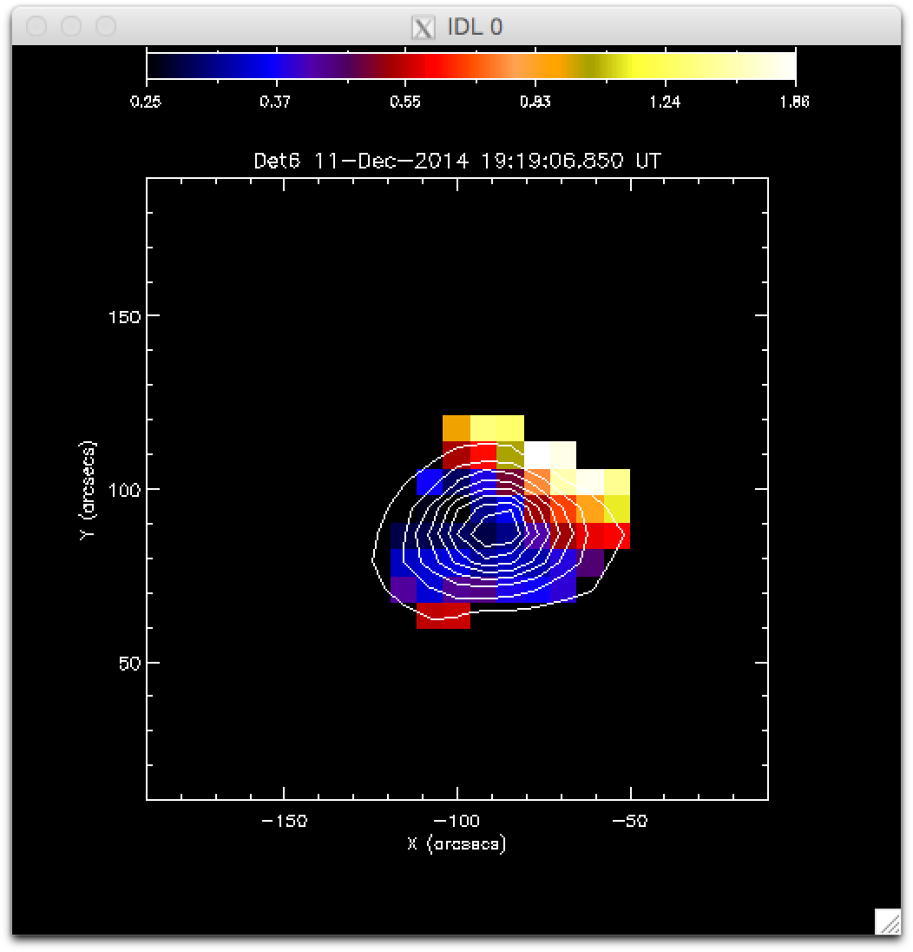
Detector 6 images of final target
Ratio of high-energy to low-energy emission is a measure of temperature.
Not calculating actual temperatures yet; need solidified instrument response for that.
Hot plasma (or nonthermal electrons) at one edge of source.
OLD
Ratio of 6-8 keV counts to 4-6 keV counts.

Slide 5
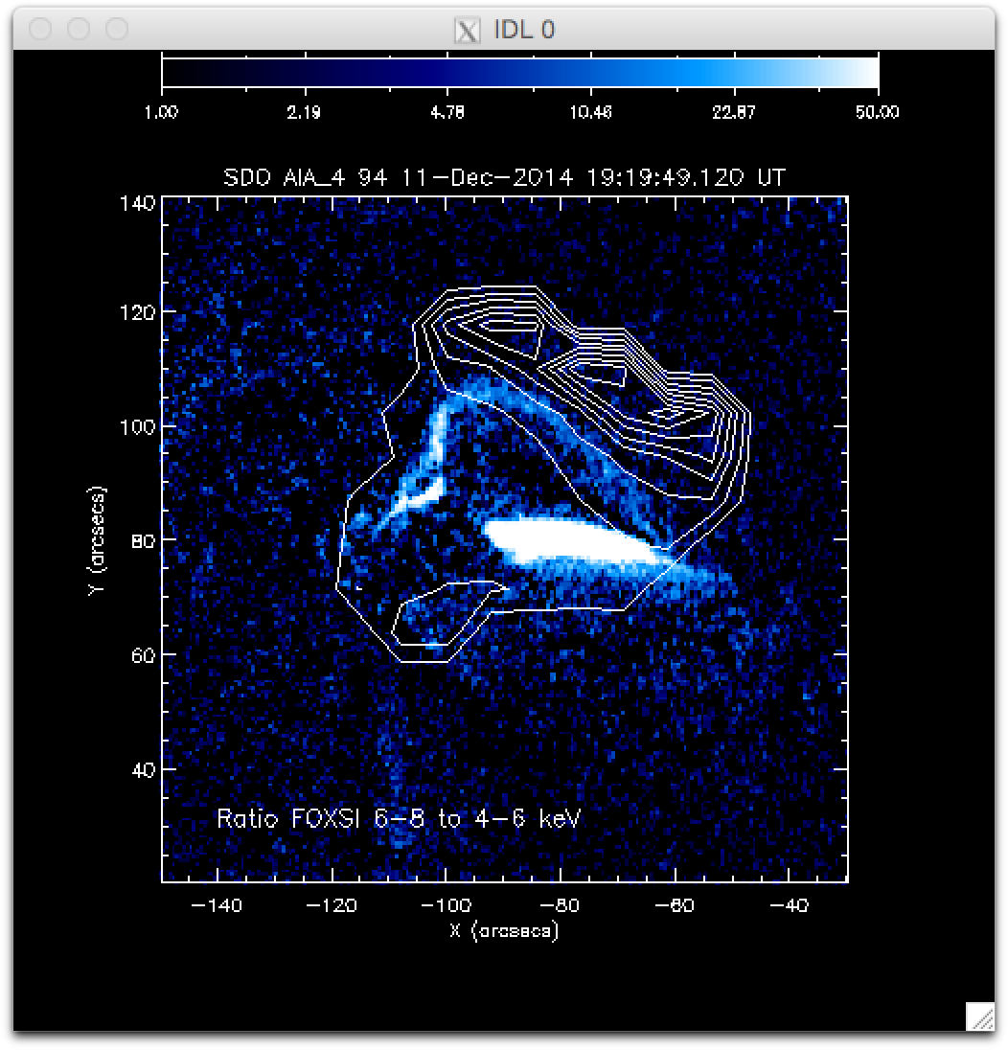
On top of AIA 94
Alignment was done by lining up brightest points in FOXSI and AIA by eye. Could be wrong!
Co-aligning with RHESSI will help…
A different alignment could put the high-temp plasma on the AIA ridge.
Or perhaps the hot plasma is adjacent to, or above the ridge.
OLD
“Knottiness” is the pixel size. No, it’s not nanoflares. ☺

Slide 6
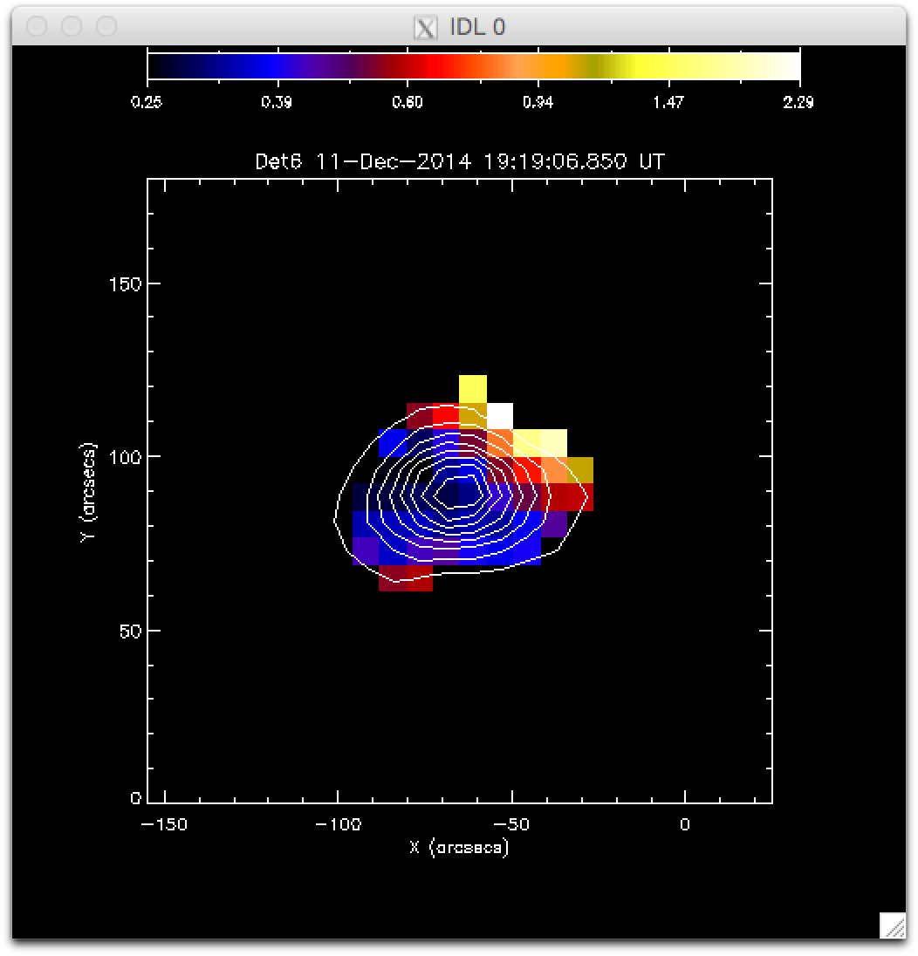
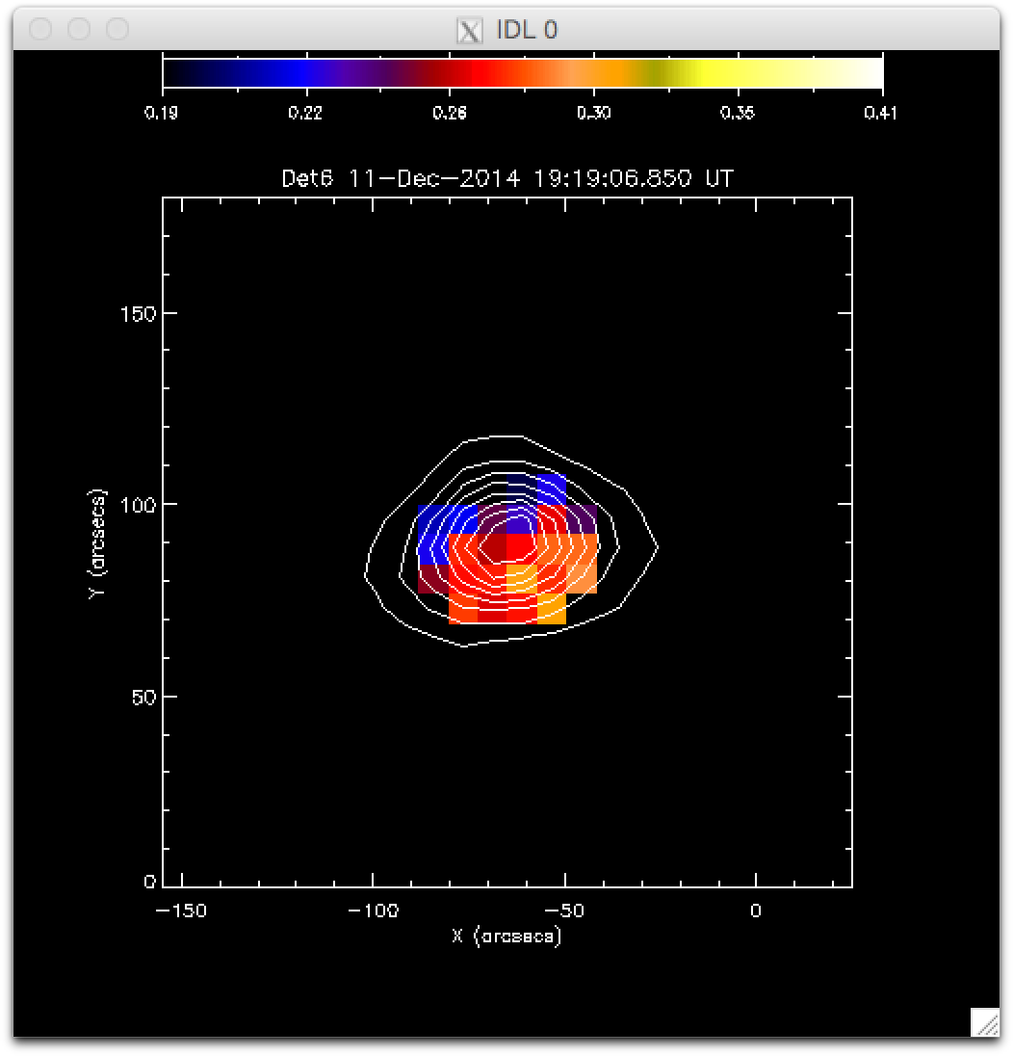
Recently, ran the exact same code…
But instead of this…
…I got this!
NEW!

Slide 7
What the &*%$?!?

Slide 8
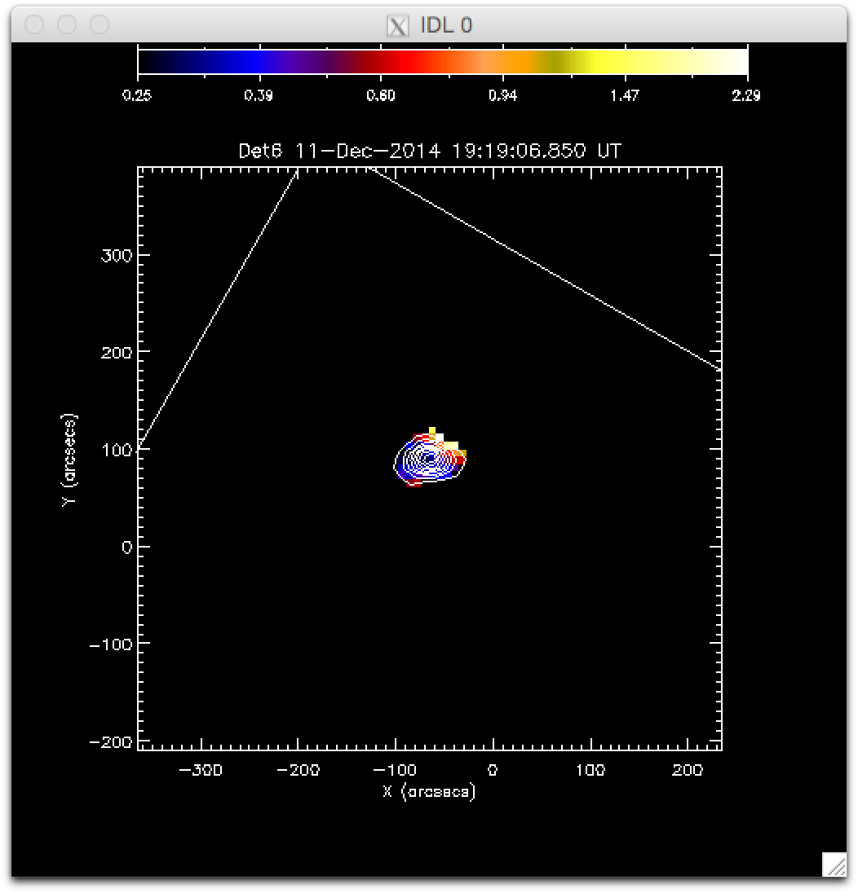

Answer: old result used incorrect cal.
(Earlier) assumption: exact calibration doesn’t matter for this ratio method because only count ratios are important.
But the earlier result used the incorrect calibration files, which meant that the strip-by-strip calibration was wrong!
This is probably an incorrectly calibrated strip.
NEW!

Slide 9
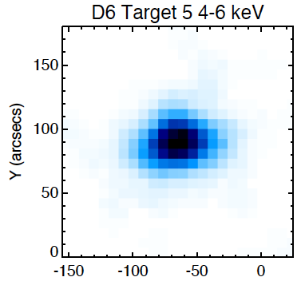
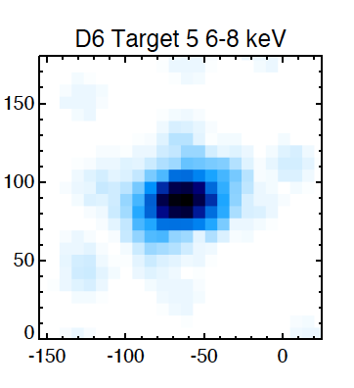
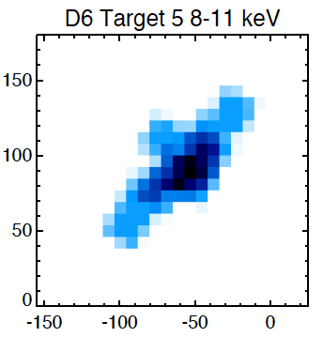
Sighhh…so what does it really look like?
NEW!

Slide 10
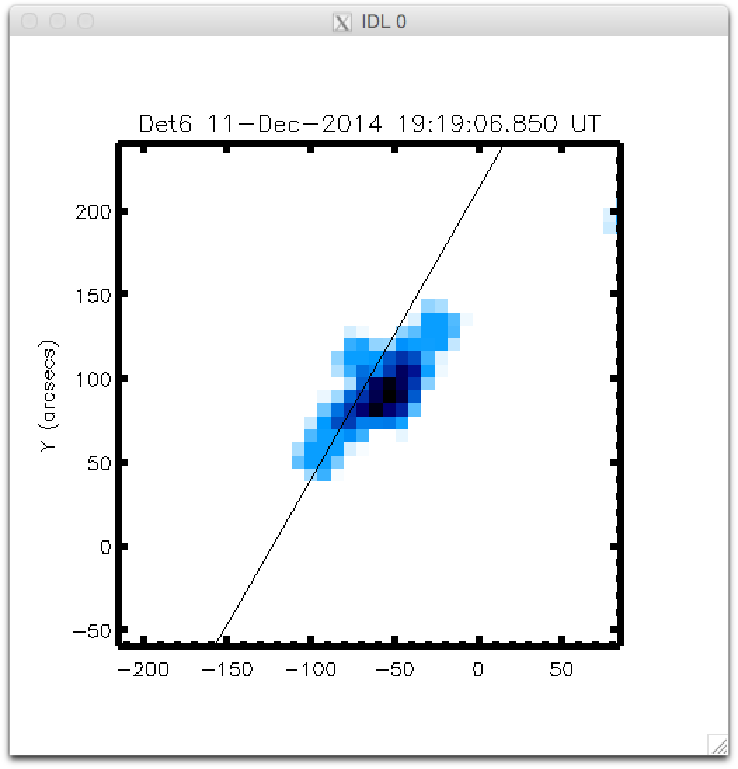
NEW!

