Slide 1
FOXSI imaging update
2014 January 8

Slide 2
Notes
Times given in titles are midpoint of observation time.
D5 sometimes shows up all pink due to funny scaling. Sorry!
For each target the last image shows all 5 Si detectors integrated together.
Absolute alignment can still be off (10s of arcsec?). A co-alignment with RHESSI has not been done yet.

Slide 3
AR1, no adjustments
Flare in progress

Slide 4
AR1 after first adjustment

Slide 5
AR1 after second adjustment
Maybe a 3rd AR?

Slide 6
AR1, one more adjustment?

Slide 7
AR 2
Maybe one more AR?
This is the AR we wanted!

Slide 8
AR3, no adjustment
Not clear if we see the NuSTAR AR or not…

Slide 9
AR3 after first adjustment

Slide 10
AR3 after second adjustment
What’s at [400,-200]? It’s not an AR but doesn’t clearly line up with an AIA brightening either…

Slide 11
Quiet Sun
Not clear if this is single bounce.

Slide 12
Quiet Sun with shutter in
D6 has no shutter
D4, D5 have no good counts

Slide 13
AR1 with shutter in
Now this guy’s flaring.

Slide 14
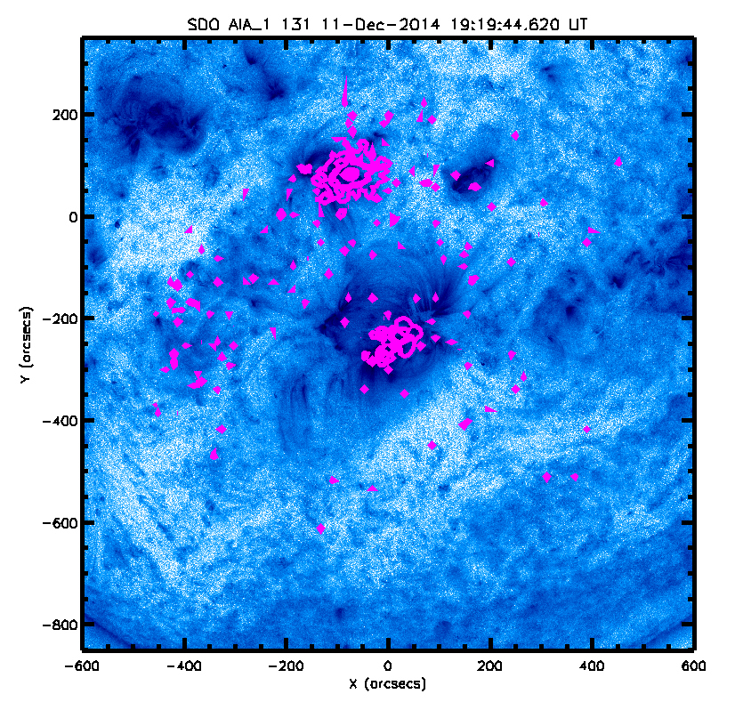
AR1 with shutter on AIA
At first glance, the counts outside the ARs don’t obviously line up with transient AIA 94 brightenings.
But it’s not random either! Many counts are confined to the bright region in the east.
Counts shown here outside the ARs are only 1-2 counts in a spot. Don’t trust triangles…those are just funny ways of drawing a contour.

