Slide 1
FOXSI-2 imaging update 2014 Dec 16

Slide 2
Notes…
No absolute SPARCS info yet for timing or positions. Instead, times are eyeballed from the data, and positions are in payload coordinates, not absolute solar coords.
Energy calibration isn’t done yet, so can’t filter hits by energy. So there are artifacts due to misidentification of the N side strips. These leave streaks across the detector that pass through the source. These were also seen in FOXSI-1 and disappeared with a proper n-side threshold.
These plots show only the Si detectors, not the CdTe.

Slide 3
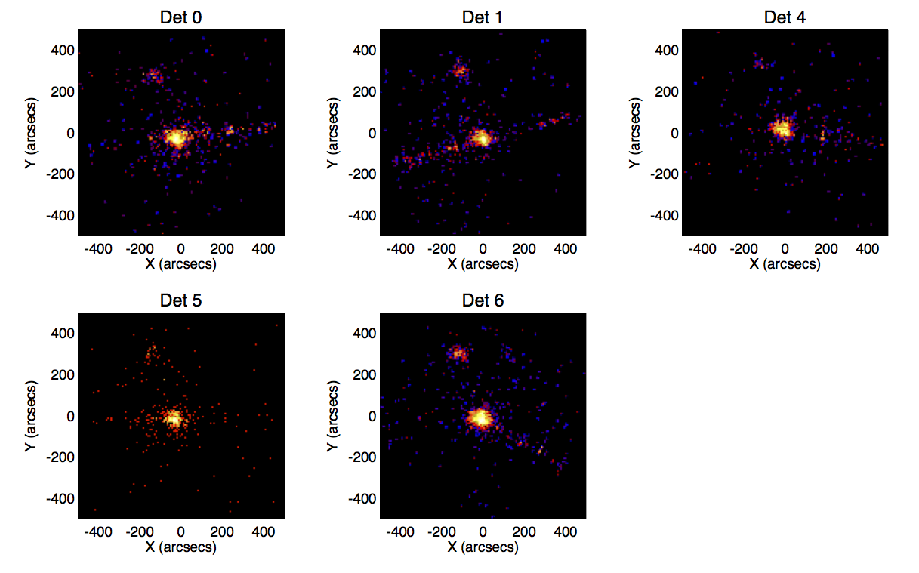
First target, after XY recentering
We did get both ARs after all! But we need log scale to see them both at once.
(log scale)

Slide 4
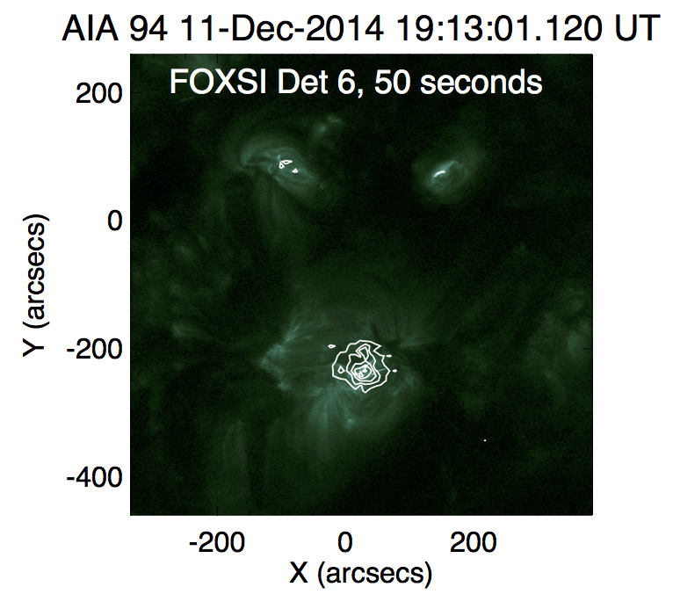
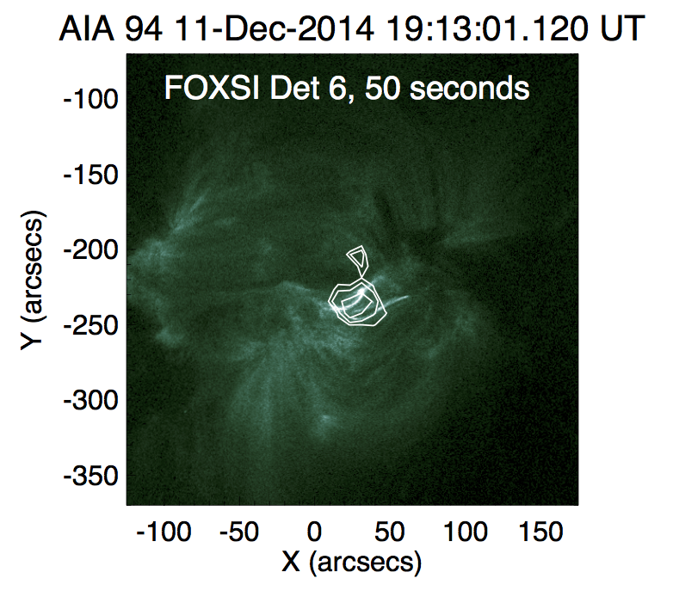
First target, with AIA 94
Sources are lined up by eye.
Note the angry monkey face.

Slide 5
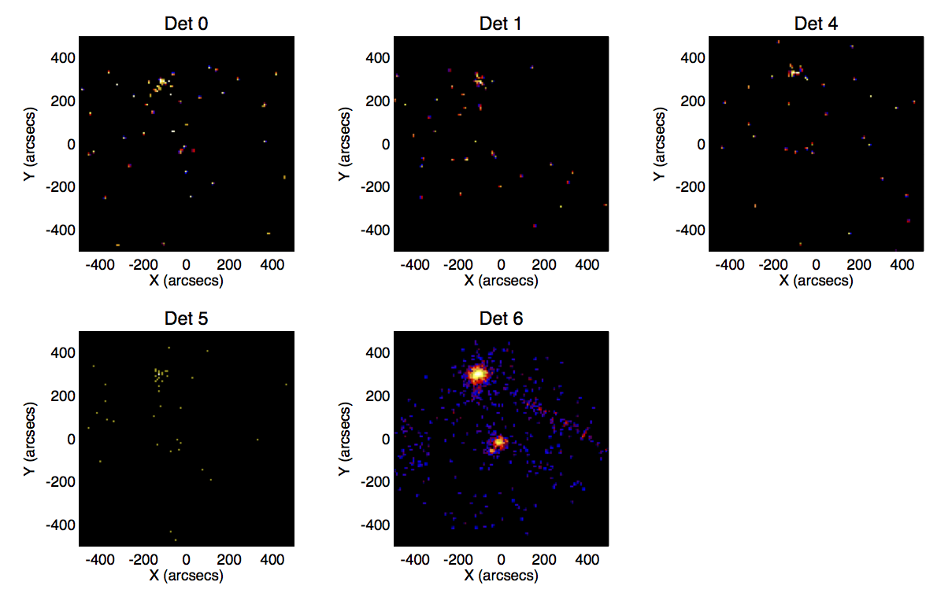
Last target (shutter in)
Center detector D6 (10-shell optic) does not have a shutter and still got a good view of the microflare. The other detectors see it a bit.
(log scale)

Slide 6
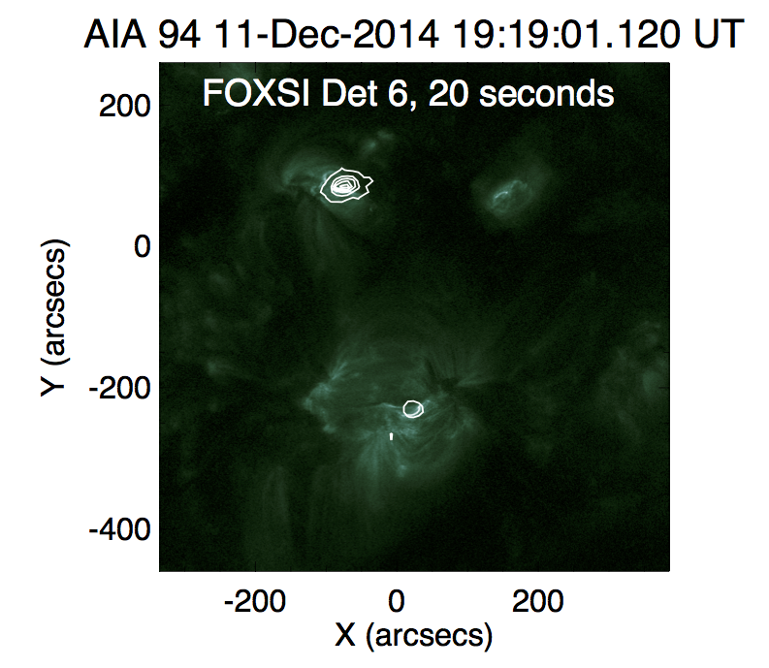
Last target, with AIA 94

