Slide 1
FOXSI flare HPD measurements
Sept 2013

Slide 3
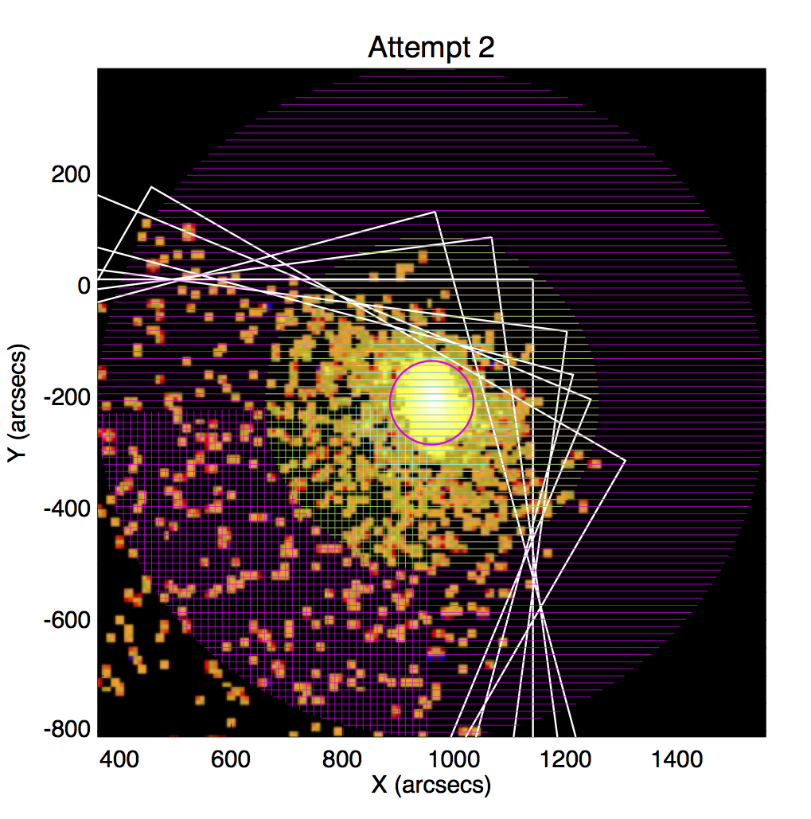
Geometry for HPD

Slide 4
Results

Slide 5
Still to do
Subtract background from measurement

