Slide 1
FOXSI-2 quicklook plots Dec. 15 2014

Slide 2
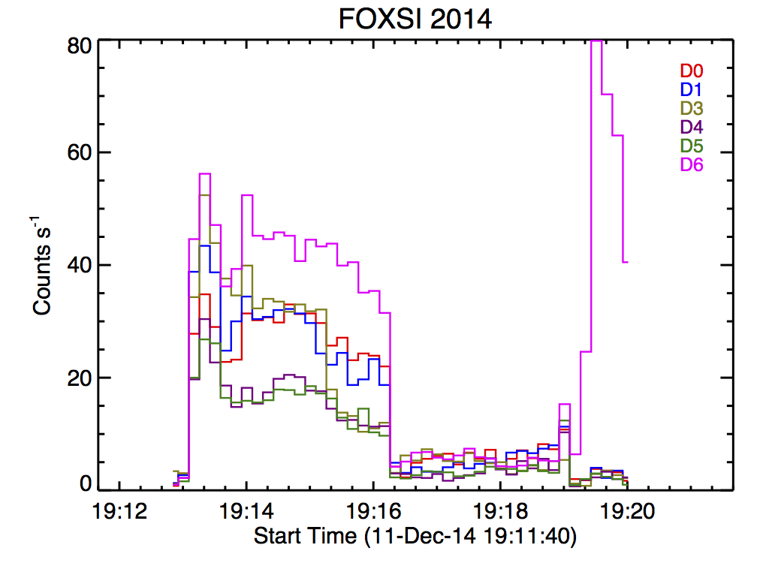
Time profile
Energy calibration not done yet, so left out D2 b/c we can’t distinguish photons from noise yet.
D6 (10-shell optic) rates are 50% greater than middle three.
D3 functions as well as the other 7-shell sets. Big drop during one of the repointings (see arrow). Something left the FOV of this (smaller) detector?
Two modules (4 and 5) have curiously low rates.
Noise at shutter motion?

Slide 3
Time profile
Quiet Sun science isn’t looking good…
D6 shows 50% more counts than D0,D1,D3 during AR pointings, but no increased rates at QS.
Could be due to differing single-bounce pattern for 7 shell vs 10 shell optics.

Slide 4
Time profile
It does look like we have flux leaking through the shutter in the final pointing, which will be good for understanding the instrument response!
Center detector w/no attenuator

Slide 5
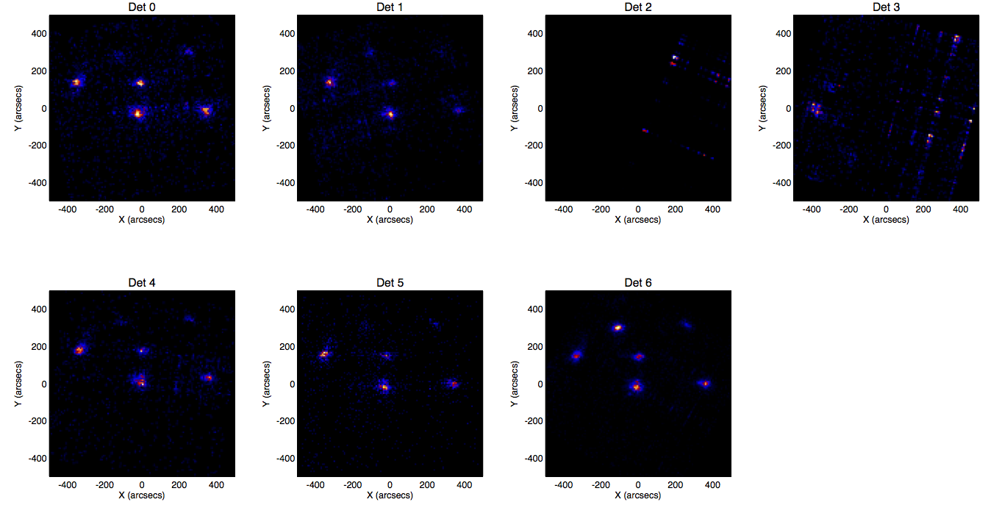
Images
In detector coordinates, with no regard for solar pointing [i.e. all sources, with all pointings for entire flight placed into one FOV]
CdTe, geometry not corrected yet
No attenuator; bright source is last target.

