Slide 1
EXO1

Slide 2
Introduction/Main Points
What is our main focus for the project?
What do we want to implement and improve on?

Slide 3

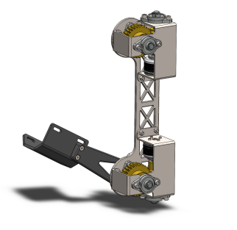

Exo skeleton
Current design of the Arm
Adapted to specific person
Remotely controlled

Slide 4
EMG Sensors

Slide 5
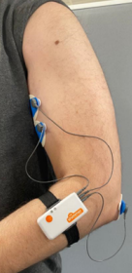
Shimmer 3
Old sensor

Slide 6

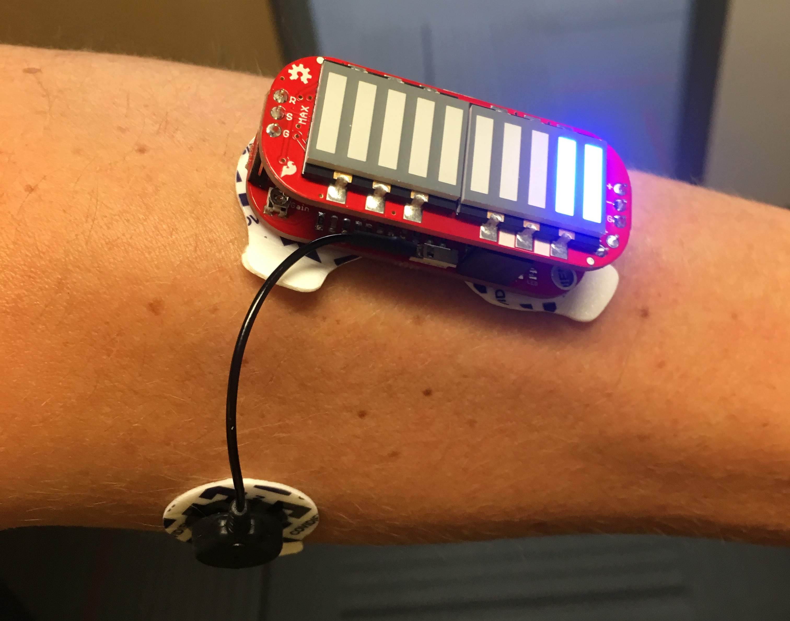
Myoware 1.0
Advancer technology
New sensor
LED Indicator for muscle activation

Slide 7
Static Struggles workout
Healtcare
Assembly Work
Fruit Gathering

Slide 8
Background
Reading material
Hardware
Software
Text and reports

Slide 9
What do we have to work with?/Background
What is already done?
What kind of resources/material are we working with?
Reports and information?

Slide 10
Research Questions / Plan for future
Can we make it attached to arm?
Can we make it run with less lag?
Can we go both backwards, forwards and rest?
Can we make it go at variable speeds?

