Slide 1
Web Usability

Slide 2
“Don’t Make Me Think” (Steve Krug)

Slide 3
When You Look At A Page…
What are you thinking?
newegg.com
badpage.com
. or ?

Slide 4
Clickables
Should be obvious…
Buttons, flat buttons, words

Slide 5
Words
Don’t get flowery/fancy
Don’t be “clever” or “cute”
Jobs
Employment Opportunities
Job-o-Rama

Slide 6
Will You Think & Act For Me?
Automagically do things
Search title, author, keyword now
Filter later if need be

Slide 7
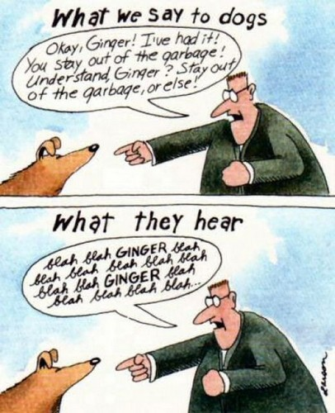
How We Read Pages
Glance
Skim
Scan
http://www.google.com/url?sa=i&rct=j&q=&esrc=s&source=images&cd=&cad=rja&uact=8&ved=0CAcQjRw&url=http%3A%2F%2Fmngboxers.com%2Fhome-new%2Fresources-2%2F182-2%2Fgary-larson-
far-side-cartoon-what-we-say-to-dogs-blah-blah-ginger%2F&ei=JOk4Va7_KIj7sAXBxYGwCA&bvm=bv.91427555,d.cGU&psig=AFQjCNGPmp8Noh0u0r-pRxfIKiqJbCzmgw&ust=1429879459938646

Slide 8
“Under Pressure”
Take first reasonable plan… eek!
Analysis? Nope. Why?
Not big penalty for wrong
In rush
Analysis boring
Analysis make not help

Slide 9
RTFM!
We don’t…
Last resort

Slide 10
Billboards
Create visual hierarchy
Prominence of items
Relate visually if related logically
Visually nested shows “part of”

Slide 11
Conventions Good
Horsie example

Slide 12
Tips
Break into clearly defined areas
Make clickables obvious
Busy, loud, crowded
Omit needless words
Eliminate b.s. & instructions
Navigation breadcrumbs (top)
Pull-downs painful

Slide 13
Usability Testing
1 > 0
1 early > 50 late
Not to prove/disprove something, to improve
Iterative process

Slide 14
Decreasing Goodwill
Hit me (formatting phone, soc. sec.)
Make me think (“ “ “)
Hide info I want (phone, shipping, price)
All flash, no sizzle
Ask for info not needed
Ask twice…
FAQs that aren’t

Slide 15
Increasing Goodwill
Make it obvious (formatting, etc.)
Helpful FAQs
Printer-friendly
Save me steps/effort (tracking link instead of number)

Slide 16
Want More?
Steve Krug
Jakob Nielsen
Bruce Tognazini
Donald Norman
Alan Cooper

