Slide 1
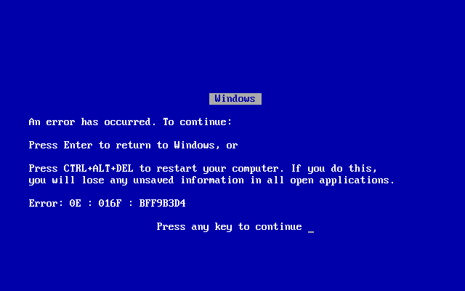
http://en.wikipedia.org/wiki/Blue_Screen_of_Death#/media/File:Windows_9X_BSOD.png
Dave: “Agh! Another *%#@ing Blue Screen of Death!”
ELIZA: “How do you feel about a *%#@ing Blue Screen of Death?”
Dave: “I hate it!”
ELIZA : “Can you elaborate on that?”
Dave: “What kind of stupid program are you anyway?” (exits program)

Slide 2
Handling Failures & Fault Tolerance

Slide 3
How Have Your Programs Handled Failures Here?
Seriously… Give me examples…

Slide 4
“Try, Catch, Exit” Isn’t Good Enough
My Horsie team DB example
What could we do?
Disk examples

Slide 5
Fault Tolerance
Goal: Avoid Downtime.
Why?

Slide 6
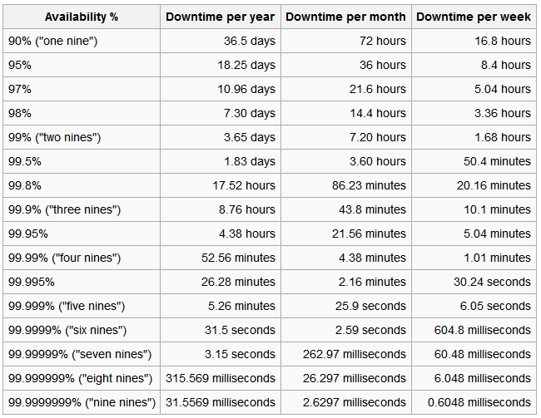
Availability
http://en.wikipedia.org/wiki/High_availability

Slide 7
Faults & Manifestations
Failure. Physical change in hardware.
Fault. Erroneous state of hardware or software resulting from failures of components, physical interference from the environment, operator error, or incorrect design.
Error. Manifestation of a fault within a program or data structure. The error may occur some distance from the fault site.
Permanent. Describes a failure, fault, or error that is continuous and stable. In hardware, permanent failure reflects an irreversible physical change. The word "hard" is used interchangeably with the word permanent.
Intermittent. Describes a fault or error that is only occasionally present due to unstable hardware or varying hardware or software states(e.g. as a function of load or activity).
Transient. Describes a fault or error resulting from temporary environmental conditions. The word " soft" is used interchangeably with transient.
http://users.ece.cmu.edu/~koopman/des_s99/fault_tolerant/

Slide 8
Ways to Make Systems More Robust
Retry/Timeout
Checkpointing
Voting
Alternate resources for failover operation
Ultimately system dependent

Slide 9
Control What You Can
Some things outside your control.
Network failure
Others are not.
How your software reacts to the network failure

Slide 10
Much Like GUIs…
Design up front, don’t slap it on later.

