Slide 1
Machine Learning Crash Course
Lili Blumenberg, fresh PhD
Python Course
2020 05 21
Slides adapted from David Fenyo and Anna Yeaton ML class slides
Notes:
Hi everyone, thanks for coming today.
I’d like to give you guys a very short introduction to machine learning and to the vocabulary used in machine learning. I am by far not the most experienced person with this topic, so for one thing, I’m going to try to give a very intuitive understanding versus a technically correct understanding. Two, I might say some things where I don’t mention exceptions or caveats, so if I do hopefully the other TAs can add some nuance in the chat. Starting with what I’m about to say, which is to try to define machine learning.
So machine learning is a class of algorithms which can help a computer automatically improve its ability to do something, in our case to predict some data, without being explicitly told how to do that thing. So without being told the value of the data.

Slide 2
If you are going to follow along live, let’s do these steps first:
In the terminal, grab updated slides and lecture and install necessary software:
git add .
git commit -m ‘my changes’
git fetch
git checkout lecture/14
conda activate itp_2020
conda install –n itp2020 pandas numpy scipy matplotlib seaborn scikit-learn pip
pip install cptac
In the jupyter notebook, download the dataset from cptac:
import cptac
cptac.download(dataset="endometrial")

Slide 3
Kinds of machine learning
3
Supervised learning
Classification (categories/qualitative/discrete)
Regression (continuous/quantitative/floats)
Unsupervised learning: Finding the structure in data.
Clustering
Dimension reduction
Notes:
There are two broad classes of machine learning, supervised and unsupervised.
Supervised learning requires us to feed the algorithm

Slide 4
Machine learning is a multi-step process
Choosing the model
2. Splitting the the data into independent training and test sets
3. Calculate model parameters with the training set
4. Evaluate the model to the test set
Data
Set
Test
Samples
Samples
Training
Features
Features

Slide 5
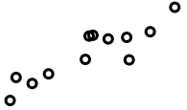
Supervised Learning: Regression
5
Trained linear model/prediction
Error for each training example
Target (O2 levels in blood)
Feature (expression of hemoglobin in blood)

Slide 6
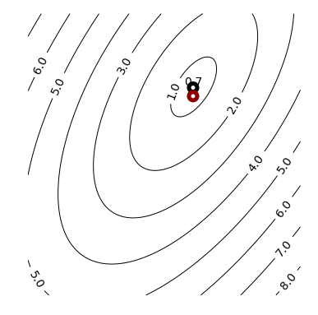
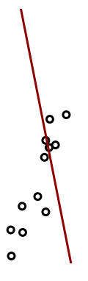
Gradient Descent

Slide 7
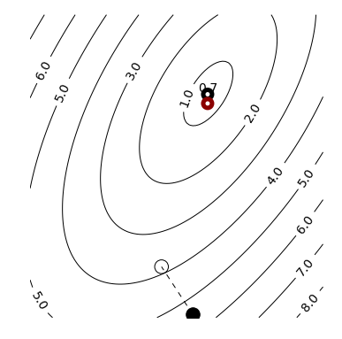
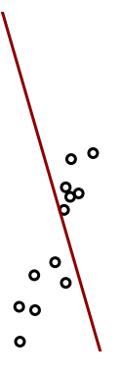
Gradient Descent

Slide 8
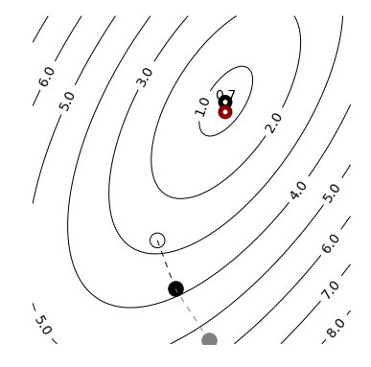
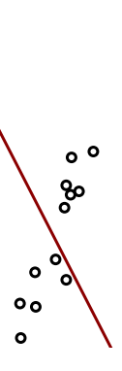
Gradient Descent

Slide 9
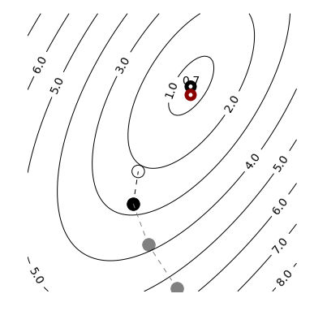
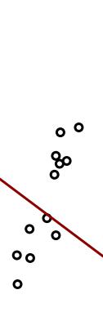
Gradient Descent

Slide 10
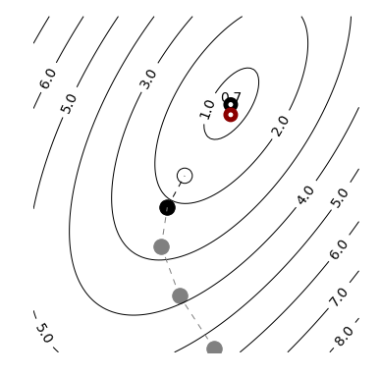
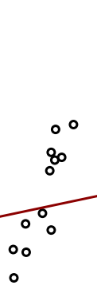
Linear Regression – Gradient Descent

Slide 11
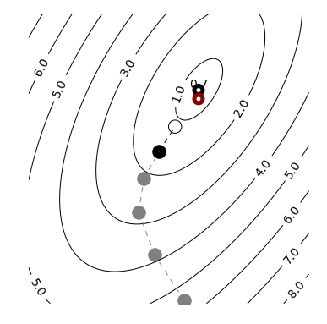
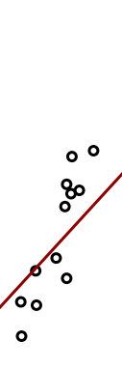
Linear Regression – Gradient Descent

Slide 12
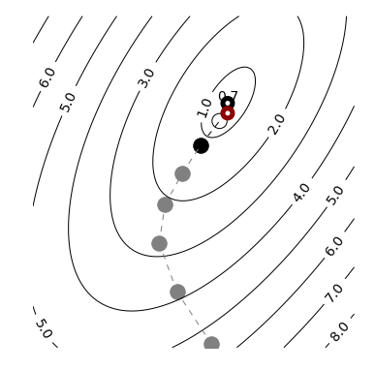
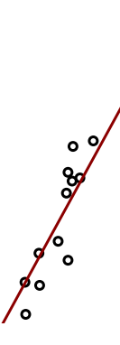
Linear Regression – Gradient Descent

Slide 13
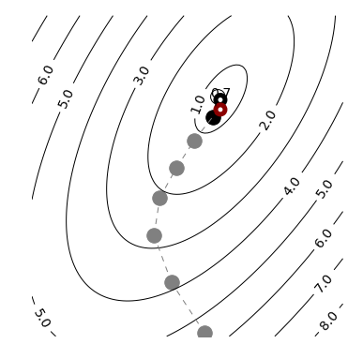
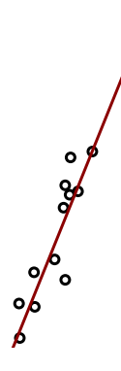
Linear Regression – Gradient Descent

Slide 14
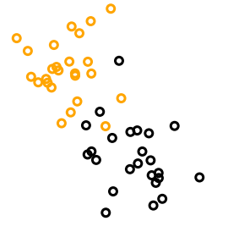
Supervised Learning: Classification
14

Slide 15
Model Evaluation and Selection: Confusion matrix
Confusion matrix in terms of Red
 | Actual Red | Actual Blue
Predicted Red | True Positive (TP) | False Positive (FP) Type I error | Total Red Predictions(P’)
Predicted Blue | False Negative (FN) Type II error | True Negative (TN) | Total Blue Predictions (N’)
 | Total Actual Red (P) | Total Actual Blue (N) | All
We want to maximize
We want to minimize

Slide 16
Model Evaluation and Selection: Confusion matrix
Predicted | Actual
Red | Red
Red | Red
Red | Red
Red | Red
Red | Blue
Red | Blue
Blue | Red
Blue | Blue
Blue | Blue
Blue | Blue
Blue | Blue
Blue | Blue
Blue | Blue
 | Actual Red | Actual Blue
Predicted Red | True Positive (TP) = 4 | False Positive (FP) = 1 | Pred R 5
Predicted Blue | False Negative (FN) = 2 | True Negative (TN) = 6 | Pred B 8
 | Actual R 6 | Actual B 7 | All 13
Linear decision boundary
Blue
Red

Slide 17
Model Evaluation and Selection: Accuracy, Error rate, Sensitivity and Specificity
Accuracy
Sensitivity
$$Accuracy=\frac{TP+TN}{All}$$
$$Sensitivity=\frac{TP}{P}$$
Percentage correctly identified
True positive recognition rate
Error
Specificity
$$Error=1−Accuracy$$
$$Sensitivity=\frac{TN}{N}$$
or
$$Error=\frac{FP+FN}{All}$$
True negative recognition rate
Percentage incorrectly identified

Slide 18
Model Evaluation and Selection: Precision, Recall and F-1 measures
Precision
F-1
$$Precision=\frac{TP}{(TP+FP)}$$
$$F−1=\frac{2∗Precision∗Recall}{Precision+Recall}$$
Percentage of data predicted as positive is actually positive
Harmonic mean of precision and recall
Perfect precision and recall result in an F-1 score of 1
At the absolute worst precision and recall F-1 score will be 0
Recall
$$Recall=\frac{TP}{(TP+FN)}$$
Percentage of positive data was predicted as positive

Slide 19
Model Evaluation and Selection: Precision, Recall and F-1 measures
Precision
F-1
$$Precision=\frac{TP}{(TP+FP)}$$
$$F−1=\frac{2∗Precision∗Recall}{Precision+Recall}$$
Percentage of data predicted as positive is actually positive
Harmonic mean of precision and recall
Perfect precision and recall result in an F-1 score of 1
At the absolute worst precision and recall F-1 score will be 0
Recall
$$Recall=\frac{TP}{(TP+FN)}$$
Percentage of positive data was predicted as positive

Slide 20
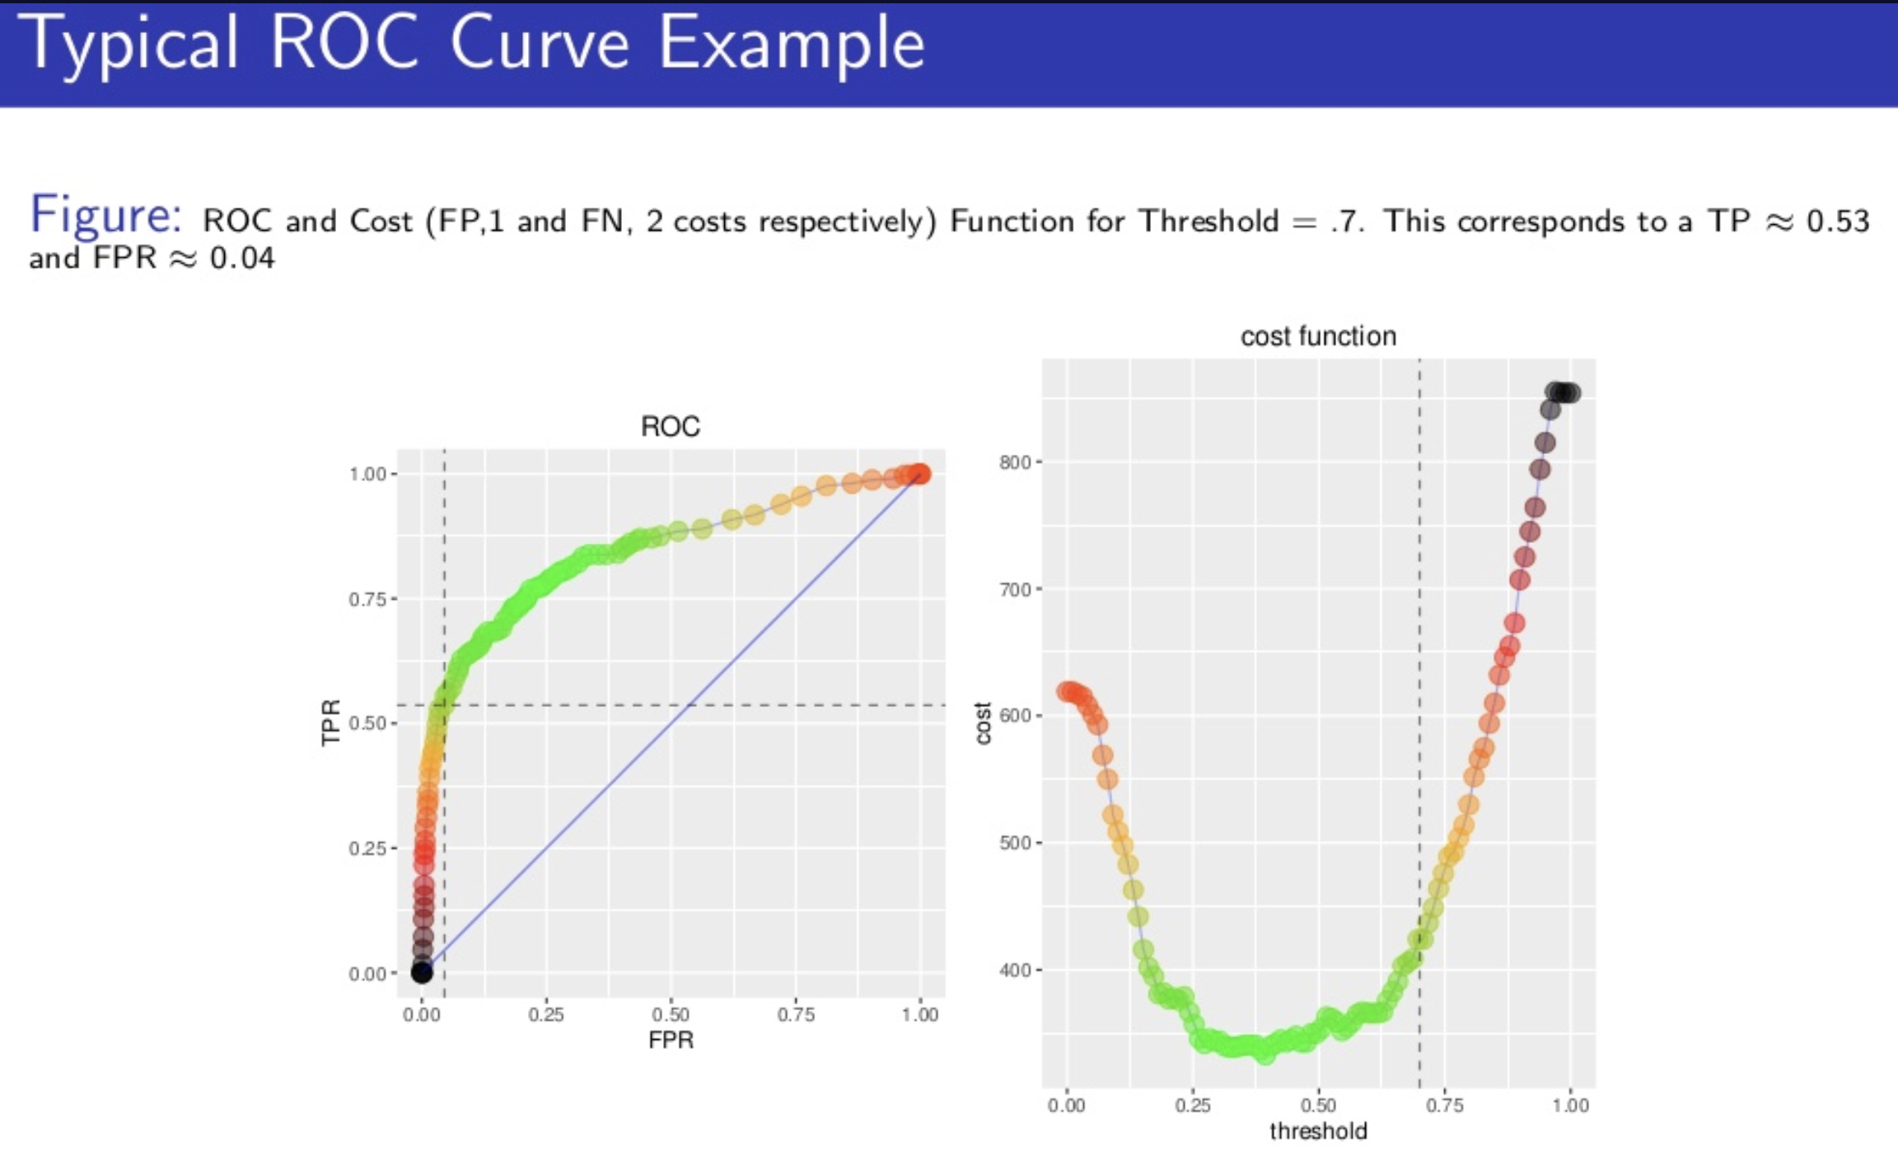
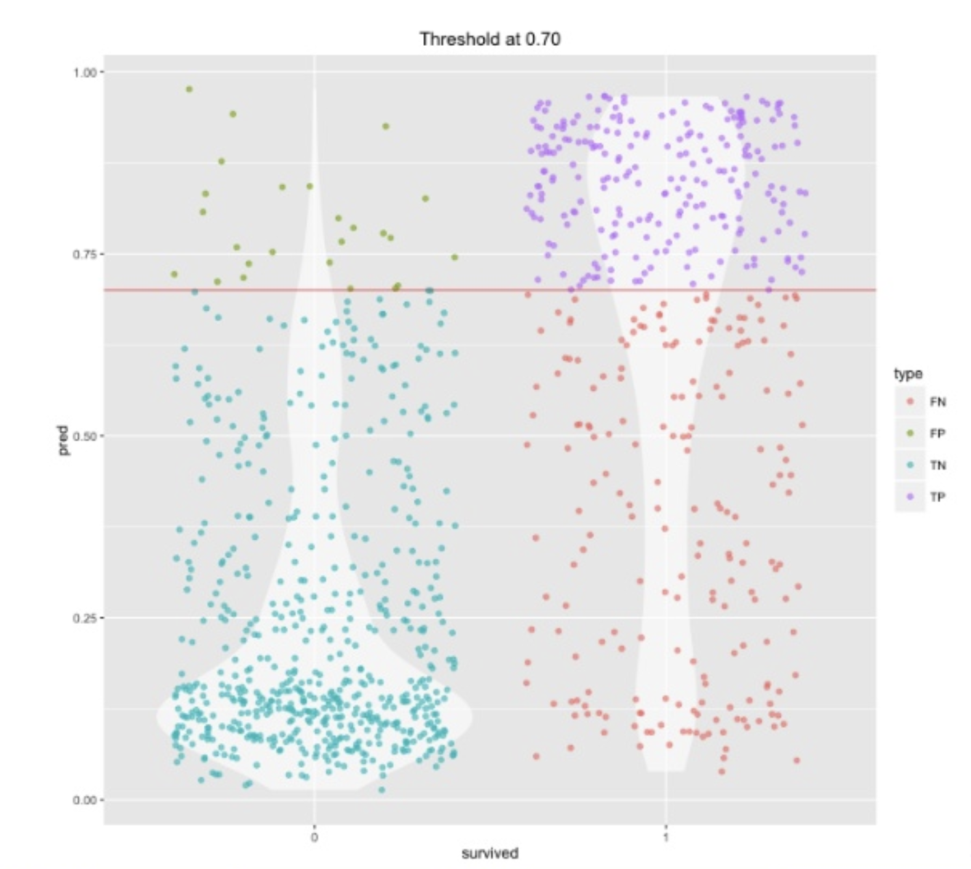
Score from logistic regression
Classification/
Category

Slide 21
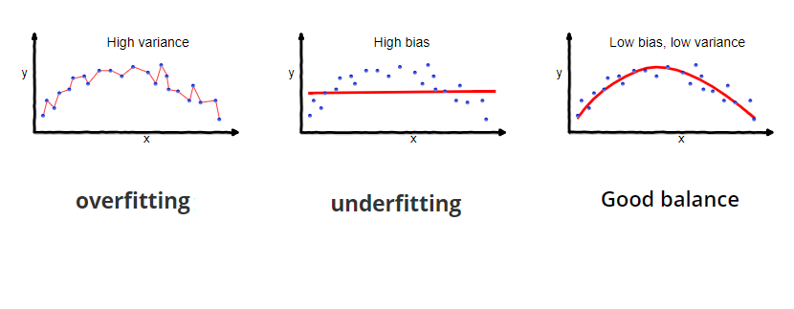
Bias vs Variance Trade-off
Seema Singh
https://towardsdatascience.com/understanding-the-bias-variance-tradeoff-165e6942b229

Slide 22
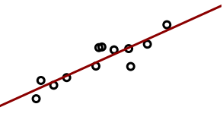
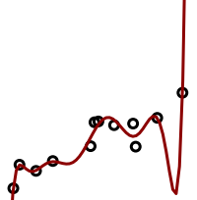
Model Capacity: Overfitting and Underfitting
22

Slide 23
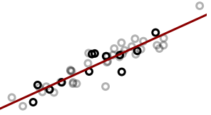

Model Capacity: Overfitting and Underfitting
23

Slide 24

Model Capacity: Overfitting and Underfitting
24

Slide 25
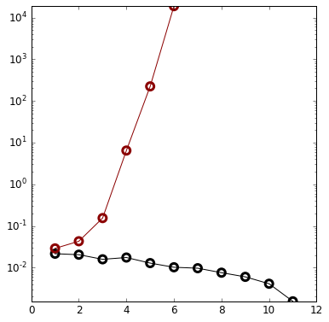
Training and Testing
Testing Error
Error on Training Set
Training Error
Degree of polynomial

Slide 26
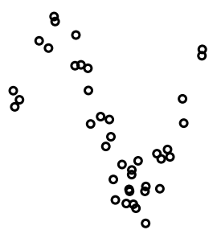
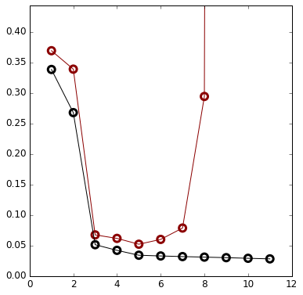
Training and Testing
Testing
Error
Error on Training Set
Training
Error
Degree of polynomial

Slide 27
Questions?
If you would like to learn more, Sackler runs an excellent Machine Learning course that is available at least to grad students.
Also this free course on coursera is great:
https://www.coursera.org/learn/machine-learning

