Slide 1
Introduction to Deep Learning Bianca Furtuna @Fur_Bi

Slide 2

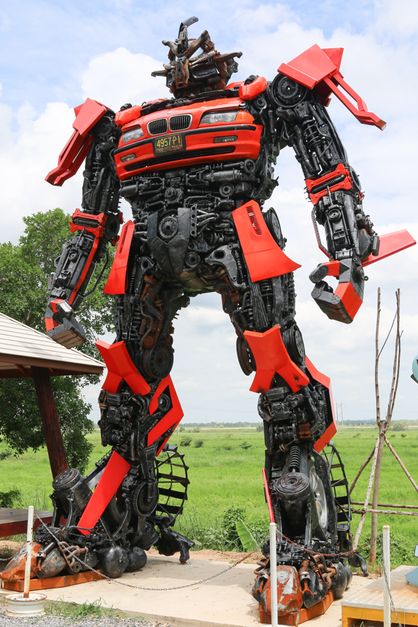
The Artificial Intelligence Hype
Weak AI
Strong AI

Slide 3

What is Deep Learning?
Area of Machine Learning
Deep Neural Networks (DNNs)
Numbers of layers
Complexity of the architecture

Slide 4
History
1940s McCulloch and Pitts – first neural network computing model
1950s Rosenblatt’s – perceptron
1960s Widrow and Hoff – ADALINE
1969 Minsky and Papert
1970s Werbos – backpropagation
1980s Renewed interest in neural networks, first conferences

Slide 5
What is a Neural Network?
Output Layer
Hidden Layers
Input Layer

Slide 6
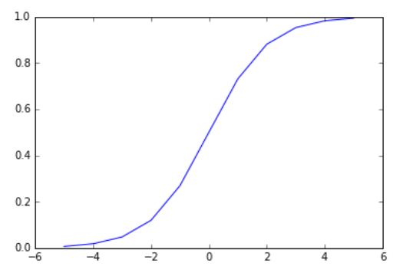















Single Neuron Model
Bias unit
$$x_{0}$$
$$z= \sum_{i=0}^{n}{w_{i}x_{i}}$$
$${ x}_{1}$$
$$w_{1}$$
$$w_{0}$$
$$x_{2}$$
$$w_{2}$$
$$Σ$$
$$z$$
$$σ$$
$$output= σ\left(z\right)= \frac{1}{1+e^{−z}}$$
Output
$$w_{3}$$
$$ε [0,1]$$
$$x_{3}$$
$$output=P\left(1\right|parameters)$$
Input features x

Slide 7

Single Neuron Model
$$Σ σ$$
Output Layer
Hidden Layers
Input Layer

Slide 8
Backpropagation
Propagation
Error
Weight Update
Notes:
Backprop – explanation from Wikipedia
The algorithm repeats a two phase cycle, propagation and weight update. When an input vector is presented to the network, it is propagated forward through the network, layer by layer, until it reaches the output layer. The output of the network is then compared to the desired output, using a loss function, and an error value is calculated for each of the neurons in the output layer. The error values are then propagated backwards, starting from the output, until each neuron has an associated error value which roughly represents its contribution to the original output.
Backpropagation uses these error values to calculate the gradient of the loss function with respect to the weights in the network. In the second phase, this gradient is fed to the optimization method, which in turn uses it to update the weights, in an attempt to minimize the loss function.

Slide 9
Recap - What is Deep Learning?
Area of Machine Learning
Deep Neural Networks (DNNs)
Numbers of layers
Complexity of the architecture

Slide 10
Convolutional Neural Networks (CNN)
Output Layer
Hidden Layers
Input Layer

Slide 11
Convolutional Neural Networks (CNN)
Softmax
Input image
Fully connected layer
Convolution
MaxPooling
Convolution
MaxPooling

Slide 12
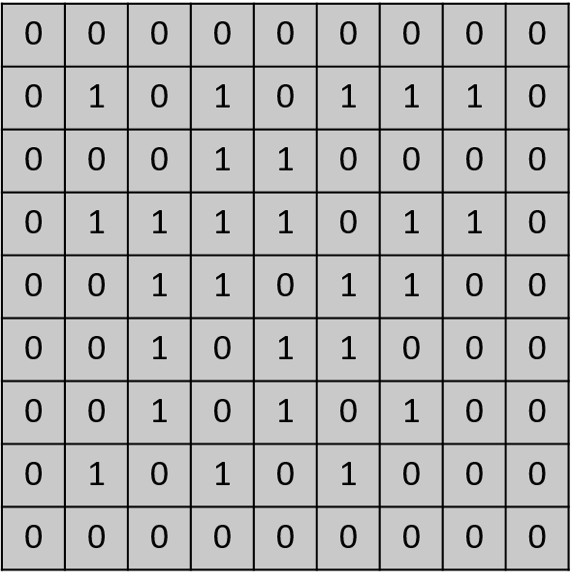
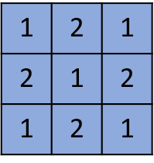
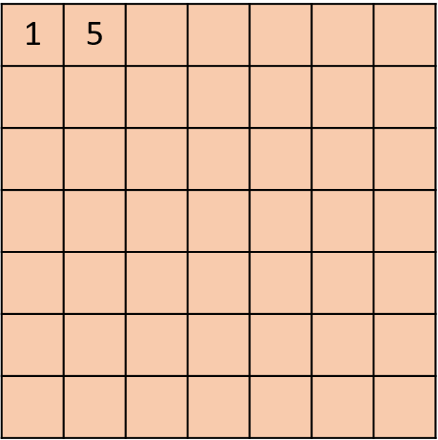
Convolutional Layer
Input Image
Kernel
Applying Kernel
Feature Map

Slide 13
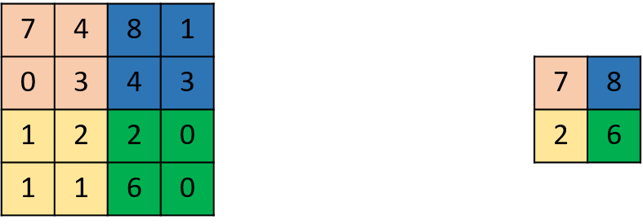
MaxPooling Layer

Slide 14
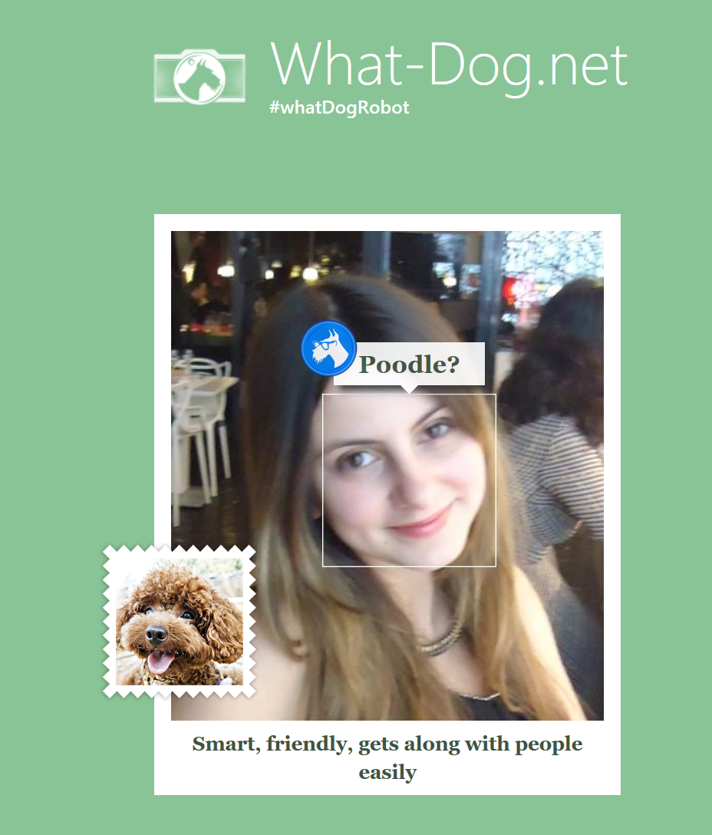
Application of DNNs
Image Processing
Speech Recognition
Machine Translation

Slide 15
Tools
Theano
Caffe
CNTK
Tensorflow
Chainer
Torch
Lasagne
Keras

Slide 16
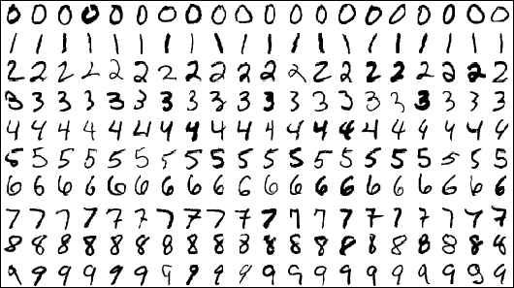
Deep Learning Scenario
MNIST dataset which consists of 70,000 grayscale images of hand-written digits
28x28 pixels

Slide 17
Azure ML Demo
Net# - define neural network architectures
Algorithm | One Hidden Layer | Two hidden layers | Basic Convolution | Convolution and pooling
Accuracy | 97.94% | 98.14% | 98.36% | 98.89%

Slide 18
Chainer Demo
Algorithm | One Hidden Layer | Two hidden layers | Basic Convolution | Convolution and pooling
Accuracy | 98% | 98.26% | 98.79% | 98.6%

Slide 19

Thank you!
@Fur_Bi

