Slide 1
TYPESCRIPT EXERCISE
User Management App
Login · User Management · DB Persistence
React + Node.js (Fastify) + PostgreSQL — Docker Compose

Slide 2
THE BRIEF
What You Gave Me
“TypeScript exercise: Login + User management + DB persistence (React frontend, NodeJS backend, Postgres) using Docker Compose.”
How I read the brief
• Full-stack TypeScript — a real client + server, not a script
• Authentication is a first-class requirement, not a stub
• “User management” implies full CRUD, not just a read-only list
• “DB persistence” means a real relational database, not in-memory state
• Everything must run via Docker Compose — one command, no manual setup steps

Slide 3
THE RESULT
What I Built
A full-stack TypeScript user-management app with real session security and RBAC — one docker compose up to run it end to end.
• Auth: email + password login, argon2-hashed passwords, short-lived JWT access token, rotating DB-stored refresh tokens with reuse detection
• User management: list with search + pagination, create, edit, delete
• RBAC: any logged-in user can browse; only ADMIN can create / edit / delete
• Validated end-to-end with Zod — one schema idea shared by client and server
• Fully containerized: React + Fastify + Postgres, all wired by a single docker-compose.yml

Slide 4
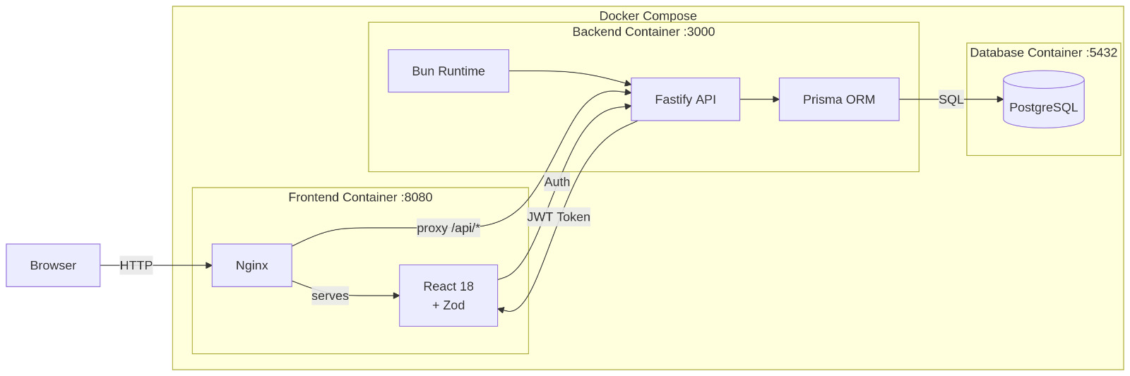
THE RESULT
Architecture Diagram

Slide 5
SYSTEM DESIGN
Architecture
Docker Compose
HTTP /api/*
JSON + JWT bearer
+ httpOnly cookie
Prisma Client
(SQL)
React SPA (:8080)
Fastify API (:3000)
PostgreSQL (:5433)
• Vite + Tailwind
• React Hook Form + Zod
• fetch client with automatic token refresh
• Access token kept in memory
• routes → services → Prisma
• JWT auth + RBAC middleware
• Zod request/response validation
• users table
• refresh_tokens table
• Prisma migrations
• seeded demo accounts
docker compose up --build → frontend :8080 · backend API · db :5433→5432

Slide 6
STACK
Tech Stack — and Why
Layer | Choice | Why
Tooling | Bun | One fast tool for installs + running TypeScript directly, no separate build step
Frontend | React + TypeScript + Vite | Fast dev server, standard, well-understood SPA tooling
Styling | Tailwind CSS | Responsive UI without pulling in a heavy component library
Forms / validation | React Hook Form + Zod | Minimal re-renders; one schema both validates and types the form
Auth state | useSyncExternalStore | React's built-in external-store API — no Context provider, no state library
Backend | Fastify + TypeScript | Lightweight, schema-first
ORM | Prisma | Type-safe queries plus first-class, versioned migrations
Database | PostgreSQL | Relational data with real constraints and indexes
Auth tokens | JWT (access) + rotating refresh | Short-lived access tokens limit blast radius; revocable refresh tokens add real session control

Slide 7
REQUEST FLOW
UI and Backend: How They Talk
• Every request: route (HTTP + Zod schema) → service (business logic) → Prisma (DB)
• One Zod schema per endpoint both validates the payload and generates its OpenAPI docs
• Access token: short-lived JWT, sent as a Bearer header, held in memory on the client — never in localStorage (XSS-safe)
• Refresh token: opaque, rotating, stored hashed in the DB; delivered as an httpOnly, sameSite cookie scoped to /api/auth
• Frontend fetch client catches a 401, calls /auth/refresh automatically, then retries the original request
• CORS: a specific origin with credentials: true — required because the refresh flow relies on a cookie
POST /auth/login
Access token (body)
+ refresh cookie (httpOnly)
Access token expires
→ 401
POST /auth/refresh
rotate & retry

Slide 8
DATA MODEL
Database — PostgreSQL via Prisma
users
refresh_tokens
• id — uuid, primary key
• email — unique
• password_hash — argon2
• first_name, last_name, phone
• role — enum: ADMIN | USER
• is_active — boolean
• created_at, updated_at
• refreshTokens — RefreshToken[] (relation)
• id — uuid, primary key
• token_hash — unique, hashed (never the raw token)
• user_id — FK → users.id
• expires_at
• revoked_at — nullable
• created_at
1 : N, ON DELETE CASCADE
• Schema history is versioned via Prisma migrations (prisma/migrations/)
• Indexes on users(createdAt) and refresh_tokens(userId) support listing and lookup
• Passwords are never stored or returned in plaintext; refresh tokens are stored as a hash, not the raw value
• A seed script creates one admin + three demo users on first boot

Slide 9
PRODUCT
Screens & Features
Screens
Core Features
• Login — email + password, inline validation, a generic error message (no user-enumeration)
• Users — searchable, paginated table; ADMIN sees Create / Edit / Delete, everyone else browses read-only
• Create / Edit User — a modal form (React Hook Form + Zod) with role and active-status controls
• Toasts + a confirm dialog for destructive actions, replacing window.alert / window.confirm
• Email/password auth with rotating, revocable refresh tokens
• Role-based access control (ADMIN vs USER)
• Full user CRUD with search + pagination
• End-to-end Zod validation on client and server
• Interactive OpenAPI contract at /docs
• One-command Docker Compose setup

Slide 10
TAKEAWAYS
What I Learnt
• Schema-first backend design: one Zod schema drives validation
• Real session security: rotating refresh tokens with reuse detection are meaningfully different from “a JWT in localStorage”
• useSyncExternalStore as a lightweight alternative to Context/Redux for small pieces of shared client state
• Docker Compose and what it is

