Slide 1


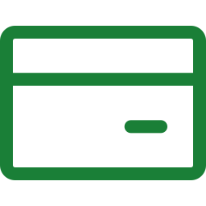

SMARTTODO
AGENTIC JOURNEY · GITHUB AND AZURE
SmartTodo
What if an agent could build your iPhone app, but only after you made the decisions, froze the tests, and passed every gate?
SESSION
COST IF LEFT RUNNING
RUNS ON
60 minutes
~$10–30/month
Functions + SQL + Foundry
IN THIS SESSION
1
Plan the work
2
Build test-first
3
Deploy to Azure
4
The factory
github.com/microsoft/agentic-journeys
Notes:
SmartTodo is the most process-focused journey. The full journey takes 3 to 4 hours across several sessions, so in one hour we walk through the workflow and show the signature prompts of each phase. The app itself is a todo list where AI breaks a task into action steps. The real product is the workflow: issues, plan interviews, red and green TDD, deterministic gates, stacked pull requests, and finally a cloud-agent factory. Timing guide: 6 minutes intro, 8 minutes planning, 20 minutes build test-first, 13 minutes deploy, 8 minutes factory, 5 minutes wrap-up.

Slide 2
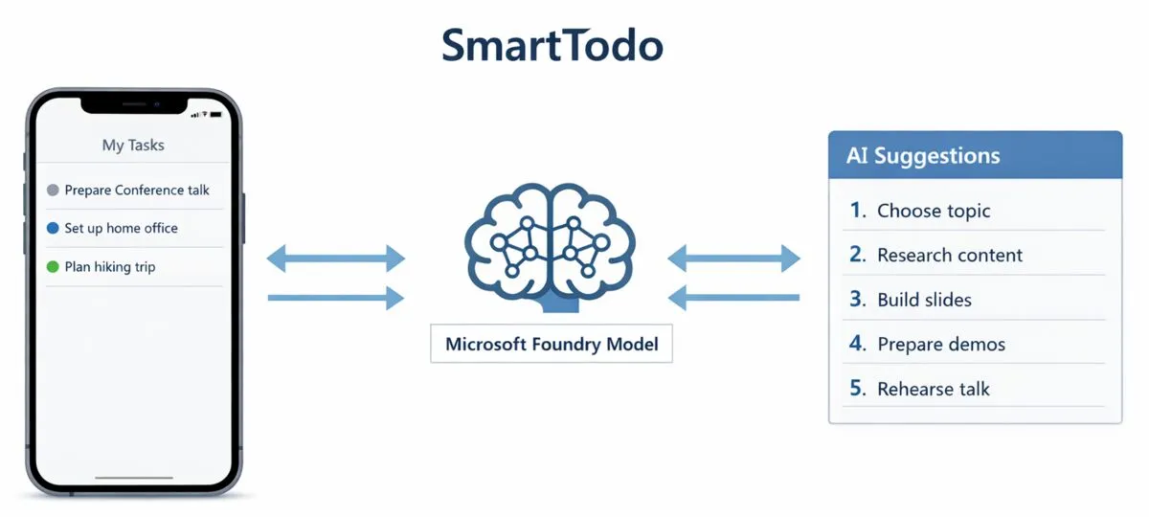
SMARTTODO
WHAT WE ARE BUILDING
Break any task into AI-generated steps
Notes:
A SwiftUI iPhone app. Add a todo such as "Plan a weekend camping trip," tap Generate Steps, and a Microsoft Foundry model breaks it into action steps. Check off steps and the todo completes automatically. You do not need a Mac to follow the API and Azure phases. The iOS phase needs macOS and Xcode.

Slide 3

SMARTTODO
THE BIG IDEA
AI output becomes trustworthy when decisions, frozen tests, and gates surround it.
You review a short test list instead of thousands of generated lines.
Notes:
This is the thesis of the journey. Humans make the decisions. Tests are written first and then frozen. Gates are deterministic scripts whose exit codes decide done, not the agent's claims. And a human reviews what ships. That changes your review job from reading every generated line to reviewing a short list of tests.

Slide 4
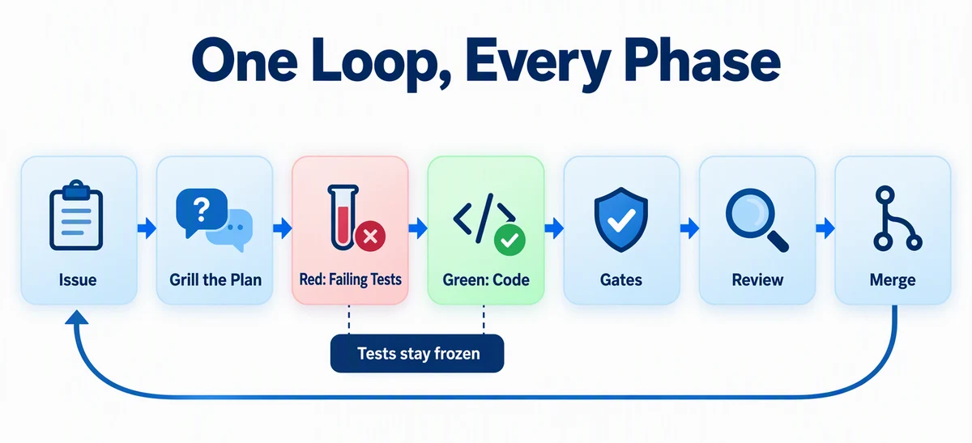
SMARTTODO
THE WORKFLOW
One loop, every phase
Notes:
Every phase runs the same loop. A GitHub issue. Grill the plan until decisions are clear. Red: write failing tests. Green: write code until the tests pass, without touching them. Run the gates. Review. Merge. Tests stay frozen from red to green.

Slide 5







SMARTTODO
ARCHITECTURE
What we are building on
AZURE RESOURCE GROUP
Azure SQL
Todos + steps
HTTPS JSON
→
identity
Microsoft Foundry
SwiftUI app
→
Functions API
gpt-5-mini
iPhone, iOS 17+
Node.js + TypeScript
Storage
Functions runtime
App Insights + Log Analytics
Notes:
The iPhone app calls a REST API on Azure Functions Flex Consumption over HTTPS. The API uses managed identity to reach Azure SQL for todos and steps, and calls a gpt-5-mini deployment in Microsoft Foundry to decompose tasks. Storage holds the Functions runtime and deployment package. Application Insights and Log Analytics collect telemetry. Locally and in tests, an in-memory store and a fake step generator stand in for SQL and the model, so tests are fast and deterministic.

Slide 6

SMARTTODO
01
SECTION 1 OF 4
Plan the work
Turn the architecture into GitHub issues, and put CI and branch protection in place before any code.
1
Plan the work
2
Build test-first
3
Deploy to Azure
4
The factory
Notes:
Section one: plan the work. About 8 minutes.

Slide 7


SMARTTODO
ONE-TIME SETUP
Guardrails before code
Terminal
Your own repository
$ node journeys/smart-todo/setup/setup.mjs
CI: api, ios, infra
Ruleset: active
CI on main: success
Protected main
Notes:
The setup script creates a workspace next to this repository, copies the journey, creates your GitHub repository, installs the CI workflow, labels, and a branch ruleset, and waits for the first CI run. It ends with "Ruleset: active" and "CI on main: success." Use --start-at to jump to a later phase with checkpoint code for the earlier ones. That is handy for a one-hour session.

Slide 8

SMARTTODO
ARCHITECTURE TO ISSUES
Let the diagram plan the work
PROMPT
@images/architecture.png This is the SmartTodo architecture. Read PLAN.md, then create the issues described in its "Issue Breakdown" section. Show me each issue number and title.
One issue per phase: API, iOS app, and Azure deployment.
Notes:
Attach the architecture image and PLAN.md, and the agent creates the Phase 1 to 3 issues. Every later prompt refers to those issue numbers, so the issues become the source of truth for decisions.

Slide 9
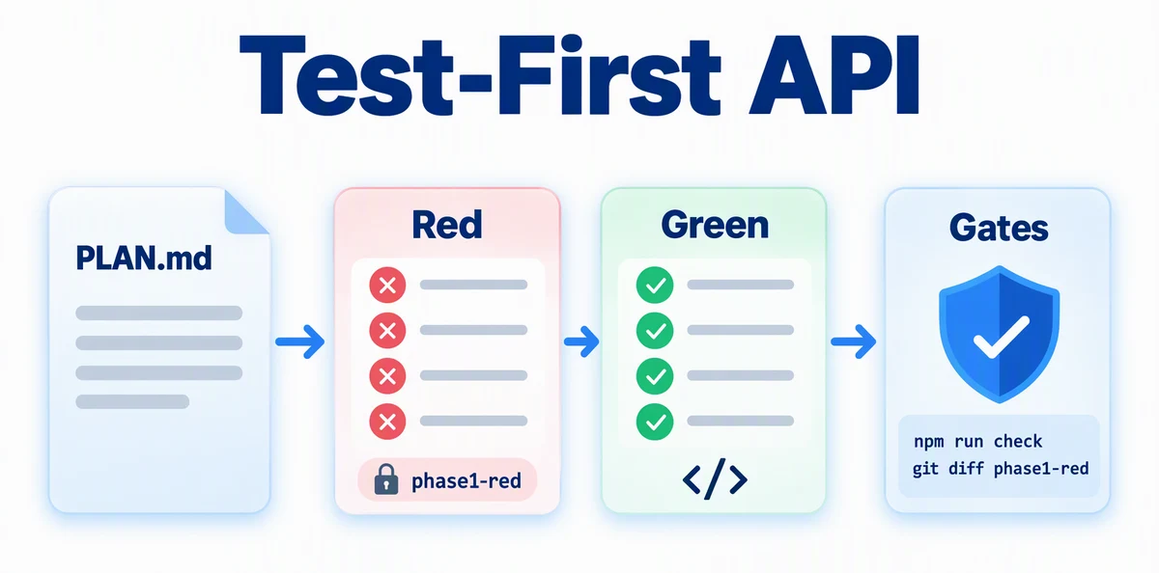
SMARTTODO
02
SECTION 2 OF 4
Build test-first
Grill the plan, write failing tests, then write code until they pass. Same loop for the API and the iPhone app.
1
Plan the work
2
Build test-first
3
Deploy to Azure
4
The factory
Notes:
Section two: build test-first. About 20 minutes. This is the core of the journey.

Slide 10



SMARTTODO
THE INNER LOOP
Grill. Red. Green.
Grill
Red
Green
→
→
You answer each Decision Point, one at a time
Failing tests for each behavior, then tag the commit
Code until the gate passes. Tests stay frozen.
Decisions + tests
phase1-red
npm run check
Notes:
Three steps. The grill-plan skill interviews you, one question at a time, about every Decision Point in the plan, then posts a Decisions table and a test list to the issue. The tdd-builder agent writes failing tests for each behavior and you tag that commit, for example phase1-red. Then the same agent implements code until the gate passes, and it is not allowed to change the tests.

Slide 11

SMARTTODO
GRILL THE PLAN
Decide before anyone codes
PROMPT
Use the grill-plan skill on issue #<api-issue>. Read PLAN.md and PLAN-phase1-api.md first. When we finish, post the Decisions and the Test list as a comment on the issue.
Start the stack first: gh stack init --base main phase-1-api
Notes:
The skill asks one question at a time. Answer each Decision Point. For example: what happens when all steps of a todo are complete? The decisions and the resulting test list are posted to the issue so everyone can see them.

Slide 12

SMARTTODO
RED
Write the tests first
PROMPT · ABRIDGED
Use the tdd-builder agent for the red phase of issue #<api-issue>. Scaffold src/api as described in … PLAN-phase1-api.md. Then write the tests from its "Test Strategy" section and the Decisions comment on the issue. Tag the red commit phase1-red.
Run npm test. Failures should be assertions, not syntax errors.
Notes:
Read the test names. This is your review surface. If a test is wrong, fix it now and keep it red. For example, the README shows a Decision Point 3 test that gives a todo only one step. Completing it triggers auto-completion, so the test needs two steps.
Full prompt:
Use the tdd-builder agent for the red phase of issue #<api-issue>. Scaffold src/api as described in the "Project Structure", "Local Providers", and "Quality Gate" sections of PLAN-phase1-api.md. Then write the tests from its "Test Strategy" section and the Decisions comment on the issue. Tag the red commit phase1-red.

Slide 13
SMARTTODO
GREEN
Make it pass. Don't touch the tests.
PROMPT
/autopilot Use the tdd-builder agent for the green phase of issue #<api-issue>. Implement src/api until "npm run check" passes. Do not change anything under src/api/test. Commit the result as a green commit.
Notes:
Autopilot is safe here because the finish line is deterministic: npm run check must pass, and the tests are frozen. If the agent reports a test that truly cannot pass, fix only that test in a new red commit and move the tag.

Slide 14

SMARTTODO
DETERMINISTIC GATES
Exit codes decide "done"
Terminal
$ npm run check
# type check + unit and contract tests
$ git diff --exit-code phase1-red -- src/api/test
# proves green did not edit the tests
Not the agent's summary. The exit codes.
Notes:
Two gates. npm run check runs type checks and tests. The git diff against the red tag proves the tests are unchanged. There is also a black-box verifier you can run against the local API. Then run /review, triage the findings, and open the first stacked pull request with gh stack submit.

Slide 15
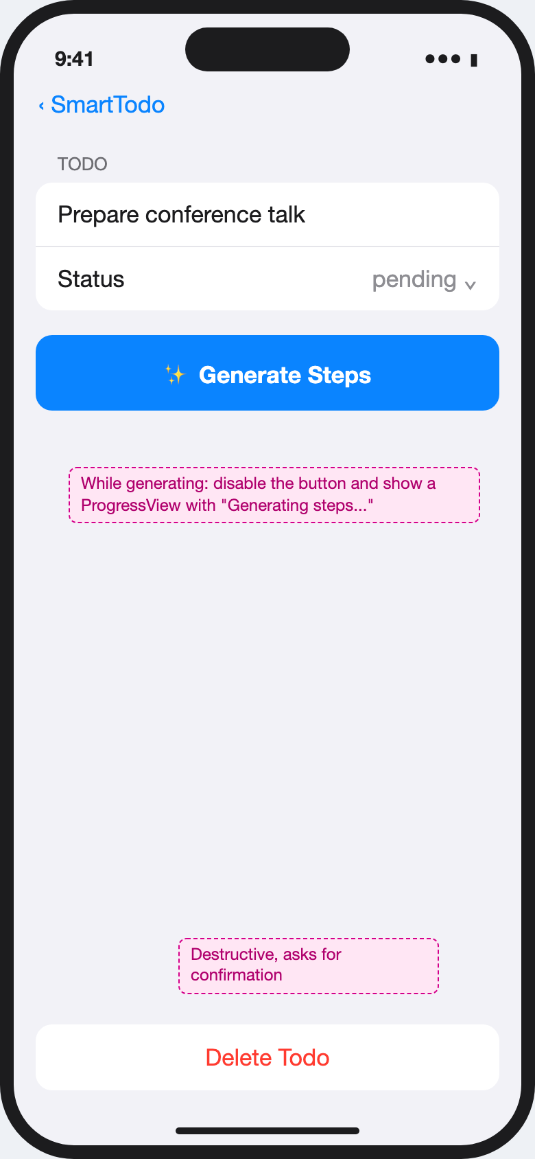
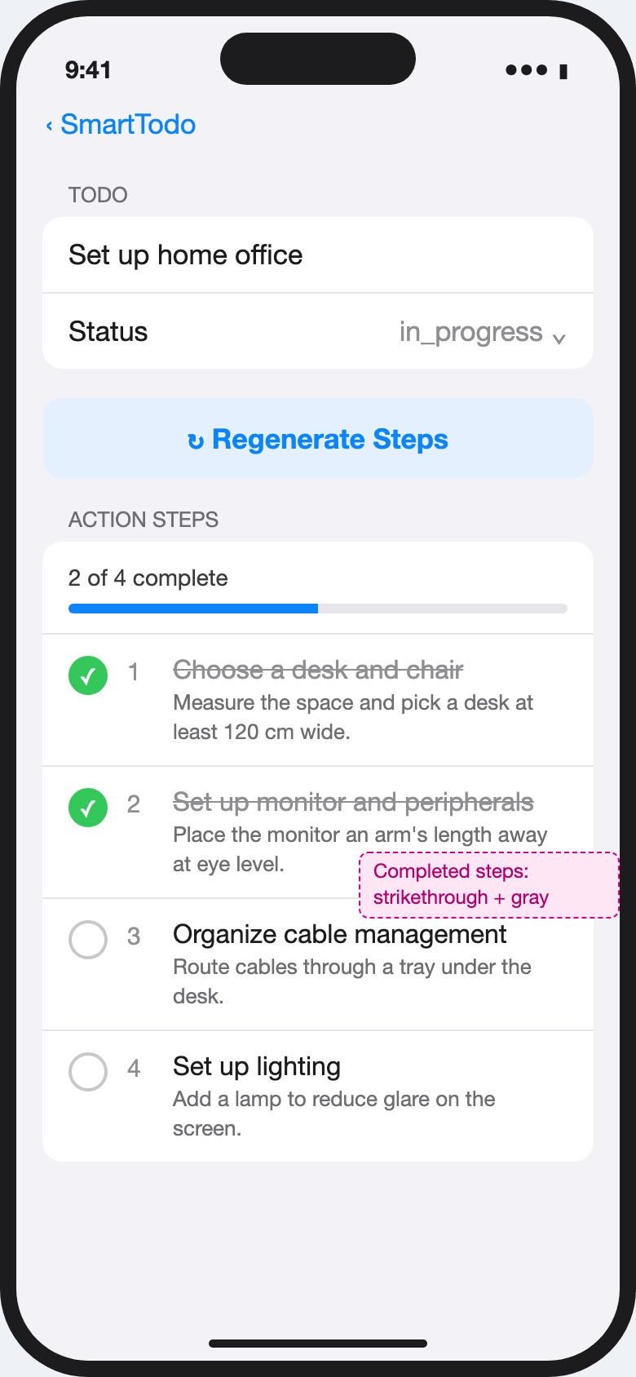
SMARTTODO
SAME LOOP, NEW PLATFORM
Mockups in. Tests first. Then the screen.
PROMPT
@images/mockups/todo-detail-empty.png @images/mockups/todo-detail-steps.png These are the SmartTodo detail screen mockups. Use the grill-plan skill on issue #<ios-issue> with PLAN-phase2-ios.md, and post the decisions to the issue.
Notes:
Phase 2 runs the same loop for the SwiftUI app, starting from a supplied starter project. Attach the mockups and grill the plan. Then red: copy the starter and write tests. Then green with /autopilot until node scripts/test-ios.mjs passes. The iOS gate needs macOS with Xcode. Exploratory checks in the simulator cover Dark Mode and large Dynamic Type.

Slide 16
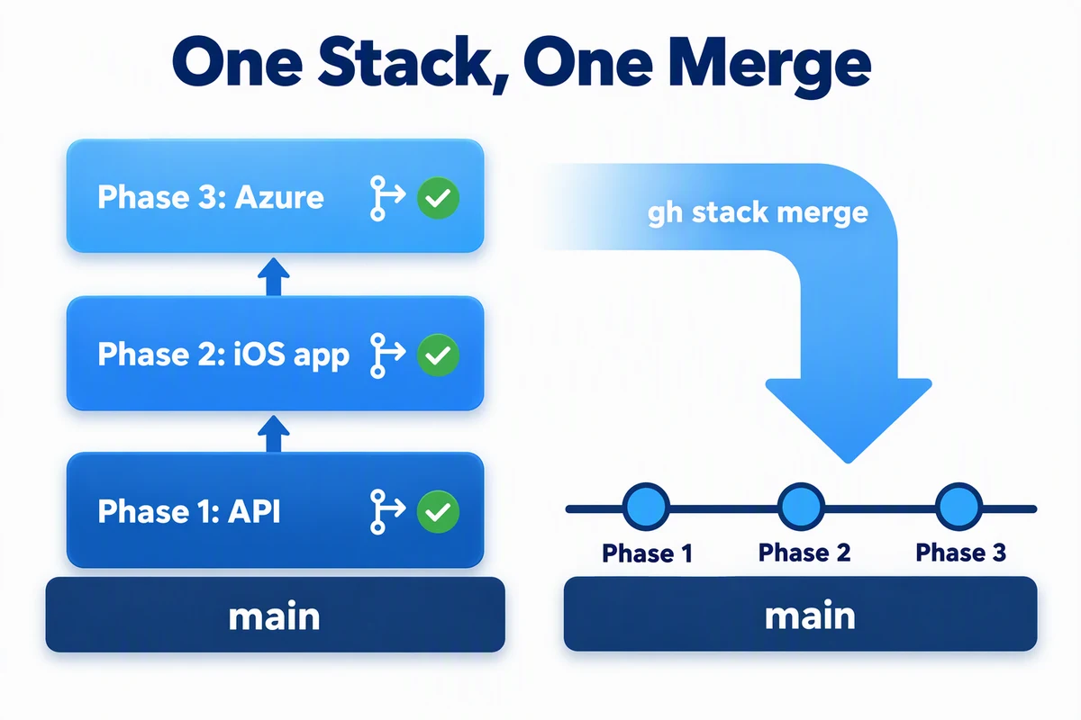
SMARTTODO
STACKED PULL REQUESTS
Reviewable layers, one merge
Notes:
Each phase is a branch stacked on the previous one: API, then iOS, then Azure. Each layer has its own pull request, tests, and gate, so reviewers see one focused change at a time. gh stack keeps them in order, and the whole stack merges once, from the top.

Slide 17
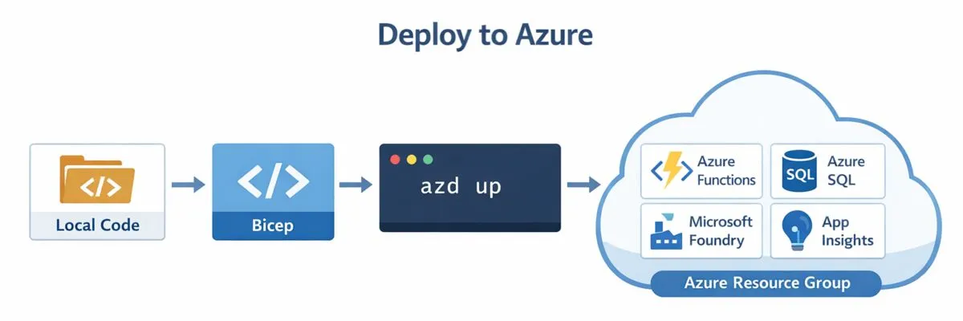
SMARTTODO
03
SECTION 3 OF 4
Deploy to Azure
Review the cost, write the infrastructure gate, and let the agent generate Bicep until it passes.
1
Plan the work
2
Build test-first
3
Deploy to Azure
4
The factory
Notes:
Section three: deploy to Azure. About 13 minutes.

Slide 18



SMARTTODO
TEST-FIRST INFRASTRUCTURE
The same loop, for Bicep
→
→
→
Cost review
Gate fails
Generate
azd up
Read-only, posted to the issue
check-infra.mjs, tag phase3-red
Until the gate passes
Then run the verifier
The verifier that proved the local API now proves the Azure one.
Notes:
Start with a read-only cost and architecture review and post your decisions to the issue. Then create the infrastructure gate and prove it fails. Then generate the infrastructure until the gate passes, prepare the azd environment, and run azd up. The same black-box verifier from Phase 1 now runs against Azure and prints the same PASS line.

Slide 19

SMARTTODO
GREEN, FOR INFRASTRUCTURE
Generate until the gate passes
PROMPT
/autopilot Generate the infrastructure in the "Azure Deployment" section of PLAN-phase3-azure.md until "node scripts/check-infra.mjs --offline" passes. Do not change scripts/check-infra.mjs.
Then azd up and node ../../.github/scripts/verify-smart-todo.mjs
Notes:
The gate checks things like managed identity instead of connection strings, Flex Consumption, the model deployment, and the SQL setup hook. After azd up, the post-provision hook prints "Post-provision SQL setup complete." Then run the verifier against API_URL. Point the iOS app at the deployed API for a final manual check.

Slide 20
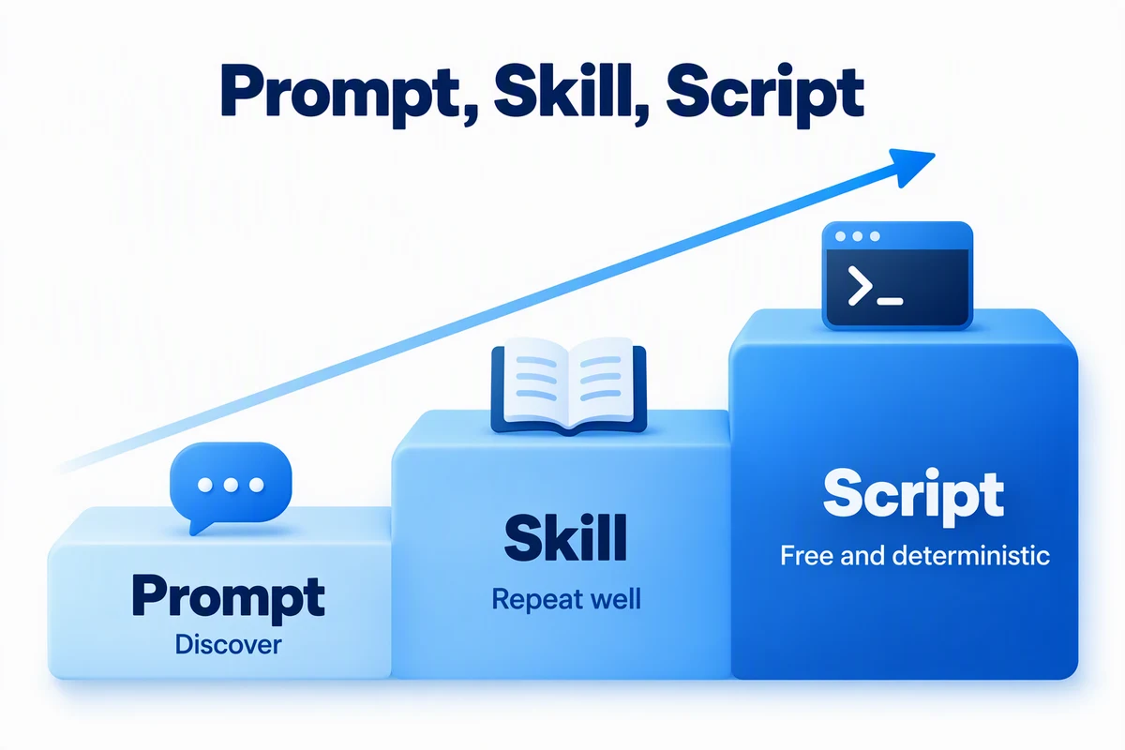
SMARTTODO
CAPTURE WHAT YOU LEARNED
Prompt → Skill → Script
Move repeatable work toward free, deterministic automation.
Notes:
After infrastructure works, capture it. A prompt is good for discovery. A skill repeats the approach well. A script is free and deterministic. Phase 3 ends by creating a reusable infrastructure skill and a scaffold script, then proving the scaffold works on a fresh copy without AI. Finally, open the Phase 3 pull request and merge the whole stack from the top.

Slide 21
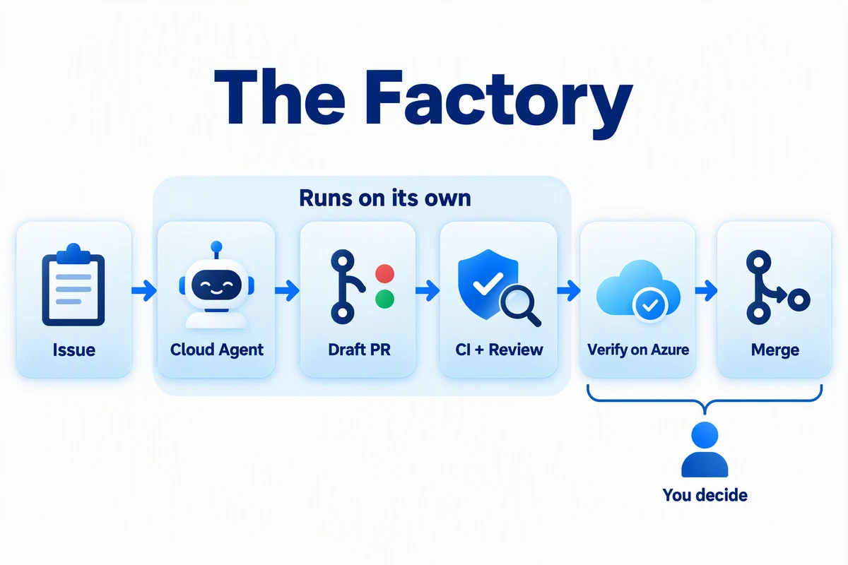
SMARTTODO
04
SECTION 4 OF 4
The factory
Encode the workflow so a cloud agent can run it for the next feature while you decide what ships.
1
Plan the work
2
Build test-first
3
Deploy to Azure
4
The factory
Notes:
Section four: the factory. About 8 minutes.

Slide 22

SMARTTODO
ENCODE THE RULES
Teach the cloud agent your definition of done
PROMPT
Create .github/copilot-instructions.md and .github/workflows/copilot-setup-steps.yml as described in the "Definition of Done" and "Cloud Agent Environment" sections of PLAN-phase4-factory.md. Open a pull request. Don't enable auto-merge.
Setup steps install Node, dependencies, and Functions Core Tools before the agent starts.
Notes:
The cloud agent is only as good as its environment and rules. The instructions file carries the definition of done: plan update, red commit, green commits. The setup steps workflow prepares its Linux environment. Validate it with gh workflow run copilot-setup-steps.yml.

Slide 23

SMARTTODO
ASSIGN THE ISSUE
Hand the next feature to tdd-builder
assign.json
{
Agent runs plan, red, green
​ "assignees": ["copilot-swe-agent[bot]"],
​ "agent_assignment": {
​ "base_branch": "main",
CI runs api, ios, infra
​ "custom_agent": "tdd-builder"
​ }
You review and merge
}
Notes:
Create the due-dates feature issue from the plan, then assign it to the Copilot cloud agent with the tdd-builder custom agent. The README uses gh api with this assign.json payload. The agent works in an ephemeral Linux environment, so it cannot build Swift. It pushes and waits for the macOS ios check in CI. You read the red test names first, review the pull request, run the deployed verifier, and merge only when checks, review, and verification all pass. Local fallback: /delegate Use the tdd-builder agent for the full cycle of issue #<number>.

Slide 24

SMARTTODO
CLEAN UP
Tear it down the same day
Terminal
$ azd down --force --purge
# Confirm it is really gone
$ az group exists --name <resource-group-name>
false
Also delete the practice GitHub repo if you no longer need it: gh repo delete <owner>/smart-todo
Notes:
Run azd down from journeys/smart-todo. If you set up the optional release pipeline, remove its role assignments and identity resource group using the values you recorded. Stop local API processes and remove the detached API worktree.

Slide 25


SMARTTODO
KEY TAKEAWAYS
What to remember
Grill the plan. Decisions live on the issue.
Red first. Freeze the tests. Green can't change them.
Exit codes decide done. Stack PRs for focused review.
Encode the workflow, then let a cloud agent run it.
NEXT JOURNEY
Grafana · Switch gears: let an agent deploy an open-source app to Azure
Notes:
Recap. Decisions come from you and live on the issue. Tests are written first and frozen. Deterministic gates decide done, and stacked pull requests keep review focused. Once the workflow is encoded, a cloud agent can run it for the next feature while you keep the final say. Next, the open-source journeys, starting with Grafana, show agents deploying existing apps.

