Slide 1

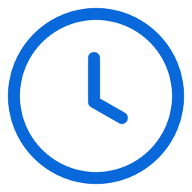
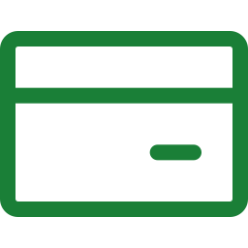
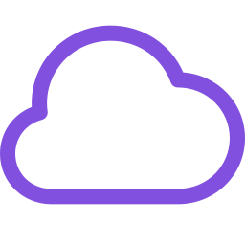
N8N
AGENTIC JOURNEY · GITHUB AND AZURE
n8n on Azure
What if an agent could deploy a production-style workflow platform to Azure, then build and run your first workflow?
SESSION
COST IF LEFT RUNNING
RUNS ON
60 minutes
~$25–35/month
Container Apps + PostgreSQL
IN THIS SESSION
1
Plan and generate
2
Deploy in parallel
3
Operate the app
github.com/microsoft/agentic-journeys
Notes:
n8n is an open-source workflow automation platform. Compared with Grafana, this journey adds a real database, careful health probes, and a post-provision hook that solves a chicken-and-egg configuration problem. Deployment takes about 7 to 15 minutes, and we will use that time to build a workflow in parallel. Timing guide: 5 minutes intro, 18 minutes plan and generate, 15 minutes deploy in parallel, 15 minutes operate, 7 minutes wrap-up.

Slide 2
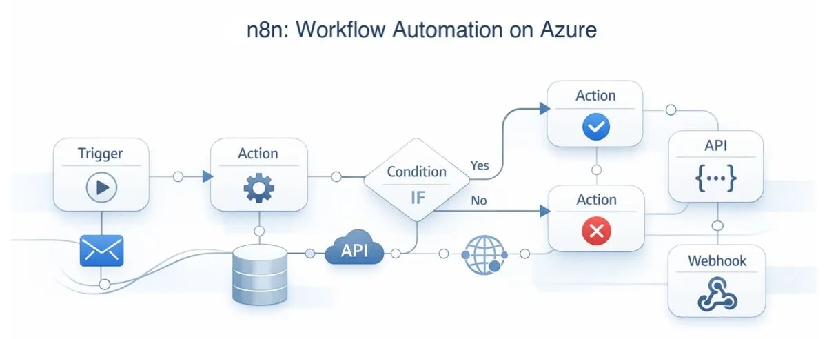
N8N
WHERE WE ARE HEADED
Workflow automation, running on Azure
Notes:
n8n connects triggers, actions, conditions, APIs, and webhooks into workflows. By the end of the session we will have n8n running on Azure with PostgreSQL, plus a workflow that the agent created and triggered through the n8n API.

Slide 3
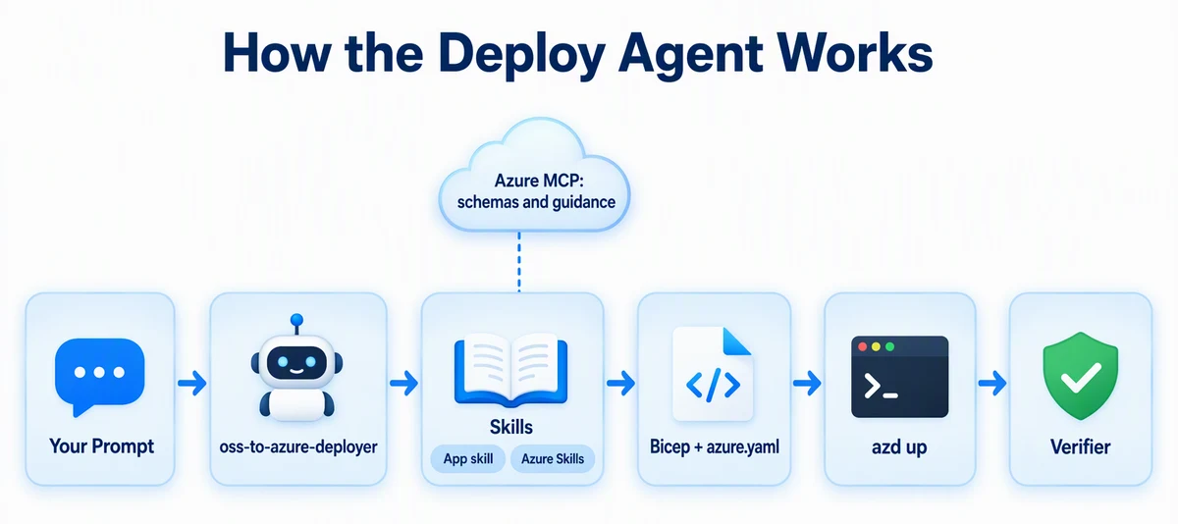
N8N
HOW IT WORKS
Your prompt, the agent, and the skills
Notes:
You write a prompt. The oss-to-azure-deployer agent uses the n8n-azure app skill in this repo and the Azure Skills plugin for current Bicep schemas and guidance. It generates Bicep, azure.yaml, and a hook. azd deploys, and a verifier proves it works.

Slide 4



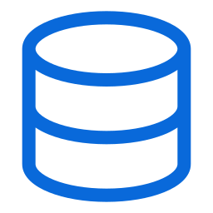


N8N
ARCHITECTURE
An app, a database, and a hook
AZURE RESOURCE GROUP
HTTPS
→
SSL
You
→
n8n
PostgreSQL
Browser or API
Container App · /healthz
Flexible Server
Log Analytics
Post-provision hook sets WEBHOOK_URL
Notes:
One resource group. The n8n container app listens on port 5678 behind HTTPS ingress, uses /healthz for its probes, and scales between 0 and 3 replicas, with minReplicas set to 1 for verification. It stores workflows in Azure Database for PostgreSQL Flexible Server over SSL. Logs go to Log Analytics. After provisioning, a hook sets WEBHOOK_URL to the app's real public URL.

Slide 5
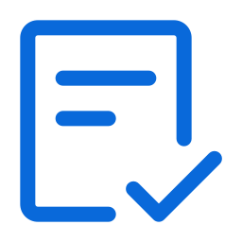
N8N
01
SECTION 1 OF 3
Plan and generate
Plan with a cost estimate, then generate and preview the infrastructure without deploying.
1
Plan and generate
2
Deploy in parallel
3
Operate the app
Notes:
Section one: plan and generate. About 18 minutes.

Slide 6

N8N
GET STARTED
Load the Azure skills and the deploy agent
copilot
> /plugin marketplace add microsoft/azure-skills
> /plugin install azure@azure-skills
> /agent
# choose oss-to-azure-deployer
The agent brings the workflow. Skills bring the app-specific know-how.
Notes:
Start Copilot CLI from the repository root. Add the Azure Skills marketplace and install the plugin once. Then choose the oss-to-azure-deployer agent with /agent.

Slide 7
N8N
PLAN AND COST FIRST
Describe it. Ask what it costs.
PROMPT
Plan an n8n deployment to Azure Container Apps with Bicep and azd: PostgreSQL Flexible Server for storage, /healthz for probes, and the westus region. List each Azure resource, its SKU, and the estimated monthly cost if left running. Don't create files or Azure resources yet.
Notes:
Same habit as every deployment journey: plan and cost before creating anything. Expect roughly 25 to 35 dollars a month if left running.
Full prompt:
Plan an n8n deployment to Azure Container Apps with Bicep and azd: PostgreSQL Flexible Server for storage, /healthz for probes, and the westus region. List each Azure resource, its SKU, and the estimated monthly cost if left running. Don't create files or Azure resources yet.

Slide 8
N8N
GENERATE AND PREVIEW
Generate, then preview
PROMPT · ABRIDGED
Generate the infrastructure for that plan: Bicep in infra-n8n/, azure.yaml, and the post-provision hook that sets WEBHOOK_URL. … Use n8n's /healthz endpoint for startup, readiness, and liveness probes. … Run azd provision --preview and summarize what it will create. Don't run azd up.
Notes:
Full prompt:
Generate the infrastructure for that plan: Bicep in infra-n8n/, azure.yaml, and the post-provision hook that sets WEBHOOK_URL. Generate secure passwords for all credentials and store them only in the azd environment. Set the Container App minReplicas to 1 so I can verify it right away without a cold start, and use n8n's /healthz endpoint for startup, readiness, and liveness probes. Prepare the azd environment for westus and my current subscription, then run azd provision --preview and summarize what it will create. Don't run azd up. If a step fails, inspect the relevant logs, make the smallest safe correction, rerun the failed step, and record the problem and resolution in issues.md. Do not print secrets.

Slide 9
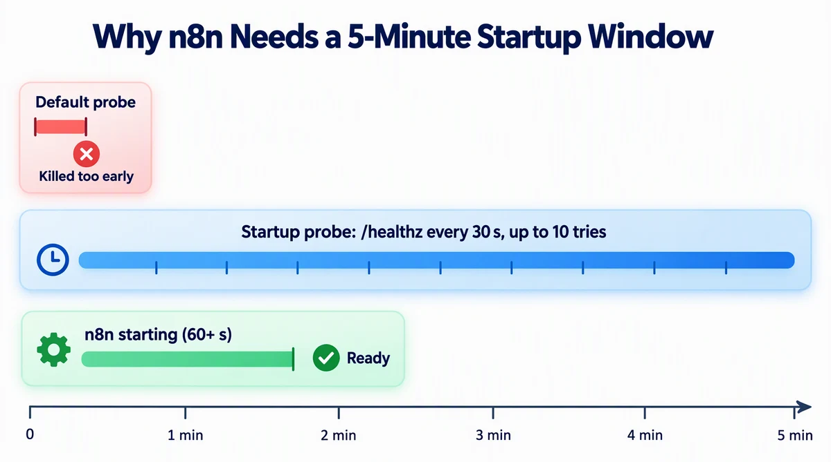
N8N
APP QUIRK
n8n needs time to start
Notes:
n8n takes over 60 seconds to start. A default probe would kill it too early and cause a restart loop. The n8n-azure skill knows this: the startup probe checks /healthz every 30 seconds, up to 10 tries, which is a five-minute window. Liveness waits 60 seconds. Ask the agent, "Why does the liveness probe have a 60-second initial delay?"

Slide 10
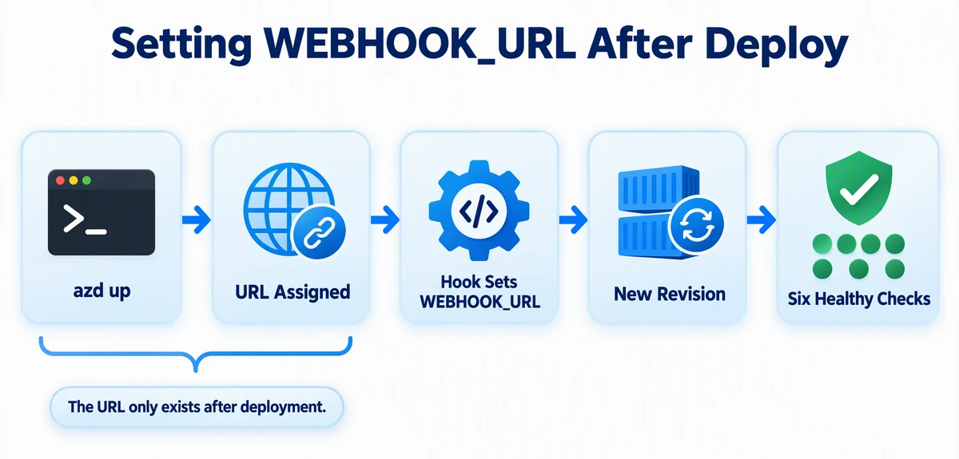
N8N
APP QUIRK
Some settings only exist after deploy
Notes:
n8n needs WEBHOOK_URL to be its own public URL, but that URL does not exist until the container app is created. The post-provision hook solves the circular dependency: after azd up assigns the URL, the hook sets WEBHOOK_URL, which creates a new revision, and waits for six consecutive healthy checks. Ask the agent, "What does the post-provision hook do?"

Slide 11
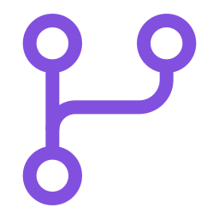
N8N
02
SECTION 2 OF 3
Deploy in parallel
While azd up runs, the agent builds your first workflow. Two jobs, at the same time.
1
Plan and generate
2
Deploy in parallel
3
Operate the app
Notes:
Section two: deploy in parallel. About 15 minutes.

Slide 12
N8N
WORK IN PARALLEL
Two terminals, two jobs
Terminal 1 · you
Terminal 2 · copilot
$ azd up
> Create the GitHub Zen
​ workflow and a runner
# Provisioning PostgreSQL...
​ script. Don't deploy.
# Deploying n8n...
# 7–15 minutes
# Writing github-zen.json...
You deploy
The agent builds
Notes:
Deployment takes 7 to 15 minutes. Do not just wait. Run azd up in one terminal. In your Copilot session, ask the agent to create the workflow and a runner script, and tell it clearly not to run any deployment commands, because azd is already running.

Slide 13
N8N
BUILD WHILE YOU WAIT
Create the first workflow
PROMPT · ABRIDGED
My azd up is running in another terminal, so don't run azd or any deployment command. Meanwhile, create n8n-workflows/github-zen.json: an n8n workflow named "GitHub Zen" … Then create scripts/run-n8n-workflow.mjs … It never prints the key. … Don't run it yet.
Notes:
Full prompt:
My azd up is running in another terminal, so don't run azd or any deployment command. Meanwhile, create n8n-workflows/github-zen.json: an n8n workflow named "GitHub Zen" with a Webhook trigger (POST, path github-zen), an HTTP Request node that calls https://api.github.com/zen, and a Respond to Webhook node that returns that text. Then create scripts/run-n8n-workflow.mjs. It reads N8N_URL through azd env get-value with an argument array and an API key from the N8N_API_KEY environment variable, and never prints the key. Through the n8n public API, it creates the workflow (or updates the one with the same name), activates it, calls its production webhook URL, and prints the response. Don't run it yet.

Slide 14

N8N
VERIFY
Prove it is healthy
Terminal
$ node .github/scripts/verify-n8n.mjs
PASS: /healthz and UI returned HTTP 200
Open the URL. You should see Set up owner account.
Notes:
When azd up finishes, run the checked-in verifier. You can also ask: "Verify the n8n deployment. Report each acceptance criterion as pass or fail." Then open the URL. n8n shows the owner setup page on first launch.

Slide 15

N8N
03
SECTION 3 OF 3
Operate the app
Create an owner account and an API key, then let the agent publish and run the workflow.
1
Plan and generate
2
Deploy in parallel
3
Operate the app
Notes:
Section three: operate the app. About 15 minutes.

Slide 16





N8N
OPERATE
From empty app to a running workflow
→
→
→
Owner account
API key
Run the script
GitHub Zen
n8n's built-in setup
Set N8N_API_KEY locally
node scripts/run-n8n-workflow.mjs
A line of wisdom comes back
The same agent that deployed the app now operates it through its API.
Notes:
Create the owner account in the browser. Generate an API key in n8n settings and set it in an environment variable: export N8N_API_KEY on Mac and Linux, or $env:N8N_API_KEY in PowerShell. Never paste the key into chat. Run the script. It creates and activates the workflow, calls the webhook, and prints a line of GitHub Zen. Check the Workflows page and execution history. Extension: ask the agent to add a timestamp node and rerun.

Slide 17

N8N
WHEN SOMETHING BREAKS
Ask the agent to investigate
PROMPT
My n8n container keeps restarting. Check the logs and tell me what's wrong.
The agent reads Container Apps logs, finds the cause, and proposes the smallest fix.
Notes:
Troubleshooting is where agents shine. Common causes are probe timing and PostgreSQL SSL settings. The README also includes a reusable failure prompt: paste the exact command and redacted error output, and ask the agent to inspect logs, explain the root cause, make the smallest safe fix, rerun, run the verifier, and log it in issues.md.

Slide 18

N8N
CLEAN UP
Tear it down the same day
Terminal
$ azd down --force --purge
# Confirm it is really gone
$ az group exists --name <resource-group-name>
false
Cost estimates assume the resources stay up for a month. Purge also clears soft-deleted resources.
Notes:
Record the resource group name with azd env get-value RESOURCE_GROUP_NAME, run azd down with force and purge, then confirm with az group exists, which should return false.

Slide 19
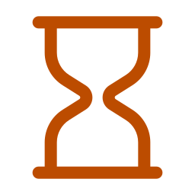
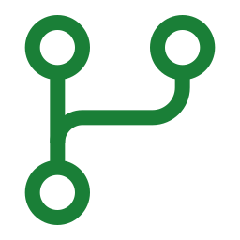
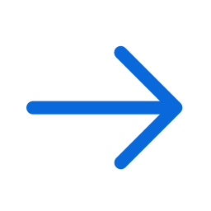
N8N
KEY TAKEAWAYS
What to remember
Plan, cost, and preview before anything is billable.
Skills carry app quirks like probe timing and SSL.
Hooks solve settings that only exist after deploy.
Use deploy time to build in parallel.
NEXT JOURNEY
Apache Superset · AKS, init containers, and a pre-deploy gate
Notes:
Recap. Plan and preview first. App skills carry the hard-won details. Post-provision hooks handle circular configuration. And deployment time is working time. Next: Apache Superset, where the app needs Kubernetes and a pre-deploy gate to avoid expensive failures.

