Slide 1




GRAFANA
AGENTIC JOURNEY · GITHUB AND AZURE
Grafana on Azure
What if you could deploy a working dashboard app to Azure by describing it, then break it on purpose to learn why?
SESSION
COST IF LEFT RUNNING
RUNS ON
60 minutes
~$10–20/month
Azure Container Apps
IN THIS SESSION
1
Plan and preview
2
Deploy and verify
3
Operate and learn
github.com/microsoft/agentic-journeys
Notes:
Grafana is the simplest open-source deployment journey: one container, no external database. You describe what you want, review the plan and cost, preview, deploy, and verify. Then we operate Grafana through its API and deliberately restart it to learn about storage tradeoffs. Deployment takes about 2 to 5 minutes, so there is time to explore. Timing guide: 5 minutes intro, 17 minutes plan and preview, 13 minutes deploy and verify, 18 minutes operate, 7 minutes wrap-up.

Slide 2
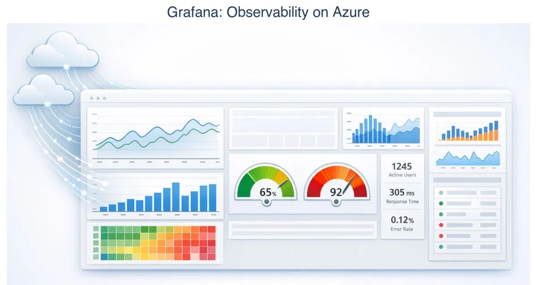
GRAFANA
WHERE WE ARE HEADED
Grafana dashboards, running on Azure
Notes:
Grafana is a popular open-source dashboard and observability tool. We will not write application code today. The agent generates the infrastructure, deploys the public Grafana image, and helps us operate it.

Slide 3
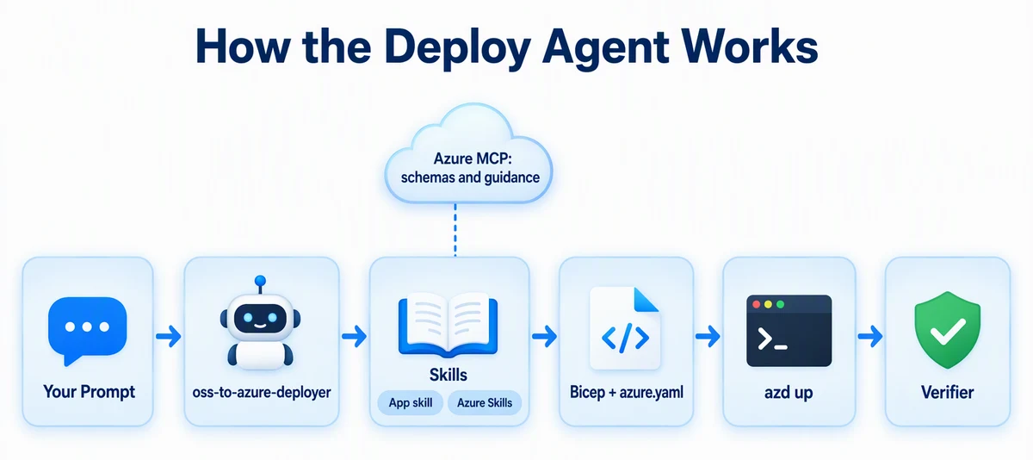
GRAFANA
HOW IT WORKS
Your prompt, the agent, and the skills
Notes:
You write a prompt. The oss-to-azure-deployer agent loads two kinds of skills: the grafana-azure app skill in this repo, and the Azure Skills plugin, which provides current Bicep schemas and guidance through Azure MCP. The agent generates Bicep and azure.yaml, azd deploys, and a verifier proves it works.

Slide 4




GRAFANA
ARCHITECTURE
One container. No database server.
AZURE RESOURCE GROUP
CONTAINER APPS ENVIRONMENT
HTTPS
→
logs
You
→
Log Analytics
Browser or API
Grafana
Logs and metrics
SQLite inside · 0–1 replicas
Notes:
One resource group. A Container Apps environment runs a single Grafana container app with public HTTPS ingress on port 3000. Grafana stores its data in SQLite on the container's local disk. That is fast and cheap, and also temporary, which we will prove later. Logs and metrics flow to Log Analytics. minReplicas is 0 so it scales to zero, and maxReplicas is 1 because SQLite cannot be shared across replicas.

Slide 5

GRAFANA
01
SECTION 1 OF 3
Plan and preview
Describe what you want, see the cost, and preview the deployment before anything is created.
1
Plan and preview
2
Deploy and verify
3
Operate and learn
Notes:
Section one: plan and preview. About 17 minutes.

Slide 6

GRAFANA
GET STARTED
Load the Azure skills and the deploy agent
copilot
> /plugin marketplace add microsoft/azure-skills
> /plugin install azure@azure-skills
> /agent
# choose oss-to-azure-deployer
The agent brings the workflow. Skills bring the app-specific know-how.
Notes:
Start Copilot CLI from the repository root. Add the Azure Skills marketplace and install the plugin once; it persists across sessions. Then choose the oss-to-azure-deployer agent with /agent. In other tools, select the same custom agent.

Slide 7
GRAFANA
PLAN AND COST FIRST
Describe it. Ask what it costs.
PROMPT · ABRIDGED
Plan a Grafana deployment to Azure Container Apps with Bicep and azd: SQLite in the container's local storage … /api/health for probes, and the westus region. List each Azure resource, its SKU, and the estimated monthly cost if left running. Don't create files or Azure resources yet.
Notes:
Plan first, with an explicit "don't create anything yet." You should get a list of resources, SKUs, and a monthly estimate around 10 to 20 dollars. This is where you catch surprises before they are billable.
Full prompt:
Plan a Grafana deployment to Azure Container Apps with Bicep and azd: SQLite in the container's local storage (no Azure Files mount), minReplicas: 0 and maxReplicas: 1, /api/health for probes, and the westus region. List each Azure resource, its SKU, and the estimated monthly cost if left running. Don't create files or Azure resources yet.

Slide 8

GRAFANA
QUESTION THE PLAN
Ask the design question out loud
PROMPT
Should I use PostgreSQL instead of SQLite for Grafana?
Agents are good at tradeoffs. Ask before you decide.
Notes:
A simple question, and a great habit. The agent should explain that SQLite is fine for demos and testing, but data lives inside the container. PostgreSQL survives restarts and supports multiple replicas, at extra cost.

Slide 9
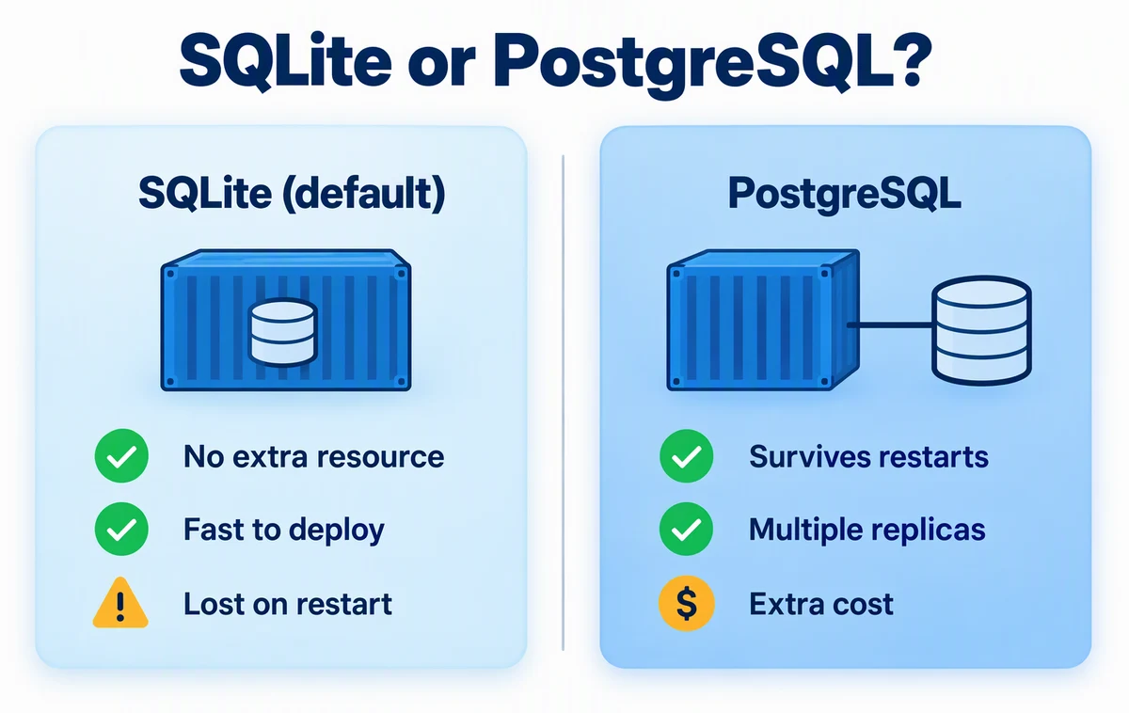
GRAFANA
THE TRADEOFF
SQLite or PostgreSQL?
Notes:
SQLite: no extra resource and fast to deploy, but data is lost on restart. PostgreSQL: survives restarts and supports multiple replicas, but costs more. Today we choose SQLite on purpose so we can see the tradeoff for ourselves in section three.

Slide 10
GRAFANA
GENERATE AND PREVIEW
Generate, then preview. Don't deploy yet.
PROMPT · ABRIDGED
Generate the infrastructure for that plan: Bicep in infra-grafana/ and azure.yaml. Generate a secure admin password and store it only in the azd environment. … Then run azd provision --preview and summarize what it will create. Don't run azd up. … Do not print secrets.
Notes:
This prompt shows several safe habits. Secrets stay in the azd environment and never print. The preview shows exactly what will be created. The agent is told how to handle failures: smallest safe fix, rerun, and log it in issues.md. And the deploy itself stays in your hands.
Full prompt:
Generate the infrastructure for that plan: Bicep in infra-grafana/ and azure.yaml. Generate a secure admin password and store it only in the azd environment. Prepare the azd environment for westus and my current subscription, then run azd provision --preview and summarize what it will create. Don't run azd up. If a step fails, inspect the relevant logs, make the smallest safe correction, rerun the failed step, and record the problem and resolution in issues.md. Do not print secrets.

Slide 11

GRAFANA
02
SECTION 2 OF 3
Deploy and verify
One command to deploy. A checked-in verifier to prove it.
1
Plan and preview
2
Deploy and verify
3
Operate and learn
Notes:
Section two: deploy and verify. About 13 minutes.

Slide 12

GRAFANA
SHIP AND VERIFY
Deploy, then prove it
Terminal
$ azd up
$ node .github/scripts/verify-grafana.mjs
PASS: <grafana-url>/api/health returned
​ HTTP 200 and database=ok
Then sign in as admin with the password from azd env get-value GRAFANA_ADMIN_PASSWORD.
Notes:
You run azd up yourself. It takes about 2 to 5 minutes. Then run the checked-in verifier. You can also ask the agent: "Verify the Grafana deployment. Report each acceptance criterion as pass or fail." Then open the URL and sign in.

Slide 13
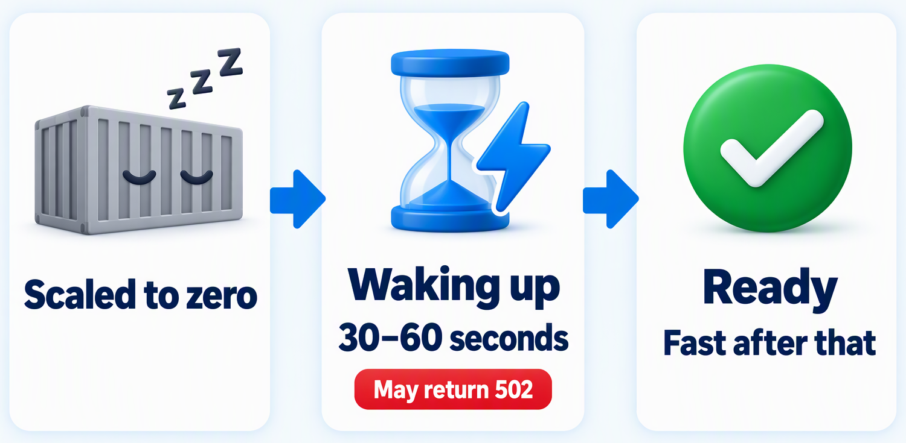
GRAFANA
EXPECT THIS
A slow first request or a 502 is normal
With minReplicas set to 0, the first request wakes the app. Give it 30–60 seconds.
Notes:
Scale to zero saves money, and the cost is a cold start. When no one has used Grafana for a while, it scales to zero. The first request starts the container, which can take 30 to 60 seconds, and may return a 502 while it starts. After that, it is fast. Knowing what normal looks like saves a lot of unnecessary troubleshooting.

Slide 14

GRAFANA
03
SECTION 3 OF 3
Operate and learn
Use the agent to operate the app through its API, then restart it and watch what happens.
1
Plan and preview
2
Deploy and verify
3
Operate and learn
Notes:
Section three: operate and learn. About 18 minutes.

Slide 15
GRAFANA
OPERATE THROUGH THE API
Let the agent build the dashboard
PROMPT · ABRIDGED
Create scripts/create-grafana-dashboard.mjs. … It never prints the password. Through the Grafana HTTP API, it creates the built-in TestData data source if it doesn't exist, then creates a dashboard named "Hello from Azure" … and prints the dashboard URL. Then run the script.
Notes:
The same agent that deployed Grafana can now operate it. It writes a small script that uses the Grafana HTTP API. Argument arrays avoid shell interpolation and work on Windows, Mac, and Linux. Open the printed URL to see the dashboard.
Full prompt:
Create scripts/create-grafana-dashboard.mjs. It reads GRAFANA_URL and GRAFANA_ADMIN_PASSWORD through azd env get-value with argument arrays and never prints the password. Through the Grafana HTTP API, it creates the built-in TestData data source if it doesn't exist, then creates a dashboard named "Hello from Azure" with one time series panel that uses it, and prints the dashboard URL. Then run the script.

Slide 16






GRAFANA
BREAK IT ON PURPOSE
Restart it and watch the dashboard vanish
→
→
→
→
Create
Restart
It's gone
Ask why
Decide
"Hello from Azure" dashboard
Restart my Grafana container app.
SQLite lived in the container
Why did my dashboard disappear?
PostgreSQL or Azure Files
Embedded storage is still a persistence decision.
Notes:
This is the most memorable moment of the session. Ask the agent to restart the container app. It creates a restart script that finds the tagged app and restarts only the active revision. After the restart, the dashboard is gone, because SQLite lived on the container's temporary disk. Ask why, then ask "How do I make Grafana dashboards persist across restarts?" The answer is PostgreSQL, or Azure Files mounted at /var/lib/grafana.

Slide 17

GRAFANA
CLEAN UP
Tear it down the same day
Terminal
$ azd down --force --purge
# Confirm it is really gone
$ az group exists --name <resource-group-name>
false
Cost estimates assume the resources stay up for a month. Purge also clears soft-deleted resources.
Notes:
Tear everything down. Record the resource group name first with azd env get-value RESOURCE_GROUP_NAME, run azd down with force and purge, then confirm with az group exists, which should return false.

Slide 18



GRAFANA
KEY TAKEAWAYS
What to remember
Plan and preview before you create anything billable.
An agent plus app skills can deploy, and then operate, the app.
Embedded storage is a persistence decision. Test it.
Cold starts after scale-to-zero are normal.
NEXT JOURNEY
n8n · Add PostgreSQL, health probes, and a post-provision hook
Notes:
Recap. Plan and preview first. The agent and skills can both deploy and operate the app. Storage choices matter even when they are invisible. And cold starts are expected with scale to zero. Next up: n8n, which adds a real database, careful health probes, and a hook that runs after provisioning.

