Slide 1




WEATHERVIEW
AGENTIC JOURNEY · GITHUB AND AZURE
WeatherView
What if a one-page product plan could become a polished, accessible weather app running on Azure, with no backend at all?
SESSION
COST IF LEFT RUNNING
RUNS ON
60 minutes
$0 on the Free tier
Azure Static Web Apps
IN THIS SESSION
1
Plan and build
2
Test and verify
3
Deploy to Azure
github.com/microsoft/agentic-journeys
Notes:
Welcome. This is the recommended starting journey. In one hour we go from a written plan to a live five-day forecast app on Azure Static Web Apps. There is no framework, no backend, no database, and no API key, so we can focus on the agentic workflow itself: plan, generate, inspect, test, refine, and deploy. Timing guide: 5 minutes intro, about 22 minutes building, 13 minutes testing, 15 minutes deploying, 5 minutes wrap-up.

Slide 2
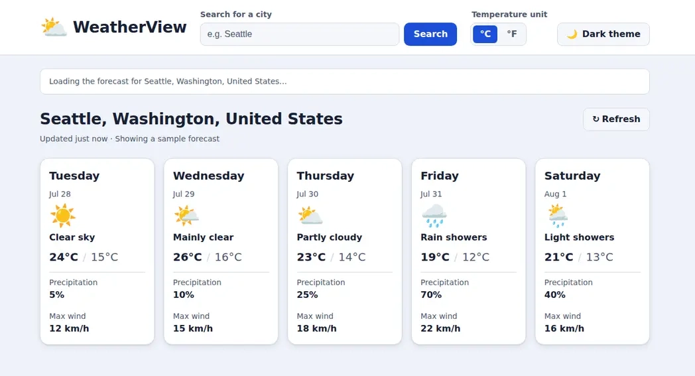
WEATHERVIEW
WHERE WE ARE HEADED
A five-day forecast, built from a plan
Notes:
This is the finished app. City search, Celsius and Fahrenheit, light and dark themes, and five forecast cards. It uses the free Open-Meteo API directly from the browser. Everything you see here is generated by the agent from PLAN.md, one small prompt at a time.

Slide 3
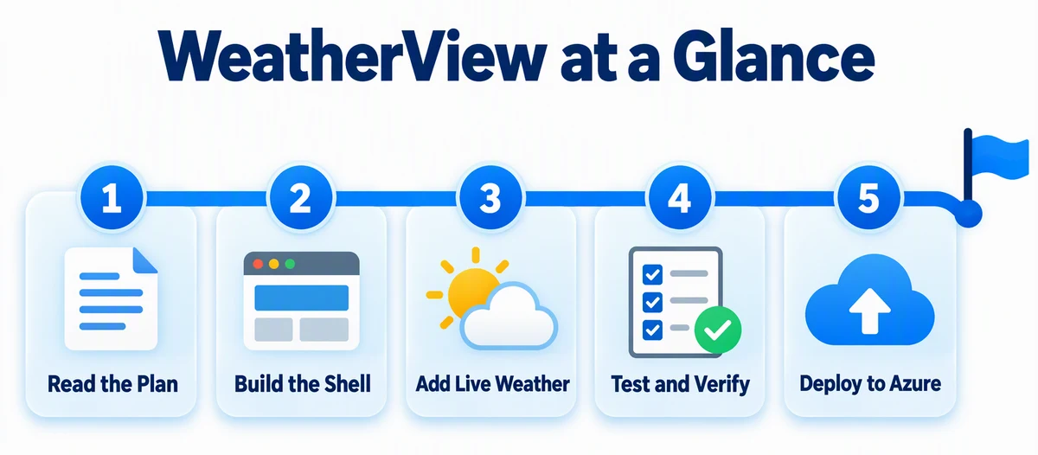
WEATHERVIEW
THE JOURNEY
Five steps from plan to Azure
Notes:
Here is the path. Read the plan, build the shell, add live weather, test and verify, then deploy to Azure. Each step is a prompt or two. We will group these into three sections today: plan and build, test and verify, and deploy.

Slide 4
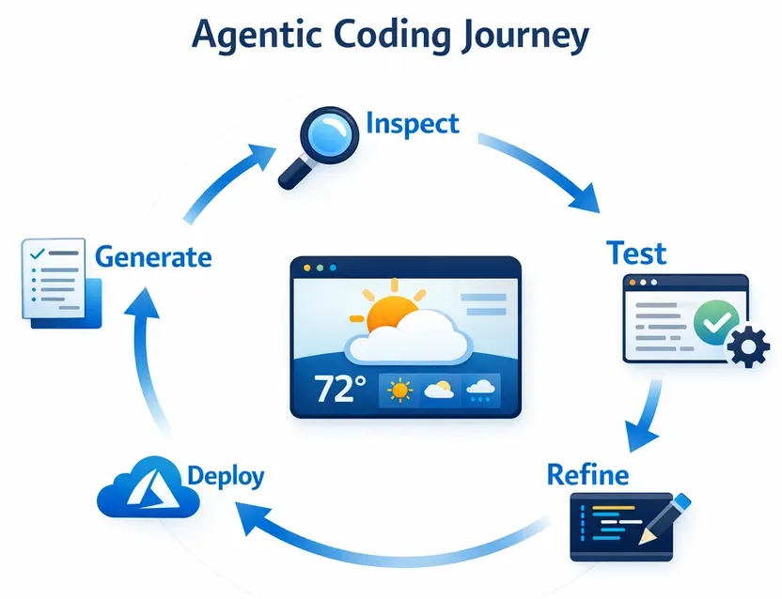
WEATHERVIEW
THE AGENTIC LOOP
Generate. Inspect. Test. Refine.
You stay in the loop the whole way.
Notes:
This is the loop you will repeat all session. The agent generates. You inspect the diff. Tests prove behavior. You refine with a follow-up prompt. When the evidence is good, you deploy. The agent does the typing. You make the decisions.

Slide 5

WEATHERVIEW
01
SECTION 1 OF 3
Plan and build
Start from the plan. Ask for a plan before any code, then build in small, reviewable steps.
1
Plan and build
2
Test and verify
3
Deploy to Azure
Notes:
Section one: plan and build. About 22 minutes.

Slide 6

WEATHERVIEW
GET STARTED
Work in your own copy
Terminal
$ node .github/scripts/create-workspace.mjs weather-view
$ cd ../weather-view-workspace/journeys/weather-view
$ copilot
An isolated workspace keeps experiments away from the original repository.
Notes:
The workspace script copies the journey into a separate repository next to this one, so you can experiment freely. Then start GitHub Copilot CLI in the journey folder. You can also use the GitHub Copilot app or VS Code. The same prompts work.

Slide 7
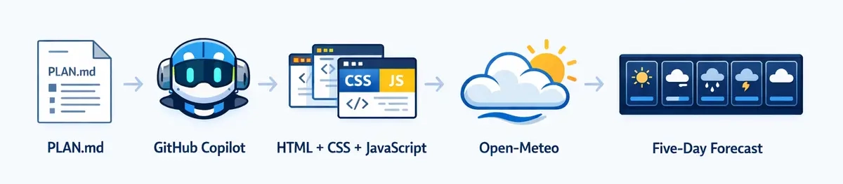
WEATHERVIEW
THE STACK
No framework. No backend. No API key.
Notes:
PLAN.md describes the product. GitHub Copilot turns it into plain HTML, CSS, and JavaScript modules. The app calls Open-Meteo for geocoding and forecasts and renders five cards. Keeping the stack tiny means every generated line is easy to review.

Slide 8


WEATHERVIEW
PLAN FIRST
Ask for a plan, not code
PROMPT
@PLAN.md Plan how you'll build the WeatherView app shell described in "Choose Your Stack," "Project Structure," "Product Experience," and "Accessibility and Performance." List each file you'll create and what it will contain. Don't write any code yet.
Switch to Plan mode (Shift+Tab). Review the file list before you approve anything.
Notes:
The @ mention attaches PLAN.md as context. Asking for a plan first lets you catch misunderstandings when they are cheap to fix. Review the list of files and what each will contain. If something is off, say so now, before any code exists.

Slide 9
WEATHERVIEW
BUILD THE SHELL
Build what you just planned
PROMPT · ABRIDGED
Build the app shell you just planned: create index.html, styles.css, package.json, app.js, weather-api.js, and weather-maps.js as PLAN.md specifies. For this step, build the semantic app shell and responsive visual system only:
header, labeled city search, °C/°F and theme controls
aria-live status region and five realistic placeholder cards
design tokens, visible focus, reduced motion, both themes
Do not call external APIs yet. … Log issues to issues.md.
Notes:
Keep each step small. This prompt builds only the shell, with placeholder data. Open it in a browser and try the keyboard. Full prompt:
Build the app shell you just planned: create index.html, styles.css, package.json, app.js, weather-api.js, and weather-maps.js as PLAN.md specifies. For this step, build the semantic app shell and responsive visual system only:
- header/navigation with branded title
- labeled city search
- Celsius/Fahrenheit control
- light/dark theme control
- aria-live status region
- resolved-location heading area
- forecast-grid container with five realistic placeholder cards
- responsive design tokens, visible focus, reduced-motion support, and both themes
Do not call external APIs yet. Add a local start script that accepts a configurable port and does not require a global package. Log issues to issues.md.

Slide 10
WEATHERVIEW
ADD LIVE WEATHER
Now make it real
PROMPT · ABRIDGED
Read "Primary User Flow," "City Search," "Weather Data," "Weather Code Mapping," "Caching," and "Application States and Resilience" in PLAN.md. Implement the real WeatherView behavior:
geolocation with a Seattle fallback
Open-Meteo city search and five-day forecast
strict payload validation and normalized day objects
loading, no-result, malformed-data, network-error, and retry states
Keep the previous successful forecast visible when a search fails.
Notes:
The plan's section names do the heavy lifting here. Full prompt:
Read "Primary User Flow," "City Search," "Weather Data," "Weather Code Mapping," "Caching," and "Application States and Resilience" in PLAN.md. Implement the real WeatherView behavior in weather-api.js, weather-maps.js, and app.js:
- browser geolocation with a bounded wait and Seattle fallback
- Open-Meteo city geocoding and five-day forecast requests
- strict payload validation and normalized day objects
- WMO code labels/icons with an unknown-code fallback
- exactly five forecast cards in one DOM update
- source-unit refetch for Celsius/Fahrenheit
- persisted theme, unit, and last successful location
- a ten-minute location+unit cache
- explicit loading, no-result, malformed-data, network-error, and retry states
Keep the previous successful forecast visible when a city search or refresh fails. Do not introduce a framework, API key, backend, or image dependency. Log issues to issues.md.

Slide 11
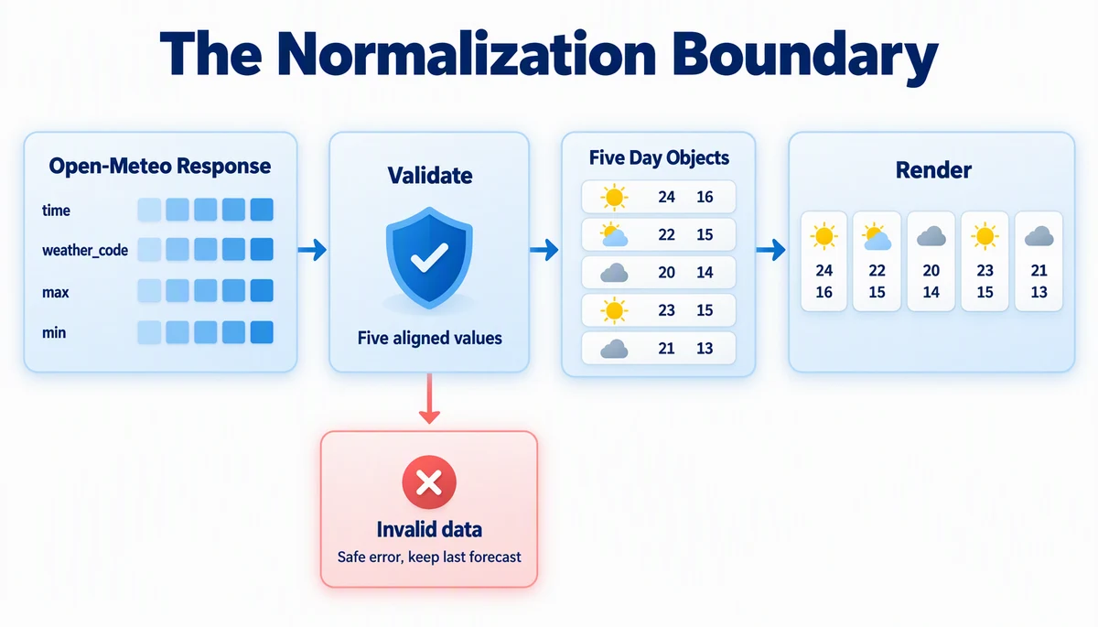
WEATHERVIEW
KEY IDEA
Validate at the boundary
Bad data never reaches the UI. The last good forecast stays.
Notes:
Open-Meteo returns parallel arrays: time, weather code, max, min. The app validates that they line up and turns them into five clean day objects before rendering. If anything is malformed, the app shows a safe error and keeps the last good forecast. Ask Copilot to show you where this boundary lives in weather-api.js.

Slide 12

WEATHERVIEW
SAFE EXPERIMENTS
Try anything. Rewind it.
PROMPT
Replace the five forecast cards with a single horizontal carousel that shows one day at a time. This is a throwaway experiment that I'll undo.
→
/rewind
Choose Conversation + files
Notes:
Try a throwaway idea: replace the five cards with a carousel. Look at it, then run /rewind, pick that turn, and choose Conversation + files. The default, Conversation only, leaves your files changed. This is how you explore without fear.
Full prompt: Replace the five forecast cards with a single horizontal carousel that shows one day at a time. This is a throwaway experiment that I'll undo, so don't change PLAN.md and don't ask me questions; just make the change.

Slide 13

WEATHERVIEW
02
SECTION 2 OF 3
Test and verify
A confident answer is not proof. Tests and a verifier turn the plan into evidence.
1
Plan and build
2
Test and verify
3
Deploy to Azure
Notes:
Section two: test and verify. About 13 minutes.

Slide 14





WEATHERVIEW
LAYERS OF EVIDENCE
Four ways to prove it works
→
→
→
Unit tests
Browser tests
Verifier
/review
Node test runner for the pure modules
Playwright with mocked weather
scripts/verify-app.mjs
A second opinion on the code
Every fix gets a test. Never weaken the app to make a test pass.
Notes:
Four layers. Unit tests cover the modules. Playwright covers real browser behavior, with geolocation and Open-Meteo mocked so results are deterministic. A verifier script checks the running app and the live API contract. And /review gives a critical second look.

Slide 15
WEATHERVIEW
GENERATE TESTS
Make the plan testable
PROMPT · ABRIDGED
Read "Local Tooling and Tests" in PLAN.md. Add tests for every listed behavior. … Browser tests must mock geolocation and Open-Meteo responses deterministically for success, no-result, malformed-payload, and network-failure cases. They must assert exactly five cards, city search, unit refetch, preference persistence, retry behavior, accessible names, and visible keyboard focus. … Do not weaken application behavior to make tests pass.
Notes:
Deterministic mocks mean the tests pass or fail for real reasons, not because the weather changed. Full prompt:
Read "Local Tooling and Tests" in PLAN.md. Add tests for every listed behavior. Use Node's built-in test runner for pure module tests when practical. Add Playwright as a pinned development dependency for browser behavior and use its bundled Chromium, not a branded Chrome channel. Browser tests must mock geolocation and Open-Meteo responses deterministically for success, no-result, malformed-payload, and network-failure cases. They must assert exactly five cards, city search, unit refetch, preference persistence, retry behavior, accessible names, and visible keyboard focus. Add test and test:e2e package scripts and tell me the exact one-time Chromium install command. Do not weaken application behavior to make tests pass.

Slide 16

WEATHERVIEW
SECOND OPINION
Review against the plan
PROMPT
/review Review the completed WeatherView implementation against PLAN.md. Skip the "Azure Deployment" section; Phase 3 builds it. Focus on correctness, accessibility, resilience, performance, browser security, and test gaps. Identify missing or incorrectly implemented requirements with file and line evidence. Do not suggest a framework rewrite.
Then fix the high-confidence findings, add a test for each fix, and rerun everything.
Notes:
The review agent reads the code with fresh eyes. Ask for file and line evidence so you can check each claim. Then use the follow-up: "Fix the high-confidence correctness, accessibility, security, and reliability findings from that review. Add a test for each fix, then rerun the unit tests, browser tests, and scripts/verify-app.mjs."
Before this, generate scripts/verify-app.mjs from the README prompt and inspect it before running it: node scripts/verify-app.mjs --base-url http://localhost:<your-port>

Slide 17
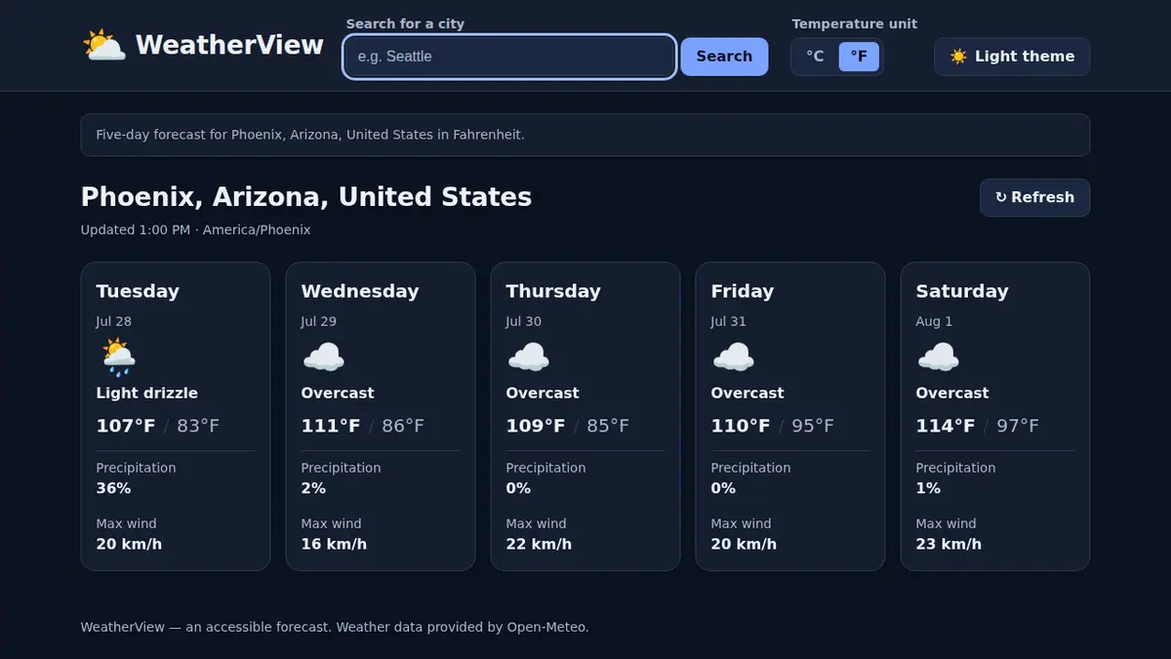
WEATHERVIEW
03
SECTION 3 OF 3
Deploy to Azure
Let the agent write the Bicep, review it before anything is created, then ship with one command.
1
Plan and build
2
Test and verify
3
Deploy to Azure
Notes:
Section three: deploy to Azure. About 15 minutes.

Slide 18




WEATHERVIEW
ARCHITECTURE
Static files, global hosting
AZURE RESOURCE GROUP
←
HTTPS
Bicep + azd
→
Static Web Apps
Free tier
Generated by the agent
Browser
HTML, CSS, JS modules
forecast
→
Open-Meteo
Free geocoding and forecast
Notes:
The architecture is intentionally small. One resource group with one Azure Static Web App on the Free tier, created by Bicep through azd. The browser loads static files from Static Web Apps and calls Open-Meteo directly. There is no backend, container, database, deployment token, or API key.

Slide 19

WEATHERVIEW
GENERATE INFRASTRUCTURE
Let Azure Skills write the Bicep
PROMPT
Read the "Azure Deployment" section in PLAN.md. Use the installed Azure Skills plugin, including current Bicep schema and azd infrastructure guidance, to create everything that section specifies: the Bicep in infra/, main.parameters.json, azure.yaml, scripts/build-static.mjs with its npm build script, and staticwebapp.config.json. Follow the section's contracts exactly, and do not create anything the section prohibits.
Install once: /plugin install azure@azure-skills
Notes:
The Azure Skills plugin gives the agent current Bicep schemas and azd guidance, so it is not guessing at API versions. Confirm the plugin is available first. Full prompt ends with: Log real generation or validation issues to issues.md.

Slide 20

WEATHERVIEW
BEFORE YOU DEPLOY
Ask for READY or NOT READY, with evidence.
A read-only pre-deployment review checks every requirement and runs azd provision --preview. Nothing is created.
Notes:
This is one of the most useful habits in agentic deployment. Before creating anything, ask for a read-only review that returns READY or NOT READY, a PASS or FAIL table with file and line evidence, and the smallest fix for each blocker. The README has the full prompt. Do not deploy while any required check is unresolved.

Slide 21

WEATHERVIEW
SHIP IT
One command to deploy
Terminal
$ azd up
$ node ../../.github/scripts/verify-weather-view.mjs
PASS: WeatherView assets and five-day
Open-Meteo contract verified
Then open the URL from azd env get-value WEB_URL and click around.
Notes:
azd provisions the Static Web App and publishes the dist folder. Then run the checked-in verifier against the live site. The journey also has an optional deployed-browser verifier with Playwright that saves a screenshot. Finally, do a quick manual pass in a real browser: search a city, switch units, reload, and switch themes.

Slide 22
WEATHERVIEW
LIVE ON AZURE
Same app, now global
Notes:
Here it is running on Azure Static Web Apps, in the dark theme with Fahrenheit selected for Phoenix. Everything came from the plan, a handful of prompts, and your review at each step.

Slide 23

WEATHERVIEW
CLEAN UP
Tear it down the same day
Terminal
$ azd down --force --purge
# Confirm it is really gone
$ az group exists --name <resource-group-name>
false
The Free tier costs $0, but cleaning up is still a habit worth building.
Notes:
Even at $0, tear down what you created so your subscription stays tidy. azd down with force and purge deletes the resource group. Confirm with az group exists, which should return false.

Slide 24




WEATHERVIEW
KEY TAKEAWAYS
What to remember
A clear plan turns into small, reviewable prompts.
Plan before code. Rewind freely when you experiment.
Tests and a verifier are the evidence, not the agent's confidence.
Review before you deploy. Verify after. Clean up the same day.
NEXT JOURNEY
AIMarket · Add an API, a React storefront, and AI search and chat
Notes:
Recap. Plans become prompts. Plan mode and rewind make the loop safe. Evidence comes from tests and verifiers. Deploy only after a review, verify the live result, and clean up. If you want more, try the assignment in the README: add a compact or comfortable density control with a Playwright test. Next up: AIMarket, a full-stack marketplace with AI features.

