Slide 1


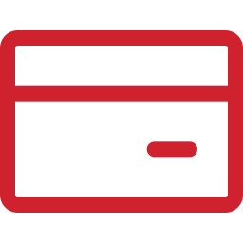
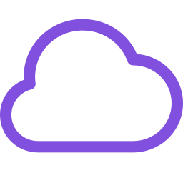
SUPERSET
AGENTIC JOURNEY · GITHUB AND AZURE
Apache Superset on AKS
What if an app needed Kubernetes? Let an agent deploy a BI platform to AKS, and make every expensive mistake before you pay for it.
SESSION
COST IF LEFT RUNNING
RUNS ON
60 minutes
~$200–215/month
AKS + PostgreSQL
IN THIS SESSION
1
Why AKS
2
Gate, then generate
3
Deploy and verify
github.com/microsoft/agentic-journeys
Notes:
Apache Superset is an open-source BI and data exploration platform. It needs init containers, a shared volume, and mounted configuration, which is why this journey uses Azure Kubernetes Service instead of Container Apps. AKS is the most expensive journey, around 200 dollars a month if left running, so we check cost and quota up front and tear down the same day. Deployment takes 15 to 25 minutes. Timing guide: 5 minutes intro, 12 minutes why AKS, 18 minutes gate and generate, 18 minutes deploy and verify, 7 minutes wrap-up.

Slide 2
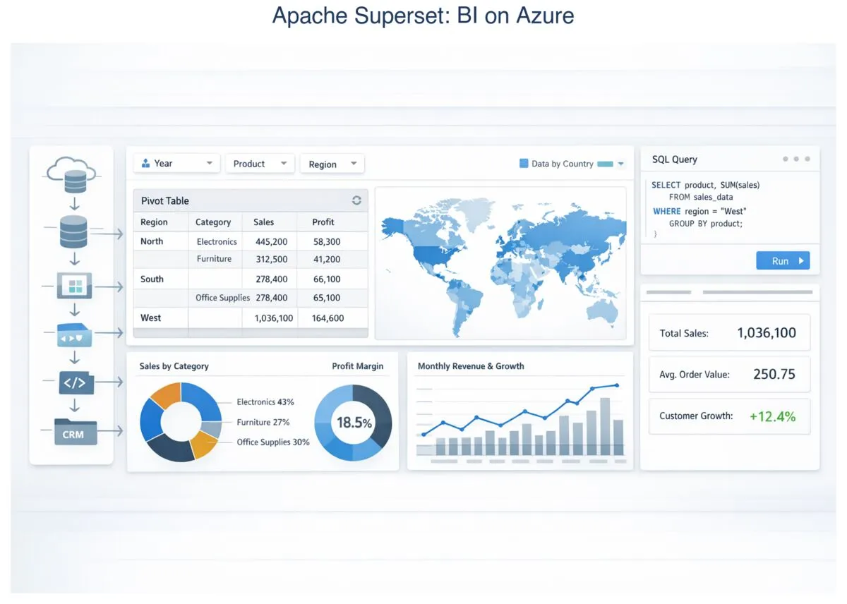
SUPERSET
WHERE WE ARE HEADED
Business intelligence on Azure
Notes:
Superset lets people explore data with charts, dashboards, and SQL. By the end, it runs on AKS backed by Azure PostgreSQL, and you sign in and create a first chart.

Slide 3
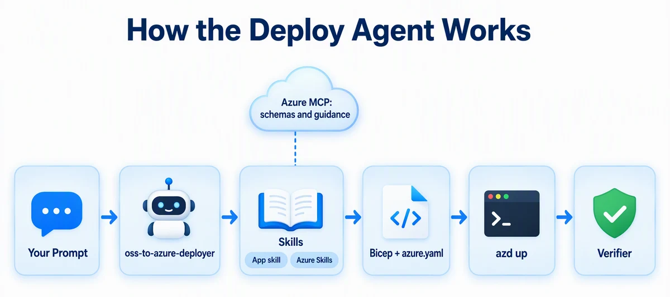
SUPERSET
HOW IT WORKS
Your prompt, the agent, and the skills
Notes:
Same pattern as the other open-source journeys. The oss-to-azure-deployer agent uses the superset-azure app skill in this repo and the Azure Skills plugin. This time it generates Bicep plus Kubernetes manifests and a hook that applies them.

Slide 4
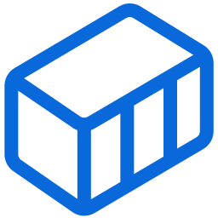
SUPERSET
01
SECTION 1 OF 3
Why AKS
Workload requirements pick the platform. Superset needs things Container Apps does not give you.
1
Why AKS
2
Gate, then generate
3
Deploy and verify
Notes:
Section one: why AKS. About 12 minutes.

Slide 5
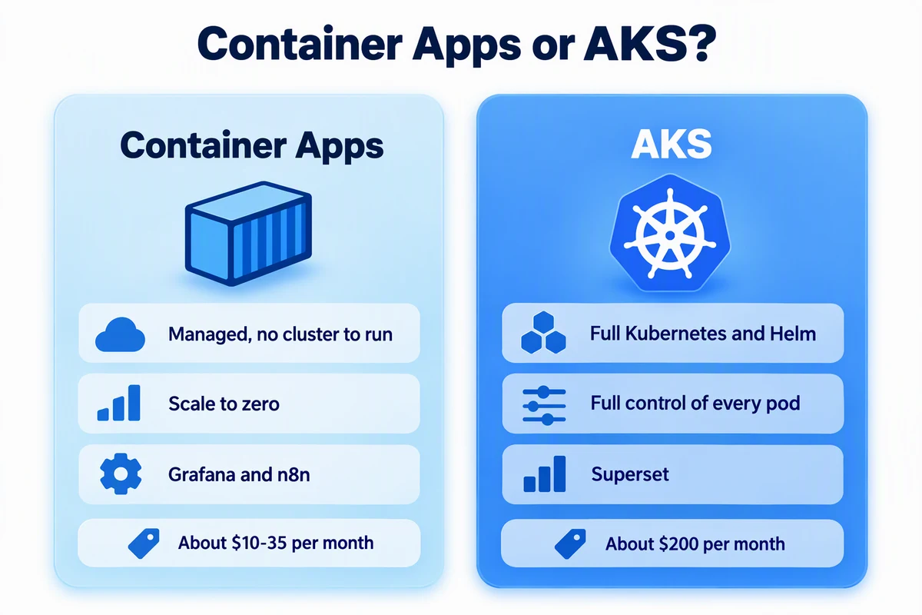
SUPERSET
CHOOSE THE PLATFORM
Container Apps or AKS?
Notes:
Container Apps is managed, scales to zero, and costs about 10 to 35 dollars a month for Grafana or n8n. AKS gives you full Kubernetes and Helm and control of every pod, at about 200 dollars a month. Do not pick AKS by default. Pick it when the workload needs it.

Slide 6
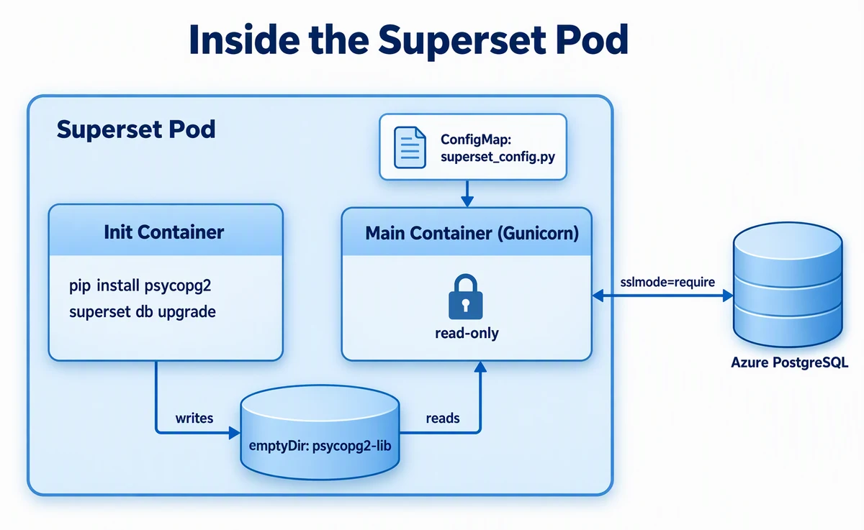
SUPERSET
WHY SUPERSET NEEDS IT
Inside the Superset pod
Notes:
The official Superset image does not include the PostgreSQL driver. An init container installs psycopg2 into a shared emptyDir volume and runs database migrations. The main Gunicorn container reads the driver from that volume and loads superset_config.py from a ConfigMap. It connects to Azure PostgreSQL with sslmode=require. Init containers, shared volumes, and ConfigMaps are Kubernetes patterns, and that is what justifies AKS here.

Slide 7

SUPERSET
GET STARTED
Load the Azure skills and the deploy agent
copilot
> /plugin marketplace add microsoft/azure-skills
> /plugin install azure@azure-skills
> /agent
# choose oss-to-azure-deployer
$ az vm list-usage --location westus --output table
The agent brings the workflow. Skills bring the app-specific know-how.
Notes:
Install the Azure Skills plugin and choose the oss-to-azure-deployer agent. Also check VM quota in your region. The cluster needs two Standard_D2s_v3 nodes, and running out of quota halfway through a deployment is a slow, expensive way to find out.

Slide 8
SUPERSET
PLAN AND COST FIRST
Ask it to justify the platform
PROMPT
Plan an Apache Superset deployment to Azure with Bicep and azd, using AKS with two Standard_D2s_v3 nodes (not Container Apps), Azure Database for PostgreSQL Flexible Server, and the westus region. List each Azure resource, its SKU, and the estimated monthly cost if left running, and explain why this workload uses AKS. Don't create files or Azure resources yet.
Notes:
Ask for cost and for the reasoning. The explanation should mention init containers, the shared volume, and ConfigMaps. Look at the monthly cost carefully before continuing.

Slide 9

SUPERSET
02
SECTION 2 OF 3
Gate, then generate
Write an automated check before the infrastructure exists, so the expensive failures happen offline.
1
Why AKS
2
Gate, then generate
3
Deploy and verify
Notes:
Section two: gate, then generate. About 18 minutes.

Slide 10





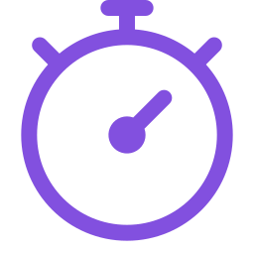
SUPERSET
TEST-FIRST INFRASTRUCTURE
Fail fast, offline, for free
→
→
→
→
Gate fails
Generate
Gate passes
Preview
azd up
infra-superset/ doesn't exist yet
Bicep, manifests, hook
Without changing the gate
azd provision --preview
Now it's worth paying for
An AKS failure costs 20 minutes. A failing gate costs seconds.
Notes:
The skill includes a spec for an infrastructure gate: a script that checks the generated Bicep and manifests for the known failure modes. At least two nodes, the /healthz load balancer probe, PYTHONPATH declared as a container environment variable, waiting for the NGINX controller before applying the Ingress, no local kubectl or Helm, and more. Create it first and prove it fails. Then generate until it passes, without editing it.

Slide 11
SUPERSET
RED
Write the gate first
PROMPT
Create scripts/check-infra-superset.mjs exactly as .github/skills/superset-azure/config/infrastructure-gate.md specifies. Run it with --offline and show me that it fails because infra-superset/ doesn't exist yet. Commit only that script, and don't generate any infrastructure yet.
Notes:
A failing gate proves the gate can detect missing work. Committing it means you can later prove it was not changed: git diff --exit-code HEAD -- scripts/check-infra-superset.mjs.

Slide 12
SUPERSET
GREEN
Generate until the gate passes
PROMPT · ABRIDGED
Generate the infrastructure for that plan: Bicep and Kubernetes manifests in infra-superset/, azure.yaml, and infra-superset/hooks/postprovision.js. Keep going until "node scripts/check-infra-superset.mjs --offline" passes, and don't change that script. … The hook must attach the Kubernetes manifests to az aks command invoke, run Helm and kubectl inside Azure … without requiring those tools on the host. … Run azd provision --preview … Don't run azd up.
Notes:
az aks command invoke runs kubectl and Helm inside Azure, so learners do not need them installed locally. Full prompt:
Generate the infrastructure for that plan: Bicep and Kubernetes manifests in infra-superset/, azure.yaml, and infra-superset/hooks/postprovision.js. Keep going until "node scripts/check-infra-superset.mjs --offline" passes, and don't change that script. Generate secure passwords for all credentials and store them only in the azd environment. The hook must attach the Kubernetes manifests to `az aks command invoke`, run Helm and kubectl inside Azure, and poll the load balancer without requiring those tools on the host. Prepare the azd environment for westus and my current subscription, then run azd provision --preview and summarize what it will create. Don't run azd up. If a step fails, inspect the relevant logs, make the smallest safe correction, rerun the failed step, and record the problem and resolution in issues.md. Do not print secrets.

Slide 13
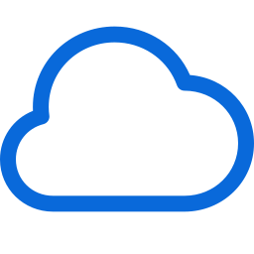


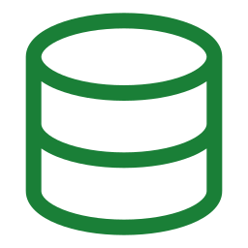


SUPERSET
ARCHITECTURE
What azd creates
AKS · 2 NODES
→
→
SSL
You
Load Balancer
→
→
PostgreSQL
NGINX ingress
Superset pod
Browser
probe /healthz
Flexible Server
Helm
init + main
Notes:
Traffic enters through a public Azure Load Balancer, whose health probe must use /healthz, not /. The NGINX ingress controller, installed by Helm, routes to the Superset service and pod on a two-node AKS cluster. The pod connects to Azure PostgreSQL Flexible Server with sslmode=require. Logs go to Log Analytics.

Slide 14

SUPERSET
03
SECTION 3 OF 3
Deploy and verify
Deploy with one command, explore a what-if while you wait, and prove Superset is really using PostgreSQL.
1
Why AKS
2
Gate, then generate
3
Deploy and verify
Notes:
Section three: deploy and verify. About 18 minutes.

Slide 15


SUPERSET
WHILE AZD UP RUNS
Fork a what-if conversation
PROMPT
How would this Superset setup run on Container Apps instead, and what would I give up?
/fork
/resume
Notes:
azd up takes 15 to 25 minutes. Use /fork to branch the conversation and ask a what-if question without cluttering your main session. When you are done, /resume takes you back. This is a great way to learn during long waits.

Slide 16

SUPERSET
VERIFY
Six checks, all green
Terminal
$ azd up
$ node ../../.github/scripts/verify-superset.mjs
PASS: 6/6 checks passed
Then sign in as admin and create your first chart.
Notes:
The verifier checks pods through az aks command invoke, confirms the logs show PostgreSQL, checks the public /health endpoint, and confirms the load balancer probe path. Get the URL and admin password with azd env get-value SUPERSET_URL and SUPERSET_ADMIN_PASSWORD. Do not paste the password into chat.

Slide 17
SUPERSET
THE TELLTALE LOG LINE
Is it really using PostgreSQL?
PostgresqlImpl
SQLiteImpl
Superset is using PostgreSQL
The PostgreSQL driver or config is missing
PROMPT
Is my Superset deployment using PostgreSQL?
Notes:
Superset quietly falls back to SQLite if the PostgreSQL driver or configuration is missing. The app starts and looks fine, but data would be lost. The log line gives it away: PostgresqlImpl is good, SQLiteImpl means psycopg2 or superset_config.py is not wired up. Ask the agent: "Is my Superset deployment using PostgreSQL?" If a pod is stuck in Init:0/1, ask it to check the init container logs and test PostgreSQL connectivity.

Slide 18

SUPERSET
CLEAN UP
Tear it down the same day
Terminal
$ azd down --force --purge
# Confirm it is really gone
$ az group exists --name <resource-group-name>
false
This is the most expensive journey. Tear it down today. AKS and PostgreSQL deletion takes 5–10 minutes.
Notes:
Record the resource group name, run azd down with force and purge, and wait. Deleting AKS and PostgreSQL takes 5 to 10 minutes. Confirm with az group exists, which should return false.

Slide 19



SUPERSET
KEY TAKEAWAYS
What to remember
The workload decides the platform. Don't default to AKS.
Init containers, shared volumes, and ConfigMaps justify Kubernetes.
Review cost and quota before a big deploy. Clean up today.
Write the gate first. Fail offline, not in Azure.
Build your own
WeatherView · Go from a plan to your own app, and deploy it the same way
Notes:
Recap. Choose the platform from the workload's needs. Kubernetes patterns like init containers justify AKS here. Write the gate before generating infrastructure. And review cost and quota before a big deployment, then clean up the same day. To build your own app from a plan, start with WeatherView.

