Slide 1




AIMARKET
AGENTIC JOURNEY · GITHUB AND AZURE
AIMarket
What if a written spec could become a full-stack marketplace with semantic search and a shopping assistant, running on Azure?
SESSION
COST IF LEFT RUNNING
RUNS ON
60 minutes
~$100–115/month
Container Apps + AI
IN THIS SESSION
1
Spec to API
2
React storefront
3
Add AI
4
Deploy to Azure
github.com/microsoft/agentic-journeys
Notes:
AIMarket takes a written specification all the way to a deployed full-stack app: a REST API, a React storefront, Azure AI Search, and a shopping assistant powered by Microsoft Foundry. In an hour we will not type every prompt. We will show the signature prompt of each phase and the habits that make the result trustworthy. Timing guide: 5 minutes intro, 12 minutes API, 8 minutes storefront, 15 minutes AI, 15 minutes deploy, 5 minutes wrap-up. Cost note: AI Search Basic drives most of the monthly estimate, so clean up the same day.

Slide 2
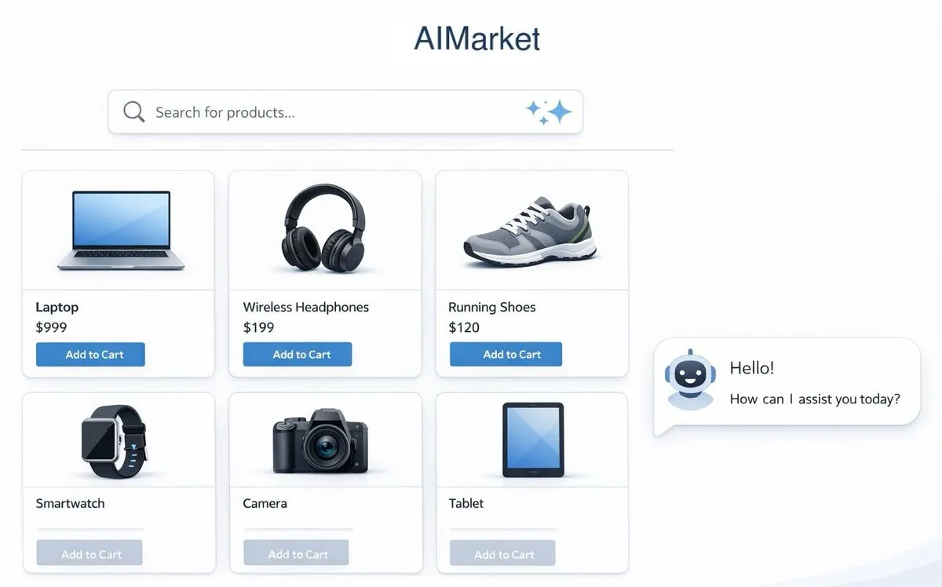
AIMARKET
WHERE WE ARE HEADED
An AI-powered marketplace
Notes:
This is the destination. A product catalog, search that understands intent, a cart, orders, and a chat assistant that only recommends products that really exist.

Slide 3
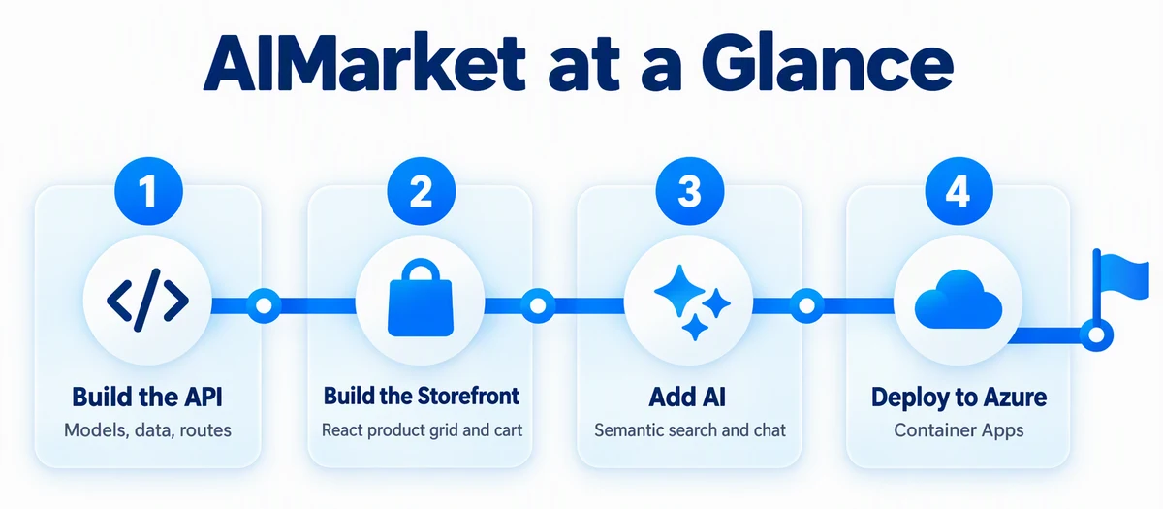
AIMARKET
THE JOURNEY
Four phases, one spec
Notes:
Four phases, each driven by a PLAN file. Build the API. Build the storefront. Add AI. Deploy to Azure. PLAN.md is the overview, and PLAN-phase1 to PLAN-phase4 hold the details for each phase.

Slide 4
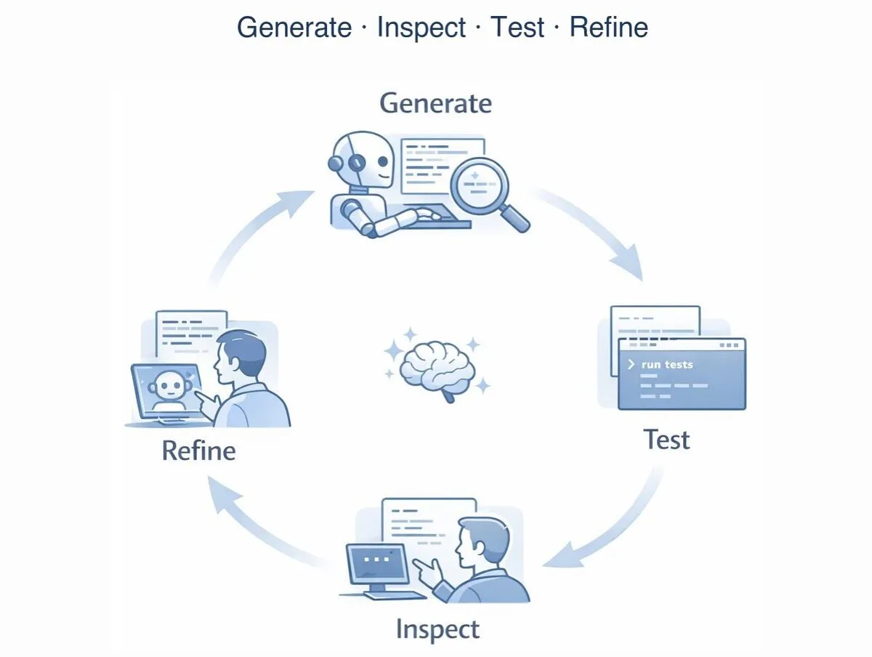
AIMARKET
THE AGENTIC LOOP
Generate. Inspect. Test. Refine.
Notes:
The loop for every step. The agent generates a layer. You inspect it. You test real behavior, not just that it compiles. Then you refine with a precise follow-up. We will see a concrete example of refine in the API section.

Slide 5
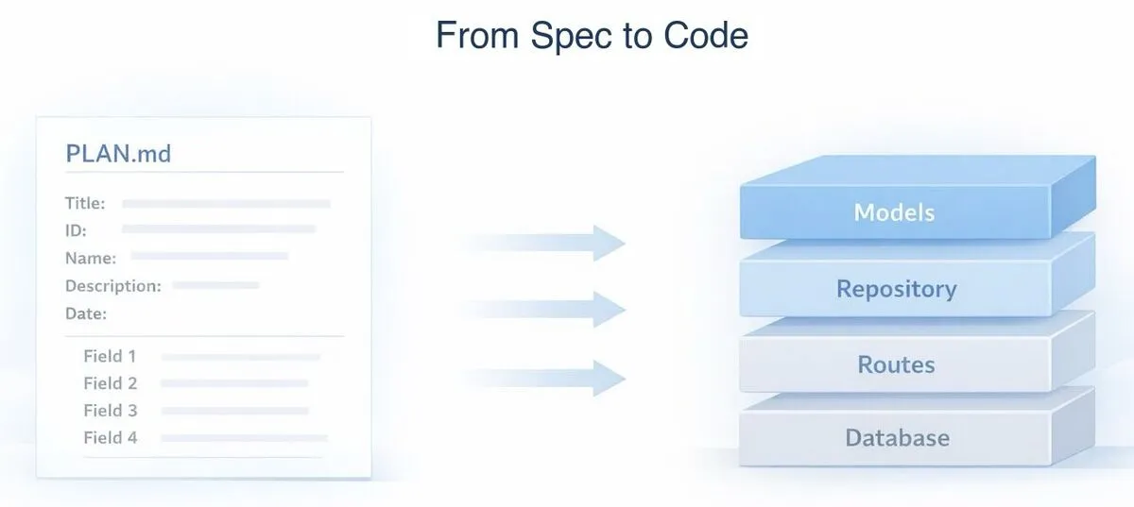
AIMARKET
01
SECTION 1 OF 4
Spec to API
Treat the spec as a contract. Build the API in layers you can review one at a time.
1
Spec to API
2
React storefront
3
Add AI
4
Deploy to Azure
Notes:
Section one: from spec to API. About 12 minutes.

Slide 6





AIMARKET
REVIEWABLE LAYERS
One layer per prompt
→
→
→
Models
Repository
Routes
Try it
Types and validation
Interfaces + SQLite + seed data
REST endpoints + errors
/api/health and 10 products
Pick your stack: Node.js by default, or Python, .NET, or Java. The spec stays the same.
Notes:
Instead of one giant prompt, build in layers you can actually review. Models first, then the repository layer, then routes, then run it. The spec includes a Choose Your Stack table, so you can pick Node.js, Python with FastAPI, .NET minimal APIs, or Java with Spring Boot. The frontend is always React.

Slide 7

AIMARKET
START FROM THE SPEC
Read the plan, build the models
PROMPT · ABRIDGED
Read PLAN.md and PLAN-phase1-api.md in this directory. Create a Node.js/Express with TypeScript project in an api/ subdirectory (or my chosen stack if I say otherwise). Initialize the project with the standard build files.
Then create just the data models from the "Data Models" section: Product, Order (with OrderItem and ShippingAddress), and User. Include validation functions for each model. … If you encounter any issues, log them to issues.md.
Notes:
Start with the workspace: node .github/scripts/create-workspace.mjs aimarket, then cd ../aimarket-workspace/journeys/aimarket and start copilot. The key phrase is "just the data models." Small scope means a small diff you can actually read. Full prompt adds: Use the recommended framework from the Choose Your Stack table in the spec.

Slide 8

AIMARKET
INSPECT, THEN REFINE
Catch what the agent missed
PROMPT
The POST /api/orders endpoint doesn't capture priceAtPurchase from the product's current price. It's using the price from the request body, which means a buyer could send any price. Fix it to look up each product's price from the database.
The code compiled and ran. Only inspection found the bug.
Notes:
This is the heart of inspect and refine. The generated code looked fine and ran fine, but it trusted the client for the price. A precise follow-up prompt that names the problem and the expected behavior fixes it. Test business rules, not just compilation.

Slide 9




AIMARKET
KEY IDEA
Swap the database, not the code
SQLite
Default, local
→
DATA_PROVIDER
Routes
DataStore
→
Cosmos DB
Never import the DB
Repository interfaces
Optional
PostgreSQL
Optional
Notes:
Routes receive a DataStore and never import the database directly. A factory reads the DATA_PROVIDER environment variable and returns SQLite by default. Cosmos DB or PostgreSQL can be added later without touching routes. This also makes testing easy. The data-access-abstraction skill in this repo describes the pattern.

Slide 10
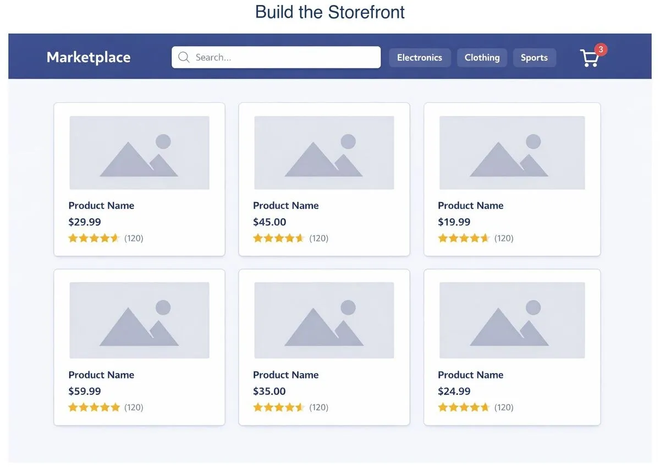
AIMARKET
02
SECTION 2 OF 4
React storefront
A React storefront on top of the API, proven with end-to-end browser tests.
1
Spec to API
2
React storefront
3
Add AI
4
Deploy to Azure
Notes:
Section two: the storefront. About 8 minutes.

Slide 11
AIMARKET
BUILD THE STOREFRONT
React, whatever the API language
PROMPT · ABRIDGED
Create a React frontend for AIMarket in a client/ directory using Vite, TypeScript, and Tailwind CSS. … Read PLAN.md and the "Frontend" section in PLAN-phase2-storefront.md. Build:
Product grid page with filtering and category buttons
Product detail page with Add to Cart
Shopping cart page with Place Order
A ChatWidget placeholder
Do not implement AI Search or AI chat yet.
Set up a Vite proxy so /api requests go to the API.
Notes:
Notice the explicit "not yet." Scoping out future work keeps each diff focused. Full prompt:
Create a React frontend for AIMarket in a client/ directory using Vite, TypeScript, and Tailwind CSS. The frontend is always React regardless of your API language. Read PLAN.md and the "Frontend" section in PLAN-phase2-storefront.md. Build:
- Product grid page with the "SearchBar: Client-Side Filtering" behavior and category filter buttons
- Product detail page with Add to Cart
- Shopping cart page with Place Order
- A ChatWidget component that follows the "ChatWidget: Shared Layout" and "ChatWidget: Placeholder State" sections in PLAN-phase2-storefront.md
Do not implement "SearchBar: AI Search Integration" or "ChatWidget: AI Integration" yet.
Set up a Vite proxy so /api requests go to http://localhost:[YOUR API PORT].

Slide 12
AIMARKET
PROVE IT IN THE BROWSER
One command to run. One to test.
Terminal
$ npm run app
# API and React start together
$ npm run test:e2e
# Playwright: 10 cards, search, filters,
# cart totals, and order confirmation
Then push to a private GitHub repo so a cloud agent can help in the next phase.
Notes:
Ask Copilot to create a single npm run app command that starts both the API and the frontend. Then ask for Playwright end-to-end tests: all 10 cards and images load, search by name and tag, Electronics shows exactly 3 products, product detail, cart totals, and order confirmation. Finally, ask Copilot to prepare the repo, check .gitignore for secrets and generated files, commit, and push to a private GitHub repository.

Slide 13
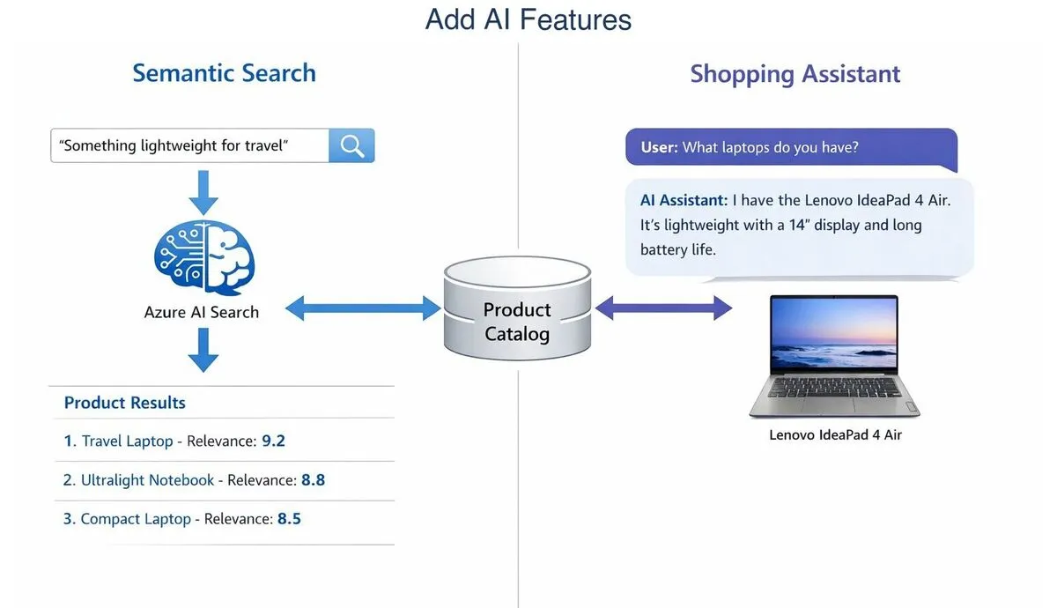
AIMARKET
03
SECTION 3 OF 4
Add AI
Semantic search and a shopping assistant grounded in the real catalog.
1
Spec to API
2
React storefront
3
Add AI
4
Deploy to Azure
Notes:
Section three: add AI. About 15 minutes.

Slide 14
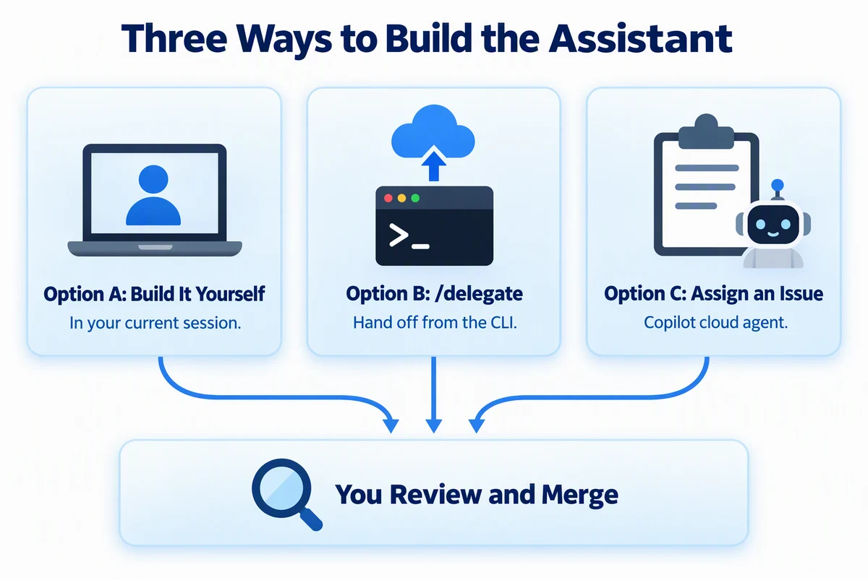
AIMARKET
CHOOSE HOW TO BUILD IT
Three ways to build the assistant
Notes:
You have three options. Build it yourself in your current session. Hand it off from the CLI with /delegate, which creates a pull request from the cloud agent. Or write a GitHub issue and assign it to Copilot cloud agent. All three end the same way: you review and merge. A nice live demo is to delegate the assistant and build search yourself at the same time.

Slide 15

AIMARKET
HAND IT OFF
Delegate while you keep building
PROMPT · ABRIDGED
/delegate Create the AI shopping assistant for AIMarket. Read journeys/aimarket/PLAN.md, PLAN-phase2-storefront.md, and PLAN-phase3-ai.md in the pushed repository. Implement the requirements in "Shopping Assistant," including POST /api/chat. Implement the frontend requirements in "ChatWidget: Shared Layout" and "ChatWidget: AI Integration." … Verify the implementation against all referenced plan requirements.
The cloud agent opens a pull request. You keep working locally.
Notes:
The cloud agent works on GitHub in parallel, and the result is a pull request you review like any other. Full prompt includes: Follow "Shopping Assistant Environment Variables" for local and deployed configuration.

Slide 16
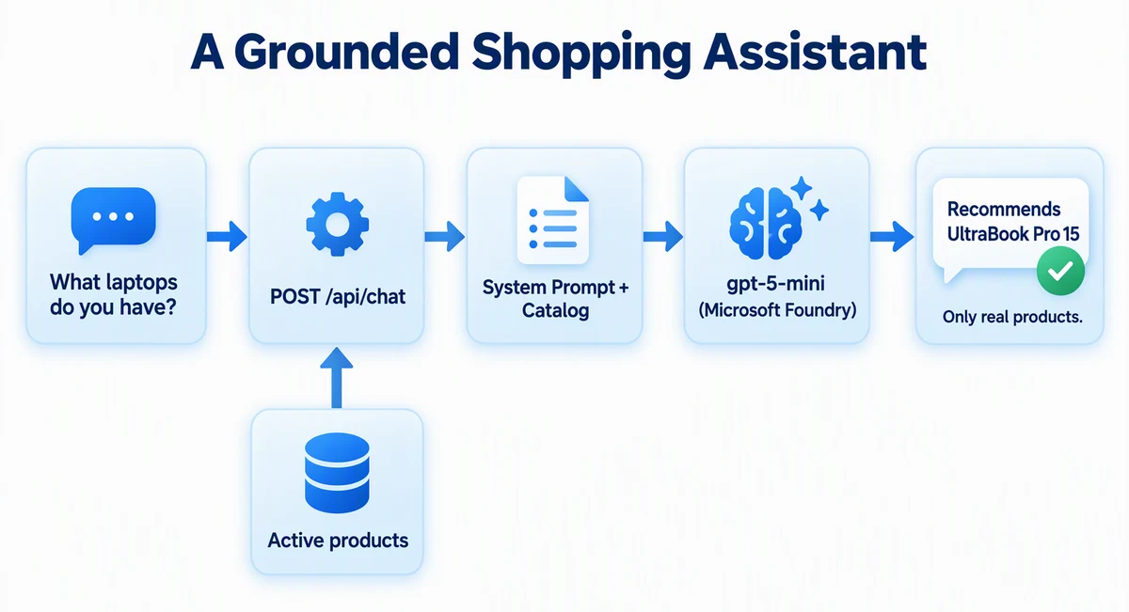
AIMARKET
GROUNDED ANSWERS
The assistant only knows your catalog
Notes:
The chat endpoint fetches active products and puts them in the system prompt, then calls a gpt-5-mini deployment in Microsoft Foundry. That grounding is what stops it from inventing products. Acceptance check: asking "What laptops do you have?" mentions the UltraBook Pro 15.

Slide 17
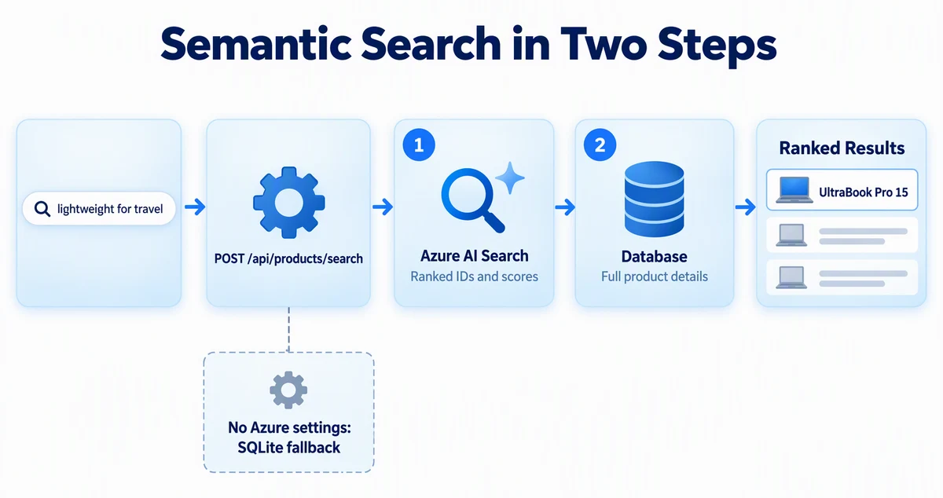
AIMARKET
SEMANTIC SEARCH
Search by meaning, not keywords
Notes:
Meanwhile, build semantic search yourself. Azure AI Search returns ranked product IDs, then the API loads full details from the database. Without Azure settings, it falls back to SQLite search, so local development still works. The query "something lightweight for travel" should find the UltraBook Pro 15.

Slide 18

AIMARKET
BEFORE INFRASTRUCTURE
Review the whole app against the spec
PROMPT
/review Review the completed AIMarket implementation against PLAN.md and all four PLAN-phase*.md files. The Phase 4 infrastructure comes next, so for Phase 4 check only that the app is ready for it. Identify missing or incorrectly implemented requirements and correctness, security, or reliability issues.
Fix the high-confidence findings, then rerun the build and the Playwright tests.
Notes:
Before you spend money on Azure, review the whole app against every plan file. Also review the cloud agent pull request, request a Copilot code review with gh pr edit --add-reviewer @copilot, and merge when checks pass.

Slide 19

AIMARKET
04
SECTION 4 OF 4
Deploy to Azure
Write the infrastructure test first. Deploy only after the gate and the review agree.
1
Spec to API
2
React storefront
3
Add AI
4
Deploy to Azure
Notes:
Section four: deploy to Azure. About 15 minutes.

Slide 20






AIMARKET
TEST-FIRST INFRASTRUCTURE
Write the gate before the Bicep
→
→
→
→
Gate fails
Generate
Gate passes
Review
azd up
check-infra.mjs, before any Bicep
Bicep, Dockerfiles, azure.yaml, hooks
Without changing the gate
READY or NOT READY
Only now do you pay
Red, then green, applied to infrastructure. The agent may not edit the gate.
Notes:
This mirrors test-driven development for infrastructure. First create scripts/check-infra.mjs from the plan and prove it fails because nothing exists yet. Tag that commit phase4-red. Then have the agent generate infrastructure until the gate passes, without changing the gate. Then run a read-only pre-deployment review. Only then run azd up.

Slide 21
AIMARKET
GENERATE INFRASTRUCTURE
Keep going until the gate passes
PROMPT · ABRIDGED
Read PLAN.md, the "Azure Deployment" section in PLAN-phase4-azure.md, and the container-apps-deployment skill. Create everything those two sources specify to deploy AIMarket to Azure Container Apps: Bicep in infra/, Dockerfiles and .dockerignore files for api/ and client/, azure.yaml, and the required postprovision and postdeploy hooks. … Keep going until "node scripts/check-infra.mjs --offline" passes, and don't change scripts/check-infra.mjs.
Notes:
The skill carries hard-won Container Apps lessons: ACR pulls with managed identity, linux/amd64 images, and the build-time API URL for the SPA. The gate is the definition of done, and the agent is not allowed to edit it. Full prompt adds: Default stack: Node.js API + React client. Set the location to westus. Log issues to issues.md.

Slide 22








AIMARKET
ARCHITECTURE
What azd creates
CONTAINER APPS ENVIRONMENT
AI Search
Semantic ranking
HTTPS
→
Shopper
→
/api
Storefront
→
API
Browser
React
SQLite inside
Microsoft Foundry
gpt-5-mini
Container Registry
App Insights + Log Analytics
Notes:
Two Container Apps, one for the React storefront and one for the API, in one Container Apps environment. Images come from Azure Container Registry. The API calls Azure AI Search and a gpt-5-mini deployment in Microsoft Foundry using managed identity. Application Insights and Log Analytics collect telemetry. SQLite lives inside the API container, so orders reset on restart. That is fine for a demo.

Slide 23
AIMARKET
SHIP AND VERIFY
Deploy, then prove it
Terminal
$ node scripts/check-infra.mjs
$ azd up
$ node ../../.github/scripts/verify-aimarket.mjs
PASS: health, 10 products, images, search,
chat, storefront, and API integration
Then open WEB_URL, search for "something lightweight for travel," and ask the assistant a question.
Notes:
Run the full gate, which includes an Azure preview, then azd up. The postdeploy hook rebuilds the frontend with the real API URL. Then run the checked-in verifier. Finally, try it yourself in the browser: semantic search and the assistant.

Slide 24

AIMARKET
CLEAN UP
Tear it down the same day
Terminal
$ azd down --force --purge
# Confirm it is really gone
$ az group exists --name <resource-group-name>
false
AI Search Basic alone is about $75/month. Clean up the same day.
Notes:
This journey has the second-highest running cost, mostly AI Search. Tear it down as soon as you are done.

Slide 25



AIMARKET
KEY TAKEAWAYS
What to remember
A spec is a contract. Build it in layers you can review.
Inspect and test business rules, not just that it compiles.
Ground AI in real data. Delegate bounded work to a cloud agent.
Gate the infrastructure before you pay for it.
NEXT JOURNEY
SmartTodo · Test-first with issues, TDD agents, stacked PRs, and a cloud-agent factory
Notes:
Recap. Treat the spec as a contract and build in reviewable layers. Inspect and test real business rules. Ground AI in live data and delegate well-bounded work. Gate infrastructure before deploying. Assignment ideas from the README: a recommendations endpoint, or an AI-generated thank-you message after an order. Next: SmartTodo, which makes the test-first approach the center of the whole workflow.

