Slide 1



FANNIE MAE AI SUMMIT
Put AI Agents to Work
The GitHub Copilot app for developers, knowledge workers, and leaders
Dan Wahlin · GitHub
Notes:
Welcome. Today is about one idea: you can hand real work to AI agents, run several at once, and stay in control of the result. You will see it for developers, project managers, business analysts, and leaders.

Slide 2

COPILOT APP
START WITH A QUESTION
How much of your day is real work?
9:00 AM
5:00 PM
Real work
Hunting for information
Switching tools
Waiting on others
Developers, project managers, analysts, and leaders all know this bar. The green part is the part you were hired for.
Notes:
Ask the room: how much of your day is real work, and how much is hunting for information and switching between tools? Get a show of hands. The bar is not data. It is the feeling most of us have.

Slide 3




COPILOT APP
THE CHALLENGE
Every role has work that waits
Developers
Project managers
Business analysts
Leaders
Bugs and missing tests wait in the backlog.
Status reports get built by hand from email and meetings.
Data moves between spreadsheets and systems by hand.
Decisions wait on all of it.
A chat assistant helps with the answers. The work still lands on you.
Notes:
Each role has its own backlog. Developers have bugs and missing tests. Project managers pull status reports together by hand. Analysts move data between systems. Leaders wait on all of that before they decide. Chat helps you get answers, but you still do the steps.

Slide 4



COPILOT APP
THE IDEA
Ideas need execution
×
=
Your ideas
Agents that do
the work
Impact
You bring the idea and the judgment. Agents do the steps.
Notes:
Everyone in this room has more ideas than time. AI agents change the execution side of the equation. You stay the owner of the idea and the judgment.

Slide 5

COPILOT APP
“Ideas are just a multiplier of execution.”
Derek Sivers
Entrepreneur and author
Notes:
Derek Sivers wrote this in 2005. A great idea with no execution is worth little. Agents raise the execution side for everyone, not only for people who write code.

Slide 6



COPILOT APP
THE GITHUB COPILOT APP
One desktop workspace for many agents
Hand off a task
GitHub Copilot app
Describe the outcome you want.
Housing website
Housing website
Running
Plan approved. Tests pass. Build done. Deploying to Azure Static Web Apps.
Excel analysis
Run several at once
Running
Each agent has its own session.
PowerPoint briefing
Running
WorkIQ session brief
Plan
Autopilot
Worktrees
Done
Review the results
Browser preview
MCP and WorkIQ
Accept only what you trust.
Automations
Notes:
The GitHub Copilot app is a desktop workspace for agents. Each session is an agent with its own branch and context. You can plan first, hand work to Autopilot, preview results in the app, connect to tools such as WorkIQ through MCP, and schedule automations.

Slide 7

COPILOT APP
ORCHESTRATE YOUR WORK
You are the conductor
Notes:
A conductor does not play every instrument. The conductor sets the direction, keeps the sections together, and listens for problems. That is your job in the Copilot app. The agents play the parts.

Slide 8
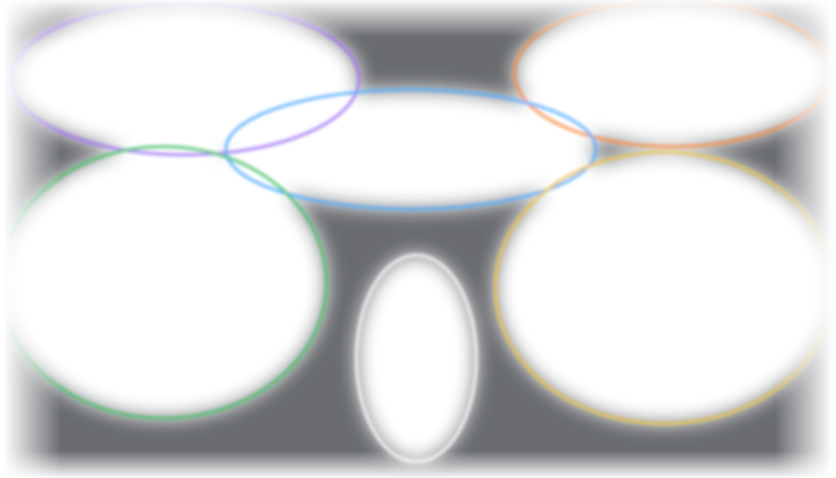






COPILOT APP
TODAY’S ORCHESTRA
Each session plays its own part
WorkIQ session brief
PowerPoint briefing
Project managers
Leaders
Housing website
Developers and IT managers
You
Excel workbook
Plan, review, approve
Weekly automation
Business analysts
Runs every Monday
Notes:
Here is today's orchestra. Each section is a session with its own agent and its own branch. The website, the Excel workbook, the PowerPoint briefing, and the WorkIQ brief all play at the same time. The automation keeps the beat every Monday. You stand in the middle: you plan, you review, and you approve.

Slide 9



COPILOT APP
TODAY’S STORY
One dataset. Four roles. Four agents.
Interactive website
Excel workbook
Public housing data
Developers and IT managers
Business analysts
FHFA House Price Index
CFPB HMDA mortgage data
50 states and DC, 100 metros, 1991 to 2026
Executive briefing
Microsoft 365 brief
Leaders and project managers
Project managers
Notes:
Here is the story for the demo. One public dataset: the FHFA House Price Index and CFPB HMDA mortgage data. Four people need four different outputs. I will start four agents at the same time, one for each output.

Slide 10




COPILOT APP
HOW YOU WORK WITH AGENTS
Plan first. Then hand it off.
Prompt
Plan
Autopilot
Review
Ship
Describe the outcome you want.
Read the plan and approve it.
Agents work at the same time.
Check diffs, previews, and files.
Merge, share, or deploy.
YOU DECIDE
YOU DECIDE
Use Plan when the task is big or new. Use Autopilot when the task is clear.
Notes:
The pattern is simple. Describe the outcome. For bigger work, read the plan first. Then switch to Autopilot. When the agent is done, you review the diff, the preview, or the file before you accept it.

Slide 11
LIVE DEMO
4
LIVE DEMO
Four agents. Starting now.
Watch the sidebar. Each session is a separate agent that works on its own branch.
Notes:
Switch to the app. Start the website session in Plan mode first, then start the Excel, PowerPoint, and WorkIQ sessions in Autopilot.

Slide 12
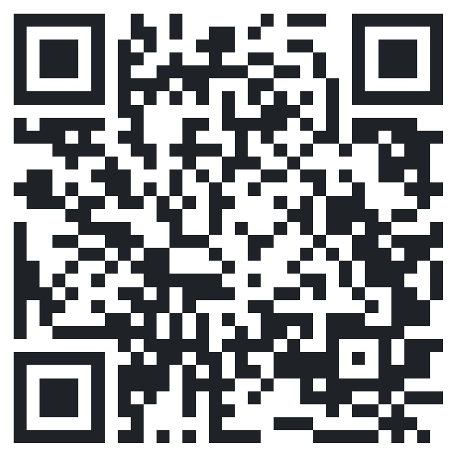
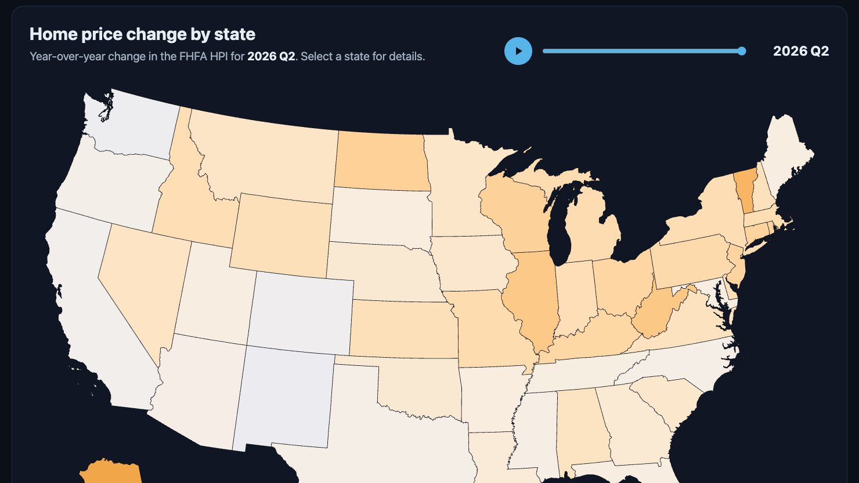
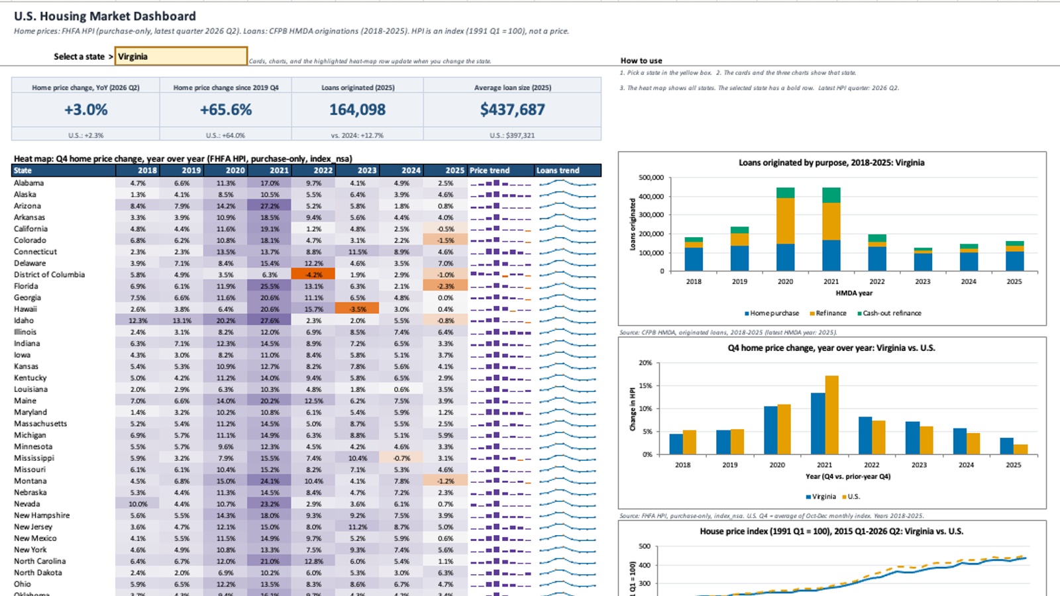
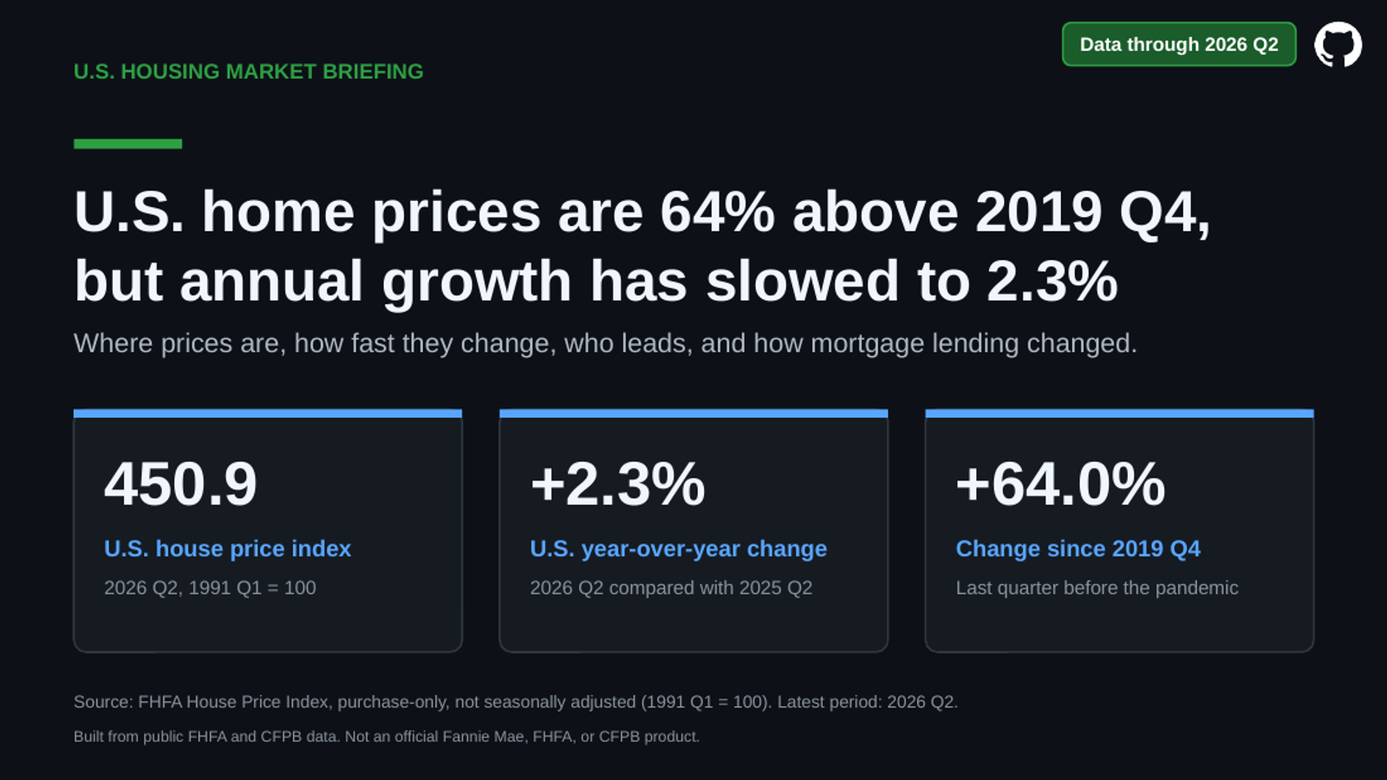
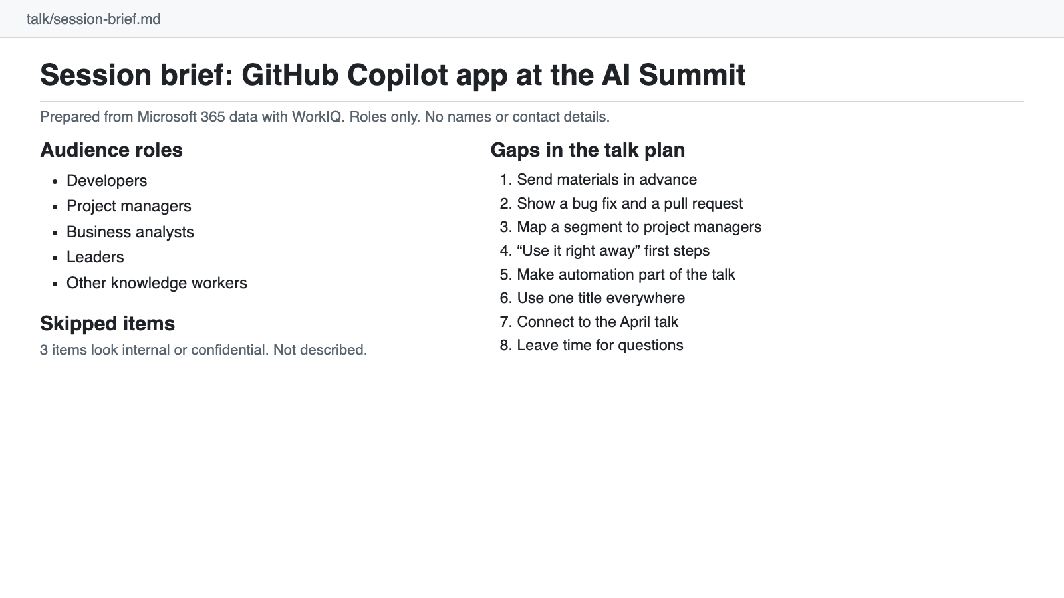
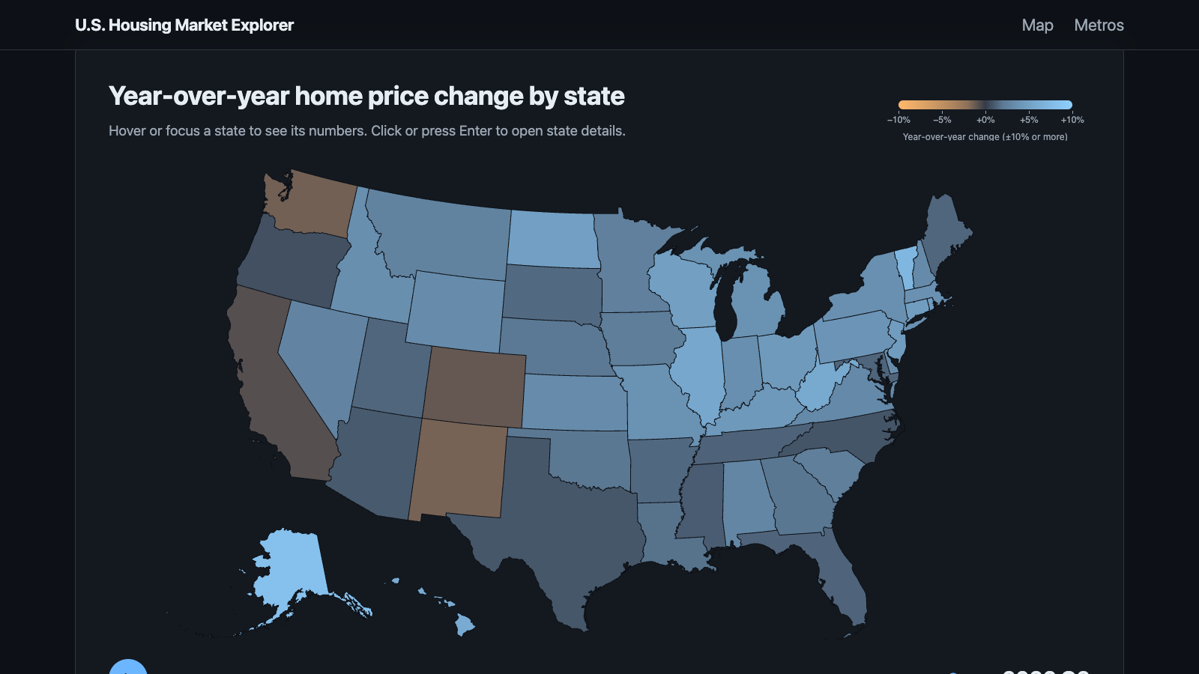
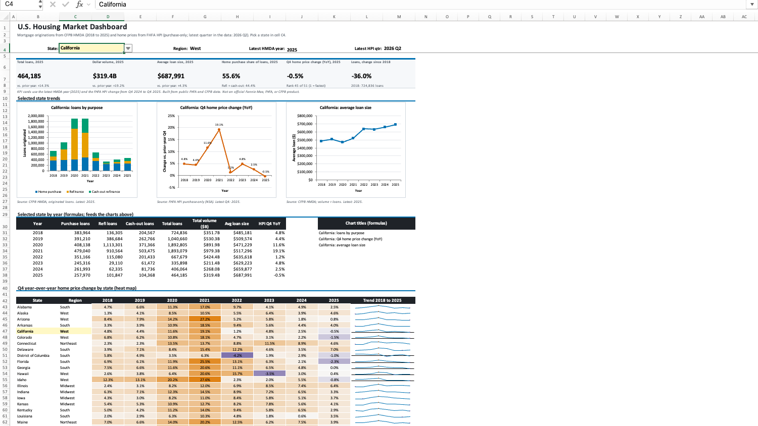
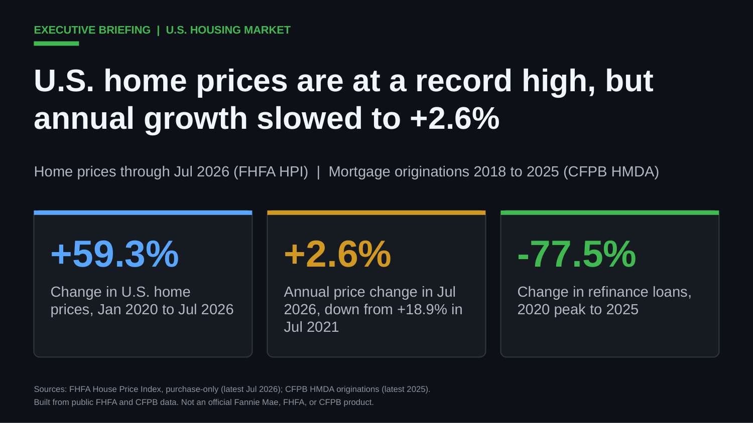
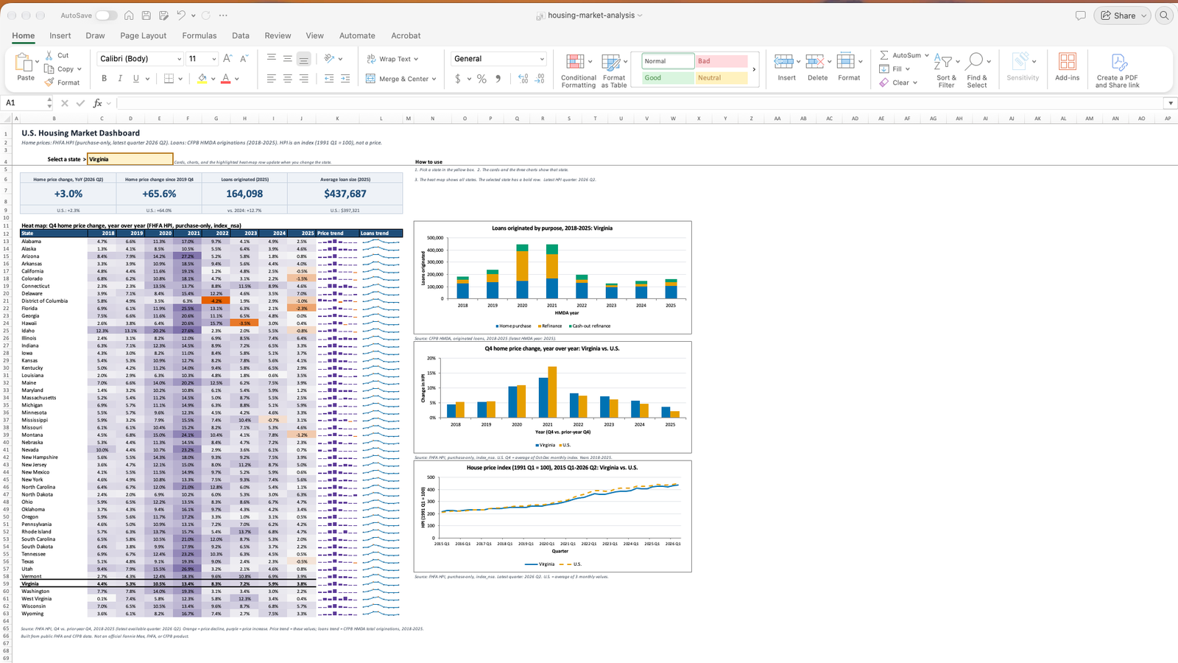
COPILOT APP
WHAT THE AGENTS BUILT
Four results, built at the same time
Scan to open the live site
Works on your phone
Interactive website
Excel workbook
Developers and IT managers
Business analysts
Executive briefing
Session brief
Leaders and project managers
Project managers
Notes:
Recap what the four agents built while we talked: a deployed website, an analyst workbook with a PivotTable, an executive briefing with native charts, and a session brief from Microsoft 365. Each one took one prompt.

Slide 13



COPILOT APP
TRUST AND CONTROL
You stay in control
Plan before work
Isolated worktrees
Read the plan before the agent changes anything.
Each agent works on its own branch, so agents do not collide.
Tool permissions
Review before you accept
Choose when the agent must ask before it runs a tool.
Check diffs, previews, and files. Then merge.
Notes:
Agents do the steps, but you own the result. Plan mode shows you the approach first. Worktrees keep agents apart. Tool permissions control what runs without asking. And nothing is accepted until you review it.

Slide 14

COPILOT APP
“The best way to predict the future is to invent it.”
Alan Kay
Computer scientist
Notes:
Alan Kay said this in 1971. With agents, more people can invent: developers, project managers, analysts, and leaders.

Slide 15
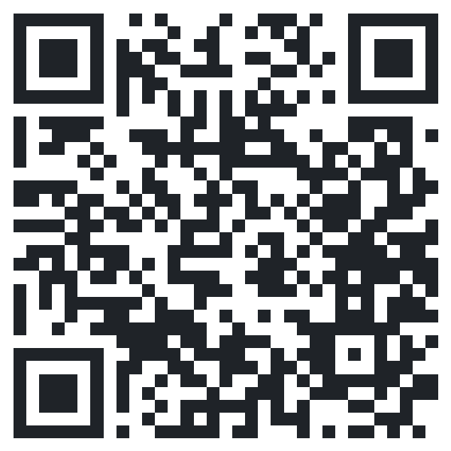
COPILOT APP
START TODAY
Hand off one task this week
Developers
Project managers
Business analysts
Leaders
Fix the bug in issue 42 and add a test.
Make a status brief from this week’s project email.
Turn this CSV into a workbook with a PivotTable.
Make a one-page briefing on this topic.
Free course: GitHub Copilot app for beginners
github.com/github/copilot-app-for-beginners
Notes:
Pick one task this week and hand it to an agent. Each role has a first prompt you can use right away. The free course walks through the app step by step.

Slide 16
THANK YOU
Questions?
Bring an idea. Put an agent to work on it.
Dan Wahlin · GitHub
Notes:
Thank you. Take questions.

