Slide 1
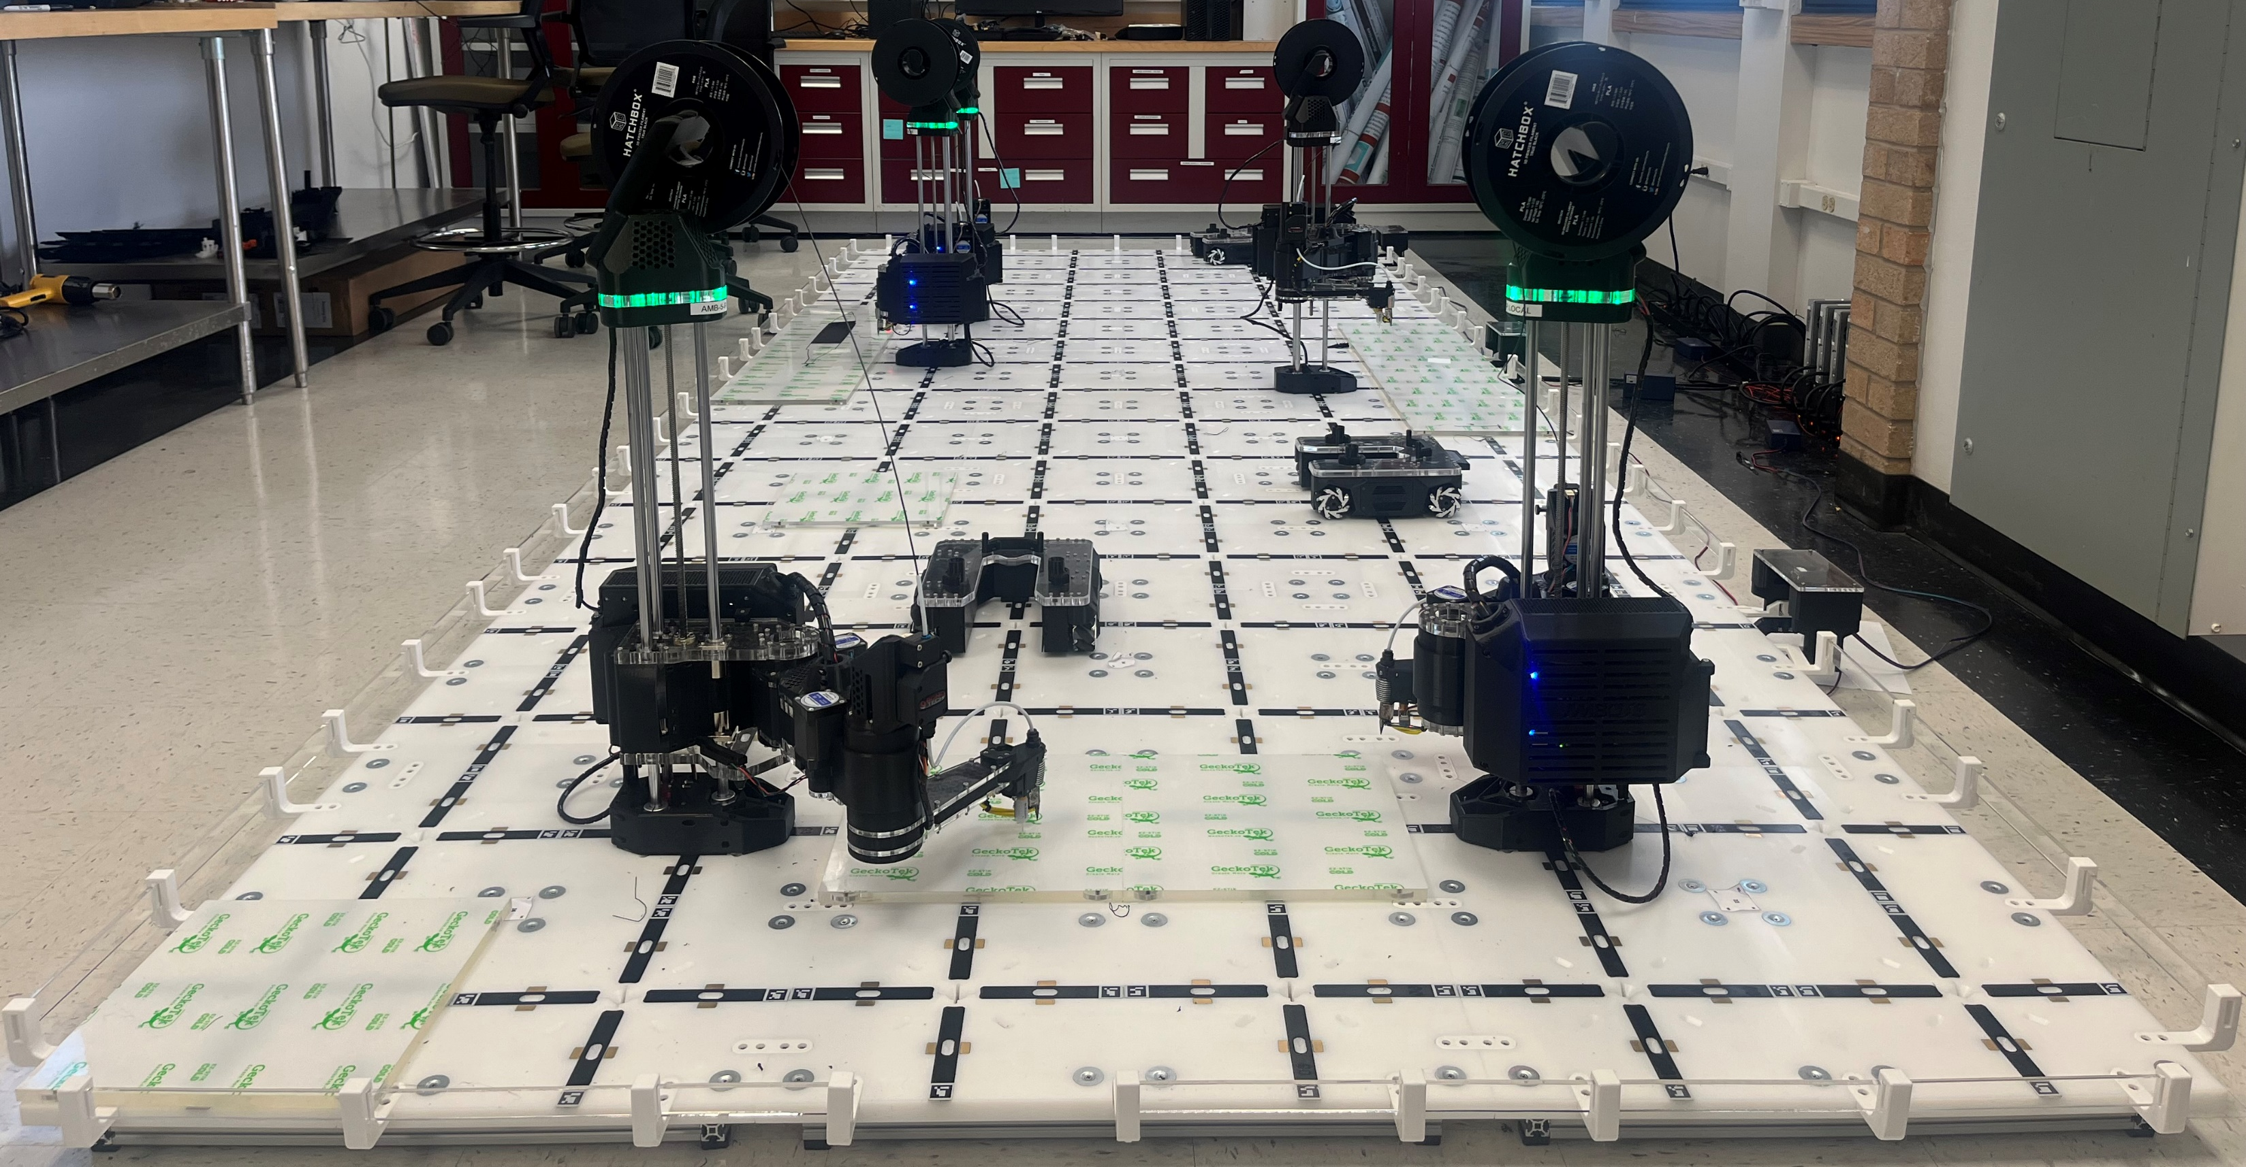
II
I

Slide 2
STL File
Discretization of 3D printing process
Chunking
Placing
Continuous 3D Process
Direct planning with multi-robots
Multi-Level Collision Avoidance
Scheduling
Path Planning
Slicing
Printing Using Multiple Robots

Slide 11
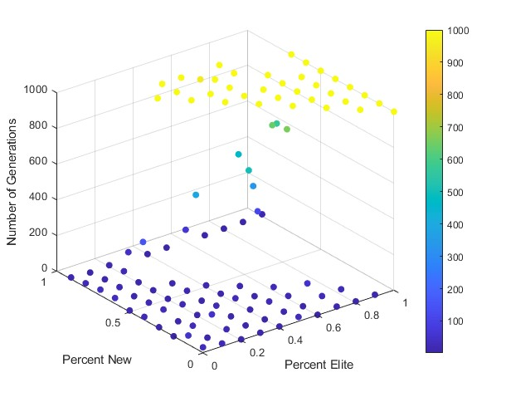
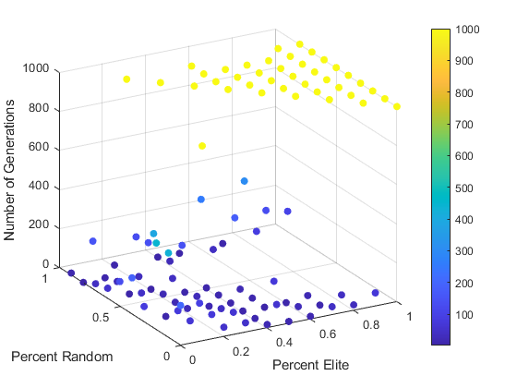
(A) First Level Results
(B) Second Level Results

