Slide 1
What we saw in the first part

Slide 2
Modules
- Function/variable/class reusable easily
- Maintability
- Imported with keyword “require/import”
- Exported with keyword modules.exports/export (default)
- scoped => no mainspace pollution
- https://developer.mozilla.org/en-US/docs/Web/JavaScript/Reference/Statements/export
- https://developer.mozilla.org/en-US/docs/Web/JavaScript/Reference/Statements/import
- http://2ality.com/2014/09/es6-modules-final.html
In bold ESNext syntax

Slide 3
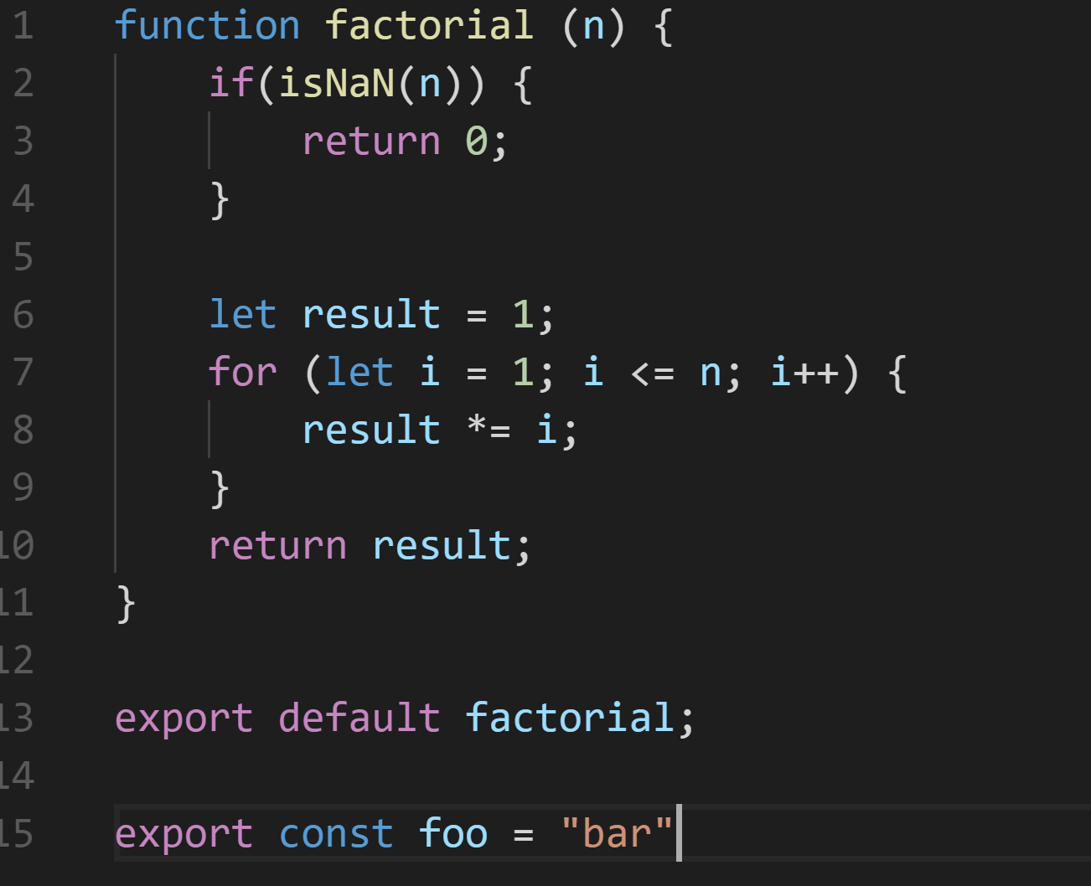
Modules (ESNext syntax) - example
Default export
(one per module)
Named export
(several per module)

Slide 4
Bundle
- File containing every modules of an application into one file
- Creates links to external resources
- Accessible on browser

Slide 5
Vocabulary
- Module: functions, classes, vars scoped and accessible with export keyword
- Bundle: file containing multiple modules to be usable on browser
- Package: bundle/modules downloadable via npm or git

Slide 6
Webpack
- Bundle manager for front-end assets
- Browserify on steroids
- Created in 2012 by Tobias Koppers
- Maintained by community (OpenSource)*
- Version 3.8.1 currently
- *https://github.com/webpack/webpack
- https://webpack.js.org

Slide 7
Loader
- Loaders allow to process more than js files
- Loaders transforms non-js code into js code
- https://webpack.js.org/concepts/#loaders
- https://webpack.js.org/concepts/loaders/

Slide 8
Loader
- Loaders allow to process more than js files
- Loaders transforms non-js code into js code
Loaders are, sort of, tasks in gulp

Slide 9
Loader - examples
- extract-loader: Extracts html/css from js files
- babel-loader: Transpiles ESNext to ES5
- eslint-loader: Lints js files (preloader)
- sass-loader: Loads and transforms a SCSS file
- vue-loader: loads and compiles .vue
- https://webpack.js.org/concepts/#loaders
- https://webpack.js.org/concepts/loaders/

