Slide 1
Unit tests
Javascript Montreal
April 2018

Slide 2
Danielo JEAN-LOUIS
Front-end developer

Slide 3
What’s unit tests?
“Method of testing each unit of code to test if they work well”.

Slide 4
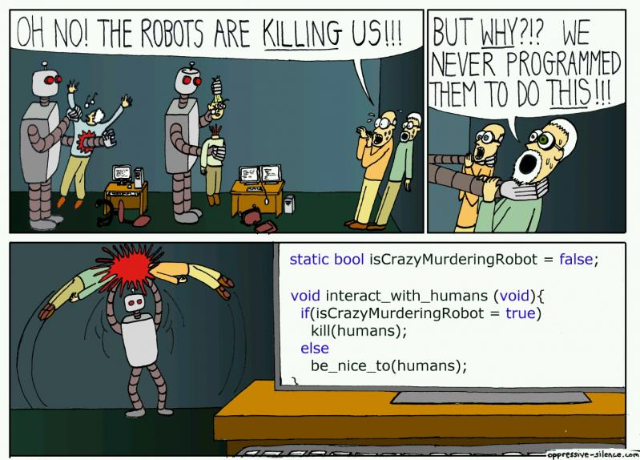
Why unit tests?

Slide 5
What’s unit tests?
- Avoid dumb tickets / bugs
- Improve code quality / reduce complexity
- Encourage modularity
- Ensure functionalities behaviors even if the code change (!)
- Document code
Sources
- https://medium.com/javascript-scene/what-every-unit-test-needs-f6cd34d9836d

Slide 6
Why unit tests?
- Avoid dumb tickets / bugs
- Improve code quality / reduce complexity
- Encourage modularity
- Ensure functionalities behaviors even if the code change (!)
- Document code
- To not replace QA. Functional test exists.
Sources
- https://medium.com/javascript-scene/what-every-unit-test-needs-f6cd34d9836d

Slide 7
But the code has to be ready for it

Slide 8
Pure function is the first step

Slide 9
Pure function
- No side effects
- Updates var outside its own scope
- Always return the same results
- E.g.: Math.random() is impure

Slide 10
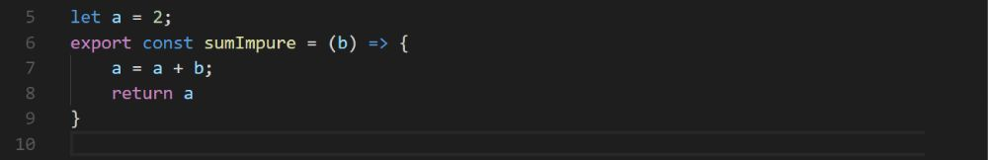
Example
Impure function
let a = 2;
export const sumImpure = (b) => {
a = a + b; // Access var outsite func
return a
}

Slide 11
Let’s test it...

Slide 12
with Jest

Slide 13
Jest
- Created by facebook
- Agnostic but made to works well with React
- Inspired by Jasmine
- Allows snapshot tests
- Jest = Jasmine + sinon + instanbul
Sources
- https://facebook.github.io/jest/

Slide 14
Now test our function

Slide 15
Example
Pure function
export const sumPure = (a = 0, b) => {
return a + b;
}

Slide 16
It works well but...

Slide 17
Did we manage every case?

Slide 18
Code coverage
- Works hand in hand with unit tests
- Detects useless code
- Forces to manage every case
- Returns the percentage of code executed
- “--coverage” param with Jest
- Jest relies on instanbul for it

Slide 19
Let’s coverage our code

Slide 20
Code coverage details
Statements (Stmts):
Proportion of statements executed
Example: const a = 42; // It’s a statement
Branches (Branch):
Conditional statements executed (if / else, switch...)
Sources
- http://2ality.com/2012/09/expressions-vs-statements.html
- https://github.com/dwyl/learn-istanbul

Slide 21
Code coverage details
Functions (Funcs):
Proportion of statements executed
Lines (lines):
Proportion of lines executed
Sources
- http://2ality.com/2012/09/expressions-vs-statements.html
- https://github.com/dwyl/learn-istanbul

Slide 22
Let’s improve the coverage

Slide 23
Code coverage details
Functions (Funcs):
Proportion of statements executed
Lines (lines):
Proportion of lines executed
Sources
- http://2ality.com/2012/09/expressions-vs-statements.html
- https://github.com/dwyl/learn-istanbul

Slide 24
100 % it’s not a dream.
It can be a reality.

Slide 25
Unit testing best practices
- Be explicit (You know what you’re testing)
- Don’t try to replace QA / functional tests
- Add them to your precommit
- TDD (Write your test then code)
- Create a mocks folder for your mocked data

Slide 26
Conclusion
- Unit testing allows to improve code quality / reduce number of bugs
- Code coverage detects useless code

Slide 27
Questions ?

