Slide 1
What’s new in Javascript?
July 2018

Slide 2
Danielo JEAN-LOUIS
Front-end developer

Slide 3
Topics of this presentation
- Variables
- Classes
- Array / Object
- Modules
- Misc.
Sources
https://en.wikipedia.org/wiki/Eating_your_own_dog_food
https://reactjs.org/docs/getting-started.html

Slide 4
const vs let vs var

Slide 5
const vs let vs var

Slide 6
const and let
Defines a scoped value

Slide 7
const and let
Defines a scoped value
No hoisting anymore

Slide 8
const and let
Defines a scoped value
No hoisting anymore
With hoisting
Without hoisting
for (var i = 0; i++; i < 5) { console.log(i); // 0, 1…, 4
} console.log(i); // 4
for (let i = 0; i++; i < 5) { console.log(i); // 0, 1…, 4
} console.log(i); // undefined

Slide 9
Please don’t use var anymore

Slide 10
An (another) javascript framework library!
Sources
http://www.nicoespeon.com/en/2015/01/pure-functions-javascript/
https://web.archive.org/web/20070504053354/http://www.ddj.com/blog/architectblog/archives/2006/07/frameworks_vs_l.html

Slide 11
What’s React ?
- Javascript library developed, open sourced and maintained by facebook
- Designed for (large) applications with data that change over the time
- Released in 2013
- Dogfed by facebook with facebook and instagram
Sources
https://en.wikipedia.org/wiki/Eating_your_own_dog_food
https://reactjs.org/docs/getting-started.html

Slide 12
What’s React ?
- Javascript library developed, open sourced and maintained by facebook
- Designed for (large) applications with data that change over the time
- Released in 2013
- Dogfed by facebook with facebook and instagram
- Relies on Virtual DOM
Sources
https://en.wikipedia.org/wiki/Eating_your_own_dog_food
https://reactjs.org/docs/getting-started.html

Slide 13
What’s React ?
- Javascript library developed, open sourced and maintained by facebook
- Designed for (large) applications with data that change over the time
- Released in 2013
- Dogfed by facebook with facebook and instagram
- Relies on Virtual DOM
Extremely fast
Sources
https://en.wikipedia.org/wiki/Eating_your_own_dog_food
https://reactjs.org/docs/getting-started.html

Slide 14
What’s React ?
- No MVC
- No MVVM
- No MVW
- No DM-VM-CM-VC-V*
- ...
*https://github.com/xlasne/MVVM-C

Slide 15
React is only view

Slide 16
React is only view
React is components
Notes:
Hello

Slide 17
React components are
Reusable
Testable
Maintainable

Slide 18
React components are not Web components
Web components are for strong encapsulation
React components are made to be sync with data
Sources
https://reactjs.org/docs/web-components.html

Slide 19
Let’s write our first component

Slide 20
Let’s write our first component
import React from 'react'; export default class MyFirstComponent extends React.Component { render() { return (
<p>It’s my first component with React !</p>
);
}

Slide 21
Let’s write our first component
import React from 'react'; export default class MyFirstComponent extends React.Component { render() { return (
<p>It’s my first component with React !</p>
);
}
render() method displays the template of the component

Slide 22
Let’s write our first component
import { render } from 'react-dom' import MyFirstComponent from ‘./MyFirstComponent’ render(
<MyFirstComponent />, document.getElementById(‘content’)
);
We start the React app
(A div can contain only one react app)

Slide 23
Component’s life cycle
Mount
Update
Unmount
Sources
https://reactjs.org/docs/react-component.html#the-component-lifecycle

Slide 24
Component’s life cycle
Mount
Update
Unmount
Error handling
Sources
https://reactjs.org/docs/react-component.html#the-component-lifecycle

Slide 25
Props and state
Props and state allow to change/set component’s content/data
Props are immutable
Props are read-only
Props are passed only by component’s closest parent
Sources
https://reactjs.org/docs/react-component.html#the-component-lifecycle

Slide 26
Props and state
Props and state allow to change/set component’s content/data
Props are immutable
Props are read-only
Props are passed only by the closest parent
State is mutable
State is handled by the component itself
Sources
https://reactjs.org/docs/react-component.html#the-component-lifecycle

Slide 27
Props and state
Props and state allow to change/set component’s content/data
Props are immutable
Props are read-only
Props are passed only by the closest parent
State is mutable
State is handled by the component itself
Updates component’s state will call component’s render method
Sources
https://reactjs.org/docs/react-component.html#the-component-lifecycle

Slide 28
Do not update the state inside render!

Slide 29
Props and state
import React from 'react'; import MyChildComponent from ‘./my-child-component’; export default class MyFirstComponent extends React.Component { constructor(props) {
// [...] this.state = { hello: “el mundo”
} setTimeout(this.myMethod, 5000);
} myMethod() { this.setState({ hello: “world”
})
} render() { return (
<MyChildComponent text={this.state.hello} />
);
}

Slide 30
Example – props & state
Sources
https://github.com/DanYellow/presentations/tree/master/react-redux-101/examples/props-and-state

Slide 31
Data flow (up)
Callback function to communicate with the closest parent

Slide 32
Data flow (up) - Parent
Callback function to communicate with the closest parent
export default class MyFirstComponent extends React.Component {
// [...] myCallback () { console.log(‘‘my child talks to me!’’);
} render() { return (
<MyChildComponent text={this.state.hello} onClickCB={this.myCallback}
/>
);
}

Slide 33
Data flow (up) - Parent
Callback function to communicate with the closest parent
export default class MyFirstComponent extends React.Component {
// [...] myCallback () { console.log(‘‘my child talks to me!’’);
} render() { return (
<MyChildComponent text={this.state.hello} onClickCB={this.myCallback}
/>
);
}
We define a method

Slide 34
Data flow (up) - Parent
Callback function to communicate with the closest parent
export default class MyFirstComponent extends React.Component {
// [...] myCallback () { console.log(‘‘my child talks to me!’’);
} render() { return (
<MyChildComponent text={this.state.hello} onClickCB={this.myCallback}
/>
);
}
We pass as props the callback function

Slide 35
Data flow (up) - Child
Callback function to communicate with the closest parent
export default class MyChildComponent extends Component { constructor(props) { super(props); this.handleClick = this.handleClick.bind(this);
} handleClick() { this.props.onClickCB()
} render() { return (
<p onClick={this.handleClick}>{ this.props.text }</p>
);
}
}

Slide 36
Data flow (up) - Child
Callback function to communicate with the closest parent
export default class MyChildComponent extends Component { constructor(props) { super(props); this.handleClick = this.handleClick.bind(this);
} handleClick() { this.props.onClickCB()
} render() { return (
<p onClick={this.handleClick}>{ this.props.text }</p>
);
}
}
We invoke the props

Slide 37
Example – callback
Sources
https://github.com/DanYellow/presentations/tree/master/react-redux-101/examples/callback

Slide 38
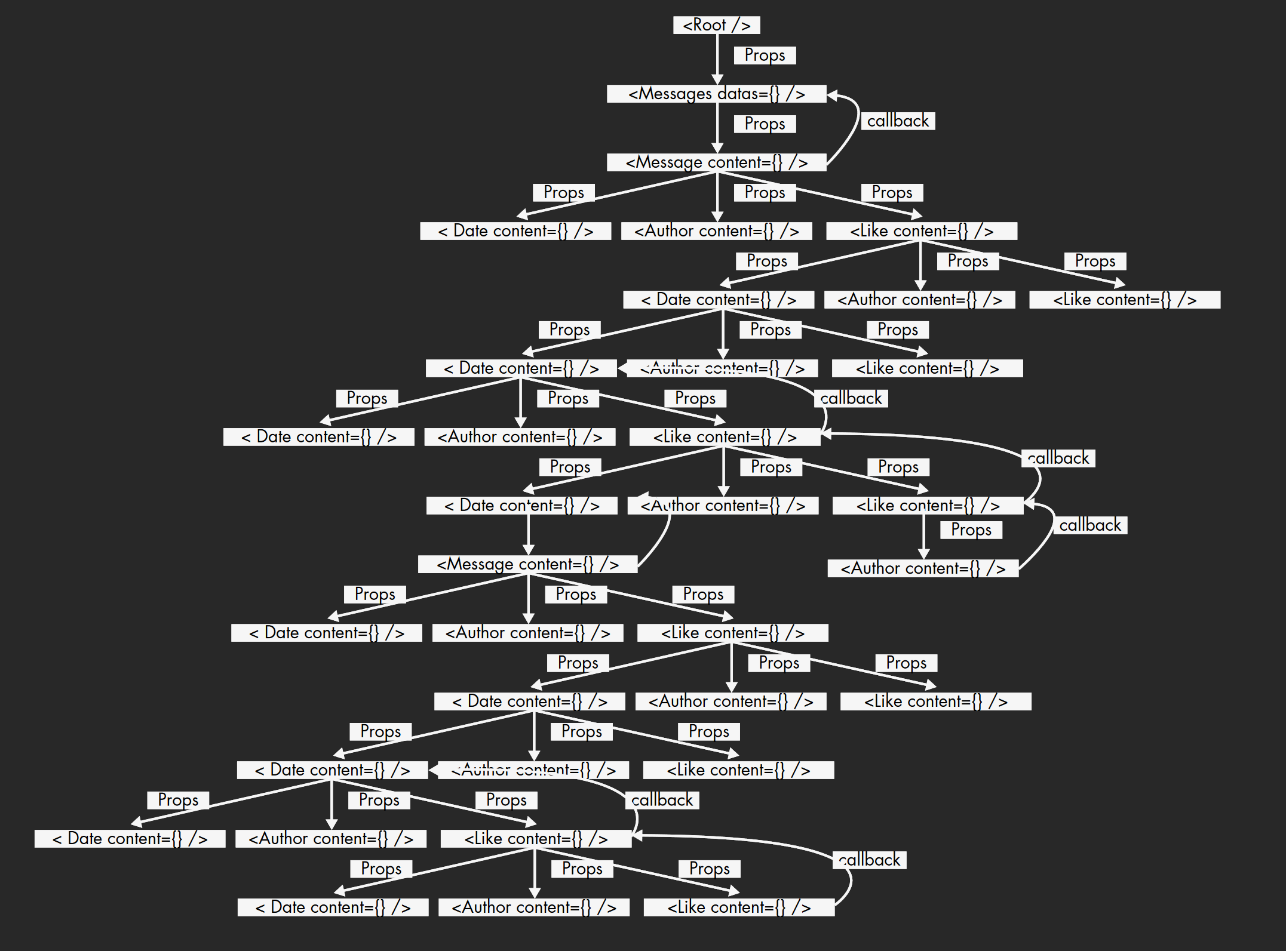
Data flow (up)

Slide 39


Slide 40
Advanced topics

Slide 41
Stateless component
When a component doesn’t need to update its state or rely on its lifecycle, it should be written as a function also called stateless component

Slide 42
Stateless component
When a component doesn’t need to update its state or rely on its lifecycle, it should be written as a function also called stateless component
Import React from ‘react’; const MyStatelessComponent = (props) => { return (
<p>
I turn myself into a stateless component. I’m a stateless component!
</p>
);
}

Slide 43
Stateless component - Advantages
- Easier to test
- Better performance (since React ≥ 16)
- No need to bind this inside methods
- Decreases bundle size within the app

Slide 44
Debugging
Browser extension for React (Firefox and Chrome)

Slide 45
Create React App
- Wonderful tool to set up a React project in less than 1 min
- Create dev and prod env
- Provide linters and unit tests setup
Sources
https://github.com/facebook/create-react-app

Slide 46
First part summary
React is only view in the MVC pattern
React relies on VDOM, it’s fast thank to it
JSX is strongly encouraged for templating
React allows a full control of the component with its lifecycle
Props allows parent to set/update children’s data
Props are immutables

Slide 47
First part summary
React is only view in the MVC pattern
React relies on VDOM, it’s fast thank to it
JSX is strongly encouraged for templating
React allows a full control of the component with its lifecycle
Props allows parent to set/update children’s data
Props are immutables
State is updated by the component itself
State is mutable

Slide 48
First part summary
React is only view in the MVC pattern
React relies on VDOM, it’s fast thank to it
JSX is strongly encouraged for templating
React allows a full control of the component with its lifecycle
Props allows parent to set/update children’s data
Props are immutables
State is updated by the component itself
State is mutable
The data flow (up) in React is a mess... except if we use...

Slide 49


Slide 51
What’s Redux ?
- Predicable state container for any javascript application
- With Redux, a React app has only one state for the whole app
- Redux is agnostic, it works with React, VueJS, Angular and of course vanilla js
Sources
https://github.com/angular-redux/ng-redux
https://github.com/reduxjs/react-redux
https://github.com/titouancreach/vuejs-redux

Slide 52
Dataflow (up and down) without Redux

Slide 53
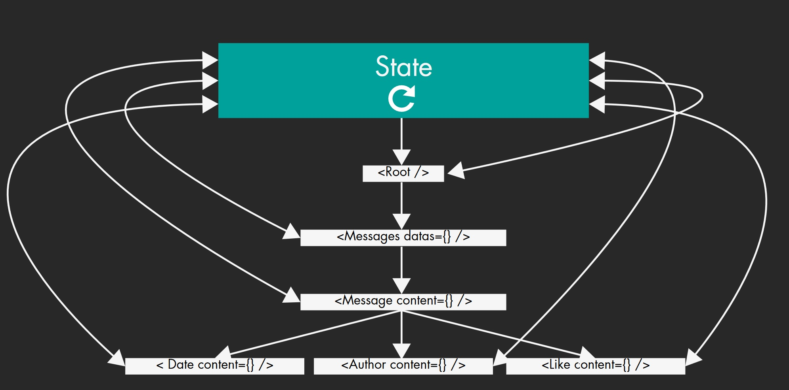
Dataflow (up and down) with Redux

Slide 54
Redux’s principles
- Single source of truth for the entire app
- State is immutable
- Changes are made with pure and synchronous functions
Sources
https://github.com/reactjs/redux/blob/master/docs/introduction/ThreePrinciples.md
https://en.wikipedia.org/wiki/Pure_function

Slide 55
Redux’s advantages
- Easier to debug ReactJS apps ; All data transit in the same place
- Brings (M)VC pattern to React (React is only View)
- Limits corrupted datas ; Redux rewrites state at each change
Sources
https://github.com/reactjs/redux/blob/master/docs/introduction/ThreePrinciples.md
https://en.wikipedia.org/wiki/Pure_function

Slide 56
Redux’s flow
Component / Container
Dispatches an action creator
Action creator
Send data
Reducer
Updates store
Container
Listens to store’s update

Slide 57
Redux’s flow
Component / Container
Dispatches
an action creator
Component / Container
It’s the View in MVC pattern
Calls an action creator
Action creator
Send data (an action)
Reducer
Updates store
Container
Listens to store’s update

Slide 58
Redux’s flow – Component / container
import React from 'react'; export default class MessageForm extends React.Component {
// [...] submitMessage (e) { e.preventDefault(); this.props.dispatch(addMessage(‘‘Hello world’’));
} render() { const { messages } = this.props; return (
<h1>{ messages[messages.length - 1] }</h1>
<form>
<textarea value={this.props.content} />
<button>Add message</button>
</form>
);
}
}
It’s the View in MVC pattern. Calls an action creator

Slide 59
Redux’s flow
Component / Container
Dispatches
an action creator
Action creator
Notifies the app that something
happened
Note : An action must return an object, to use a function use redux-thunk
Action creator
Send data (an action)
Reducer
Updates store
Container
Listens to store’s update

Slide 60
Redux’s flow – Action creator
export const addMessage = function (text) { return { type: ‘ADD_MESSAGE’, payload: { text: text }
}
}
Notifies the app that something happened
Action
Action creator
Sources
http://redux.js.org/docs/basics/Actions.html

Slide 61
Redux’s flow
Component / Container
Dispatches
an action creator
Reducer
Compute the action triggered with the current store
Action creator
Send data (an action)
Reducer
Updates store
Container
Listens to store’s update

Slide 62
Redux’s flow – Reducer
const DEFAULT_STATE = { text: ‘’ } const messageReducer = function (state = DEFAULT_STATE, action) { switch (action.type) { case ‘ADD_MESSAGE’: return action.payload.text; default: return state;
}
} export default messageReducer
Associates action and current state to get next state.
Indicates how the store should respond to any action
(previousState, action) => newState
Sources
http://redux.js.org/docs/basics/Reducers.html

Slide 63
Redux’s flow - Container
Component / Container
Dispatches
an action creator
Container
Links store (global state) to its component
It’s the Controller in MVC pattern
Action creator
Send data (an action)
Reducer
Updates store
Container
Listens to store’s update

Slide 64
Redux’s flow – Container
// [...] import { connect } from ‘react-redux’; import Messages from ‘../components/Messages’
// Mainly Message Container definition function mapStateToProps(state) { return { messages: state.messages
}
} export default connect(mapStateToProps)(Messages)
Add some logic to component. It’s the Controller in MVC pattern
Sources
http://redux.js.org/docs/basics/Reducers.html

Slide 65
Redux’s vocabulary
Container
React component aware of redux. It calls the connect() method.
A container is also called a “smart component”
Component
“Dumb component” (also called “presentational component”) it just consumes props from its parents
Action creator
Function which triggers a store update. It doesn’t update the store just indicates what’s happened.
Reducer
Indicates how the store should respond to any action
The best way to communicate with a developer, it’s to have the same language
Sources
https://medium.com/@dan_abramov/smart-and-dumb-components-7ca2f9a7c7d0

Slide 66
Example – messages
Sources
https://github.com/DanYellow/presentations/tree/master/react-redux-101/examples/messages

Slide 67
« You might get the wrong impression from over-engineered tutorials and all the stuff that community has built around it.
But Redux itself is very simple. »
Dan Abramov, Redux’s co-creator
Sources
https://www.reddit.com/r/reactjs/comments/4npzq5/confused_redux_or_mobx/d46k2bl
http://www.slideshare.net/tedpennings/how-to-redux
http://redux.js.org/index.html

Slide 68
Good practices

Slide 69
Good practices
- Name your action type like… an action
- redux-ducks architecture
- Never ever use a function like push or reassign the state inside a reducer. Use Object.assign or the spread operator
Sources
https://github.com/erikras/ducks-modular-redux

Slide 70
Advanced topics

Slide 71
Context API – React ≥ 16.3
- Built-in “equivalent” of redux inside react
- Allows to bypass container-component hierarchy
- Relies between two members:
- Provider: Redux’s smart component
- Consumer: Redux’s dumb component
Sources
https://reactjs.org/docs/context.html

Slide 72
Context API – React ≥ 16.3
- Built-in “equivalent” of redux inside react
- Allows to bypass container-component hierarchy
- Relies on two parts:
- Provider: Redux’s smart component
- Consumer: Redux’s dumb component
Note: React has a deprecated context API. You should never use it
Sources
https://reactjs.org/docs/context.html

Slide 73
MapDispatchToProps
Second parameter of redux high-order function (HOF) connect
Allows to bind actions creator to any container
3 (main) ways to bind actions as props to a container
- connect(…, object): short-hand syntax
- connect(…, function): useful to split the logic between store’s and actions creator
- connect(…, undefined): adds a props function called dispatch inside the container to call directly inside the component an action creator.
E.g.: this.props.dispatch(actionCreator(param))

Slide 74
MapDispatchToProps
Second parameter of redux high-order function (HOF) connect
Allows to bind actions creator to any container

Slide 75
Debugging
Browser extension for redux (redux dev-tools)
Use it only on dev!
Sources
https://github.com/zalmoxisus/redux-devtools-extension

Slide 77
Questions ?

Slide 79
More resources
- Presentation + examples : https://github.com/DanYellow/presentations/tree/master/react-redux-101
Notes:
Twitter encourages to use npm now

