Slide 1
GraphQL
November 2018

Slide 2
GraphQL or APIs done right
November 2018

Slide 3
Danielo JEAN-LOUIS
Front-end developer

Slide 4
Current workflow of an API

Slide 5
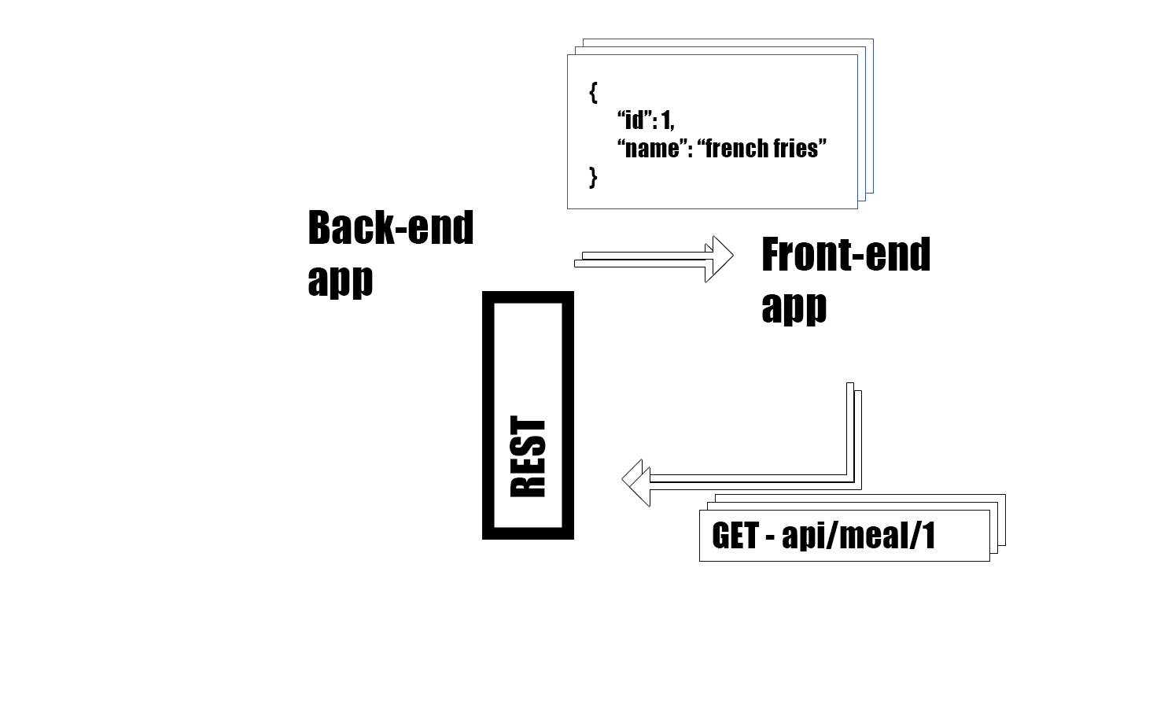

Slide 6
Current workflow of an API
- Front-end asks for a resource
- Backend analyse the request
- Backend queries the db
- DB returns the data
- Backend returns the resource

Slide 7
Works well but...

Slide 8
...what’s happen if the response is too complex ?

Slide 9
At Facebook, they have (I guess) User Stories like this one

Slide 10
As a user I want to know if one of my n+2 friend likes french fries and only this

Slide 11

{}
{{}}
{{{}}}

Slide 12
GET /users/me
{
“user”: {
[…] friends: [1, 2, 3, 4...]
}
}

Slide 13
GET /users/me
{
“user”: {
[…] friends: [1, 2, 3, 4...]
}
}
Oh wait, I need my friends’ friends

Slide 14
GET /users/me
GET /users/23
{
“user”: {
[…] friends: [1, 2, 3, 4...]
}
}

Slide 15
GET /users/me
GET /users/23
{
“user”: {
[…] friends: [1, 2, 3, 4...]
}
}
Oh wait, I need my friends’ friends’ friends

Slide 16
For n+2 level friend’s info, I need to do, at least, three requests

Slide 17
And there’s more problems!

Slide 18
Problems
- Bunch of useless keys returned*
- Use bandwidth intensively
- Multiple queries
- Can lead to complex queries
- Multiple endpoints (One for each CRUD part)
* Yeah, we can pass has parameters which ones I need, but… no

Slide 19
Change request !

Slide 20
The product owner doesn’t want this feature anymore

Slide 21
But what about the old version of the app?

Slide 22
I can’t remove the key “love_french_fries”.*
* Yeah, we can create a new version of the API, but… no

Slide 23
What about new developers and API’s documentation ?

Slide 24
I forgot to create a swagger file.

Slide 25
Facebook devs had to handle this often, too often

Slide 26
So they created GraphQL

Slide 27
GraphQL
Developed by Facebook
Used internally since 2012
Open sourced in July 2015
Exists for almost all backend languages
Sources
https://graphql.org/learn/queries/

Slide 28
GraphQL
No new server type

Slide 29
GraphQL
No new server type
No new programming language

Slide 30
Just a data query langage for your APIs

Slide 31
You get only what you want, what you need

Slide 32
Workflow with GraphQL

Slide 33
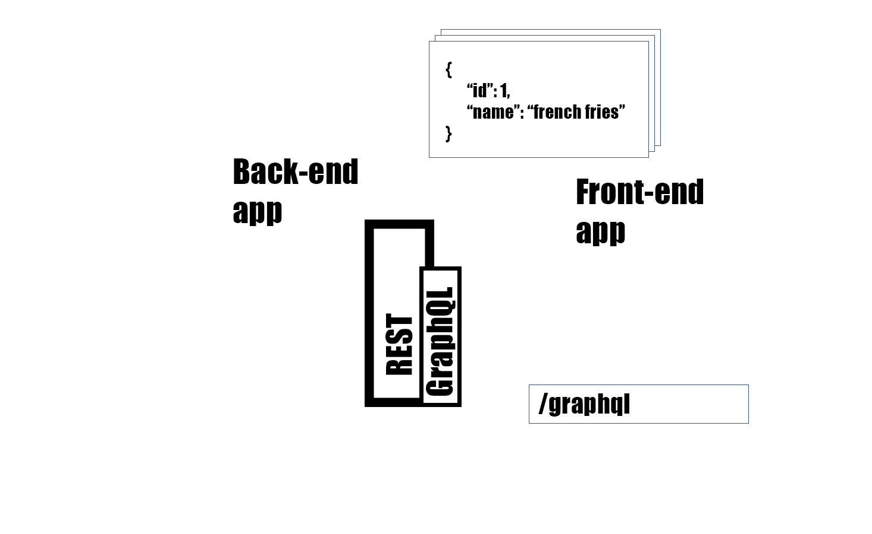

Slide 35
Let’s summary our main problems with the old way

Slide 36
Main problems with the old way
- Over-fetching (useless keys)
- Documentation
- Multiple queries

Slide 37
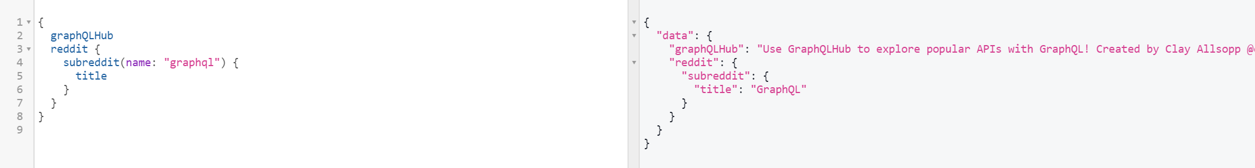
Over-fetching

Slide 38
Over-fetching

Slide 39
Over-fetching*
* It also fixes the issue with the API versioning

Slide 40
Documentation
GraphQL need a data schema in order to work and to create the documentation automatically

Slide 41
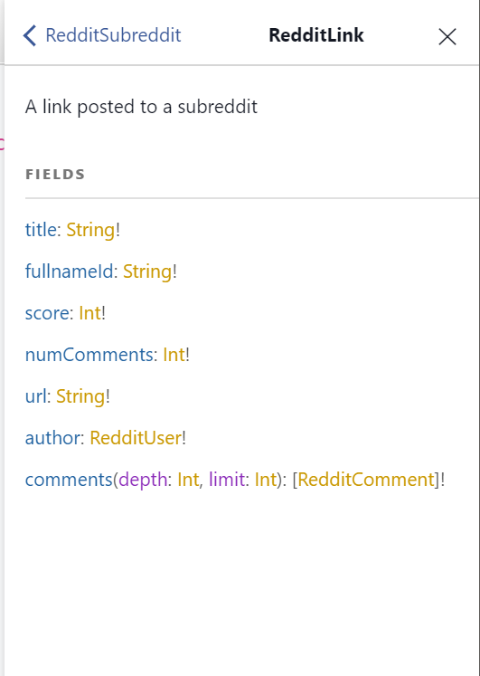
Documentation

Slide 42
Documentation

Slide 43
Documentation

Slide 44
Multiple queries
- We provide a data schema to GraphQL

Slide 45
Multiple queries
- We provide a data schema to GraphQL
- The data schema contains entities relationships

Slide 46
Multiple queries
- We provide a data schema to GraphQL
- The data schema contains entities relationships
- And we get in one query everything we need

Slide 47
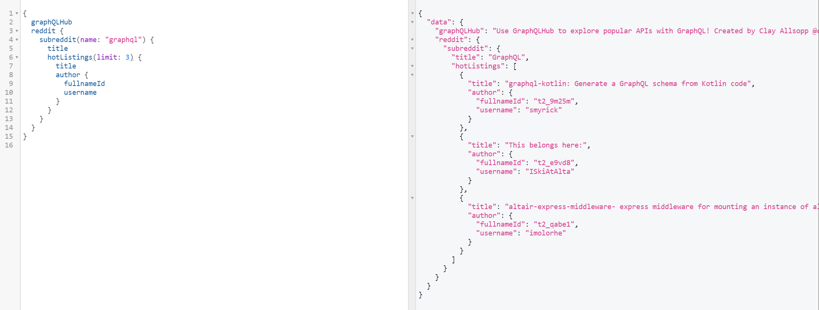
Multiple queries

Slide 48
Multiple queries

Slide 49
Multiple queries

Slide 50
All of our problems are fixed

Slide 51
GraphQL other nice features
- fragment
- mutations (for RUD of CRUD)
- query aliases
- filters
- directives
- and more
Sources
https://graphql.org/learn/queries/

Slide 52
Demo

Slide 53
Who’s using GraphQL?
- Facebook
- GitHub
- Pinterest
- Allocine
- Shopify
...
Sources
https://graphql.org/users/

Slide 54
Who’s using GraphQL?
- Facebook
- GitHub
- Pinterest
- Allocine
- Shopify
...
- You?
Sources
https://graphql.org/users/

Slide 55
Who’s using GraphQL?
- Facebook
- GitHub
- Pinterest
- Allocine
- Shopify
...
- You?
- Your backend developers?
Sources
https://graphql.org/users/

Slide 56
Summary / conclusion
- GraphQL is not a new programming language
- It allows to “get only what you want” from backend
- Fixes frequent problems with “classic API”

Slide 58
Questions ?

Slide 60
More resources
- Presentation + examples: https://github.com/DanYellow/presentations/tree/master/graphql
- GraphQL playgrounds: http://apis.guru/graphql-apis/ deez
- Official documentation: https://graphql.org/
Notes:
Twitter encourages to use npm now

