Slide 1
Let’s talk about unit tests.
April 2018

Slide 2
Danielo JEAN-LOUIS
Front-end developer

Slide 3
What’s unit tests?
“Method of testing each unit of code to test if they work well as an unit”.

Slide 4
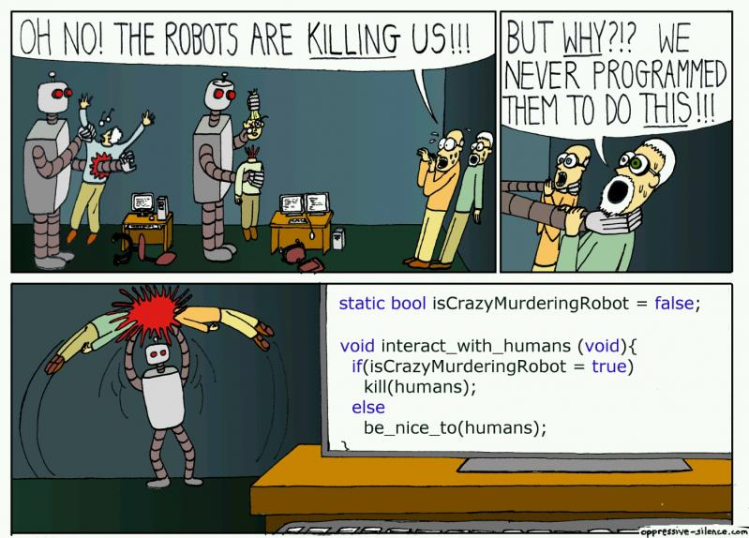
Why unit tests?

Slide 5
Why unit tests?
- Reduce the number of tickets / bugs
- Improve code quality / reduce complexity
- Encourage modularity
- Ensure old functionalities behaviors even if the code change (!)
- Document code
Sources
- https://medium.com/javascript-scene/what-every-unit-test-needs-f6cd34d9836d

Slide 6
But your code has to be ready for it

Slide 7
Pure function is the first step

Slide 8
Pure function
- No side effects
- Doesn’t update variables outside its own scope
- Always return the same results
- E.g.: Math.random() (js) is impure

Slide 9
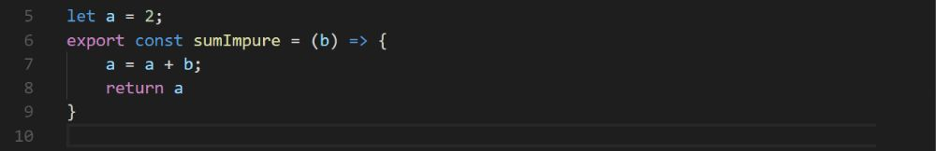
Example
Impure function
let a = 2;
export const sumImpure = (b) => {
a = a + b; // Access var outsite func
return a
}

Slide 10
Let’s test it...

Slide 11
with Jest

Slide 12
Jest
- Unit test framework
- Created by facebook
- Agnostic but made to work well with React
- Inspired by Jasmine
- Allows snapshot tests
- Jest = Jasmine + sinon + istanbul
Sources
- https://facebook.github.io/jest/

Slide 13
Now test our function

Slide 14
Example
Pure function
export const sumPure = (a=0, b=0) => {
return a + b;
}

Slide 15
It works well but...

Slide 16
Did we manage every case?

Slide 17
Code coverage
- Works hand in hand with unit tests
- Detects useless code
- Forces to manage every case
- Returns the percentage of code executed
- “--coverage” param with Jest
- Jest relies on istanbul for it

Slide 18
Let’s check the coverage

Slide 19
Code coverage details
Statements (Stmts):
Proportion of statements / instructions executed
Example: const a = 42; // It’s a statement
Branches (Branch):
Conditional statements executed (if / else, switch...)
Sources
- https://www.w3schools.com/js/js_statements.asp
- http://2ality.com/2012/09/expressions-vs-statements.html
- https://github.com/dwyl/learn-istanbul

Slide 20
Code coverage details
Functions (Funcs):
Proportion of functions / methods called
Lines (lines):
Proportion of lines executed
Sources
- http://2ality.com/2012/09/expressions-vs-statements.html
- https://github.com/dwyl/learn-istanbul

Slide 21
Let’s improve the coverage

Slide 22
Code coverage details
- /coverage/ to get more details about the latest code coverage

Slide 23
100 % code coverage, it’s not a dream.
It can be a reality.

Slide 24
Best practices
- Be explicit (You know what you’re testing)
- Don’t try to replace QA / functional tests
- Add them to your precommit
- TDD (Write your test then code)
- Define a naming convention
- Create a mocks folder for your mocked data
- Considerate unit tests as a task

Slide 25
Best practices - Mocking
export const listItemsTpl = (apiRes) => (
apiRes
.filter(entry => entry.name)
.map(entry => (
`<li>${entry.name}</li>`
))
)

Slide 26
Best practices - Mocking
- Avoid (real) API calls
- Improves unit tests’ speed
- Enforce the concept:
One function, one functionality

Slide 27
Conclusion
- Unit testing allows to improve code quality / reduces number of bugs
- Code coverage detects useless code
- Unit tests mustn’t replace QA. Functional tests exist for this.

Slide 28
Questions ?

Slide 29
More sources
- Presentation + examples : https://github.com/DanYellow/presentations/tree/master/unit-tests
Notes:
Twitter encourages to use npm now

