Slide 1
React and Redux 101
July 2018

Slide 2
Danielo JEAN-LOUIS
Front-end developer

Slide 3
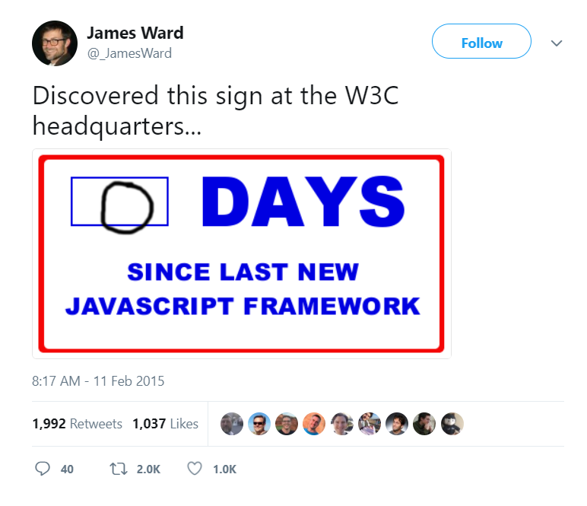

Slide 4
An (another) javascript framework

Slide 5
An (another) javascript framework library!
Sources
http://www.nicoespeon.com/en/2015/01/pure-functions-javascript/
https://web.archive.org/web/20070504053354/http://www.ddj.com/blog/architectblog/archives/2006/07/frameworks_vs_l.html

Slide 6
What’s React ?
- Javascript library developped, open sourced and maintened by facebook
- Designed for (large) applications with data that change over the time
- Released in 2013
- Dogfeed by facebook with facebook and instagram

Slide 7
What’s React ?
- Javascript library developped, open sourced and maintened by facebook
- Designed for (large) applications with data that change over the time
- Released in 2013
- Dogfeed by facebook with facebook and instagram
- Relies on Virtual DOM

Slide 8
What’s React ?
- Javascript library developped, open sourced and maintened by facebook
- Designed for (large) applications with data that change over the time
- Released in 2013
- Dogfeed by facebook with facebook and instagram
- Relies on Virtual DOM
Extremely fast

Slide 9
What’s React ?
- No MVC
- No MVVM
- No DM-VM-CM-VC-V*
- ...
Sources
https://github.com/xlasne/MVVM-C

Slide 10
React is only view

Slide 11
React is only view
React is components

Slide 12
React components are
Reusable
Testable
Maintainable

Slide 13
React components are not Web components
Web components are for strong encapsulation
React components are made to be sync with data
Sources
https://facebook.github.io/react/docs/webcomponents.html

Slide 14
Let’s write our first component
import React from 'react'; export default class MyFirstComponent extends React.Component { render() { return (
<p>It’s my first component with React !</p>
);
}
Sources
https://facebook.github.io/react/docs/webcomponents.html

Slide 15
Let’s write our first component
import React from 'react'; export default class MyFirstComponent extends React.Component { render() { return (
<p>It’s my first component with React !</p>
);
}
render() method displays the template of the component
Sources
https://facebook.github.io/react/docs/webcomponents.html

Slide 16
Let’s write our first component
import { render } from 'react-dom' import MyFirstComponent from ‘./MyFirstComponent’ render(
<MyFirstComponent />, document.getElementById(‘content’)
);
We start the React app
(A div can contain only one react app)

Slide 17
Component’s life cycle
Mount
Update
Unmount
Sources
https://reactjs.org/docs/react-component.html#the-component-lifecycle

Slide 18
Component’s life cycle
Mount
Update
Unmount
Error handling
Sources
https://reactjs.org/docs/react-component.html#the-component-lifecycle

Slide 19
Props and state
Props and state allow to change/set component’s content/data
Props are immutable
Props are read-only
Props are passed only by the closest parent
Sources
https://reactjs.org/docs/react-component.html#the-component-lifecycle

Slide 20
Props and state
Props and state allow to change/set component’s content/data
Props are immutable
Props are read-only
Props are passed only by the closest parent
State is mutable
State is handled by the component itself
Sources
https://reactjs.org/docs/react-component.html#the-component-lifecycle

Slide 21
Props and state
Props and state allow to change/set component’s content/data
Props are immutable
Props are read-only
Props are passed only by the closest parent
State is mutable
State is handled by the component itself
Update component’s state will call component’s render method
Sources
https://reactjs.org/docs/react-component.html#the-component-lifecycle

Slide 22
Props and state
Props and state allow to change/set component’s content/data
Props are immutable
Props are read-only
Props are passed only by the closest parent
State is mutable
State is handled by the component itself
Update component’s state will call component’s render method
Sources
https://reactjs.org/docs/react-component.html#the-component-lifecycle

Slide 23
Do not update state inside render!

Slide 24
Props and state
import React from 'react'; import MyChildComponent from ‘./my-child-component’; export default class MyFirstComponent extends React.Component { constructor(props) {
// [...] this.state = { hello: “el mundo”
} setTimeout(this.myMethod, 5000);
} myMethod() { this.setState({ hello: “world”
})
} render() { return (
<MyChildComponent text={this.state.hello} />
);
}

Slide 25
Example – state & props

Slide 26
Data flow (up)
Use callback function to communicate with the closest parent

Slide 27
Example – callback

Slide 28
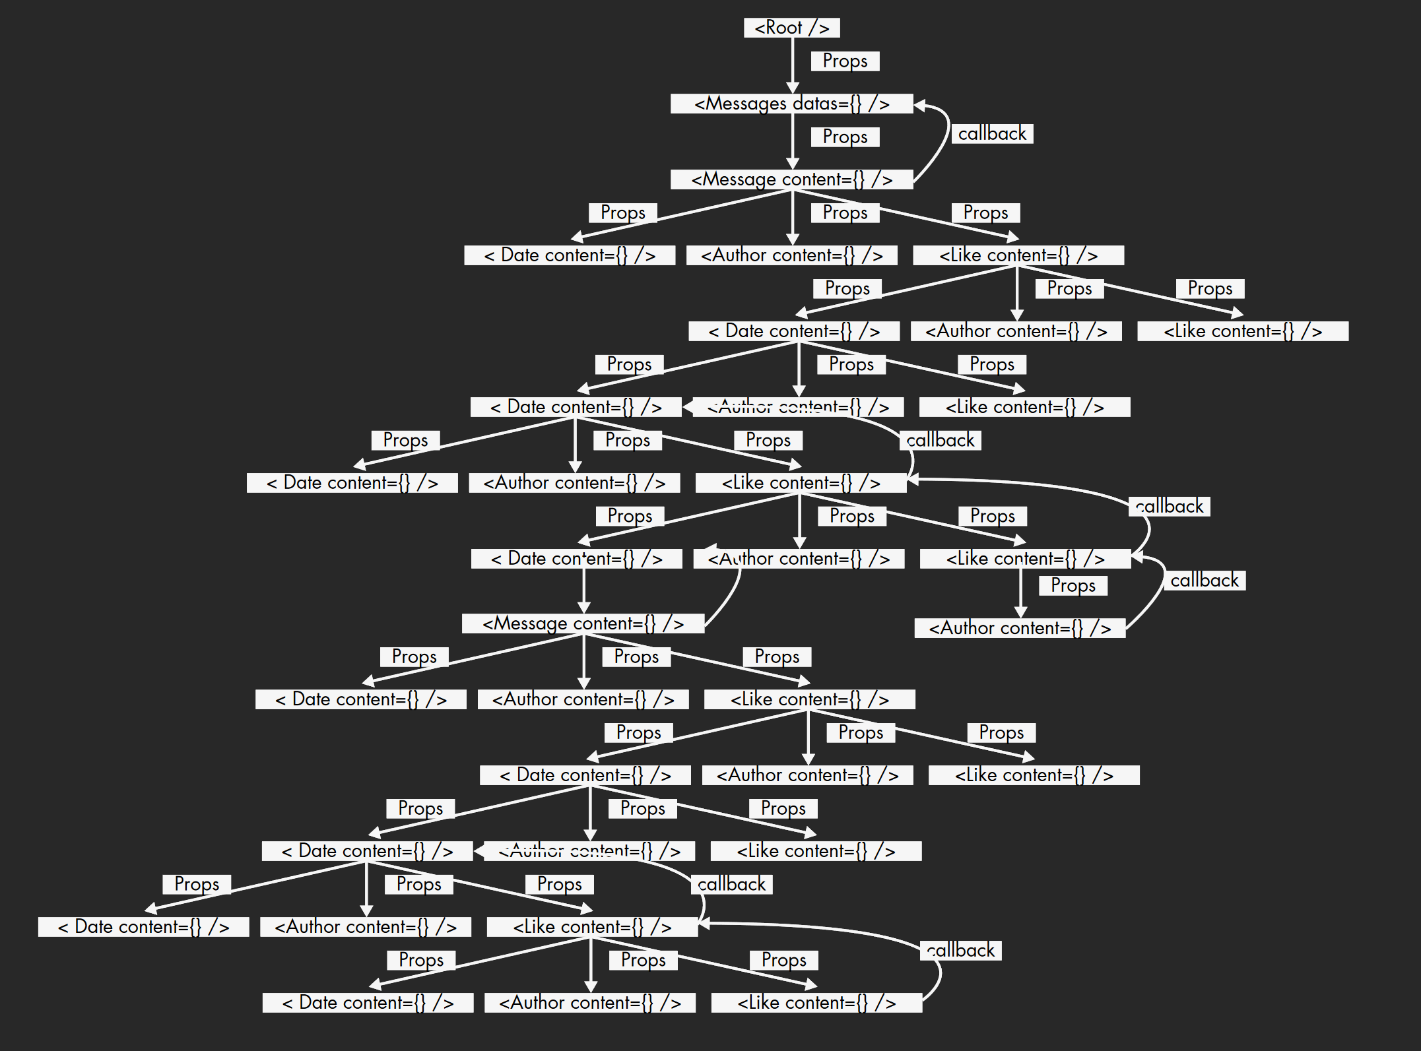
Data flow (up)

Slide 29


Slide 30
First part summary
React is only view in the MVC pattern
React relies on VDOM, it’s fast thank to it
JSX is strongly encouraged for templating
React allows a full control of the component with its lifecycle
Props allows parent to set/update children’s data
Props are immutables

Slide 31
First part summary
React is only view in the MVC pattern
React relies on VDOM, it’s fast thank to it
JSX is strongly encouraged for templating
React allows a full control of the component with its lifecycle
Props allows parent to set/update children’s data
Props are immutables
State is updated by the component itself
State is mutable

Slide 32
First part summary
React is only view in the MVC pattern
React relies on VDOM, it’s fast thank to it
JSX is strongly encouraged for templating
React allows a full control of the component with its lifecycle
Props allows parent to set/update children’s data
Props are immutables
State is updated by the component itself
State is mutable
The data flow (up) in React is a mess... except if we use...

Slide 33


Slide 34
What’s Redux ?
Predicable state container for any javascript application
With Redux, a React app has only one state for the whole app

Slide 35
Dataflow (up and down) without Redux

Slide 36
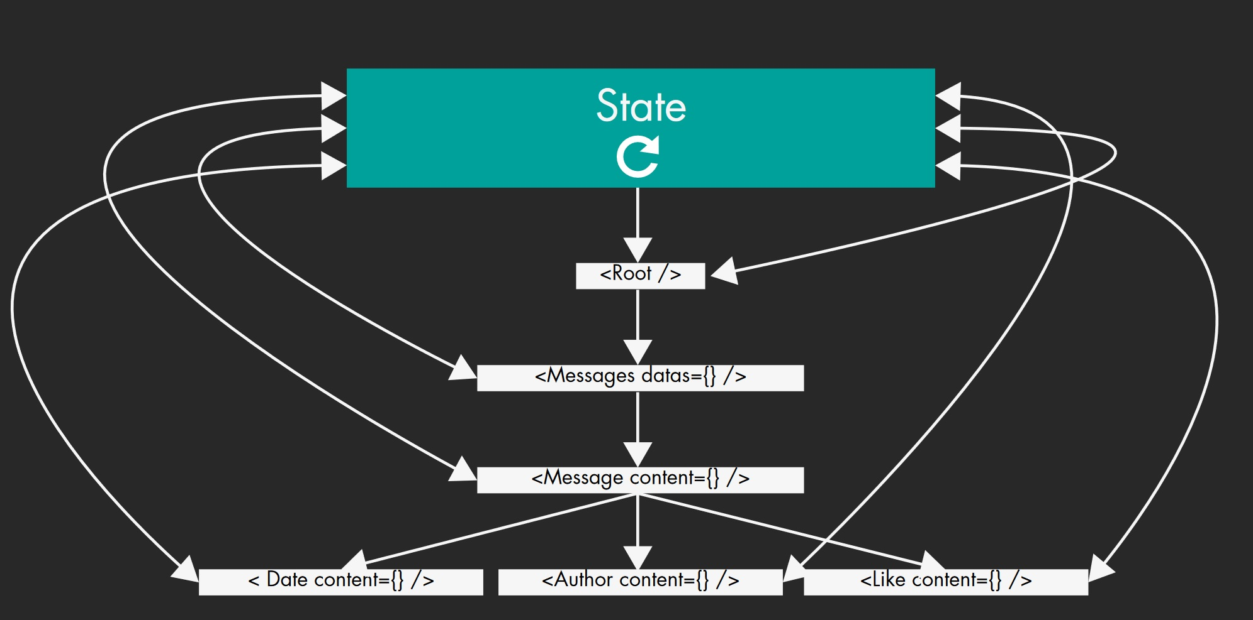
Dataflow (up and down) with Redux

Slide 37
Redux’s principles
- Single source of truth
- State is immutable
- Changes are made with pure and synchronous functions
Sources
https://github.com/reactjs/redux/blob/master/docs/introduction/ThreePrinciples.md
https://en.wikipedia.org/wiki/Pure_function

Slide 38
Redux’s advantages
- Easier to debug ReactJS apps ; All data transit in the same place
- Brings (M)VC pattern to React (React is only View)
- Limits corrupted datas ; Redux rewrites state at each change
Sources
https://github.com/reactjs/redux/blob/master/docs/introduction/ThreePrinciples.md
https://en.wikipedia.org/wiki/Pure_function

Slide 40
Example – todo-list

Slide 41
« You might get the wrong impression from over-engineered tutorials and all the stuff that community has built around it.
But Redux itself is very simple. »
Dan Abramov, Redux’s co-creator
Sources
https://www.reddit.com/r/reactjs/comments/4npzq5/confused_redux_or_mobx/d46k2bl
http://www.slideshare.net/tedpennings/how-to-redux
http://redux.js.org/index.html

Slide 42
For further

Slide 43
Context API – React ≥ 16.3
import React from 'react'; import MyChildComponent from ‘./my-child-component’; export default class MyFirstComponent extends React.Component { constructor(props) {
// [...] this.state = { hello: “el mundo”
} setTimeout(this.myMethod, 5000);
} myMethod() { this.setState({ hello: “world”
})
} render() { return (
<MyChildComponent text={this.state.hello} />
);
}

Slide 44
Web extensions (Chrome and FF)
- React
- redux dev-tools

Slide 45
Architecture
- redux-ducks https://github.com/erikras/ducks-modular-redux

Slide 47
Questions ?

Slide 49
But your code has to be ready for it

Slide 50
Jest
- Unit test framework for javascript
- Created by facebook
- Agnostic but made to work well with React
- Inspired by Jasmine
- Allows snapshot
- Jest = Jasmine + sinon + istanbul
Sources
- https://facebook.github.io/jest/

Slide 51
Pure function is the first step

Slide 52
Pure function
- No side effects
- Doesn’t update variables outside its own scope
- Always return the same results
- E.g.: Math.random() (js) is impure
Sources
- http://www.nicoespeon.com/en/2015/01/pure-functions-javascript/
- https://medium.com/javascript-scene/master-the-javascript-interview-what-is-a-pure-function-d1c076bec976

Slide 53
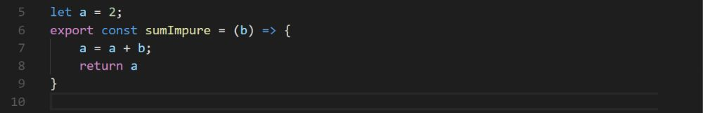
Example
Impure function
let a = 2;
export const sumImpure = (b) => {
a = a + b; // Access var outsite func
return a
}

Slide 54
Let’s test it...

Slide 55
with Jest

Slide 56
Jest
- Unit test framework for javascript
- Created by facebook
- Agnostic but made to work well with React
- Inspired by Jasmine
- Allows snapshot
- Jest = Jasmine + sinon + istanbul
Sources
- https://facebook.github.io/jest/

Slide 57
Now test our function

Slide 58
Let’s analyze the command
jest* impure.test.js
* Assuming jest is installed in global or run from our npm scripts.
If not you’ll need to prefix it with ‘node_modules/.bin/’

Slide 59
Let’s analyze the command
jest* impure.test.js
Jest command
File(s) to test
* Assuming jest is installed in global or run from our npm scripts.
If not you’ll need to prefix it with ‘node_modules/.bin/’

Slide 60
Example
Pure function
export const sumPure = (a=0, b=0) => {
return a + b;
}

Slide 61
It works well but...

Slide 62
Did we manage every case?

Slide 63
Code coverage
- Works hand in hand with unit tests
- Detects useless code
- Forces to manage every case / scenario
- Returns the percentage of code executed
- “--coverage” param with Jest
- Jest relies on istanbul for it

Slide 64
Let’s check the coverage

Slide 65
Code coverage details
Statements (Stmts):
Proportion of statements / instructions executed
Examples: const a = 42; // It’s a statement const b = 42; console.log(b) // It’s two statements
Branches (Branch):
Conditional statements executed (if / else, switch...)
Sources
- https://www.w3schools.com/js/js_statements.asp
- http://2ality.com/2012/09/expressions-vs-statements.html
- https://github.com/dwyl/learn-istanbul
- https://github.com/gotwarlost/istanbul/issues/639

Slide 66
Code coverage details
Functions (Funcs):
Proportion of functions / methods called
Lines (lines):
Proportion of lines executed
Sources
- http://2ality.com/2012/09/expressions-vs-statements.html
- https://github.com/dwyl/learn-istanbul

Slide 67
Let’s improve the coverage

Slide 68
Code coverage details
- /coverage/ to get more details about the latest code coverage

Slide 69
100 % code coverage, it’s not a dream.
It can be a reality.

Slide 70
Best practices
- Be explicit (You know what you’re testing)
- Don’t try to replace QA / functional tests
- Add them to your precommit
- TDD (Write your test then code)
- Define a naming convention
- Create a mocks folder for your mocked data
- Considerate unit tests as a task

Slide 71
Best practices - Mocking
export const listItemsTpl = (apiRes) => (
apiRes
.filter(entry => entry.name)
.map(entry => (
`<li>${entry.name}</li>`
))
)

Slide 72
Best practices - Mocking
- Avoid (real) API calls
- Improves unit tests’ speed
- Enforce the concept:
One function, one functionality /
Single Responsibility Principle
Sources
- https://en.wikipedia.org/wiki/Single_responsibility_principle

Slide 73
Conclusion
- Unit testing allows to improve code quality / reduces number of bugs
- Code coverage detects useless code
- Unit tests mustn’t replace QA. Functional tests exist for this.

Slide 74
More sources
- Presentation + examples : https://github.com/DanYellow/presentations/tree/master/unit-tests
Notes:
Twitter encourages to use npm now

