Slide 1

THABAT
SATELLITE-BASED ROAD RESILIENCE
Satellite-based environmental screening and inspection prioritisation for UAE road corridors
Team: Thabat Team
Theme 5: Sustainable Urban Planning and Smart Cities
Country: United Arab Emirates
Notes:
Title. Insert the THABAT logo, team name and hackathon theme in the marked placeholders. One-liner: THABAT screens road segments using Earth-observation evidence to help teams decide where to inspect first.

Slide 2
Road health is monitored reactively
02 · THE PROBLEM AND WHO IS AFFECTED
Environmental exposure
WHO IS AFFECTED
Heat, rainfall, surface conditions
1
Road authorities
Responsible for network condition
Potential road stress
2
Infrastructure / asset managers
Varies across roads and locations — not proof of damage
Decide where effort goes
3
Maintenance teams
Large road network
Act on what gets flagged
Too many segments to inspect often
4
Inspectors
Limited inspection resources
Cannot be everywhere at once
Teams and time are finite
5
Road users
Ultimately feel the outcome
Need to prioritise inspections
Exposure ≠ damage. Environmental stress is a reason to look — not proof of failure.
Where should we look first?
Notes:
Authorities cannot physically inspect every segment frequently, and environmental stress varies across locations. We do not claim exposure equals damage; the problem is prioritisation under limited inspection capacity.

Slide 3
From satellite evidence to inspection priority
03 · BUSINESS USE CASE AND END USER
END USER
TODAY
THABAT
Road / infrastructure asset-management teams
Inspect broadly and react to problems
Screen → rank → inspect priority segments
THE DECISION
“Where should we inspect first?”
Little visibility of where environmental stress is concentrated
A ranked, explainable inspection queue — not an engineering verdict
Satellite data
Environmental evidence
Road-segment scoring
Inspection priority
THABAT is a screening and prioritisation layer — not an engineering replacement.
Notes:
End user: asset-management teams. Decision: where to inspect first. THABAT is a screening layer that ranks segments for physical inspection; it does not certify condition or replace engineering assessment.

Slide 4
Multi-source Earth observation for road resilience
04 · DATA
Source | Resolution | What it contributes | Role in THABAT | Status
Landsat 9 C2 L2 surface temperature | ~100 m thermal (30 m product) | Segment thermal statistics, AOI-A and AOI-B | Thermal screening evidence; not pavement proof | Used
Sentinel-2 L2A | 10–20 m multispectral | 19 Sep vs 4 Oct 2026 comparison | Context; cannot resolve fine defects | Used
Hyperspectral (EnMAP / Tanager) | ~30 m, ~230 bands (EnMAP) | Spectral / material discrimination | Intended spectral layer | Investigated; AOI-A coverage not confirmed
Road segments (ArcGIS Pro) | Vector | A-001–A-005 and B-001–B-004 | Unit of aggregation | Used
Rainfall / environment | To be confirmed | Event and moisture context | Future layer | Not integrated
VHR / Satellite 813 | Dataset-dependent | Pavement and geometry validation | Only with coverage and usage rights | Not confirmed
Resolutions are nominal sensor values, not the scale at which pavement condition can be assessed.
Notes:
Each source and its honest role. Landsat thermal is broad contextual evidence. Sentinel-2 provides context but cannot resolve fine pavement defects. Hyperspectral coverage over AOI-A is not confirmed. VHR only if legally usable. Rainfall is a next-step input and is not integrated in the PoC.

Slide 5
Why hyperspectral matters
04 · HOW HYPERSPECTRAL DATA IS USED
Multispectral — few broad bands
Narrow feature averaged out
OUR INTENDED ROLE
Hyperspectral can help identify unusual spectral behaviour that may justify inspection.
Wavelength →
Schematic — illustrative, not measured data
Hyperspectral — many narrow bands
Narrow feature resolved
WHAT WE DO NOT CLAIM
That hyperspectral detects pavement damage.
CURRENT STATUS
EnMAP and Tanager investigated; AOI‑A coverage not confirmed. Not used in current results.
Wavelength →
Schematic — illustrative, not measured data
Notes:
Multispectral instruments sample a few broad bands, which can average out narrow spectral features. Hyperspectral samples many narrow bands. The graphic is a schematic, not data. Our claim is limited: hyperspectral can flag unusual spectral behaviour that may justify inspection. It does not detect pavement damage. EnMAP and Tanager were investigated; coverage of AOI-A is not confirmed.

Slide 6
How THABAT works
05 · APPROACH / WORKFLOW
1
2
3
4
5
Road segments
Landsat 9 surface temperature
Segment thermal statistics
Quality and sanity checks
Robust standardisation
ArcGIS Pro: A2011001–A2011005, B2011001–B2011004
DN → Kelvin → °C; DN = 0 is nodata
Median, range, valid pixels
Support: high / medium / low
Median and range standardised
6
7
8
CONTEXT CHECK
OUTPUT
Anomaly + spread
Screening priority
Tables and figures
Sentinel-2 L2A visual comparison, 19 Sep ↔ 4 Oct 2026
A ranked, explainable inspection queue
max(z_median, 0) + max(z_range, 0)
Higher / lower, with support flag
Exported to results/ by the notebook
FUTURE LAYERS · NOT IN CURRENT RESULTS
Hyperspectral fusion
Rainfall / environment
VHR / Satellite 813
Field validation
Notes:
Only implemented steps are shown as solid cards; future layers are dashed. Method from notebook 02_main_analysis.ipynb: Kelvin = DN x 0.00341802 + 149.0, degC = Kelvin - 273.15, DN = 0 treated as nodata. Score = max(z_median,0) + max(z_range,0). Support thresholds (30+ / 10-29 / <10 valid pixels) are reporting thresholds for transparency, not a calibrated confidence model.

Slide 7
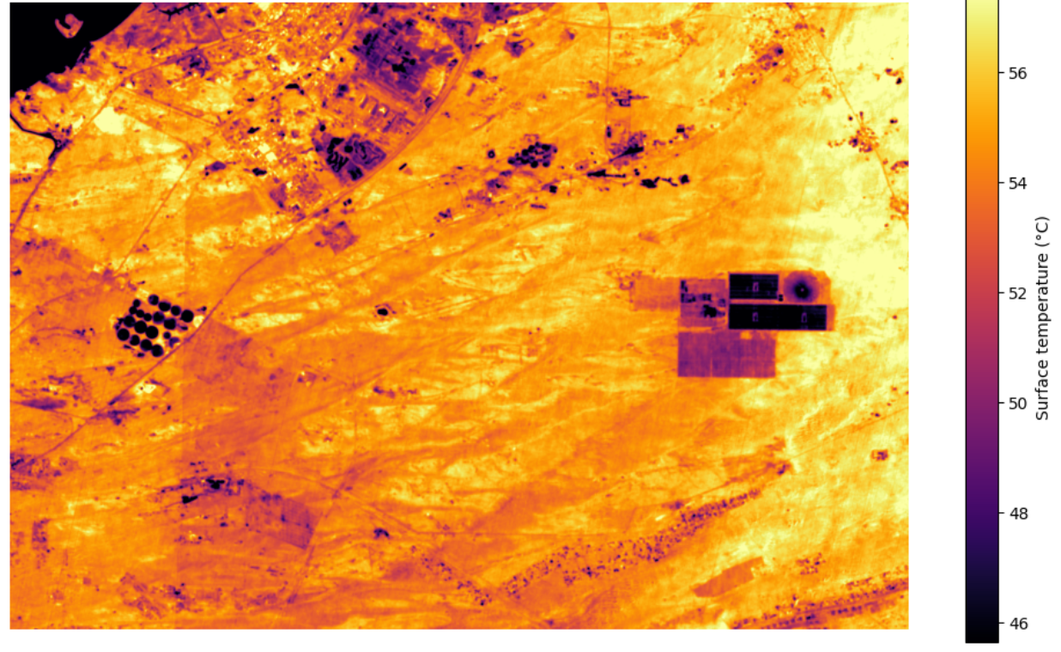
What THABAT produces
06 · EXAMPLE OUTPUTS · 1 OF 2
STUDY AREA
AOI-A — Saih Al Salam Street D42
SEGMENTS
A-001 – A-005 (88–91 px each)
SCENE
Landsat 9 C2 L2
LC09_L2SP_160043_20260831_02_T1
Landsat surface-temperature context for AOI-A
ACQUIRED
31 August 2026
Reported cloud cover: 0%
CONVERSION
K = DN × 0.00341802 + 149.0
°C = K − 273.15; DN = 0 → nodata
Landsat 9 surface-temperature context (°C), 31 Aug 2026 — DN 0 masked as no-data; segment statistics are shown on the next slide
Notes:
Core slide. Replace the placeholder with the AOI-A thermal map (Landsat_ST_AOI_Clip.tif, or the figure regenerated from 02_main_analysis.ipynb). Do not use the old summary PNGs: their scoring logic has changed. Scene: LC09_L2SP_160043_20260831_02_T1, 31 Aug 2026, 0% reported cloud cover.

Slide 8
From measurements to segment-level evidence
06 · EXAMPLE OUTPUTS · 2 OF 2
AOI-B — LOW SUPPORT
Segment | Median LST °C | Valid pixels | Thermal screening
B-001 | 24.310 | 2 | Lower priority / low support
B-002 | 24.950 | 3 | Moderate / low support
B-003 | 24.250 | 3 | Lower priority / low support
B-004 | 24.690 | 3 | Lower priority / low support
Only 2–3 valid thermal pixels per segment: not equivalent to AOI-A evidence.
AOI-A — HIGH SUPPORT · 88–91 VALID PIXELS PER SEGMENT
Segment | Median LST °C | Range °C | Valid pixels | Support | Thermal screening | Sentinel-2 context
A-001 | 54.602 | 4.013 | 88 | HIGH | Higher priority | No obvious visual change
A-002 | 54.197 | 1.025 | 90 | HIGH | Lower priority | No obvious visual change
A-003 | 54.035 | 1.241 | 90 | HIGH | Lower priority | No obvious visual change
A-004 | 54.233 | 2.041 | 91 | HIGH | Lower priority | No obvious visual change
A-005 | 55.607 | 3.391 | 91 | HIGH | Higher priority | No obvious visual change
Chart axis starts at 52 °C. Source: supplied segment statistics, Landsat 9 C2 L2 ST. Flags are relative screening outputs, not engineering verdicts.
Notes:
Real values from the supplied segment statistics. Screening priority = max(z_median,0) + max(z_range,0); A-001 and A-005 flag higher. AOI-B has only 2-3 valid pixels per segment, so it is shown for transparency and is not equivalent evidence. Sentinel-2 wording: no obvious visual change in the tested comparison, never no deterioration. Regenerate the CSV and figures from the final notebook so deck and repo match exactly.

Slide 9
What we can prove — and what we cannot
07 · VALIDATION AND LIMITATIONS
EVIDENCE — WHAT HAS BEEN CHECKED
LIMITATION → WHAT THABAT IS DESIGNED TO DO NEXT
AOI-A: five segments, 88–91 valid thermal pixels each (high support)
Thermal anomaly is not proof of pavement damage
✓
→ Screens for inspection priority only
Landsat 9 DN → Kelvin → °C conversion; DN = 0 treated as nodata
AOI-B has only 2–3 valid pixels per segment
✓
→ Low support; needs finer thermal / VHR data
Sentinel-2 is a visual context check
Support flagged per segment: 30+ high, 10–29 medium, under 10 low
→ Not fine-defect detection
✓
Hyperspectral, rainfall, VHR not in results yet
Sentinel-2 L2A, 19 Sep vs 4 Oct 2026: no obvious visual road-surface change
→ Conditional on coverage and usage rights
✓
Support thresholds are not calibrated confidence
→ Calibrate against field data
AOI-B flagged low support: only 2–3 valid thermal pixels per segment
!
No field validation yet
→ Compare with inspection and maintenance records
Notes:
Credibility slide. Left: what was actually checked. Right: limitations, each framed as what THABAT is designed to do next. AOI-B is shown honestly as low support. Sentinel-2 showed no obvious visual change in the tested views, so we make no deterioration claim. Physical inspection remains necessary.

Slide 10
Why THABAT matters
08 · IMPACT
Satellite coverage
Scalable screening
Better prioritisation
Targeted inspection
Proactive maintenance
POTENTIAL VALUE
Prioritise inspections
Reduce unnecessary inspection effort
Identify stressed corridors
Rank segments by evidence
Potential benefit, to be validated
Spot environmentally stressed road corridors
Support proactive maintenance
Create a scalable evidence layer
Allocate resources more intelligently
Shift from reactive toward proactive
A common layer for road authorities
Targeted, explainable decisions
Qualitative impact only — no savings or percentages are claimed until validated.
Notes:
Impact is qualitative. We do not state financial savings or percentage gains because none are verified. Value comes from scalable screening feeding better-targeted inspection.

Slide 11
From PoC to operational road intelligence
09 · NEXT STEPS FOR INCUBATION
NOW
NEXT
NEXT
NEXT
NEXT
FUTURE
Working thermal-screening PoC
Better pavement representation
Environmental fusion
Hyperspectral fusion
Field validation
Scale and operational dashboard
AOI-A strong; AOI-B low support
VHR, or Satellite 813 if provided
Rainfall and event history
If EnMAP / Tanager cover the AOI
Inspection and maintenance records
More corridors; automated ingestion
INCUBATION POTENTIAL
Additional road corridors
Larger datasets
Automated data ingestion
Stronger validation
Deployment with road authorities
THABAT turns Earth-observation data into a smarter starting point for road inspection.
Notes:
Roadmap: working PoC now; then better pavement representation, rainfall and other environmental inputs, field validation, and more roads; ultimately an operational dashboard. Incubation would add corridors, larger datasets, automated ingestion, stronger validation and deployment with road authorities.

