Slide 1
BOOK-CROSSING DATASET Data cleaning and EDA
Dana Drouskin

Slide 2
Project Description
Data
The Book-Crossing Dataset collected by Cai-Nicolas Zeigler includes 3 files containing users information, books information and book-ratings
Objectives
Analyze the demographics of users – age and location
Analyze the relationship between implicit and explicit book ratings behavior.
Analyze Books/Authors/Publishers popularity

Slide 3
Dataset Collection
Books
ISBN
Ratings
Users
Book-Title
Book-Author
Year-Of-Publication
Publisher
Image-URL-S
Image-URL-M
Image-URL-L
271,379 rows
1,048,575 rows
278,859 rows
User-ID
Location
Age
User-ID
ISBN
Book-Rating
Dimension
Fact
Dimension

Slide 4
Workflow and Tools
Data Cleaning
Spark Environment in Google Colab
Data Visualization
Tableau
Insights
Libraries: pyCountry, isbnlib, python-Levenshtein

Slide 5
What’s an ISBN?
A unique numeric identifier assigned to each publication
The ISBN is 10-digits long if assigned before 2007, and 13-digits long if assigned afterwards
Characters are either 0-9 or the uppercase letter ‘X’

Slide 6
Data Cleaning and Preparation - Books
ISBN Column Transformations:
Uppercase - to avoid lowercase letter ‘x’.
There are 118 ISBNs which contain invalid characters.
All invalid ISBN characters removed.
Most ISBNs in the data are 10-digits long. There are 117 ISBNs with length different than 10.
Use of isbnlib which provides methods and functions to validate, clean and transform ISBNs.
A udf defined to transform the ISBN column per the validate_isbn() function rules.
Ended up with 114 ISBNs that couldn’t be validated and turned to nulls.
Dropped null and duplicate ISBNs as this column is a key to later connect with the Ratings dataframe.
A row added, which is ‘Unknown’ (or -1) for all fields, as a preparation for later relating Ratings dataframe with the Books dataframe. This will allow keeping all rows in the fact table, even for ratings per ISBNs that aren’t available in the Books table.
Dropped the 3 URL columns as they are irrelevant for the analysis.

Slide 7
Data Cleaning and Preparation - Books
Book-Title, Book-Author and Publisher Columns Transformations:
Used regexp_replace() to replace substrings and punctuation marks which create clutter.
Extracted all characters that aren’t letters from the Book-Author and Publisher columns to remove clutter, but also to help with homogenizing values as possible (i.e., J K Rowling and J. K. Rowling). This method avoided per the Book-Title column, as there are punctuation marks there that should remain as part of the title.
Used a while loop to replace each 2 subsequent spaces with 1 space until there are no more extra spaces.
Converted the columns to uppercase to help homogenize values as possible.
Converted different anonymous values (i.e., ‘NA’, ‘Not Available’, etc.) to ‘Unknown’ for homogenization.
* The dataset contains diacritics (accent signs written above or below letters), therefore loaded the file with encoding=‘windows-1252’ to avoid unrecognized characters.

Slide 8
Data Cleaning and Preparation - Books
Year-Of-Publication Column Transformations:
Year-Of-Publication column has a min value of 0 and max value of 2050. Both values don’t make sense.
While this dataset was curated in 2004, there are 72 books with YOP higher than 2004. 46 of these with the year 2005 will be considered as valid, assuming that the dataset might have been updated shortly after collected. All YOP above 2005 then, are invalid.
Books started to get printed in the 15th century, therefore 4559 books with YOP lower than 1500 is less likely to be valid, especially as most of these values are zeros.
All invalid YOP transformed to (-1).

Slide 9
Data Cleaning and Preparation - Users
User-ID Column Transformations:
This column is quite clean: there are no duplicates, no non-numeric characters, or empty spaces.
1 null User-ID row was dropped.
Location Column Exploration:
The Location column consists of city, state, country separated by coma.
Split the column into 3 columns and explore each column individually.
There are many issues with the City, State, and Country columns:
Nulls
Whitespaces
Punctuation marks clutter
Numbers (street numbers, zip codes, or just in random)
City values which belong to state or country columns, and vice versa.
Misspelling and intentional incorrect values (i.e., ‘space’ or ‘somewhere’)

Slide 10
Data Cleaning and Preparation - Users
City, State, Country Columns Process:
The plan is to build dictionaries for City, State, and Country with validated, homogenized values by running a series of 3 functions to maximize the chances for validation.
Each function will perform validation rules. If the value is valid, it will be entered to the designated dictionary. Else, it will be appended to a list container for unvalidated values, which will then go through the search rules of the 2nd function. This process will be repeated through the 3rd function as well.
UDFs were defined to transform values by the respective dictionaries if the values exist, or ‘Unknown’ for values which don’t exist in the dictionaries. In this step, all ‘Unknown’ values earlier turned to nulls are being set back to ‘Unknown’.

Slide 11
Data Cleaning and Preparation - Users
City, State, Country Columns Preparation:
Replaced some characters in order to improve the chances of these locations to be validated. For example, replacing ‘&’ with ‘and’ will allow places such as ‘Trinidad and Tobago’ to get validated.
Removed all punctuation marks.
Removed all digits. Although there is a chance that some numbers will get validated with pyCountry as country codes etc., after testing this option, it provided almost no matches. Moreover, it made matters worse as it prevented validation of locations that otherwise could get validated.
Some values provided in full or short length (i.e., ‘Saint Paul’ and ‘St. Paul’). Homogenized by converting all ‘Saint’ to ‘St’, ‘Fort’ to ‘Ft’, ‘Township’ to ‘Twp’. Etc.
Converted all ‘Unknown’ values (temporarily) to nulls as to avoid these from participating in the validation process.
There are 765 nulls in City, 17457 nulls in State and 4739 nulls in Country.

Slide 12
Data Cleaning and Preparation - Users
City, State, Country Columns Functions:
Compared city, state and country values with corresponding values uploaded from a csv file downloaded from data.world containing 195 country names, 3,401 state (or region) names, and 132,149 city names. In order to maximize chances for validation, all character transformations applied here as well, and then collected 3 lists of city, state and country for comparison.
Used the python library pyCountry which provides standard info for countries and subdivisions of countries to validate country, state and city values.
Used the python-levenshtein library in combination with the values from the lists collected from the data.world file to validate city, state, and country values by calculating the levenshtein’s distance between 2 strings.

Slide 13
Data Cleaning and Preparation - Users
City, State, Country Columns Results:
City >> 20557 ‘Unknown’ values
State >> 50312 ‘Unknown’ values
Country >> 4294 ‘Unknown’ values
Age Column Transformations:
There are 110,762 nulls in the Age column, which is about 40% of total age values!
There are also unreasonable ages such as 0 or 244. Assuming an acceptable min age for leaving a book review is 8, and max age is 95. There are 1,338 unreasonable age values.
All nulls and unreasonable age values were set to -1.

Slide 14
Data Cleaning and Preparation - Ratings
User-ID Column Transformations:
After removing some punctuation marks, there are no nulls and no non-numeric characters.
Casted User-ID column to int datatype.
ISBN Column Transformations:
Uppercase - to avoid lowercase letter ‘x’.
There are 2,203 ISBNs which contain invalid characters.
Removed all invalid ISBN characters.
Most ISBNs in the data are 10-digits long. There are 9,503 ISBNs with length different than 10.
Using isbnlib which provides methods and functions to validate, clean and transform ISBNs.
A udf defined to transform the ISBN column per the validate_isbn() function rules.
Ended up with 12,730 ISBNs that couldn’t be validated and turned to nulls.
Dropped unvalidated null ISBNs.
All validated ISBNs were collected into a list and compared to the ISBNs list from the Books dataframe using a udf. ISBNs that were found in the Books dataframe were returned as is, while ISBNs that weren’t found in the Books dataframe were converted to ‘Unknown’. These ‘Unknown’ ISBNs will relate to the row entered manually to the Books dataframe. With this, all these rows with ratings per ‘Unknown’ books are kept.

Slide 15
Data Cleaning and Preparation - Ratings
Book-Rating Column Transformations:
There are no nulls, no non-numeric values.
Casted the Book-Rating column to int datatype.
There are 17 duplicates, which were dropped.
Unique Book-Rating values are 0-10.
One way of distinguishing types of users' feedback is whether they are explicit or implicit.
Explicit Ratings –
when the users actively provide information about their preference of an item by rating it.
In this dataset, ratings between 1-10 given by users are explicit ratings.
Implicit Ratings –
when users' preferences are derived from observing their behavior.
In this dataset, ratings equal to 0 are implicit ratings.
Counting implicit ratings per item determines the number of interactions with the item and represents interest in the item, although the sentiment (like/dislike) is unknown.

Slide 16
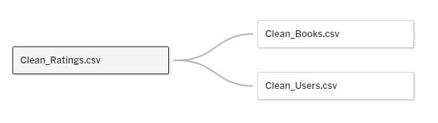
Tableau – Connecting to Data source
3 clean files loaded to Tableau.
Ratings dataframe is the Fact table. Books and Users data frames are Dimension tables.
Ratings and Books are related by the ISBN columns. Ratings and Users are related by the User-ID columns.
5 dashboards created per the different aspects of the data: Ratings, Books, Authors, Publishers, and Users. The dashboards are connected via navigation buttons.
Each dashboard includes relevant domain numbers presented in cards, and visualization reports.
To save on space, improve data presentation, and adding interactivity functions, a parameter which allows to switch between 2-3 visualizations per dashboard was added.
A ‘Top-N’ parameter which enables switching between top-5 / top-10 results when applicable is included.

Slide 17
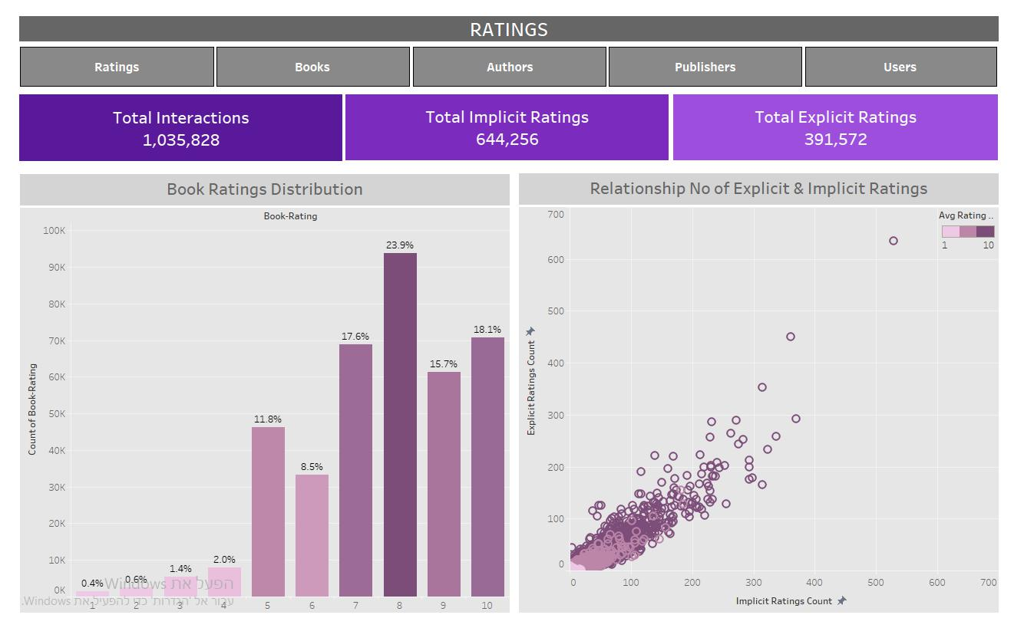
RATINGS Dashboard

Slide 18
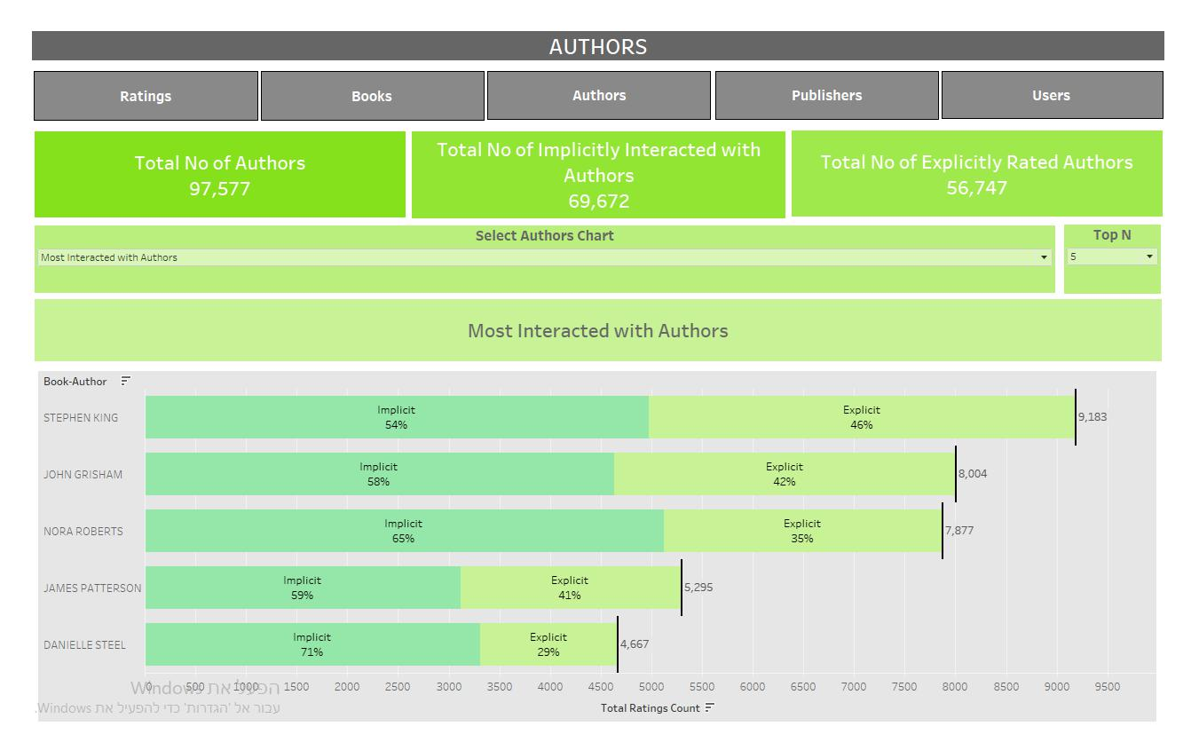
AUTHORS Dashboard

Slide 19
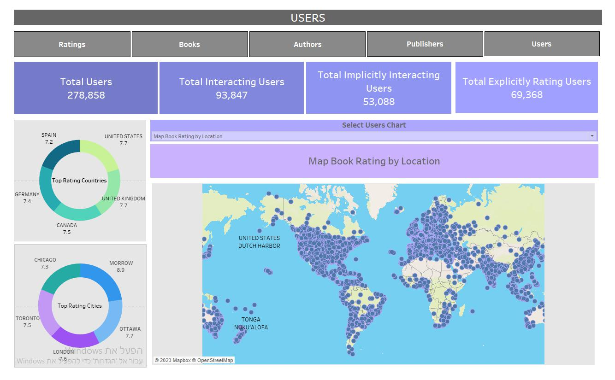
USERS Dashboard

Slide 20
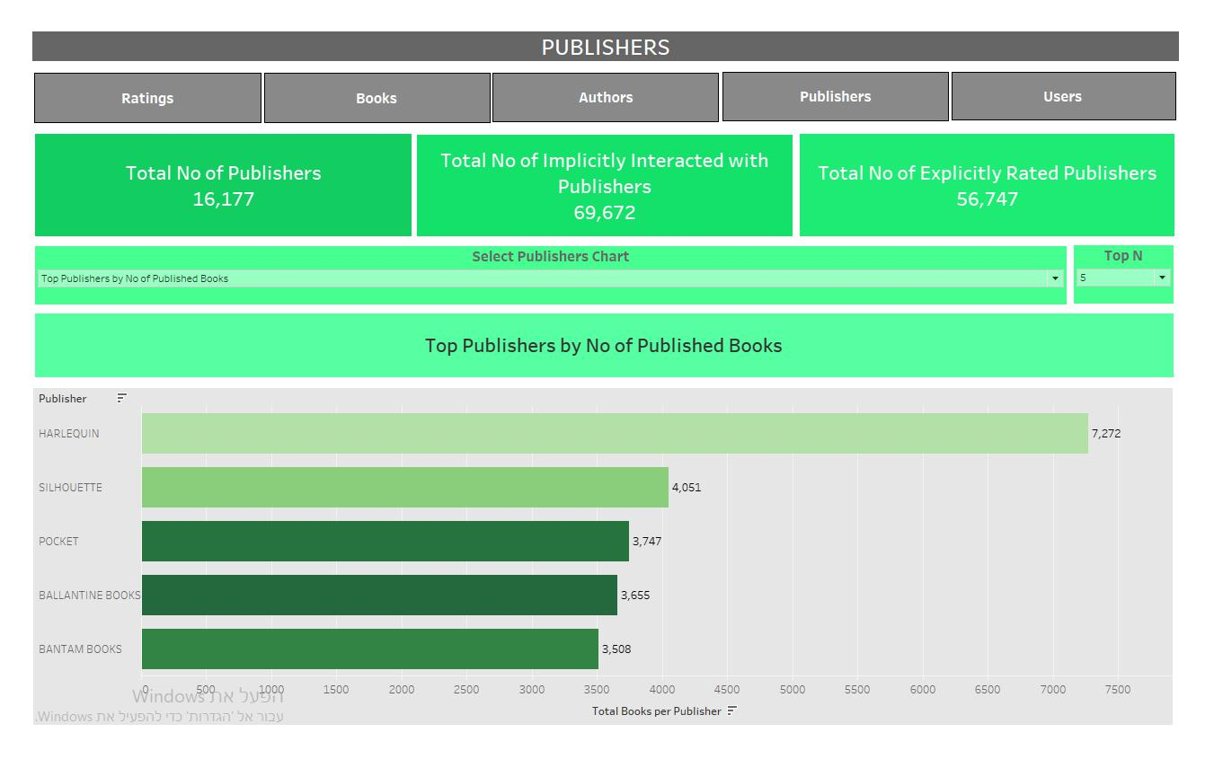
PUBLISHERS Dashboard

Slide 21
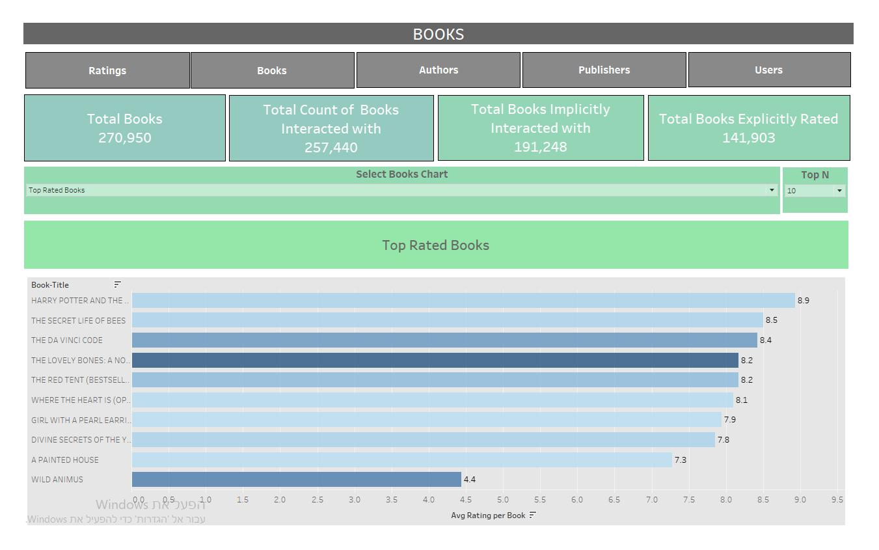
BOOKS Dashboard

Slide 22
Measures
Avg Rating per Book:
{ FIXED [ISBN_New]: AVG(IF [Book-Rating] != 0 THEN [Book-Rating] END)}
Total Books per Author:
{FIXED [Book-Author]: COUNTD([ISBN_New])}
Total No of Explicitly Rated Publishers:
COUNTD(IF [Book-Rating] != 0 THEN [Book-Author] END)
Total Implicitly Interacting Users:
COUNTD(IF [Book-Rating] == 0 THEN [User-ID] END)

Slide 23
Groups
Age Grouped in bins of 10 years each.
Top-N parameter and sets
Top-N parameter which allows to switch between top-5 and top-10 values.
Top-N parameter in designated sets per each dimension subject used for filtering.
>>For example, Top-N Book-Authors by Explicit Ratings Count.

Slide 24
Calculated Fields
For example, Rating Status:
IF [Book-Rating] == 0 THEN 'Implicit' ELSE 'Explicit' END
>> Then used this calculation to break-down total ratings by their status (explicit or implicit).
Table Calculations
Percent of total using specific dimensions.

Slide 25
Select Chart parameters combined
with Switch Chart calculated field
This combination enables switching between visualizations in the dashboards.
Filters
Added some filters to context to provide data is being filtered in the desired order of operations.
In the Users dashboard, visualizations can be filtered by choosing different country slices of the countries donut chart.

Slide 26
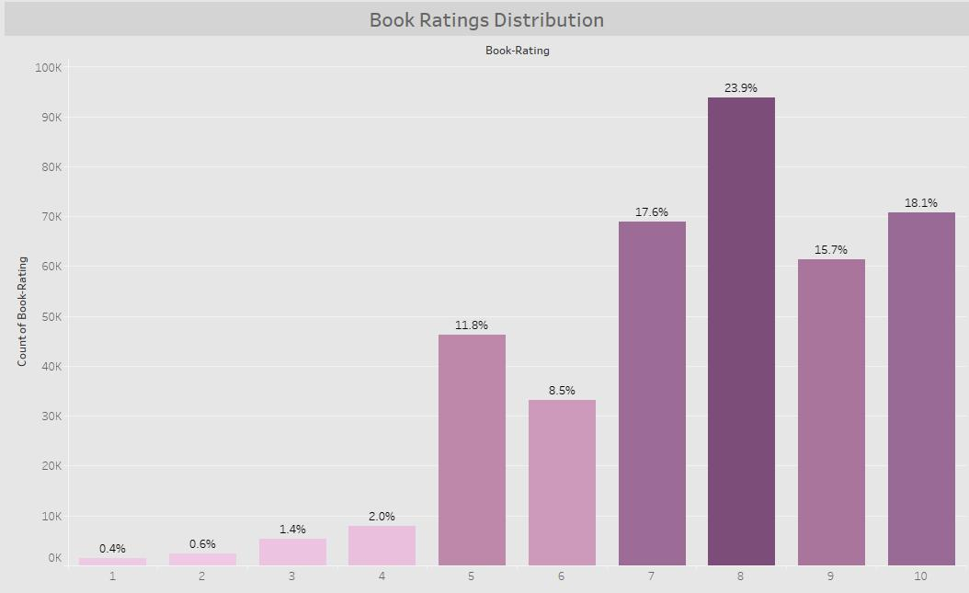
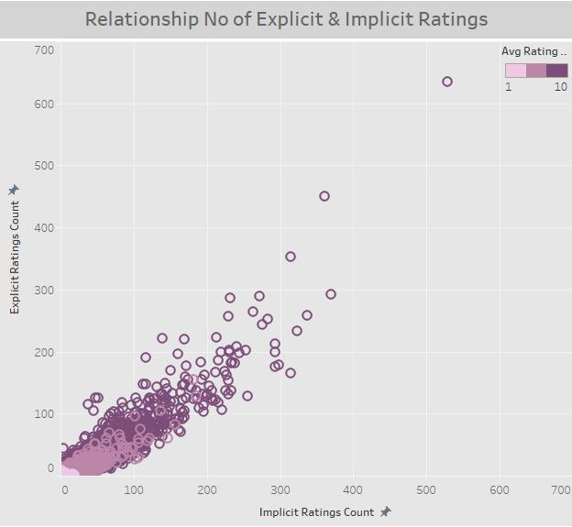
Insights
Most rated score is 8 (24%)
Higher scores are much more frequent than the lower-end scores.
Books that have many implicit ratings are also frequently explicitly rated.
There is no relationship between number of implicit ratings and avg score from explicit ratings.

Slide 27
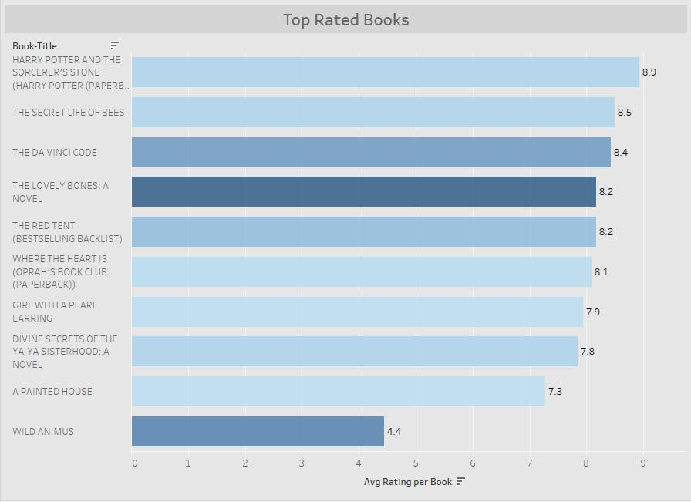
Insights
This visualization first filters by top-10 counts of ratings (to avoid presenting high rating scores of books with low rating counts). The higher the count, the stronger the color. By filtering by top count of ratings, we can consider books not only by their avg rating, but also by their popularity.
Then, the results are sorted by descending avg rating.
It’s important to note that results may vary when alternating to 5-top, per this setting of combining filtering and sorting of 2 different measures.
The highest rated book is "Harry Potter and the Sorcerer’s Stone" with an 8.9 score, although it hasn’t received the most count of ratings.
The book "The Lovely Bones: A Novel" is scored 8.2, but it received a higher count of ratings – 635.
We can notice the 10th rated book "Wild Animus" – although it ranks low with 4.4 avg rating, it has entered the list per its popularity with 526 ratings count.

Slide 28
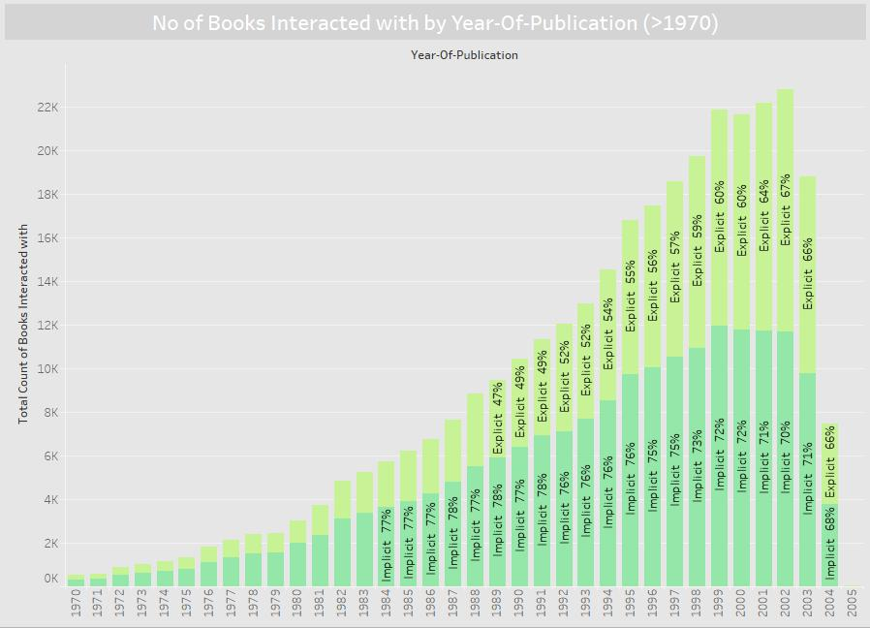
Insights
More recent books are more popular in terms of getting more explicit and implicit ratings.

Slide 29
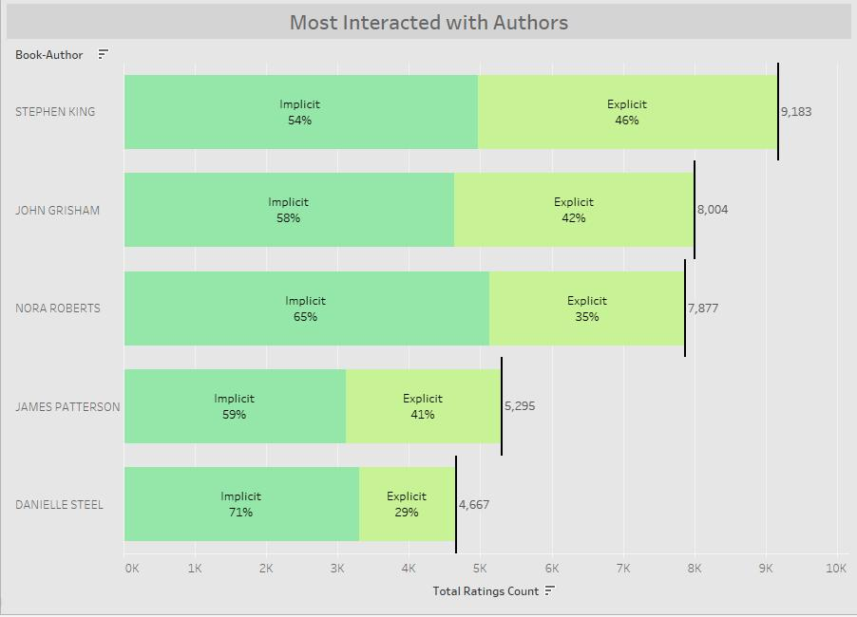
Insights
Implicit interactions with books per specific author are more frequent in general with over 50% of total interactions (explicit and implicit).
Stephen King is the most interacted with author with a total of 9183 interactions.

Slide 30
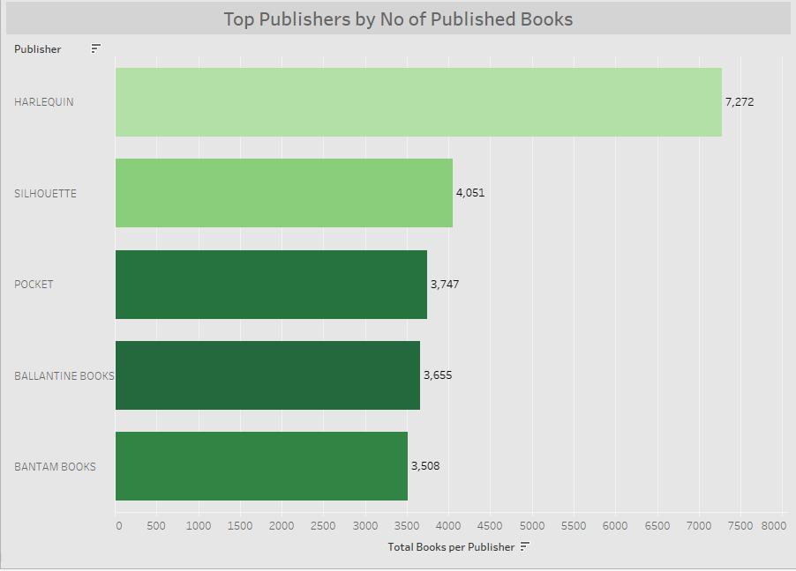
Insights
The top publisher by number of published books is Harlequin with a total of 7,272 books published.
It’s interesting to see that although Harlequin published about double the books than the other publishers, on average its books are ranked lower than the smaller publishing houses.

Slide 31
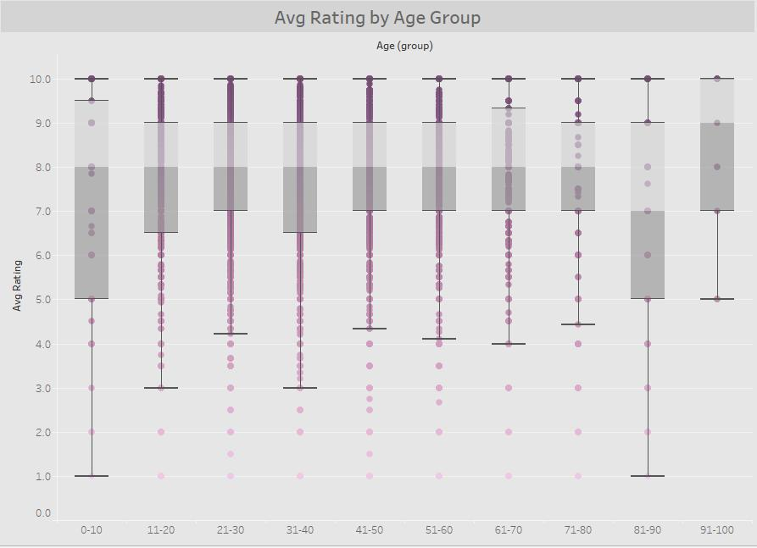
Insights
Age groups higher than 10 and lower than 60 are much more compressed in terms of count of users and with their lower deviation.
The median rating in almost all age groups is 8, except for 81-90 age group with median rating score of 7, and users in the 91-100 age group with median rating score of 9.

