Slide 1
The Furniture Supply Company
By Dana Freitas

Slide 2
About this company
Founded 2010 to create and sell luxury furniture to stores around the Midwest.
Based in 39w Mullberry Lane, Des Moines, Iowa.
Been growing rapidly throughout the years as knowledge of the high quality goods spreads throughout the region.

Slide 3
Why I did this
I wanted to make a diagram based upon a business. I found basing one on one of my hobbies to be infeasible.
I remembered that it couldn’t be too much like the bookstore.
I imagine a business more in the manufacturing business than the distributing.

Slide 4
How it works
There are suppliers that import raw materials into the factory, such as wood, at the beginning of the week. Note that “raw materials” is used generously, as it includes items such as screws.
There, the materials are made into finished goods, such as chairs and pillows.
There are orders made around the Midwest for these products. At the end of the week, there are contractors who are hired to drive these products to their destinations. There are contracting companies that this is done through.

Slide 5
Formatting
The ERD diagram is fairly simple in terms of relationships.
Every table is only connected to two other tables.
However, there are two many to many relationships: raw goods from suppliers to finished items, and finished items to those that purchase them.
There are two bridging tables that handle this.

Slide 6
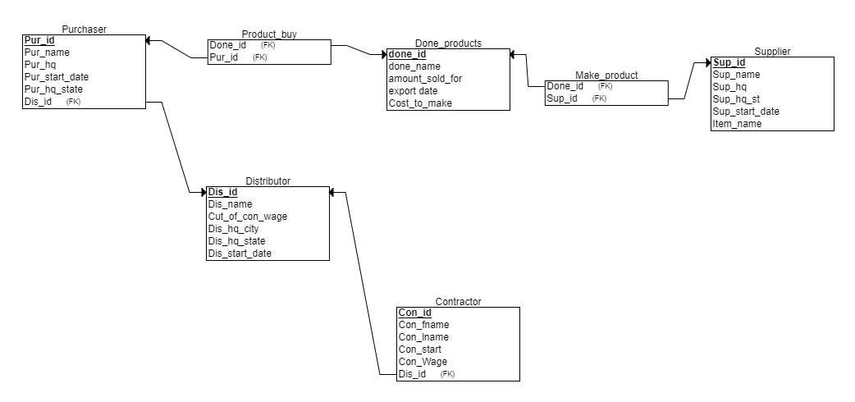
My database

Slide 7
Questions: Ch 8
Q1 Which done products sold for more than $15,000
SELECT DONE_NAME, AMOUNT_SOLD_FOR FROM DONE_PRODUCTS
WHERE AMOUNT_SOLD_FOR > 15000;
Q2 Which distributors are not from Chicago?
SELECT DIS_NAME, DIS_HQ FROM DISTRIBUTOR
WHERE DIS_HQ != 'CHICAGO';

Slide 8
Ch 9
Q3 What are the start dates of the supplier compared to the purchasers?
SELECT s.Sup_start_date, p.Pur_start_date FROM Supplier s JOIN Make_products m USING (Sup_id)
JOIN Done_products d USING (Done_id)
JOIN Product_buy pr USING (Done_id)
JOIN Purchaser p USING (Pur_id);

Slide 9
Ch 9 part2
Q4 There are companies that have purchased goods and use distributors. What are the names of the distributors whose purhcasing partners are based in either Ohio or Illinois?
SELECT d.Dis_name FROM purchaser p JOIN distributor d
USING (Dis_id) WHERE Pur_hq_state = 'OH'
UNION
SELECT d.Dis_name FROM purchaser p JOIN distributor d
USING (Dis_id) WHERE Pur_hq_state = 'IL';

Slide 10
Ch 10
Q5 What are the starting years and first name of all of the contractors?
SELECT SUBSTR(CON_START,8,11), CON_Fname
FROM CONTRACTOR;
Q6 What are the full names (in one column) and wages of the contractors if they are rounded on the left side of he decimal?
SELECT CON_FNAME || ' ' || CON_LNAME AS "Full Name", ROUND(CON_WAGE,-1)
FROM CONTRACTOR;

Slide 11
Ch 11 part 1
Q7 Assuming they all work 8 hours in one day, what is the total amount of money contractors will make in 1 day THAT STARTED BEFORE JANUARY 1ST, 2016?
SELECT SUM(CON_WAGE * 8) AS "TOTAL WAGES"
FROM CONTRACTOR
WHERE CON_START < '01-JAN-2016';

Slide 12
Ch 11 part 2
Q8 What is the average amount an item or items was sold for by date, where the average amount per date is greater than $20,000?
SELECT EXPORT_DATE, AVG(AMOUNT_SOLD_FOR) "Maximum amount"
FROM DONE_PRODUCTS
GROUP BY EXPORT_DATE
HAVING AVG(AMOUNT_SOLD_FOR) > 20000;

Slide 13
Ch 12
Q9 Which distributors started working with the company before the last supplier began working with the company?
SELECT DIS_NAME, DIS_START_DATE
FROM DISTRIBUTOR
WHERE DIS_START_DATE < (SELECT MAX(SUP_START_DATE) FROM SUPPLIER);

Slide 14
Ch 12 part 2
Q10 Who are the contractors that make less than the contractor who makes the least who started after December 31, 2013
SELECT CON_FNAME || ' ' || CON_LNAME AS "Full Name", CON_WAGE
from CONTRACTOR
WHERE CON_START >ANY (SELECT CON_START FROM CONTRACTOR WHERE CON_START > '30-DEC-2013');

