Slide 1

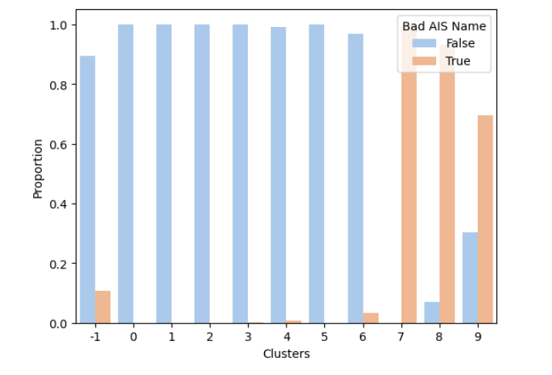
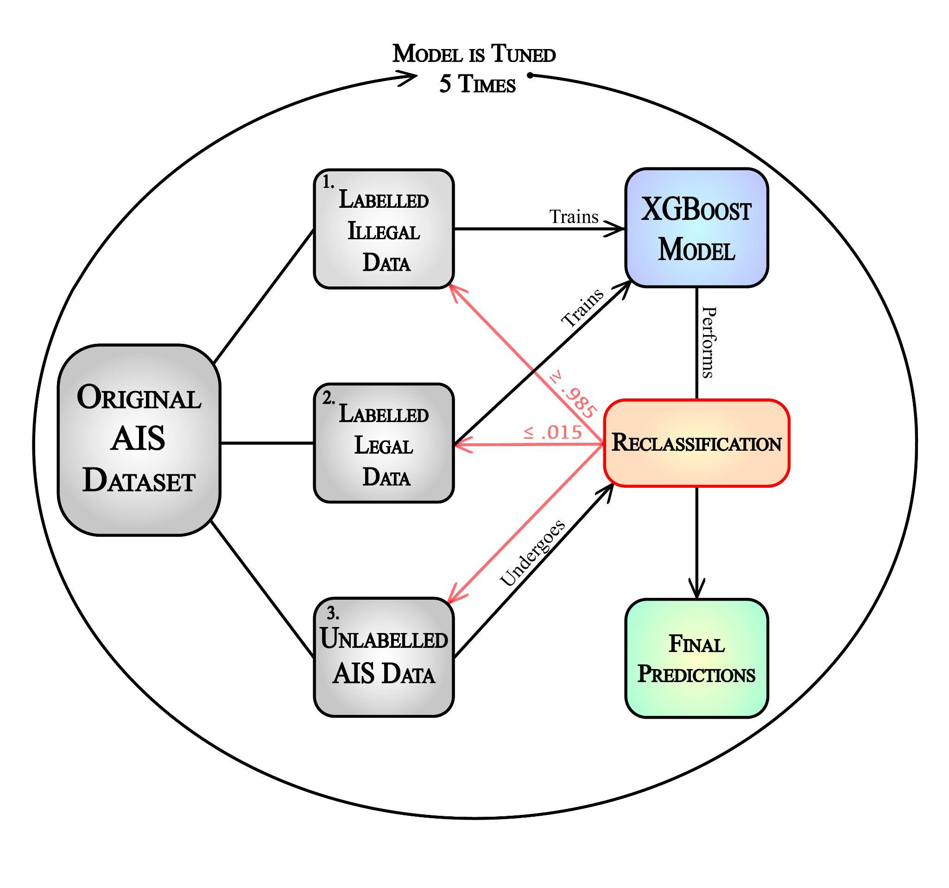
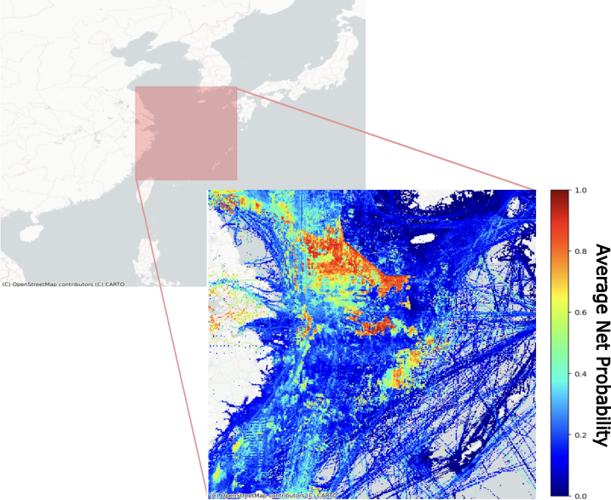
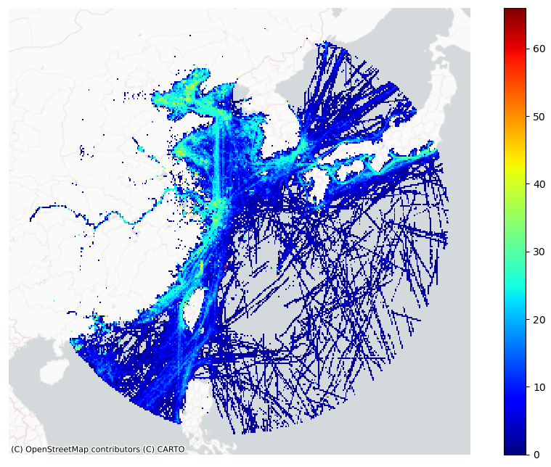

Exploring Illegal, Unreported, and Unregulated Fishing Detection using AIS Data and Machine Learning
Samuel Brown, Danielle Katz, Dana Korotovskikh,, and Stephen Kullman
Your names and the names of the people who contributed to this presentation
What is the Issue with IUU Fishing?
Goal:
Clustering Analysis
Environmental & economic impacts
Tied to drug & human trafficking
Estimated cost of $23 billion annually
Explore how AIS data be used to aid in IUU fishing net detection
Automatic Identification Systems (AIS)
What are they?
Standard tracking devices on vessels used primarily for collision avoidance
Commonly illegally exploited on fishing nets or buoys to protect large hauls
These impersonated AIS signals are harmful towards legal vessels, leading to a critical need for improved IUU regulation.
Modeling Approaches ✎
⟶ UNSUPERVISED ⟵
Treats dataset as truly unlabelled
Performs iterative application of hierarchical density-based clustering
Model develops 10 cluster groups of varying densities, with 3 distinct clusters as primarily illegal nets
Proves: AIS positional features may serve as good indicators of IUU nets
Data Overview:
XGBoost Model Workflow
Region of Interest: Southeast Asia
Spatial, temporal, & user inputted data obtained from CCRi
Pre-processing steps:
Aggregated by distinct device trips
‘Red flag’: Indicators of non-standard naming conventions and movement characteristics (score from 0 - 4)
These indicators are then used for performance analysis or labelling
⟶ SEMI-SUPERVISED ⟵
Manually labels dataset based on created ‘red flag’ conditions
Illegal vessels chosen by having a bad naming convention and more than 3 red flags
Trains on small sample of labelled AIS data
Iteratively builds pseudo-labels on remaining observations and retrains on updated labelled dataset
Employed with gradient boosted decision trees (XGBoost) and ANN
1. net_name | Names including a ‘V’, ‘%’, ’buoy’, or ’net’
2. mmsi_length | MMSI values not equal to 9 digits
3. spawn_offshore | Vessels whose first transmission is offshore (1 nautical mile off the coastline)
4. spoof | Devices with unreasonably high calculated speeds (>= 150 knots)
XGBoost Test Predictions
⟶ SUPERVISED ⟵
Projecting 100 hours of data
Output probability of 1 indicates illegal activity likely to have occurred in region
Looking at restricted area
Manually labels dataset based on created ‘red flag’ conditions
Illegal vessels chosen by having a bad naming convention and more than 3 red flags
Uses pseudo-labeled training data once to build model
Employed with fundamental ANN
Regional Analysis
Overlay region with grid between 107° to 142° longitude and 14° to 44° latitude, with 1°x1° cells – approximately 36 mi²
Position each AIS signal within its corresponding grid cell
Calculate hot_score: total number of unique red flags, divided by the total count of unique vessels
Aggregate together each hours hot_score per grid cell and obtain a total
Assign a color gradient to each grid cell based on these scores
Results ✓
September 1st, Day 1
Model | Test Accuracy | TPR | TNR
Semi-supervised XGBoost | 0.891 | 0.915 | 0.848
Semi-supervised ANN | 0.879 | 0.900 | 0.842
ANN | 0.867 | 0.907 | 0.801
References
[1] AIS (Automatic Identification System) Overview. NATO Shipping
Centre. (n.d.). https://shipping.nato.int/nsc/operations/news/2021/ais-
automatic-identification-system-overview
[2] Brennan, J. (2020, March 16). Fast and easy gridding of point
data with geopandas. Retrieved from james-brennan.github.io website:
https://james-brennan.github.io/posts/fastg riddingg eopandas/
[3] MIS Marine. (2020). The Use of AIS Data to Identify Dark Activity
for Marine Auditing Purposes. In Marine Assurance Technology
Experts | MIS (pp. 0–25). Marine Information Solutions. Retrieved
from Marine Information Solutions website: https://mismarine.com/wp-
content/uploads/2020/02/The-Use-of-AIS-Data-to-Identify-Dark-Activity-
for-Marine-Auditing-Purposes-v3.pdf
[4] National Intelligence Council. (2016, September 19). Global Im-
plications of Illegal, Unreported, and Unregulated (IUU) Fishing.
https://irp.fas.org/nic/fishing.pdf
[5] Nicholas Kalinowski, Jessica Kimbrell, Christopher Longchamp, and Anne
Louise Seekford. (2023). Exploration of Illegal, Unreported, Unregulated
Fishing and Vessel Relationships using AIS Data and Machine Learning.
Zenodo. https://doi.org/10.5281/zenodo.8008295
[6] United Nations. (2021, June 5). International Day Against Illegal Fishing.
United Nations. https://www.un.org/en/observances/end-illegal-fishing-day
Future Work ➚
Process a longer duration of AIS data
Expand model applications to alternative, larger regions
Explore a recurrent neural network (RNN) with AIS temporal data, then process with positional features

