Slide 1
BADIRA
Early awareness.
Better-timed care.
A bilingual AI companion for preeclampsia risk awareness — built around Risk × Reliability × Time.
RISK
RELIABILITY
TIME
BADIRA
01

Slide 2
THE PROBLEM
Preeclampsia risk can be easy to miss
It may develop without clear symptoms — while the information women find is often broad, fragmented, or delayed until the next appointment.
The gap
“Do I wait —
or act now?”
01
Symptoms can be unclear
Early warning signs are not always obvious or easy to interpret.
02
Information is incomplete
Generic searches rarely account for pregnancy week, history, and recent readings together.
Timing is the decision
BADIRA is designed for that moment of uncertainty.
03
Women need clarity on when to monitor, contact a doctor, or seek urgent care.
Source: BADIRA Business Model Canvas (uploaded)
02

Slide 3
THE SOLUTION
One assessment. Three signals.
BADIRA combines pregnancy context with an explicit check on data quality — then communicates urgency without pretending to diagnose.
R
Risk
✓
Reliability
T
Time
Screens submitted history, symptoms, and measurements for preeclampsia risk.
Checks completeness and consistency; asks for more information instead of guessing.
Uses gestational stage to make timing and urgency easier to understand.
Bilingual input → structured summary → share with a healthcare professional
A bridge to the doctor — not a replacement.
Source: BADIRA Business Model Canvas (uploaded)
03

Slide 4
COMPETITIVE LANDSCAPE
Focused where broader platforms aren’t
Capability
Materna BP
Nabta Health
Sehhaty
BADIRA
Core focus
Hypertension / preeclampsia
Women’s health
National healthcare
Preeclampsia awareness
Explicit reliability layer
Not clearly positioned
Not core
Not dedicated
Core differentiator
Risk × Reliability × Time
No
No
No
Yes
Saudi / Arab positioning
International
Regional / MENA
Saudi
Saudi + Arab
Bilingual product design
Not BADIRA’s positioning
Regional positioning
Arabic + English environment
Built into the experience
Positioning: specialized early-awareness companion — not a universal replacement for clinical care.
Source: BADIRA — Top 3 Competitor Comparison (uploaded)
04

Slide 5
WHY BADIRA
A sharper answer to a specific decision
BADIRA’s advantage is not “more features.” It is a focused, honest framework designed around early awareness for Saudi and Arab women.
01
Focused
02
Honest
Preeclampsia awareness is the core purpose — not one feature inside a broad platform.
Reliability is visible; missing information triggers questions rather than false certainty.
03
Localized
04
Action-oriented
Arabic + English communication and Saudi / Arab context are part of the product design.
The output links risk and timing into a concise summary to share with a professional.
Risk × Reliability × Time
Sources: BADIRA Business Model Canvas + competitor comparison (uploaded)
05

Slide 6
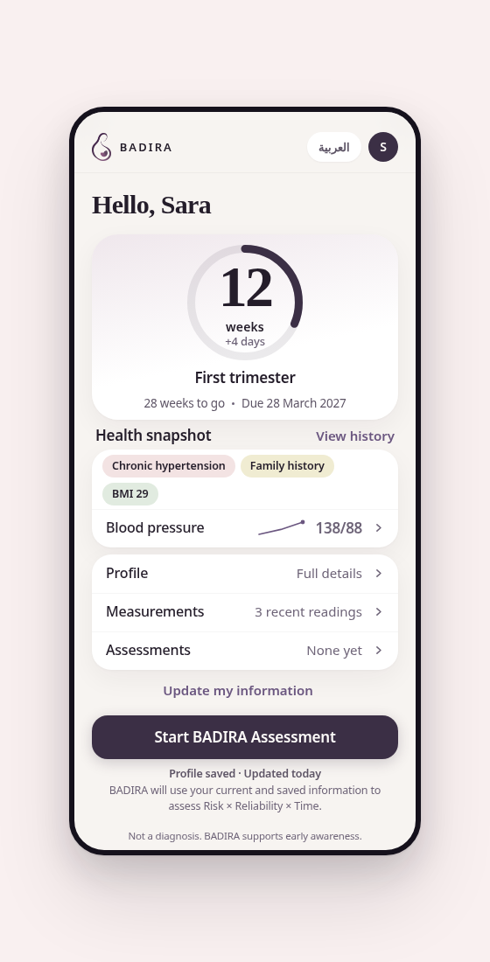
PRODUCT DEMO
From profile to assessment in one clear flow
1
Confirm context
Pregnancy week, history, symptoms, and measurements.
2
Start assessment
BADIRA evaluates Risk × Reliability × Time together.
3
Act with clarity
Review the result and share a structured summary with a healthcare professional.
Live prototype
Open BADIRA demo →
Not a diagnosis. BADIRA supports early awareness.
Demo: badira-ai.netlify.app
06

