Slide 1


Junior Project
WEB-BASED COURSE ALLOCATION SYSTEM
CAS
Presented by:
Dana Al Safadi
Mahra AlKuhoori
Amna AlShamsi
Asma AlAli

Slide 2

INTRODUCTION
  Course allocation is an essential process in every department.
  Our CAS system aims to make it simpler, more organized, and more efficient through automation and smart design.
2

Slide 3


PROBLEM STATEMENT
  Course allocation is still manual → time-consuming, error-prone, and not transparent.
  HoDs struggle to match faculty expertise with courses.
  Faculty preferences and qualifications are overlooked.
  Need for a centralized, automated, and fair system.
3

Slide 4

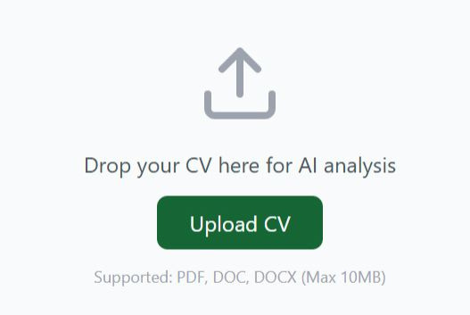
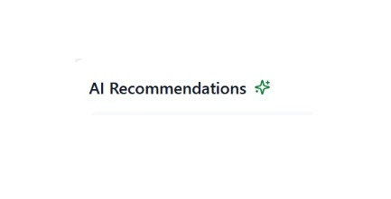
AIMS & OBJECTIVES
Automate course allocation using a web-based system
Allow faculty to upload CVs + Submit preferences
Provide AI-generated course recommendations to HoDs
4

Slide 5
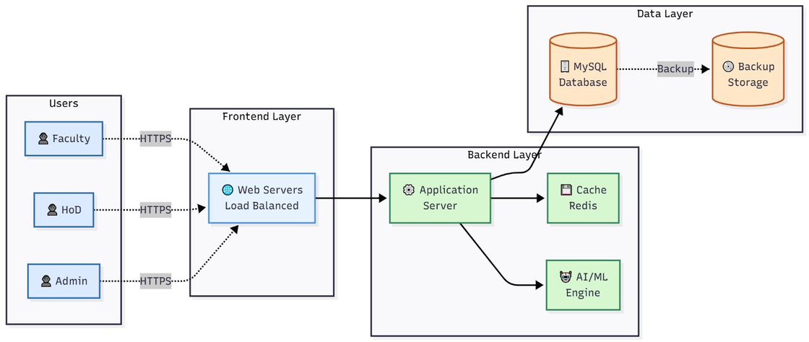
SYSTEM ARCHITECTURE
  Three-tier system
Client-side → Application Server → Data Source
  Designed for scalability, data integrity, and secure access
  Includes diagrams for structure + behavior
5

Slide 6
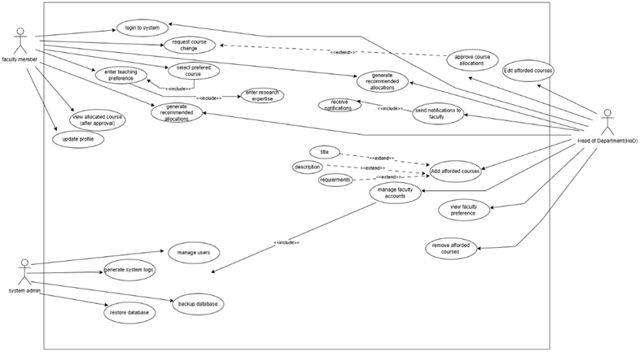
USE CASE DIAGRAM
User Roles/Stakeholders
Main Actors
  Faculty Member
  Head of Department
  System Administrator
6

Slide 7
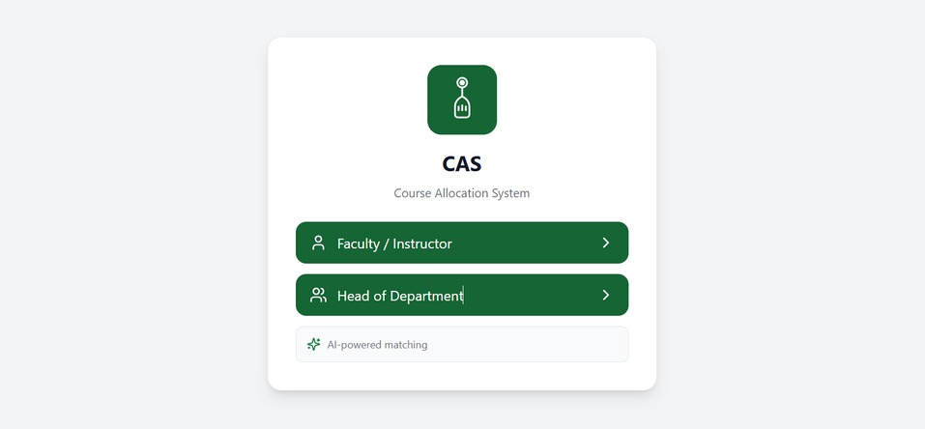
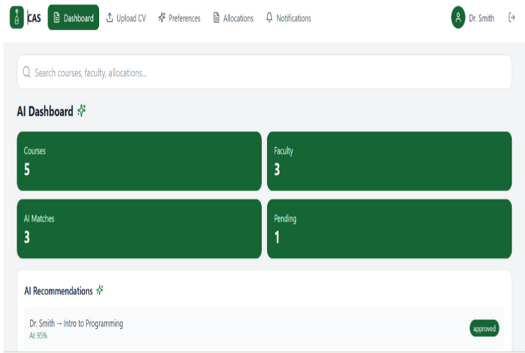
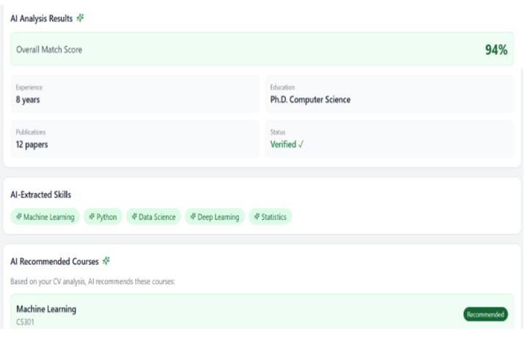
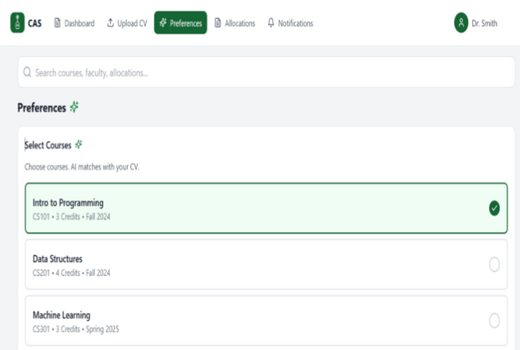
Login/Sign Up
Main Dashboard
USER INTERFACE
AI Analysis Page
Preferences Page
7

Slide 8

AI Matching Process
  CV Extraction : System extracts skills, expertise, and past teaching
  Course Requirement Analysis : AI checks what each course needs
  Match Score: AI compares faculty skills with course needs.
  Recommendations: System suggests the best instructor for each course
  HoD Approval: HoD reviews and finalizes the allocation
8

Slide 9

FUTURE ENHANCEMENTS
  Syllabus Intelligence Engine
AI reads syllabus and matches instructor.
  Advanced AI Matching
  Mobile Access
  AI Faculty Workload Prediction
AI predicts how much workload each faculty can handle
  Instructor Performance Integration
System recommends best instructor based on students feedback
9

Slide 10
CONCLUSION
Our project, CAS, will become even more useful and efficient as we continue building on the solid base we created, allowing us to add more valuable features in the next stages.
10

Slide 11

THANK YOU
FOR
LISTENING
11

