Slide 1
Architecture of the lowest SDN Application Layer Express Introduction
Thorsten Heinze
08.11.2021

Slide 2
Motivation for Modular Application Layer
Monolithic block off-the-shelf = fastest way to cover a wide range of functionality, …
… but it will not cover all needs
Customizing existing monolithic block = invest into proprietary code = sunk cost, in case of discontinued supplier relationship = lock-in

Slide 3
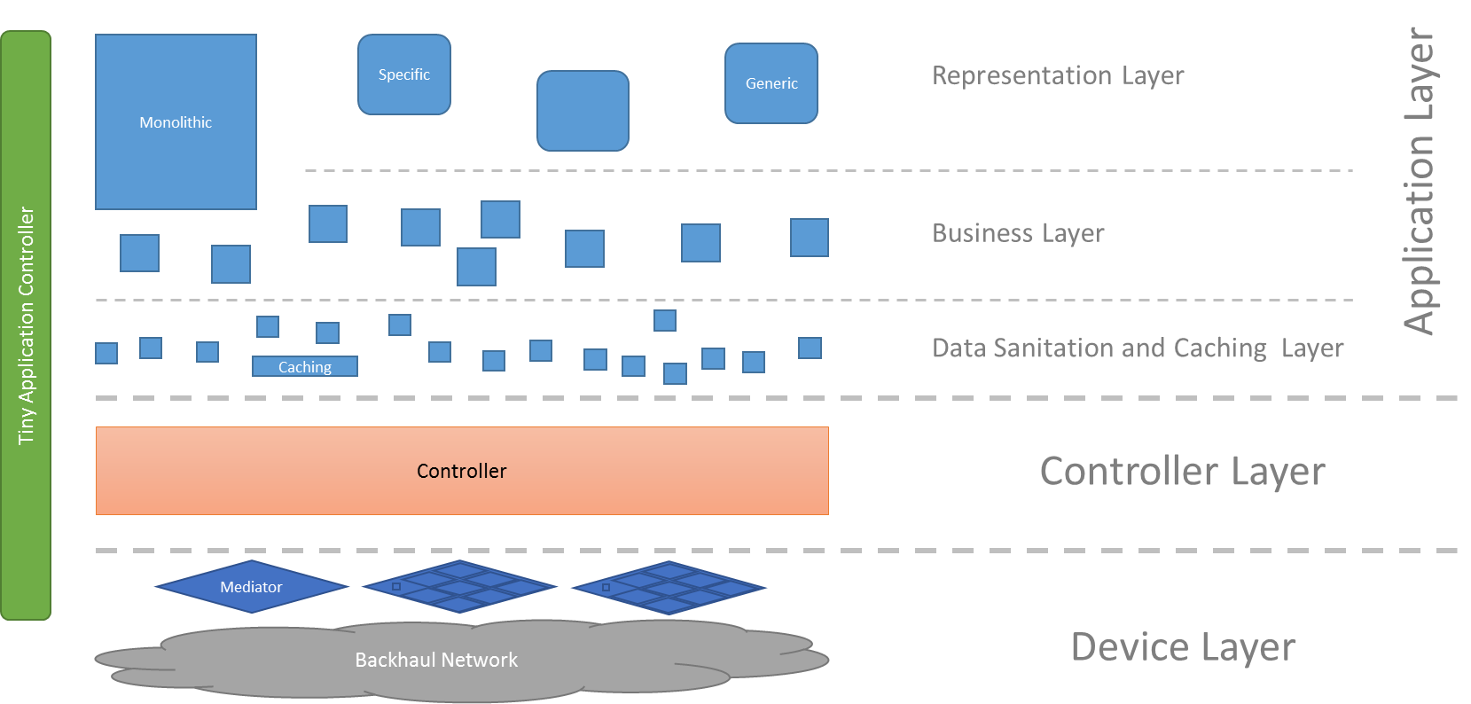
Substructure of the Modular Application Layer

Slide 4
Learnings from the first set of applications
Without guidance, applications …
have tendency to grow exuberantly
do things they shouldn’t do
disregard basic management requirements
disregards security requirements
don‘t support
transparency,
system debugging,
life cycle management
automated commissioning
….

Slide 5

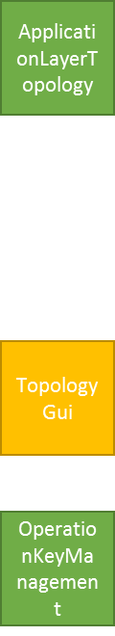
Microservice Management
OAS specification of first 5 components reached 90% maturity:
The TypeApprovalRegister stores already granted approvals
All applications will automatically register at the RegistryOffice
ExecutionAndTraceLog is logging all service activities
OamLog is logging all administrative activities
AdministratorAdministration is authenticating OaM requests
ApplicationLayerTopology represents interface and forwarding
OperationKeyManagement keeps operation keys in synch

Slide 6
Application Pattern
Specification based development (OAS, Postman, LOADfile)
Supports automated code generation
Supports test driven development and continuous integration (automated testing)
Supports automated deployment
Specification pattern
Integrates into the Microservice Management structure
High code re-use ratio
Lean implementation + Automation => Short Implementation Period

Slide 7
Thanks ☺

