Slide 1

Image Cartoonifier
Lebanese University
Faculty of Engineering III, Hadath
Presented by: Tala Karaki 5582
Dana Tarhini 5640
Presented to: Dr. Mohamad Aoude

Slide 2
Project Plan
Introduction
Libraries and Functions
Cartoonify an Image
Conclusion

Slide 3
Project Plan
Introduction
Libraries and Functions
Cartoonify an Image
Conclusion

Slide 4
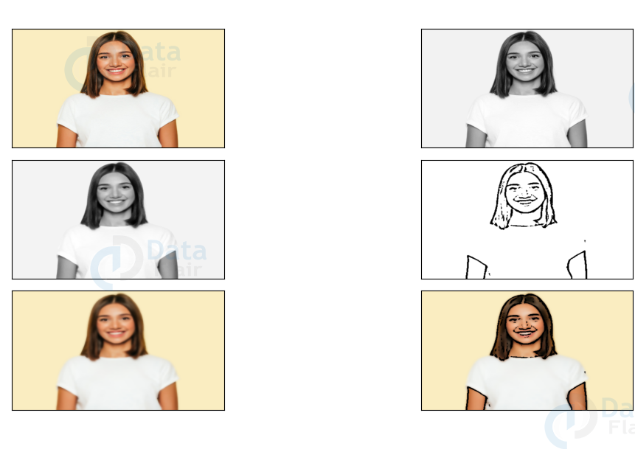
Introduction

Slide 5
Project Plan
Introduction
Libraries and Functions
Cartoonify an Image
Conclusion

Slide 6
Libraries & Functions
OpenCV
OpenCV-Python is a library of Python bindings designed to solve computer vision problems.
EasyGUI
This library is used to open the filebox.
It allows us to select any file from our system

Slide 7
Libraries & Functions
NumPy
This library is used for multi-dimensional arrays and matrices.
It’s used to store the image.
Imageio
It provides an easy interface to read and write a wide range of image data.

Slide 8
Libraries & Functions
Sys
It provides functions and variables which are used to manipulate different parts of the Python Runtime Environment.
Matplotlib.pyplot
It’s a collection of functions that make matplotlib work like MATLAB.

Slide 9
Libraries & Functions
OS
It provides functions for interacting with the operating system.
Tkinter
Tkinter is a standard library in python used for creating Graphical User Interface (GUI) for Desktop Applications.

Slide 10
Project Plan
Introduction
Libraries and Functions
Cartoonify an Image
Conclusion

Slide 11
Cartoonify an Image
Start
Import the modules
Build a File Box to choose a file
Store the image in forms of number

Slide 12
Cartoonify an Image
Change colors of the image from BGR to RGB
Resize the image
Image is found?
Print « Image not Found »
YES
NO
Transform the image into grayscale image
Terminate

Slide 13
Cartoonify an Image
Smoothen the grayscal image
Plot the whole transition
Retrieve the edges of the image
Save the resultant image
Smoothen the original image
Make the main window
Combine the retrieved edges and the smoothen image
Make the cartoonify button in the main window

Slide 14
Cartoonify an Image
Make a save button in the main window
Build the tkinter window
END

Slide 15
Project Plan
Introduction
Libraries and Functions
Cartoonify an Image
Conclusion

Slide 16
Conclusion
An image cartoonifier application is finally made.
We think that this application can put a smile on anyone's face.
With machine learning in python ' The sky is the limit '.

Slide 17
Thank You For Your Attention!

