Slide 1
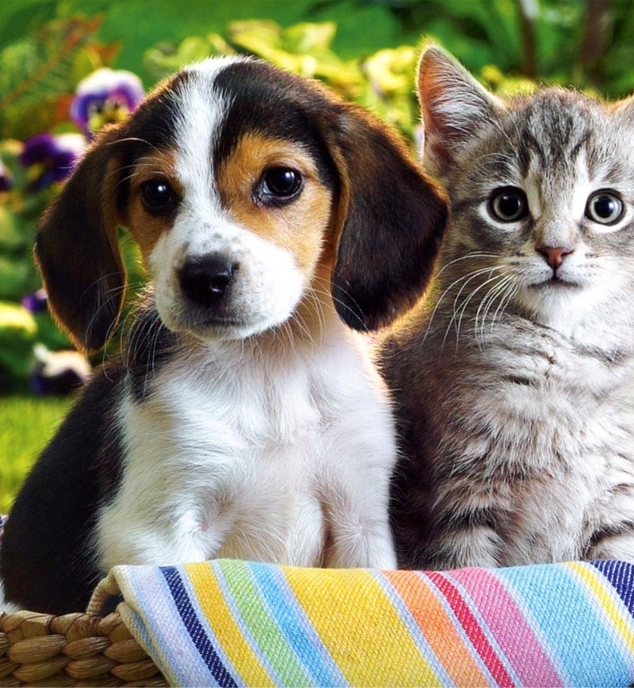
HOME AUTOMATION SYSTEM PET FEEDER
GROUP 10-10

Slide 2
TEAM MEMBERS
IT NUMBER | NAME
IT24101357 | BANDARA N.H.M.W.W.D.S.
IT24101620 | KALUARACHCHI K.A.T.H.
IT24102021 | GUNASINGHE B.A.C.M.
IT24102947 | RAMIN V.P.
IT24100542 | ABDEEN M.A.L.
IT24103279 | DUSHMANTHI W.D.H.

Slide 3

OVERVIEW
BACKGROUND
AIM
SYSTEM DIAGRAM
METHODOLOGY
EVALUATION METHODS
CONCLUSION

Slide 4
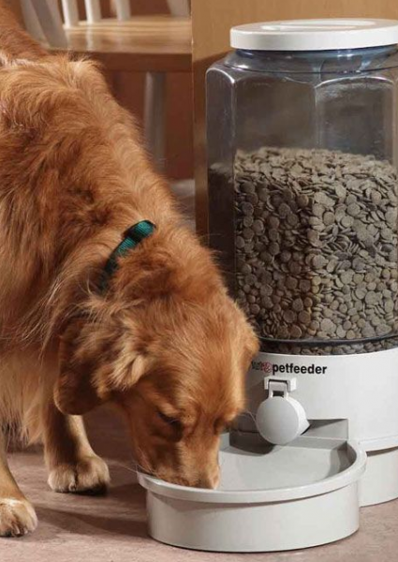
BACKGROUND
Modern pet owners struggle with consistent and timely feeding due to busy lifestyles and travel.
There is a growing demand for automated pet care solutions driven by smart home technologies.
The Internet of Things (IoT) enables remote monitoring and control, allowing pet owners to manage feeding schedules from any location.

Slide 5

AIM
Ensure timely and accurate feeding schedules for pets.
Enhance convenience for pet owners through remote monitoring.
Promote pet health with precise portion control.
Utilize IoT technology for seamless connectivity and control.
Provide a user-friendly interface for easy management.

Slide 6
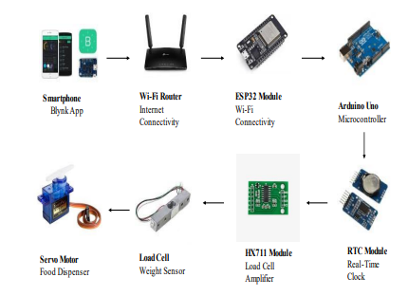
SYSTEM DIAGRAM

Slide 7

METHODOLOGY
Hardware Components:
Arduino uno
Servo motor
Weight sensor and HX711 module
Real-time clock module
ESP32 Wi-Fi module
Jumper wires
Breadboard

Slide 8

METHODOLOGY
Software Components:
Arduino IDE
HX711 Library
Blynk
Servo Library
RTC Library
ESP32 Wi-Fi Library

Slide 9

METHODOLOGY
Steps:
Hardware Assembly
Firmware Development
Testing and Debugging
User Interface Design

Slide 10

EVALUATION METHODS
Usability Testing
A/B testing
Survey and Feedbacks
Accessibility Testing
Performance Testing
Field Testing

Slide 11

CONCLUSION
The IoT-enabled automated pet feeder offers a reliable and convenient solution for pet owners.
It ensures precise feeding schedules and allows for remote monitoring
It paves the way for future advancements in smart pet care solutions.

Slide 12

Q & A

