Slide 1
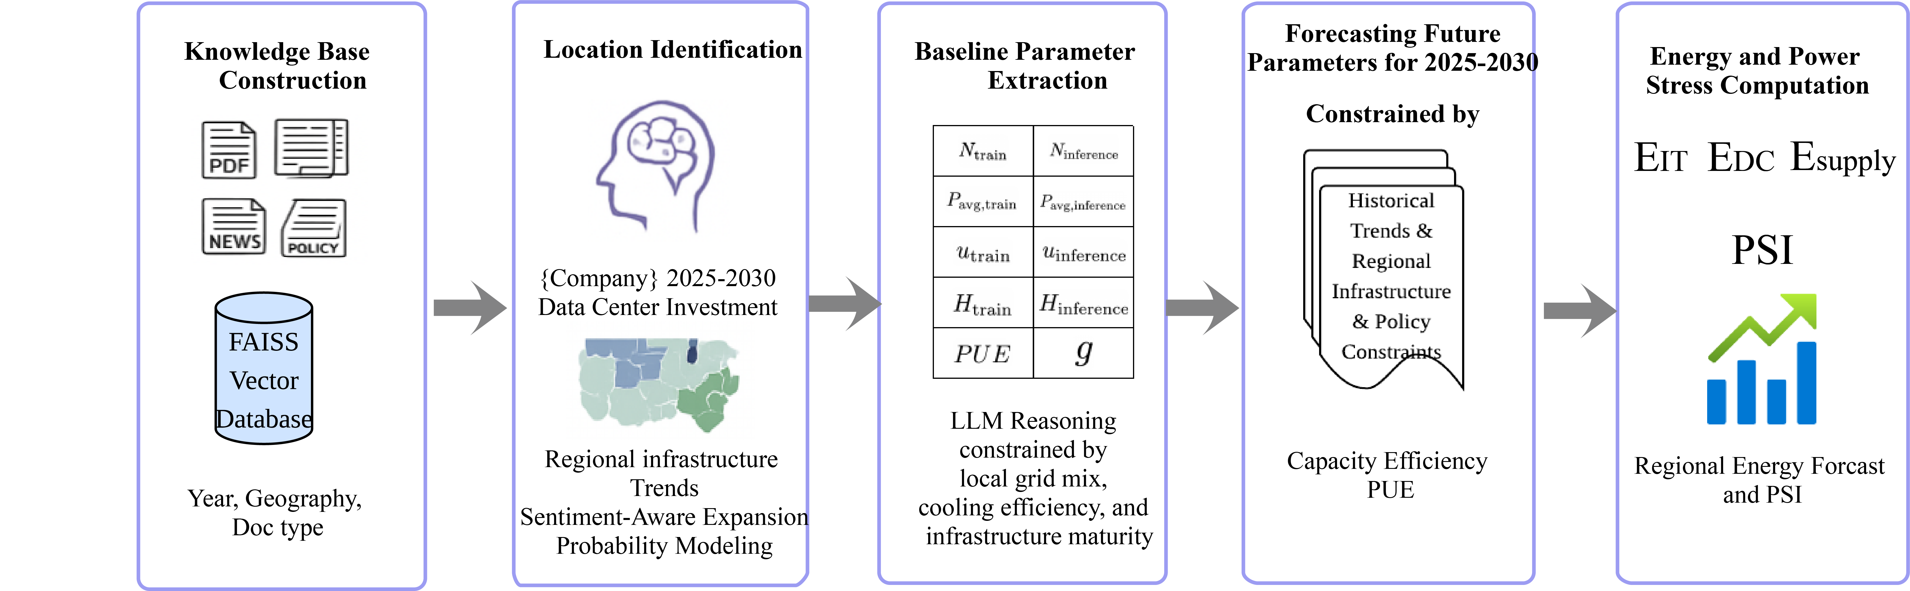
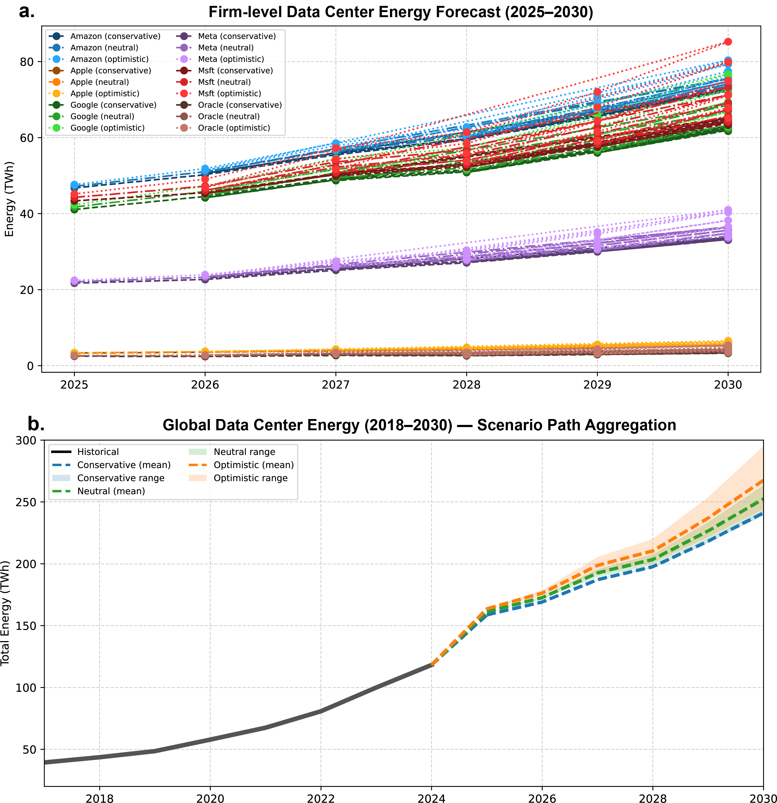
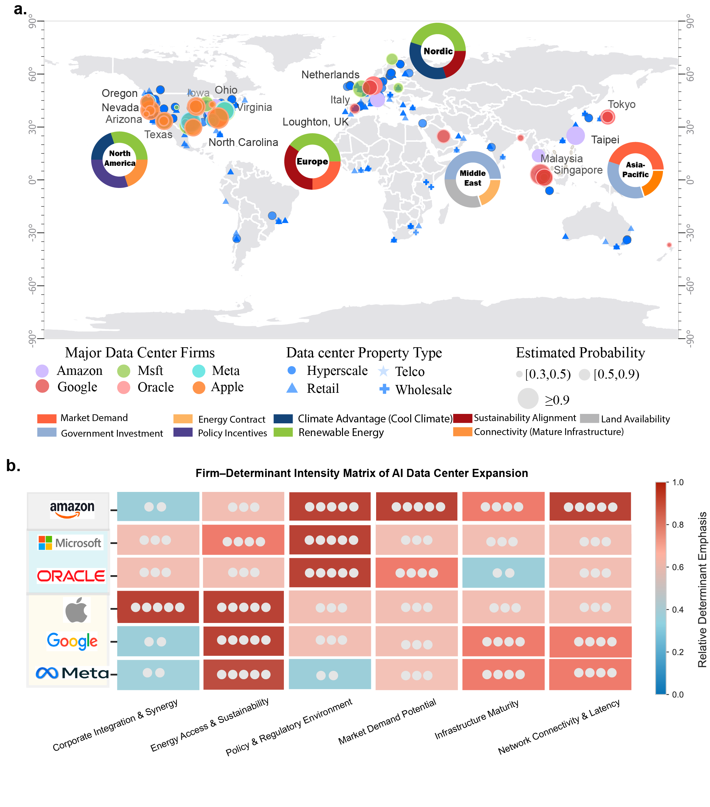
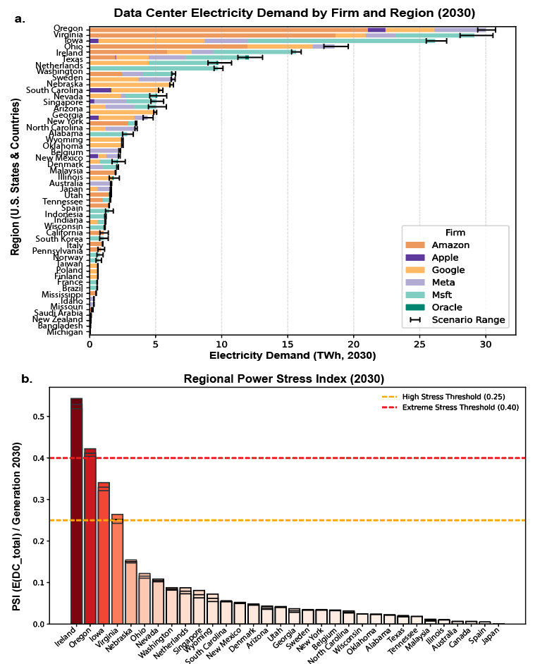
The Energy Cost of Artificial Intelligence
Global DC Electricity
415 TWh
-Modeling AI-Driven Data Center Electricity Demand with LLM Predictions
2024 ➡ 945 TWh (2030)
IEA projection — data centers only
Danbo Chen • The Ohio State University • AAEA conference 2026
Zijun Zhou • Meta Platform
≈ 3 % of global power by 2030
6× more power than legacy racks
Background & Motivation
Framework: AI–Energy Coupling (RAG + LLM Pipeline)
Result 2 — Electricity Demand Forecast (2025–2030)
• Generative AI is driving unprecedented growth in global computational demand
• AI GPU racks consume up to 6× more power than conventional server racks
• Energy demand scales super-linearly with model size; deployment is globally uneven
• Conventional forecasts fail to capture spatial concentration and firm-level siting strategies
• The compute–energy nexus is poorly quantified in current energy-planning frameworks
Stage | Description
1. KB | Corpus 2015–25: filings, ESG, policy, news
2. ID | Sentiment-aware RAG → siting probabilities
3. Params | LLM extracts GPU count, PUE, utilization
4. Forecast | 3 scenarios: 15 / 25 / 35 % annual growth
5. PSI | PSI = Eᴰᶜ / Eˢᵘᵖᵖˡʸ
Fig. 2 (a) Firm-level trajectories; (b) Global aggregated scenario forecast 2018–2030.
Metric | Value
Baseline 2024 | ~118 TWh
Conservative 2030 | ~239 TWh
Optimistic 2030 | ~295 TWh
CAGR | 13–17 %
IEA cross-check | ~265 TWh
Equiv. load | ~27 M US HH/yr
118 TWh
239–295
13–17 %
6-firm baseline (2024)
TWh by 2030 (modeled)
CAGR (2024–2030)
Research Questions
• Amazon, Microsoft, Google dominate absolute demand
• Growth accelerates post-2027 with large-scale generative-AI deployment
• Modeled range cross-validated against IEA benchmark (≈265 TWh implied)
¹ Where will AI data centers be built, and what drives siting decisions?
² How fast will their electricity demand grow from 2025 to 2030?
³ Which regions face grid stress from concentrated AI loads?
Result 3 — Regional Power Stress Index (PSI)
Tools: all-MiniLM-L6-v2 · FAISS · GPT-4o-mini · LangChain · Python
PSI = Eᴰᶜ / Eˢᵘᵖᵖˡʸ ● > 0.40 Extreme ● > 0.25 High ● < 0.10 Resilient
Result 1 — Global AI Data-Center Distribution & Siting Determinants
Data & Inputs
• Corporate disclosures: SEC EDGAR filings, ESG reports, earnings calls
• Infrastructure registry: S&P Capital IQ — facility counts 2015–2024
• Energy data: IEA, U.S. EIA (state-level), World Bank, OECD Energy Statistics
• Geospatial: Landsat 8 / Sentinel-2 via Google Earth Engine, OpenStreetMap
• Policy documents: U.S. DOE, European Commission DG-ENER, national grid operators
Firms covered: Amazon · Microsoft · Google · Meta · Oracle · Apple
Fig. 3 (a) DC demand by firm & region 2030. (b) PSI bar chart; dashed lines at 0.25 and 0.40 thresholds.
Region | PSI (2030) | Status
Ireland | ~0.50 | Extreme ⚠
Oregon | ~0.40 | High ⚠
Iowa / Virginia | 0.20–0.30 | Elevated
Texas / Japan | <0.10 | Resilient ✓
Result 1 — Global Siting Patterns
• <10 regions account for ≈two-thirds of total projected AI electricity load
• PSI > 0.25 signals need for dedicated transmission expansion
• Texas advantage: independent grid, renewable diversity, efficient interconnection
• >90 % of AI compute concentrated in North America, Western Europe, and Asia–Pacific
• Siting driven by renewables, policy corridors, and connectivity — not user proximity
• Five strategic archetypes identified:
– Renewable-anchored — Google, Meta
– Policy-responsive — Microsoft, Oracle
– Market-expanding — Amazon
– Vertically integrated — Apple
• Top hubs: Virginia, Texas, Oregon, Iowa (US) · Netherlands, Nordic (EU) · Singapore, Taiwan, Japan (APAC)
Conclusions & Policy Implications
Key Findings
• AI infrastructure is evolving from a marginal load into a structural grid component
• Spatial clustering creates a “digital energy divide” between stressed and resilient regions
• Absent coordination, AI demand could offset planned renewable additions by 2030
Policy Recommendations
• Incorporate AI load projections into national capacity-expansion plans
• Pair fiscal incentives with mandatory renewable procurement requirements
• Deploy data centers as anchor loads for PPAs and demand response
• Strengthen grid interties in high-stress corridors (Oregon, Ireland, Virginia)
• Direct new investment toward renewable-rich, resilient regions (Texas, Nordic)
Fig. 1 (a) Global distribution of data-center sites: small markers = legacy; large circles = new AI sites (size ∝ siting probability). (b) Firm–determinant intensity matrix.
Data: IEA · U.S. EIA · S&P Capital IQ · SEC EDGAR · World Bank · OECD Energy Statistics | Model: RAG + GPT-4o-mini · LangChain · FAISS · all-MiniLM-L6-v2 | Code & data available upon request

