Slide 1
Assignment 3 (NLP) Writeup DO NOT TAG
Name: Danbo Chen
GT Email:dchen497@gatech.edu

Slide 2
Seq2Seq Results – Default configuration Values are for last epoch
RNN
Training Loss: 4.6139
Training Perplexity: 100.8779
Validation Loss: 4.6959
Validation Perplexity: 109.5020
LSTM
Training Loss: 3.1755
Training Perplexity:23.9392
Validation Loss: 3.3385
Validation Perplexity: 28.1773
RNN-with-Attention
Training Loss: 3.2857
Training Perplexity: 26.7286
Validation Loss: 3.4203
Validation Perplexity: 30.5791
LSTM-with-Attention
Training Loss: 3.1065
Training Perplexity: 22.2986
Validation Loss: 3.3198
Validation Perplexity: 27.6549

Slide 3
Seq2Seq Explanation (RNN vs LSTM)
Compare your RNN result to your LSTM result and explain why they differ.
Comparing the results, I find following differences and show the main explanations:
the LSTM-based Seq2Seq model performs significantly better than the vanilla RNN model. The RNN model achieves a training perplexity of about 100.88 and a validation perplexity of 109.50, while the LSTM model reduces the training perplexity to 23.94 and the validation perplexity to 28.18.
(2) Main Explanations: This large performance gap is mainly due to the architectural differences between RNN and LSTM.
A standard RNN suffers from the vanishing gradient problem, which makes it difficult for the network to capture long-range dependencies in sequences. During backpropagation through time, gradients can shrink exponentially, preventing the model from learning relationships between tokens that are far apart in the sequence. In a Seq2Seq translation task, this limitation is critical because the encoder must summarize the entire input sentence into hidden representations that the decoder uses to generate translations.
LSTM networks address this issue by introducing a memory cell and gating mechanisms (input gate, forget gate, and output gate). These gates regulate the flow of information through the network and allow the model to preserve important context over longer time spans. LSTM networks address this issue by introducing a memory cell and gating mechanisms (input gate, forget gate, and output gate). These gates regulate the flow of information through the network and allow the model to preserve important context over longer time spans.

Slide 4
Seq2Seq Explanation (RNN vs RNN-with-Attention)
Compare your RNN result to your RNN-with-Attention result and explain why they differ.
Comparing the results, I find following differences and show the main explanations:
First, the RNN-with-Attention model performs much better than the standard RNN model. The vanilla RNN has a validation perplexity of about 109.50, while the RNN-with-Attention reduces it to around 30.58, indicating a significant improvement in translation quality.
(2) Main Explanations: The main reason for this difference is the information bottleneck in the basic Seq2Seq architecture.
In the vanilla RNN model, the encoder compresses the entire input sequence into a single fixed-length hidden vector, which is then passed to the decoder. This compression often causes important information to be lost, especially for longer sequences, making it harder for the decoder to generate accurate outputs.
The attention mechanism alleviates this problem by allowing the decoder to dynamically focus on different encoder hidden states during each decoding step. Instead of relying only on the final encoder state, the decoder can selectively attend to the most relevant parts of the input sequence when predicting each output token.

Slide 5
Seq2Seq Results – Best model Values are for last epoch
Your best model after hyper-parameter tuning
Best model
Training Loss: 2.7735
Training Perplexity: 16.0151
Validation Loss: 3.2045
Validation Perplexity: 24.6432
List your best model hyper-parameter values including model type: ?
encoder_emb_size = 256
encoder_hidden_size = 256
encoder_dropout = 0.3
decoder_emb_size = 256
decoder_hidden_size = 256
decoder_dropout = 0.3
learning_rate = 5e-4
model_type = "LSTM“
EPOCHS = 25

Slide 6
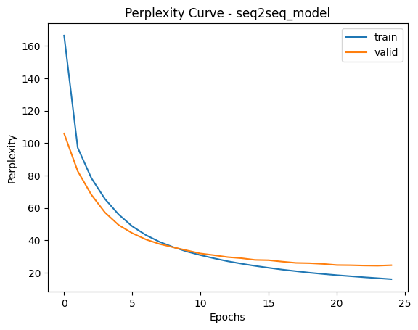
Seq2Seq Best model Learning Curves (Perplexity)

Slide 7
Seq2Seq Explanation – Best model
Explain the details of your best model. Explain what you did to improve your model’s performance and why
My Best Model Setting and Performance: the best performing model in our experiments is an LSTM-based Seq2Seq model with attention. After hyper-parameter tuning, the model achieved a training perplexity of 16.02 and a validation perplexity of 24.64, which improves upon the earlier configurations.
Explanations: several hyper-parameters were adjusted to improve performance.
First, the embedding size and hidden size were increased from 128 to 256, allowing the model to capture richer semantic representations of the input and output sequences.
Second, the learning rate was reduced from 1e-3 to 5e-4, which stabilized the optimization process and allowed the model to converge more smoothly.
Additionally, the dropout rate was increased to 0.3, which helps reduce overfitting and improves generalization on the validation set.
Finally, the number of training epochs was increased to 25, giving the model more time to learn the sequence patterns.
Meanwhile, combining LSTM with an attention mechanism significantly improves translation quality. The LSTM architecture captures long-range dependencies through its gated memory cells, while the attention mechanism allows the decoder to focus on the most relevant encoder hidden states at each decoding step. This reduces the information bottleneck present in the basic Seq2Seq architecture and results in lower loss and perplexity.

Slide 8
Transformer Results Values are for last epoch
Default configuration (Encoder Only)
Training Loss: 2.1522
Training Perplexity: 8.6038
Validation Loss: 3.1143
Validation Perplexity: 22.5184
Default configuration (full transformer)
Training Loss: 1.4871
Training Perplexity: 4.4244
Validation Loss: 1.7627
Validation Perplexity: 5.8282
Best model (full transformer)
Training Loss: 1.4909
Training Perplexity: 4.4409
Validation Loss: 1.7602
Validation Perplexity: 5.8137
List your best model hyper-parameter values (full transformer): ?
"hidden_dim": 256, "num_heads": 4, "dim_feedforward": 1024,
"learning_rate": 5e-4, "epochs": 15

Slide 9
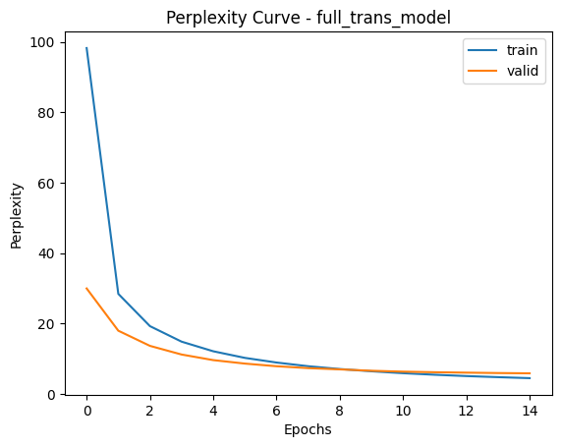
Full Transformer Best model Learning Curves (Perplexity)

Slide 10
Full Transformer Explanation – Best model
Explain what you did here and why you did it to improve your model performance.
The best model is a full Transformer with tuned hyperparameters:
hidden_dim = 256, num_heads = 4, dim_feedforward = 1024, learning_rate = 5e-4, and epochs = 15.
Compared with the default full Transformer, the tuned model achieves a slightly lower validation loss and validation perplexity, indicating a small but meaningful improvement in generalization performance.
First, I increased the hidden dimension and feedforward dimension, which gave the Transformer greater representational capacity to learn richer contextual features from the input sequence.
I chose 4 attention heads, which provides a good balance between multi-head attention diversity and computational efficiency.
I also reduced the learning rate to 5e-4, which makes optimization more stable and helps the model converge more smoothly.
Performance explanation: The tuned model does not greatly reduce training loss compared with the default full Transformer, but it achieves a slightly better validation result. This suggests that the hyperparameter changes mainly improved generalization rather than simply making the model fit the training data more aggressively. Overall, the results show that the full Transformer is substantially stronger than the encoder-only version, and careful tuning further improves its validation performance.

Slide 11
Transformer (Encoder Only) Translation Results (default settings)
Put translation results for your model (1st 9 sentences) here. You may remove duplicate <pad> and <eos> tokens for each sentence.
True Translation | Predicted Translation
'<sos>', 'a', 'man', 'in', 'an', 'orange', 'hat', 'starring', 'at', 'something', '<eos>', '<pad>' | '<sos>', 'a', 'man', 'in', 'an', 'orange', 'hat', 'hat', 'something', 'something', 'something', '<eos>'
'<sos>', 'a', 'boston', 'terrier', 'is', 'running', 'on', 'lush', 'green', 'grass', 'in', 'front', 'of', 'a', 'white', 'fence', '<eos>' | '<sos>', 'a', 'boston', 'vendor', 'runs', 'walking', 'grass', 'green', 'grass', 'grass', 'of', 'of', 'of', 'fence', 'fence', 'fence', '<eos>'
'<sos>', 'a', 'girl', 'in', 'karate', 'uniform', 'breaking', 'a', 'stick', 'with', 'a', 'front', 'kick', '<eos>' | '<sos>', 'a', 'girl', 'in', 'a', 'a', 'green', 'with', 'a', 'a', 'a', 'a', '<eos>'
'<sos>', 'five', 'people', 'wearing', 'winter', 'jackets', 'and', 'helmets', 'stand', 'in', 'the', 'snow', 'with', '<unk>', 'in', 'the', 'background', '<eos>' | '<sos>', 'five', 'people', 'in', 'in', 'and', 'helmets', 'helmets', 'with', 'helmets', 'the', 'snow', 'in', 'in', 'in', 'in', '<eos>'
'<sos>', 'people', 'are', 'fixing', 'the', 'roof', 'of', 'a', 'house', '<eos>' | '<sos>', 'people', 'are', 'starting', 'the', 'a', 'the', '<eos>'
'<sos>', 'a', 'group', 'of', 'people', 'standing', 'in', 'front', 'of', 'an', 'igloo', '<eos>' | '<sos>', 'a', 'group', 'of', 'people', 'standing', 'standing', 'in', 'a', '<eos>'
'<sos>', 'a', 'guy', 'works', 'on', 'a', 'building', '<eos>' | '<sos>', 'a', 'guy', 'is', 'on', 'a', 'building', 'building', '<eos>'
'<sos>', 'a', 'man', 'in', 'a', 'vest', 'is', 'sitting', 'in', 'a', 'chair', 'and', 'holding', 'magazines', '<eos>' | '<sos>', 'a', 'man', 'in', 'a', 'vest', 'vest', 'on', 'on', 'a', 'chair', 'a', 'holding', '<eos>'
'<sos>', 'a', 'mother', 'and', 'her', 'young', 'song', 'enjoying', 'a', 'beautiful', 'day', 'outside', '<eos>' | '<sos>', 'a', 'mother', 'and', 'her', 'small', 'son', 'son', 'a', '<eos>', 'day', 'day', '<eos>'
Table 1

Slide 12
Full Transformer Translation Results (best model)
Put translation results for your best model (1st 9 sentences) here. You may remove duplicate <pad> and <eos> tokens for each sentence.
True Translation | Predicted Translation
'<sos>', 'a', 'man', 'in', 'an', 'orange', 'hat', 'starring’, 'at', 'something', '<eos>' | '<sos>', 'a', 'man', 'in', 'an', 'orange', 'hat', 'is', 'fixing', 'something', '<eos>'
'<sos>', 'a', 'boston', 'terrier', 'is', 'running', 'on', 'lush', 'green', 'grass', 'in', 'front', 'of', 'a', 'white', 'fence', '<eos>' | '<sos>', 'a', 'boston', 'worker', 'runs', 'across', 'the', 'green', 'grass', 'in', 'front', 'of', 'a', 'white', 'fence', '<eos>'
'<sos>', 'a', 'girl', 'in', 'karate', 'uniform', 'breaking', 'a', 'stick', 'with', 'a', 'front', 'kick', '<eos>' | '<sos>', 'a', 'girl', 'in', 'a', 'karate', 'uniform', 'is', 'taking', 'a', 'kick', 'with', 'a', 'kicks', '<eos>'
'<sos>', 'five', 'people', 'wearing', 'winter', 'jackets', 'and', 'helmets', 'stand', 'in', 'the', 'snow', 'with', '<unk>', 'in', 'the', 'background', '<eos>' | '<sos>', 'five', 'people', 'in', 'traditional', 'outfits', 'and', 'helmets', 'stand', 'in', 'the', 'snow', 'with', 'helmets', 'in', 'the', 'background', '<eos>'
'<sos>', 'people', 'are', 'fixing', 'the', 'roof', 'of', 'a', 'house', '<eos>' | '<sos>', 'people', 'are', 'fixing', 'the', 'roof', 'of', 'a', 'house', '<eos>'
'<sos>', 'a', 'group', 'of', 'people', 'standing', 'in', 'front', 'of', 'an', 'igloo', '<eos>' | '<sos>', 'a', 'group', 'of', 'people', 'standing', 'in', 'front', 'of', 'a', 'fire', '<eos>'
'<sos>', 'a', 'guy', 'works', 'on', 'a', 'building', '<eos>' | '<sos>', 'a', 'guy', 'working', 'on', 'a', 'building', '<eos>'
'<sos>', 'a', 'man', 'in', 'a', 'vest', 'is', 'sitting', 'in', 'a', 'chair', 'and', 'holding', 'magazines', '<eos>' | '<sos>', 'a', 'man', 'in', 'a', 'vest', 'is', 'sitting', 'on', 'a', 'chair', 'holding', 'a', 'cup', '<eos>'
'<sos>', 'a', 'mother', 'and', 'her', 'young', 'song', 'enjoying', 'a', 'beautiful', 'day', 'outside', '<eos>' | '<sos>', 'a', 'mother', 'and', 'her', 'son', 'enjoying', 'a', 'nice', 'day', 'outdoors', '<eos>', 'outside', '<eos>'
Table 2

Slide 13
Seq2Seq (Best model) Translation Results
Put translation results for your best model (1st 9 sentences) here. You may remove duplicate <pad> and <eos> tokens for each sentence.
True Translation | Predicted Translation
'<sos>', 'a', 'man', 'in', 'an', 'orange', 'hat', 'starring’, 'at', 'something', '<eos>' | ['<sos>', 'a', 'man', 'in', 'a', 'orange', 'hat', 'is', '<eos>'
'<sos>', 'a', 'boston', 'terrier', 'is', 'running', 'on', 'lush', 'green', 'grass', 'in', 'front', 'of', 'a', 'white', 'fence', '<eos>' | '<sos>', 'a', 'brown', 'white', 'dog', 'is', 'running', 'on', 'a', 'a', 'in', 'in', 'a', 'of', 'a', '<eos>'
'<sos>', 'a', 'girl', 'in', 'karate', 'uniform', 'breaking', 'a', 'stick', 'with', 'a', 'front', 'kick', '<eos>' | '<sos>', 'a', 'girl', 'in', 'a', 'a', 'is', 'a', 'a', 'a', 'with', 'a', 'a', '<eos>'
'<sos>', 'five', 'people', 'wearing', 'winter', 'jackets', 'and', 'helmets', 'stand', 'in', 'the', 'snow', 'with', '<unk>', 'in', 'the', 'background', '<eos>' | '<sos>', 'five', 'people', 'wearing', 'in', 'and', 'and', 'are', 'in', 'in', 'in', 'in', 'in', 'in', 'background', 'background', '<eos>'
'<sos>', 'people', 'are', 'fixing', 'the', 'roof', 'of', 'a', 'house', '<eos>' | '<sos>', 'people', 'are', 'on', 'a', 'a', 'of', 'of', '<eos>'
'<sos>', 'a', 'group', 'of', 'people', 'standing', 'in', 'front', 'of', 'an', 'igloo', '<eos>' | '<sos>', 'a', 'group', 'of', 'people', 'standing', 'in', 'front', 'a', 'a', '<eos>'
'<sos>', 'a', 'guy', 'works', 'on', 'a', 'building', '<eos>' | '<sos>', 'a', 'guy', 'working', 'working', 'a', 'a', 'a', '<eos>'
'<sos>', 'a', 'man', 'in', 'a', 'vest', 'is', 'sitting', 'in', 'a', 'chair', 'and', 'holding', 'magazines', '<eos>' | '<sos>', 'a', 'man', 'in', 'a', 'suit', 'suit', 'sitting', 'sitting', 'a', 'chair', 'chair', '<eos>'
'<sos>', 'a', 'mother', 'and', 'her', 'young', 'song', 'enjoying', 'a', 'beautiful', 'day', 'outside', '<eos>' | '<sos>', 'a', 'mother', 'and', 'her', 'daughter', 'enjoying', 'enjoying', 'a', 'a', '<eos>'
Table 3

Slide 14
Compare Transformer (Encoder Only) to Transformer (Full transformer)
Compare your results for default settings for Encoder Only Transformer vs best model for Full transformer both quantitatively and qualitatively. Explain why you see differences.
Comparison: the full Transformer model significantly outperforms the encoder-only Transformer both quantitatively and qualitatively.
Quantitatively, the encoder-only model has much higher validation perplexity (about 22.5) compared to the full Transformer (≈5.8), indicating that the full Transformer models the target sequence much more effectively.
Qualitatively, the encoder-only Transformer frequently produces repetitions, incomplete sentences, and incorrect word choices, because it lacks a dedicated decoder and cannot properly model the sequential dependencies of the output sentence.
The full Transformer generates more coherent and grammatically correct sentences. The model captures better contextual relationships between words and produces translations that closely match the ground truth. This improvement comes from the encoder-decoder architecture and attention mechanism, which allows the decoder to dynamically attend to relevant parts of the input sequence during generation.
Overall, these results demonstrate that the full Transformer architecture is substantially more effective for sequence-to-sequence translation tasks than an encoder-only Transformer.

Slide 15
Compare Seq2Seq to Transformer (Best models)
Compare your Seq2Seq best model results to your Transformer best model results both quantitatively and qualitatively and explain the differences.
Model | Training Loss | Validation Loss | Validation Perplexity
Seq2Seq (LSTM + Attention) | 2.77 | 3.20 | 24.64
Transformer (Full) | 1.49 | 1.76 | 5.81
Quantitative comparison: The Transformer achieves much lower validation loss and perplexity, indicating that it models the sequence distribution more accurately and generalizes better to unseen data.
Qualitative comparison:
The translation examples further highlight the difference in performance. The Seq2Seq model often produces incomplete sentences, repeated tokens, or incorrect word choices, which indicates limitations in modeling long-range dependencies.
In contrast, the Transformer generates more fluent and accurate translations. The predicted sentences are generally closer to the true translations and maintain better grammatical structure.
Explanations: the improvement mainly comes from the architectural advantages of the Transformer:
Self-attention allows the model to capture long-range dependencies more effectively than the sequential LSTM structure in Seq2Seq.
Multi-head attention enables the model to attend to different aspects of the input sentence simultaneously.
The Transformer processes tokens in parallel, which improves representation learning and training efficiency.

Slide 16
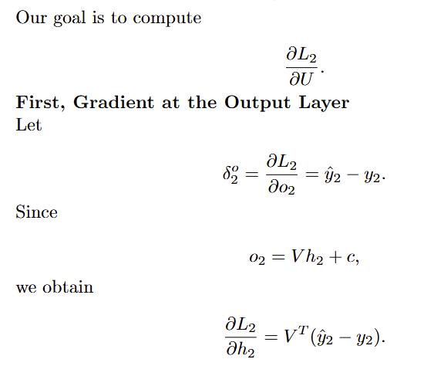
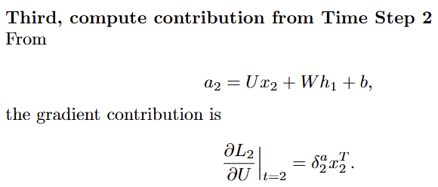
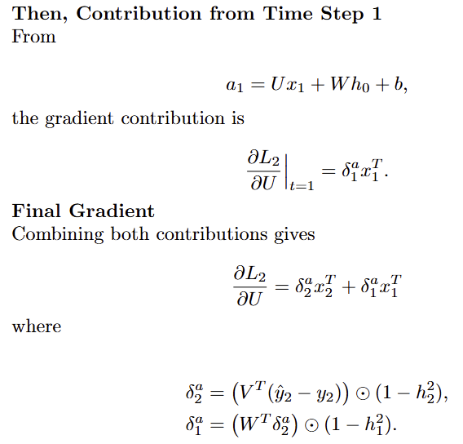
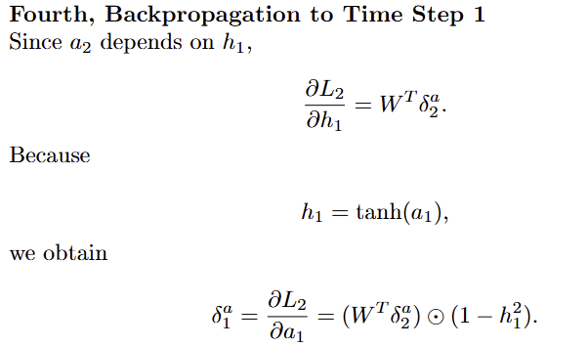
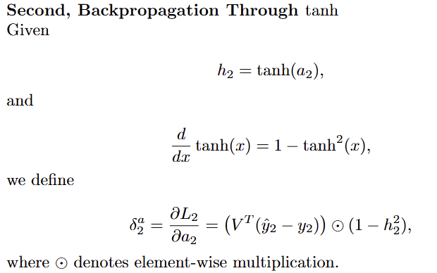
Theory question
Add additional slides if necessary
Solution:

Slide 17
Paper discussion
My review paper is: “Do Vision Transformers See Like Convolutional Neural Networks?”. Here is my short paper review.
The paper “Do Vision Transformers See Like Convolutional Neural Networks?” studys whether Vision Transformers (ViTs) learn visual representations in the same way as traditional Convolutional Neural Networks (CNNs). Rather than focusing only on model performance, the authors analyze the internal representation structures of the two architectures. Using techniques such as Centered Kernel Alignment (CKA), attention distance analysis, and linear probing experiments, the paper shows that ViTs and CNNs learn fundamentally different visual representations.
The main contribution of this paper is the systematic comparison of representation structures between ViTs and CNNs. The authors discover that ViTs exhibit more uniform representations across layers, while CNNs show stage-like transformations where representations evolve significantly between early and later layers. Moreover, ViTs can capture global information much earlier due to self-attention, whereas CNNs rely on gradually expanding receptive fields to aggregate global context. Additionally, the paper also highlights the importance of skip connections in ViTs, which strongly propagate representations through the network. And another key finding is that ViTs require large-scale pretraining datasets to learn effective local features that CNNs obtain naturally through convolutional inductive biases.
Main strength of the paper is its comprehensive empirical analysis using multiple methods, including representation similarity metrics, attention visualization, and transfer learning experiments. These analyses provide deeper insights into how the two architectures process visual information. What’s more, the paper connects observed behaviors directly to architectural components such as self-attention and residual connections. However, the paper also has some limitations. The experiments focus mainly on image classification tasks, which may limit generalization to other computer vision problems. Additionally, the reliance on a single similarity metric (CKA) may not capture all aspects of neural representations.
My personal takeaway is that Vision Transformers do not simply replicate CNN behavior but instead learn visual features through a fundamentally different mechanism. The study also highlights the importance of dataset scale for transformer models. A promising future research direction would be designing hybrid architectures that combine CNN inductive biases with transformer flexibility, which may achieve strong performance while reducing the need for extremely large datasets.

Slide 18
Paper discussion
My review paper is: “Do Vision Transformers See Like Convolutional Neural Networks?”. Here is my answer to Q1.
Vision Transformers (ViTs) and Convolutional Neural Networks (CNNs) differ fundamentally in both architecture and training behavior, which leads to distinct learned feature representations.
First, about architectural differences, CNNs rely on convolutional filters with local receptive fields, meaning early layers process information from small spatial regions and gradually expand to capture global context. This hierarchical structure imposes strong inductive biases, such as translation equivariance and locality. In contrast, ViTs process images as sequences of patches and apply self-attention, allowing each token to attend to all other tokens in the image from the earliest layers. As a result, ViTs can aggregate global information much earlier than CNNs. The paper shows that ViT layers have more uniform representation similarity across layers, while CNNs exhibit stage-like representation structures corresponding to convolutional blocks.
Second, about representation structure, using Centered Kernel Alignment (CKA), the authors find that ViT representations remain highly similar across layers, whereas CNNs show more progressive feature transformation. In CNNs, lower layers focus on edges and textures while higher layers capture semantic concepts. In ViTs, features propagate more directly across layers due to strong residual connections.
Third, for the Global and local information, self-attention enables ViTs to combine both local and global information early in the network. Experiments show that some attention heads focus on local regions while others attend globally, even in early layers. CNNs cannot access such global context early because their receptive fields grow gradually.
Finally, to training differences. ViTs depend heavily on large-scale pretraining datasets (e.g., JFT-300M) to learn useful representations. Without sufficient data, they struggle to learn local features effectively. CNNs perform well even with smaller datasets because their convolutional structure already encodes useful image priors.

Slide 19
Paper discussion
My review paper is: “Do Vision Transformers See Like Convolutional Neural Networks?”. Here is my answer to Q2.
Spatial localization refers to a model’s ability to preserve and identify the spatial position of visual features within an image. In other words, it describes how well the model can determine where an object or feature appears in the input image. For tasks such as object detection, segmentation, and tracking, maintaining spatial information is crucial because the model must identify both what the object is and where it is located.
In the paper, the authors analyze spatial localization by measuring the similarity between representations of tokens in the network and different image patches. They show that Vision Transformers (ViTs) maintain strong correspondence between tokens and their original spatial locations, even in higher layers of the network. This means that each token representation remains closely related to its corresponding image patch, preserving spatial structure throughout the model.
ViTs may therefore be better suited for object detection because they retain clearer spatial information than CNNs in later layers. In contrast, CNNs typically use operations such as pooling and global aggregation that gradually reduce spatial precision. Additionally, ViTs use self-attention, which allows each token to attend to all other regions in the image. This enables the model to capture both local details and long-range relationships, which can help identify objects more accurately and understand their context.
Overall, the strong spatial localization properties of ViTs make them promising architectures for tasks requiring precise object location.

