Slide 1
OBJECT ORIENTED WEB PROGRAMMING USING RUBY
Day 10: 15/June/2017
Test Script writing and
Test running / First Coding

Slide 2
Share ToDo/Done with others
Use Markdown notation.
How to write? See attached Document in the lecture slides folder.
How to view the file in the LINUX environment? There is a Firefox add-on.

Slide 3
What is Test Driven Development
TDD: Test Driven Development Definition
"Test-driven development" refers to a style of programming in which three activities are tightly interwoven: coding, testing (in the form of writing unit tests) and design (in the form of refactoring).
https://www.agilealliance.org/glossary/tdd/

Slide 4
TDD Procedure
It can be succinctly described by the following set of rules:
write a "single" unit test describing an aspect of the program
run the test, which should fail because the program lacks that feature
write "just enough" code, the simplest possible, to make the test pass
"refactor" the code until it conforms to the simplicity criteria
repeat, "accumulating" unit tests over time

Slide 5
RSpec : BDD
Now Behavior Driven Development
RSpec: Behaviour Driven Development for Ruby. Making TDD Productive and Fun.
http://rspec.info/

Slide 6
RSpec
RSpec is testing tool for the Ruby programming language. Born under the banner of Behaviour-Driven Development, it is designed to make Test-Driven Development a productive and enjoyable experience with features listed in the next page.
Ref: http://rspec.info/
See details in the above site.

Slide 7
RSpec features:
a rich command line program (the rspec command)
textual descriptions of examples and groups (rspec-core)
flexible and customizable reporting
extensible expectation language (rspec-expectations)
built-in mocking/stubbing framework (rspec-mocks)

Slide 8
Why we learn RSpec now?
Because, there is a principle for Ruby on Rails programmer, as
“Until we fails the test, we should not write any product code!”
What does it mean?

Slide 9
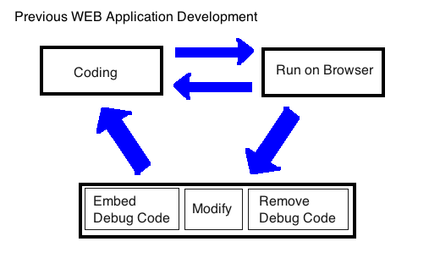
Conventional WEB application Development
We had written the code, run, and checked with its actual runtime environment.
P304, Kiso Ruby on Rails, Impress Japan, 2007

Slide 10
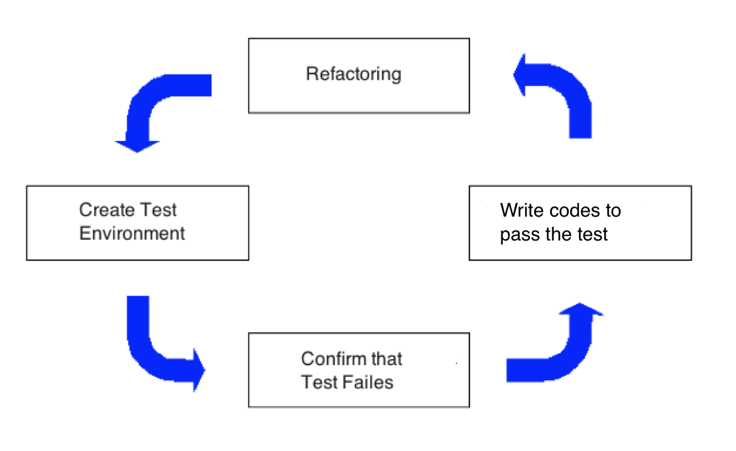
Procedure of TDD
Create Test Environment First.
P304, Kiso Ruby on Rails, Impress Japan, 2007

Slide 11
In Test, “Failure” has meaning
We prepare “Test” before we start writing programs. This will become ‘specification.’
We Test first before we write program, the test should “Fail” and that proves the “Test works properly.”
Here the “Failure” is not an “Error”

Slide 12
4 steps to introduce Test
Step 1: Write “Test”
Make Specification Clear, and write “Test” according to how it should work.
Step 2: Confirm it “fails” before writing program.
Prepare “Test Script” and execute test to prove it works before writing programs. (Debug the test script.)
Step 3: Coding
So that the program passes the test
Step 4: Refactoring
Keep it passes the test, and clean the source code.

Slide 13

Let us introduce RSpec
Now type the following command in the GNOME terminal;
gem install rspec-rails
If you get version display by typing the following command, RSpec is successfully installed.
rspec –v

Slide 14
Add RSpec to Gemfile
Open (projects)/Gemfile, then add the following scripts;
group :test, :development do
gem "rspec-rails"
gem "rails-controller-testing"
gem "factory_girl_rails"
gem "capybara"
gem "database_cleaner"
end

Slide 15
bundle install
Type the following as usual, after you edit the Gemfile
bundle install

Slide 16
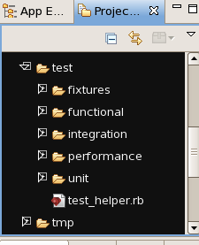
Test folder and the files
You would see ‘test’ folder in the project directory, however they are all for Test::Unit and we will not use those files.

Slide 17
What have we installed?
RSpec – test automation suite
FactoryGirl – Generation of Test Data
Capybara – Web screen input emulator
DatabaseCleaner – Test Data remover
https://github.com/thoughtbot/factory_girl
https://github.com/teamcapybara/capybara

Slide 18
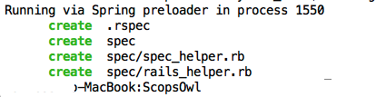
Prepare RSpec environment
Type the following command to prepare RSpec environment
rails g rspec:install

Slide 19

Now we catch up!
We catch up with the principle;
“We should not write any code until we had failed the test.”
Prepare rspec for commodity model! Type
rails g rspec:model ik_memo

Slide 20
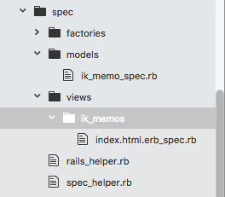

Rspec file for Views
Now then we generate test for views;
rails g rspec:view ik_memos index
Now we get ik_memo_spec.rb
and
index.html.erb_spec.rb
rspec files.

Slide 21
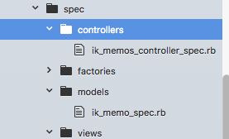
Rspec file for controller
For controller, type
rails g rspec:controller ik_memos

Slide 22
RSpec’s way of thinking…
Before you write a program code, we should write a specification first in principle.
First, we describe the program’s behaviour as an executable sample.
Here, the group of logical test cases is ‘behaviour,’ and the verification of the code is called as ‘expectation.’

Slide 23
Preparation to use FactoryGirl
in spec directory, there is a file rails_helper.rb
Uncomment the following line (near line23):
Dir[Rails.root.join(‘spec/support/**/*.rb’)].each { |f| require f }
Then, add the following:
config.include FactoryGirl::Syntax::Methods
and
require 'capybara/rails’

Slide 24
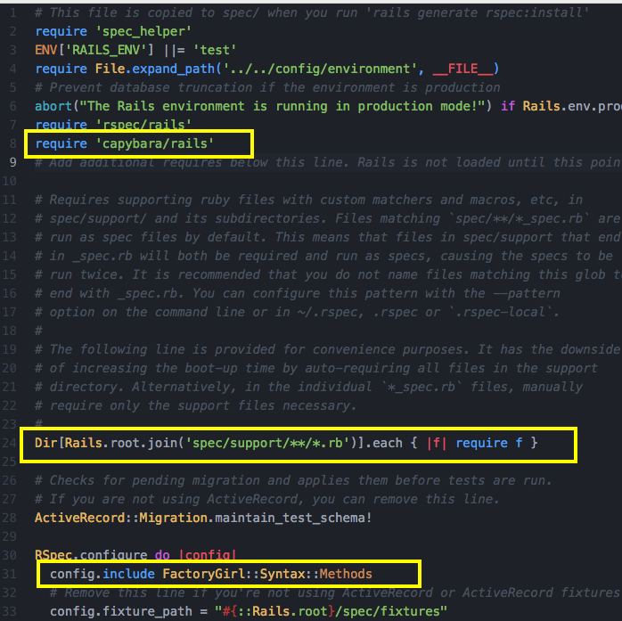
Spec/rails_helper.rb

Slide 25
Prepare Database Cleaner
In
spec/spec_helper.rb
Add the following in the configure block;
config.before(:suite) do
DatabaseCleaner.strategy = :truncation
end
config.before(:each) do
DatabaseCleaner.start
end
config.after(:each) do
DatabaseCleaner.clean
end

Slide 26
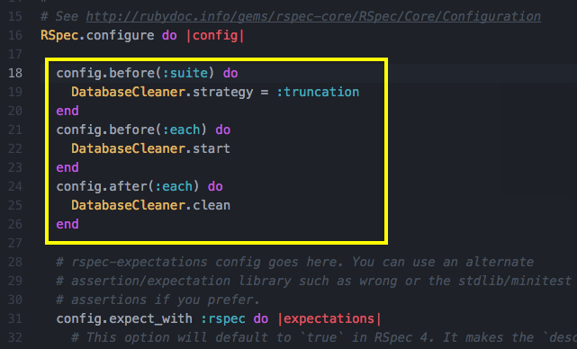
Spec/spec_helper.rb

Slide 27
Prepare to use test table
Rails migration generate database table for “Development” purpose, not for “Test” purpose. So type the following command:
rake db:migrate RAILS_ENV=test
When we complete with the test, we should set it back to the development mode;
rake db:migrate RAILS_ENV=development

Slide 28
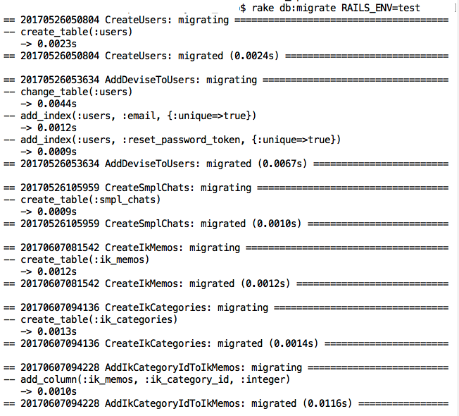
rake db:migrate RAILS_ENV=test

Slide 29
how to write spec file
We write RED part and BLUE part in the left.
RED parts are variables, methods, and conditional statements.
Blue parts are mainly for English, which comes between it and and, so that we can easily READ the specs.
describe Array, "when empty" do
before do
@empty_array = []
end
it "should be empty" do
@empty_array.should be_empty
end
after do
@empty_array = nil
end
end

Slide 30
Then, the question is …
How to write those spec files!
See ‘good rspec file samples,’ in here
http://betterspecs.org/
You are strongly recommended to read through the above site!

Slide 31
Before we go forward…
Please read the above site carefully,
as the principles for an ‘advanced’ Ruby on Rails programmer.
Here we have one thing more…
That is ‘Factory Girl.’

Slide 32
What is Factory Girl?
factory_girl is a fixtures replacement with a straightforward definition syntax, support for multiple build strategies (saved instances, unsaved instances, attribute hashes, and stubbed objects), and support for multiple factories for the same class (user, admin_user, and so on), including factory inheritance.
from
https://github.com/thoughtbot/factory_girl

Slide 33
In short, with factory_girl
we can easily build the test data(fixtures) and strategies for the test specification description.
This will replace rails fixtures.

Slide 34
How to use Factory Girl
Let us see this site;
https://github.com/thoughtbot/factory_girl/blob/master/GETTING_STARTED.md

Slide 35
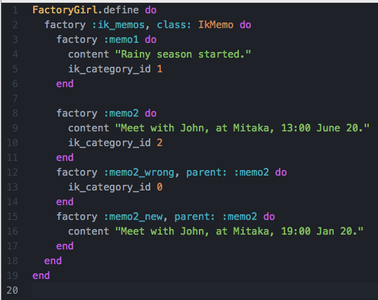
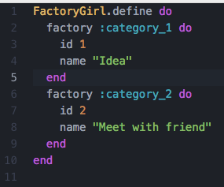
Spec/factories/ik_memos.rb
Each factory has a name and a set of attributes. The name is used to guess the class of the object by default, but it's possible to explicitly specify it:

Slide 36
Spec/factories/ik_memos.rb
FactoryGirl.define do
factory :ik_memos, class: IkMemo do
factory :memo1 do
content "Rainy season started."
ik_category_id 1
end
factory :memo2 do
content "Meet with John, at Mitaka, 13:00 June 20."
ik_category_id 2
end
factory :memo2_wrong, parent: :memo2 do
ik_category_id 0
end
factory :memo2_new, parent: :memo2 do
content "Meet with John, at Mitaka, 19:00 Jan 20."
end
end
end

Slide 37
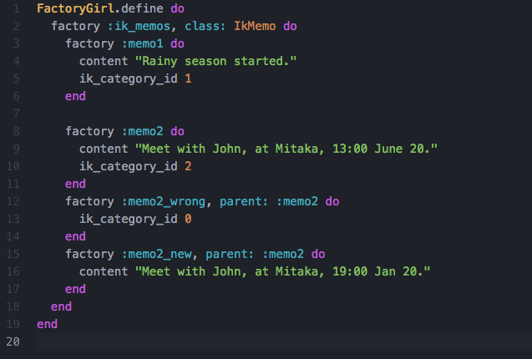
Spec/factories/ik_memos.rb

Slide 38
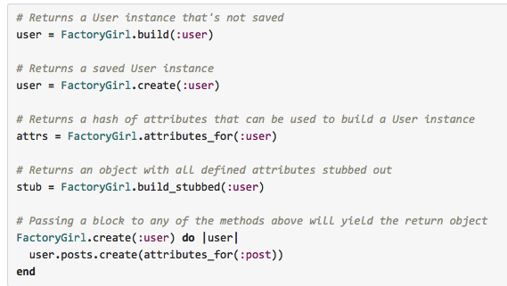
How to use factories
factory_girl supports several different build strategies: build, create, attributes_for and build_stubbed:

Slide 39
spec/controllers/memos_controller_spec.rb (1/2)
require 'rails_helper'
RSpec.describe IkMemosController, type: :controller do
before(:all) do
@c_idea = FactoryGirl.create(:c_idea)
@c_meet = FactoryGirl.create(:c_meet)
@memo1 = FactoryGirl.create(:memo1)
@memo2 = FactoryGirl.create(:memo2)
end
after(:all) do
DatabaseCleaner.clean
end
describe '#index' do
it "displays using index template" do
get :index
expect(response).to render_template :index
end
end

Slide 40
spec/controllers/memos_controller_spec.rb (2/2)
describe "#update" do
context( "when category_id is null, ") do
it "will not be updated, and return to edit." do
get :edit, params: { id: @memo2 }
patch :update, params: { id: @memo2, ik_memo: attributes_for(:memo2_wrong) }
expect(response).to render_template :edit
end
end
context( "when category_id is not null, ") do
it "will be updated" do
get :edit, params: { id: @memo2 }
patch :update, params: { id: @memo2, ik_memo: attributes_for(:memo2_new) }
@memo2.reload
expect(@memo2.ik_category_id).to eq(2)
expect(@memo2.content).to eq("Meet with John, at Mitaka, 19:00 Jan 20.")
end
it "will redirect, after updated, " do
get :edit, params: { id: @memo2 }
patch :update, params: { id: @memo2, ik_memo: attributes_for(:memo2_new) }
expect(response).to redirect_to action: :show, id: @memo2.id
end
end
end
end

Slide 41
Spec/views/ik_memos/index.html.erb_spec.rb
require 'rails_helper'
RSpec.describe "ik_memos/index", type: :view do
feature 'in the ik_memos/index screen,' do
scenario 'When index is displayed, database creation message should appear.' do
visit ik_memos_path # Ik Memos index page
# click_on (t :click_here ) # click Click Here link
expect(page).to have_content 'This is a sample page of database creation.'
end
end
end

Slide 42
Perform Test
Run automated test by typing the following command
rspec spec/*/*_spec.rb spec/views/*/*_spec.rb

Slide 43
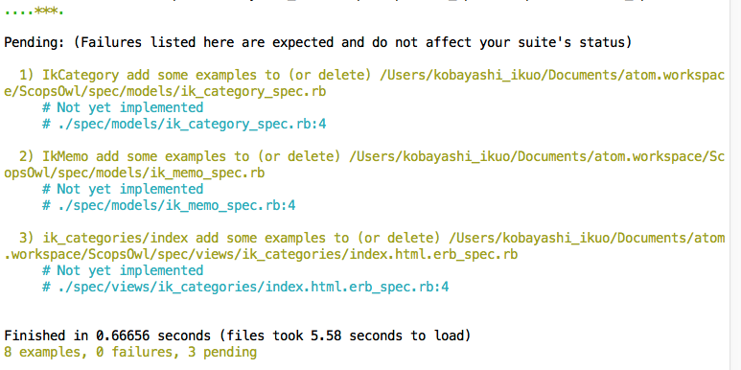
Perform Test
Run automated test by typing the following command
rspec spec/*/*_spec.rb spec/views/*/*_spec.rb

Slide 44
Find some examples…
Please try find the RSpec and factory_girl examples, such site as
http://blog.thefrontiergroup.com.au/2014/12/using-factorygirl-easily-create-complex-data-sets-rails/
Before we write code, we shall write tests,
Before we write tests, we shall define factories,
And, before we need to write rspec and factories, we shall learn much more about the rspec and factories better expressions.
So, please read many many samples as possible about rspec and factory_girl.

Slide 45
RSpec writings
are not ‘must’ in this class.
If you want to try, please write those test codes.
And this may be reflected to the grading.

Slide 46
Now, install your DB and screen.
(If you could, write the test first, then,)
install your Database according to your schema, and design the views.
Now all the technical introduction on Ruby on Rails are completed.
Next, we share codes each other using the tools on which other member had written, or create a link to other members pages.
We introduce sharing ToDo files, and Done.

Slide 47
Show your Test scripts, next week
If you try to write test scripts, demonstrate running rspec.

