Slide 1
OBJECT ORIENTED WEB PROGRAMMING USING RUBY
Day 8: 01/June/2017
Login User Registration

Slide 2
Changes: Removal of LESS
I guess we are not going to use LESS, so I have removed
# gem ‘less-rails’

Slide 3
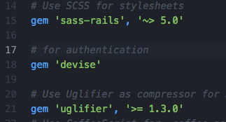
Add login authentification
Today, we add the authentication.
We use devise, and we follow the same procedure we introduced last week.
Open Gemfile, add gem ‘devise,
Then, bundle install.
Try this on your trial project.

Slide 4
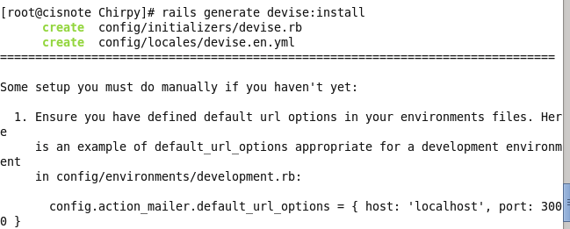
Install Devise to the project
Type the following command,
rails generate devise:install
to install devise to your project, at the project root directory.

Slide 5
Read the message from the system carefully
===============================================================================
Some setup you must do manually if you haven't yet:
1. Ensure you have defined default url options in your environments files. Here
is an example of default_url_options appropriate for a development environment
in config/environments/development.rb:
config.action_mailer.default_url_options = { :host => 'localhost:3000' }
In production, :host should be set to the actual host of your application.
2. Ensure you have defined root_url to *something* in your config/routes.rb.
For example:
root :to => "home#index"
3. Ensure you have flash messages in app/views/layouts/application.html.erb.
For example:
<p class="notice"><%= notice %></p>
<p class="alert"><%= alert %></p>
4. If you are deploying on Heroku with Rails 3.2 only, you may want to set:
config.assets.initialize_on_precompile = false
On config/application.rb forcing your application to not access the DB
or load models when precompiling your assets.
5. You can copy Devise views (for customization) to your app by running:
rails g devise:views
===============================================================================

Slide 6
3 steps to use devise
Ensure you have defined default url options in your your environments files.
cancels if it causes an error!
2. Ensure you have defined root_url to *something* in your config/routes.rb.
3. Ensure you have flash messages in app/views/layouts/application.html.erb.

Slide 7
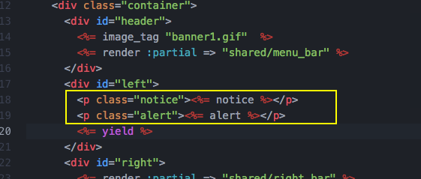
Add two lines for login result message display (Step 3)
Modify
(project)/app/views/layouts/application.html.erb
Add the following two lines before <%= yield %>
<p class="notice"><%= notice %></p>
<p class="alert"><%= alert %></p>

Slide 8
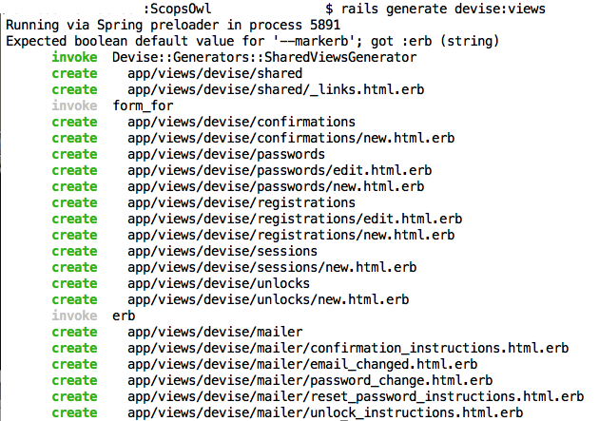
View for devise
Here we generate views for devise. Type
rails generate devise:views

Slide 9
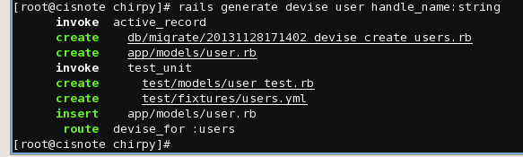
User model
User model for authentication could be used to register the user.
So, this can contain the handle name, real name, and such. Add the necessary attributes for it. If you think you do not need to keep the real name for your system, use the following sample.
rails generate scaffold user email:string handle:string

Slide 10
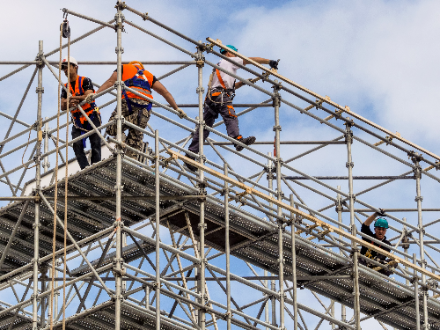
What is Scaffold?
Necessary files for DB maintenance.

Slide 11
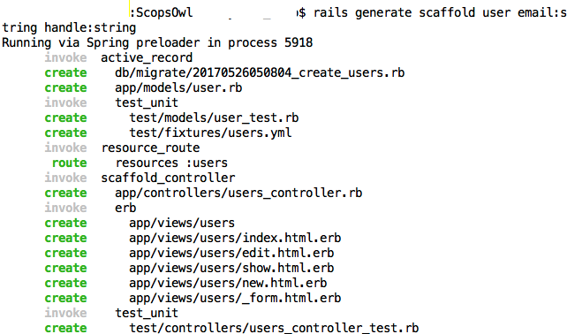
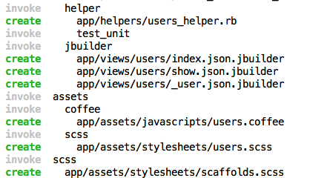
Generated Files

Slide 12

Migration
Every time you generated database tables, you need to migrate, to create tables.
rake db:migrate

Slide 13
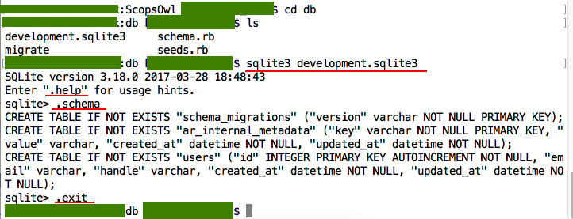
By migrating, what happened?
Database tables are generated.

Slide 14
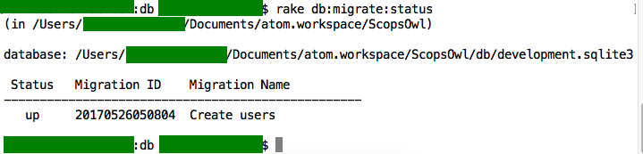
How to see table conditions
Type command:
rake db:migrate:status

Slide 15
Do not remove tables manually
Schema_migrations table is maintained by rails.
So, if you remove db table manually, rails will fail to find the table which is registered in the maintenance record, to cause an error.

Slide 16
So, how to cancel table creation
Cancel command of rails generation is “destroy.” I.e., to cancel “rails generate scaffold user email:string handle:string, you need to type;
rails destroy scaffold user
Before you remove the scaffold, you need to type;
rake db:rollback
to let rails remove the table.

Slide 17
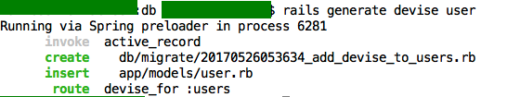
Use ‘user’ table for authentication
Generate devise to manage the login authentication for ‘users’ table
rails generate devise user

Slide 18
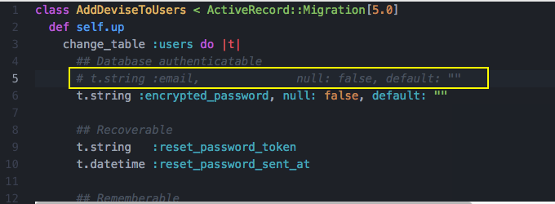
Modify migration file
Remove the following line
t.string :email, null: false, default: “”
in the file:
db/migrate/2017xxxx_add_devise_to_users.rb

Slide 19
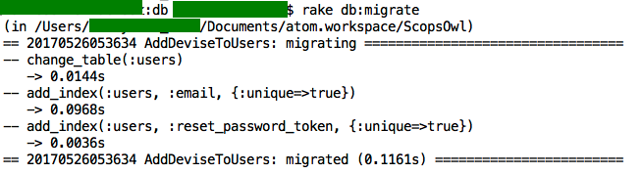
Check migration file, and migrate
Type
rake db:migrate

Slide 20
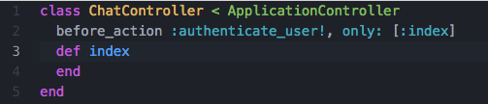
Request to login
Add the following line in ChatController
before_action :authenticate_user! only: [:index]
Authenticate method is provided by devise gem. “user” is the model name which is assigned for the authentication control.
So, if you created member table, and “rails generate devise member” the method name should be :authenticate_member!

Slide 21

Sign Out path
Check by “rake routes”
You will find destroy_user_session_path in the routing list.
In _menu_bar.html.erb, three lines had been added.
if current_user.present?
menu_items.push( {:link => destroy_user_session_path,
:name=>'Sign Out', :method=>'delete'})
end

Slide 22
Apply bootstrap to Users
The following command will automacitaly apply bootstrap classes to the scaffold.
rails g bootstrap:themed Users
See the following page;
http://getbootstrap.com/components/

Slide 23
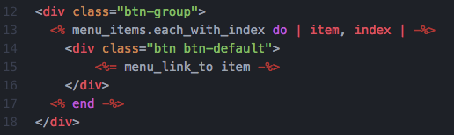
Bootstrap Arrange
Sample for menu_bar

Slide 24
Result of Scaffold generation
CRUD of database are all ready for Users
Class name : User

Slide 25
Action Mailer
Generate Sign up mailer
rails g mailer SignupMailer
Then manually register
signup_email.html.erb, and
signup_email.text.erb

Slide 26
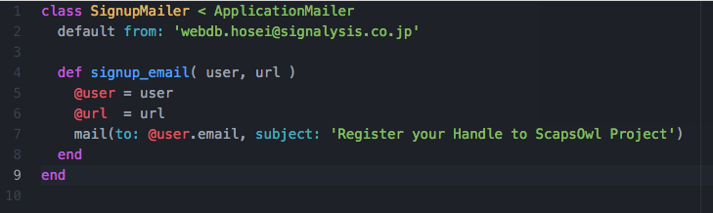
Signup Mailer
Mailers / signup_mailer.rb is generated.
Modify as the following

Slide 27
Now design your own portal
How many screens do you write?
What kind of data do you need to store?
Think about the screen links.
Next presentation:
Screen proto-types,
Database Schema

