Slide 1
My idea of Rails project
Determination of site design

Slide 2
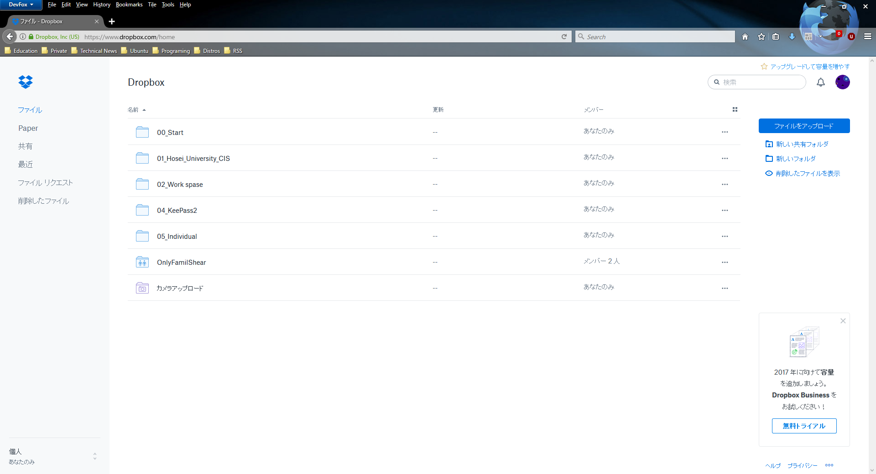
1. Design of original Dropbox
Account button
Directory indicator
Search bar
Site links
Operation buttons
Main contents

Slide 3
2. Design of proposal file server
Aimed at visual design
Using “Material Design”
Material design is a new visual UI and UX created by Google
Basically, this system follows guidelines of Material Design
Notes:
Because of some gems different implements, this design might be change.

Slide 4










$LOGO_MARK
$USER_NAME /
$CHAT_USER_NAME
Name
Last update
Permission
File size
Folder Name01
18/05/2017 me
Private
-
C
Hi, What are you doing?
Folder Name02
18/04/2017 me
Private
-
5 mins ago
File_Name.md
18/05/2017 me
Public
5.1KB
I’m doing a presentation : )
Now
+
Write a message

Slide 5


$LOGO_MARK
$USER_NAME /
$CHAT_USER_NAME
Name
Last update
Permission
File size
Folder Name01
18/05/2017 me
Private
-
C
Hi, What are you doing?
Folder Name02
18/04/2017 me
Private
-
5 mins ago
File_Name.md
18/05/2017 me
Public
5.1KB
I’m doing a presentation : )
Now
Create new folder…
Upload a file…
+
Write a message

Slide 6




$LOGO_MARK
$USER_NAME /
File_Name.md
Name
Last update
Permission
File size
No Image
Folder Name01
18/05/2017 me
Private
-
Folder Name02
18/04/2017 me
Private
-
File_Name.md
18/05/2017 me
Public
5.1KB
Format
Markdown
Size
5.1 KB
Modified
18/05/2017
Created
11/05/2017
Permission
Public
File Download
Share Option
+

Slide 7







33,150,243)
U
LOGO_MARK
USER_NAME /
$CHAT_USER_NAME
$USER_NAME
$USER_MAIL_ADDRESS
Last update
Name
Permission
File size
Folder Name01
18/05/2017 me
Private
-
C
Hi, What are you doing?
$FILE_SERVER_NAME
Folder Name02
18/04/2017 me
Private
-
5 mins ago
File_Name.md
18/05/2017 me
Public
5.1KB
I’m doing a presentation : )
$CHAT_NAME
$EDU_PORTAL_NAME
Now
$BUS_DELAY_NAME
$EDU_DOC_FDR _NAME
$WELLCOME_NAME
+
Write a message

