Slide 1
My idea of Rails project Screen and Database design
Jun 8, 2017

Slide 2
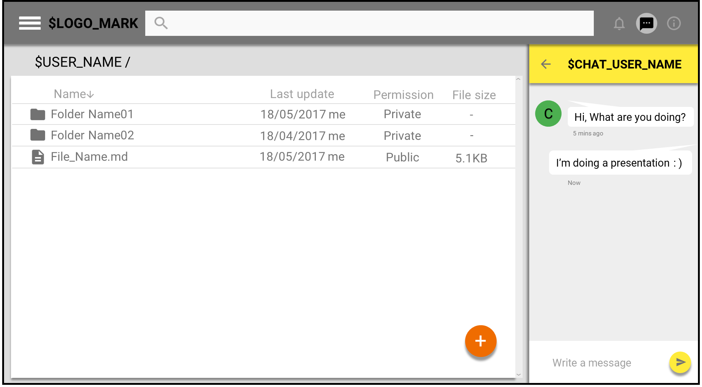
Design of screen :Main Page

Slide 3
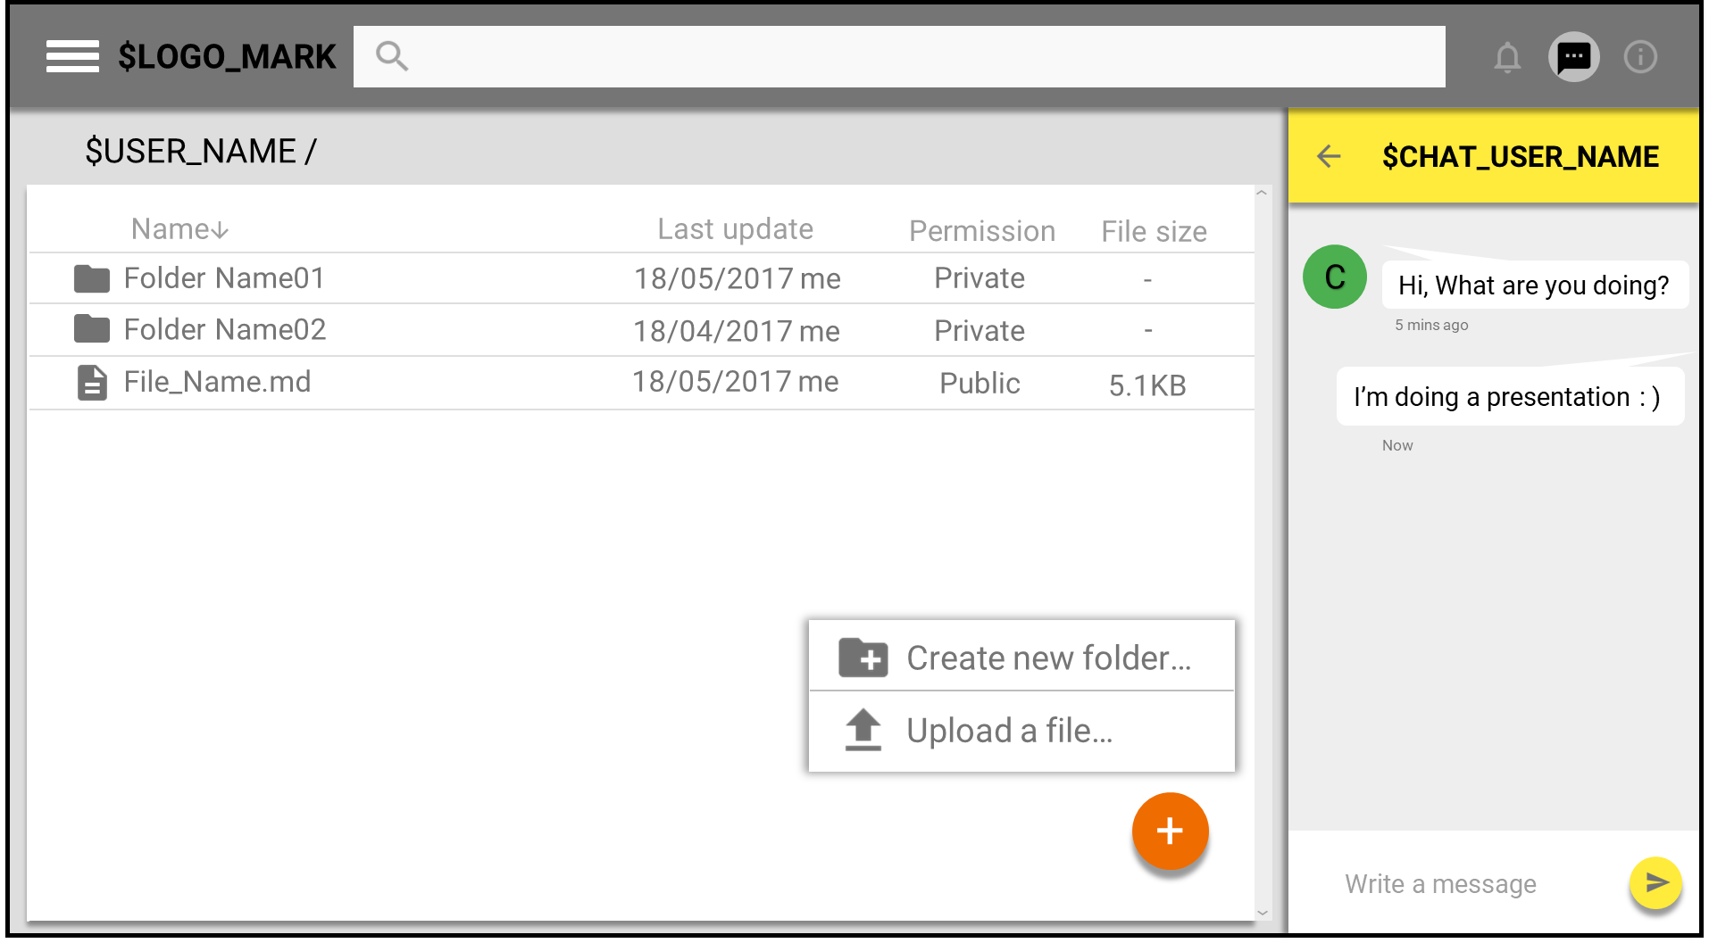
Design of screen :Operation

Slide 4
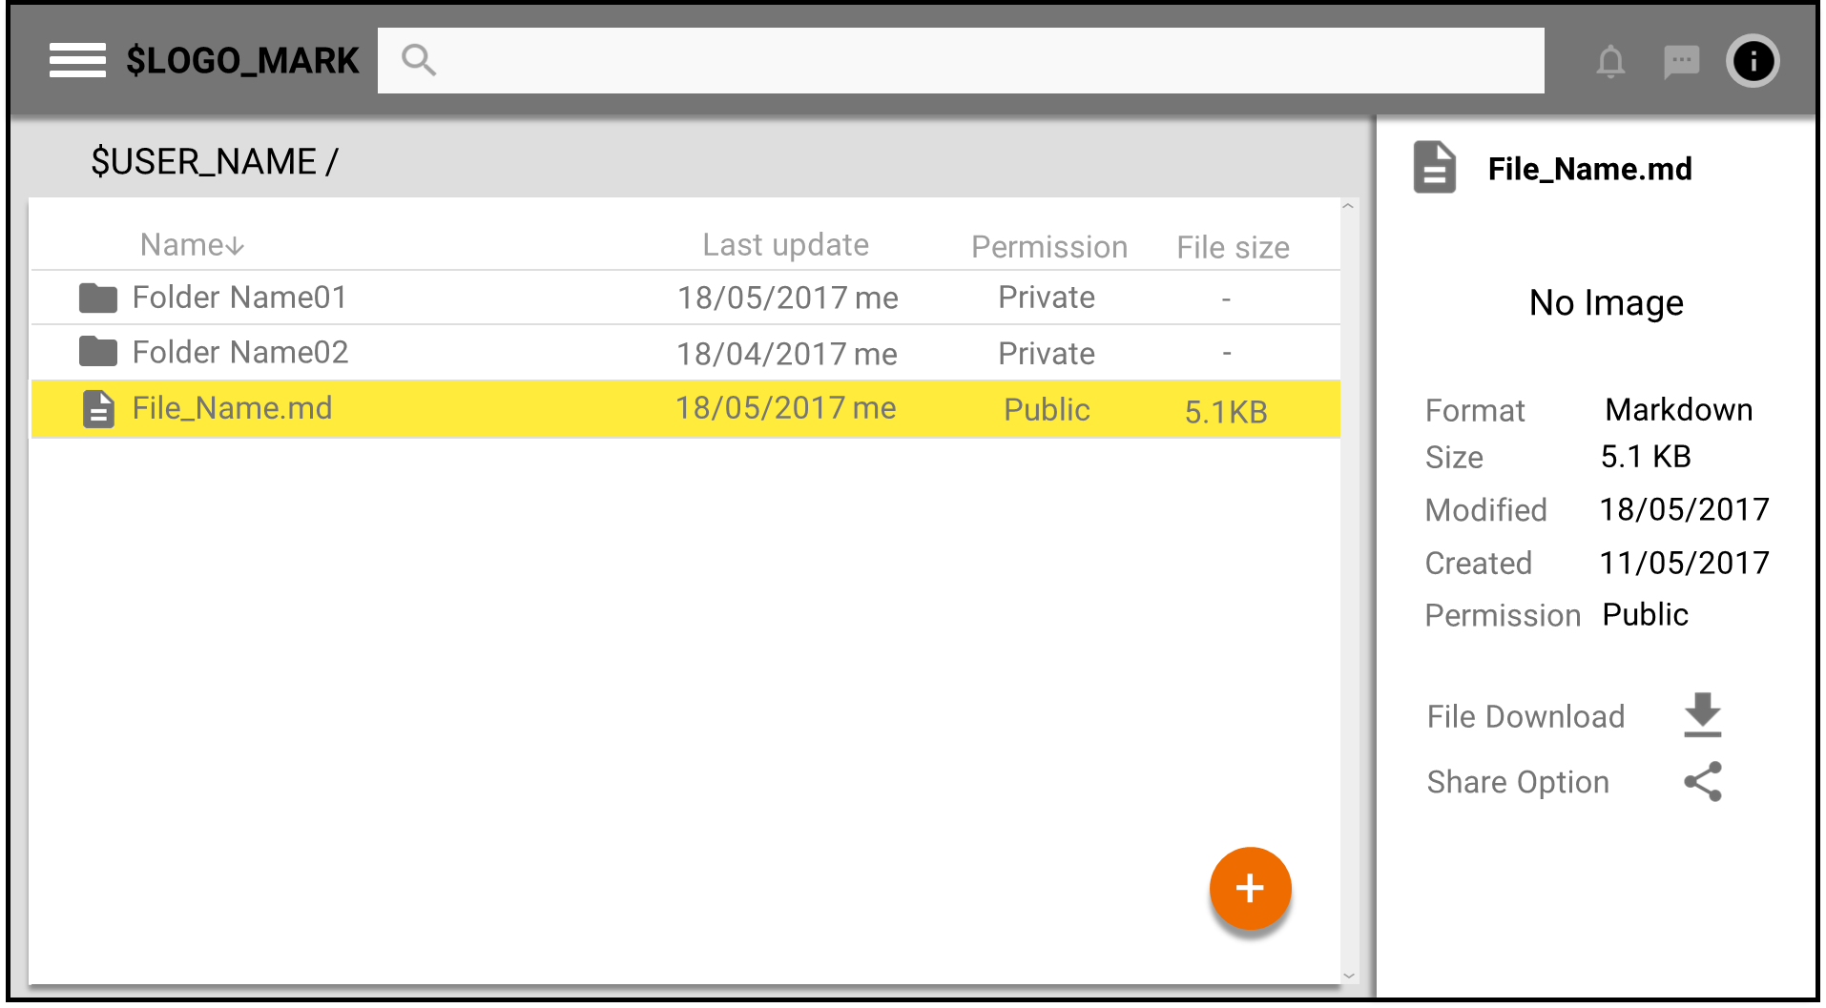
Design of screen :Display details

Slide 5
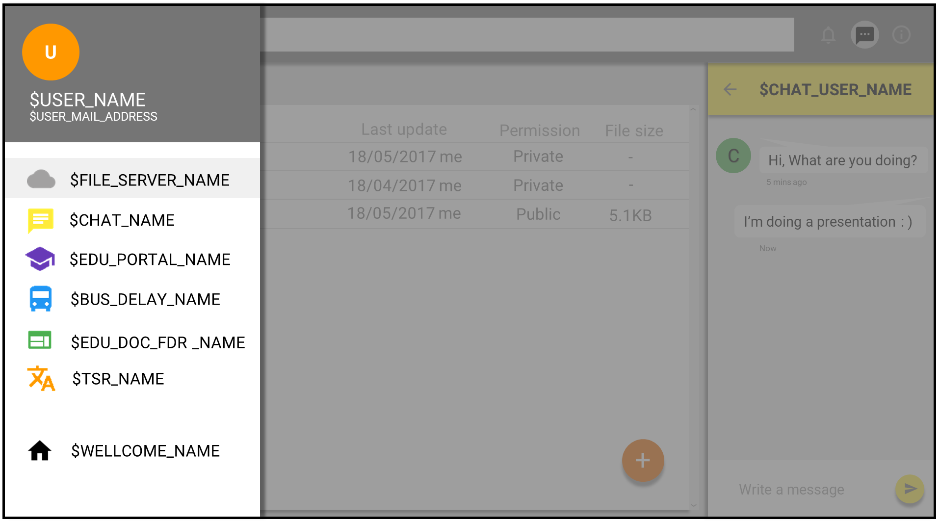
Design of screen :Display some links

Slide 6
What to store in the Database
Notes:
Gr_files_table, Gr_users_table
File type is obtained by file extension using mime type class object of Ruby on rails.
File Name and File size is obtained from database, so run command “rails g model attachment filename” then store the data to database.
File timestamp obtain from ruby method mtime

