Slide 1
OBJECT ORIENTED WEB PROGRAMMING USING RUBY
Day 6: 18/May/2017
Merge the design

Slide 2
Step 1
Everyone “push” the design presentation document to the repository.
Add the presentation document to the project tree, ‘docs’ directory.
Then, ‘push’ the document to each forked repository.
‘New pull request’: will ask the project owner to ‘pull’ the forked document.
Currently, no conflict should happen.

Slide 3
Step 1 : share
We all pull the changes in the original webdbhosei master’s, to share the design documents of our team members.
git pull origin(or origin name) master
https://help.github.com/articles/pushing-to-a-remote/

Slide 4
Step 2
Now latest “common” project source code in each computer.
Note: View designer will generate controller.
Webdbhosei will ‘pull’ those changes.

Slide 5
Step 3 : discussion
While the assigned person “generate” the models or the controllers, we will check the “fields,” “actions,” and such.
Give “Note” to the project.
We share “ToDo” documents in our project.

Slide 6
Step 3 : Understand the specs.
https://semaphoreci.com/community/tutorials/getting-started-with-rspec
https://github.com/thoughtbot/factory_girl/blob/master/GETTING_STARTED.md
https://github.com/teamcapybara/capybara

Slide 7
Step 3 : Understand the specs.
In Japanese
http://www.atmarkit.co.jp/ait/articles/1409/30/news037_2.html
http://tech.grooves.com/entry/2015/04/28/173025
http://qiita.com/jnchito/items/607f956263c38a5fec24

Slide 8
Step 4
If we have come to think that we need to install new gem, what we should do?
Before adding the gems to Gemfile, write the “Discussion” file in “docs.”
What should we have?
“ToDo.txt”, “Proposal.txt,” and “Discussion.txt”?

Slide 9
Team ToDo and personal ToDo
Edit .gitignore to Add personal ToDo.txt

Slide 10
Presentation
List up functions of your part (what you image.)
Mockup the view of your screen/ or a wireframe is accepted.
Even a rough sketch will be accepted.
https://graphicdesign.stackexchange.com/questions/30860/what-is-the-difference-between-wireframes-and-mockups

Slide 11
Appendix
Generation of Welcome Screen
The command is
rails generate controller welcome index

Slide 12
What happened?
create app/controllers/welcome_controller.rb
route get 'welcome/index'
invoke erb
create app/views/welcome
create app/views/welcome/index.html.erb
invoke test_unit
create test/controllers/welcome_controller_test.rb
invoke helper
create app/helpers/welcome_helper.rb
invoke test_unit
invoke assets
invoke coffee
create app/assets/javascripts/welcome.coffee
invoke scss
create app/assets/stylesheets/welcome.scss

Slide 13
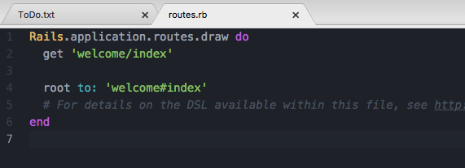
Make this welcome#index as root
Edit routes.rb, and added the following line
root to: 'welcome#index'

Slide 14
app/views/welcome/index.html.erb
Read the file, as the Top page sample.

Slide 15
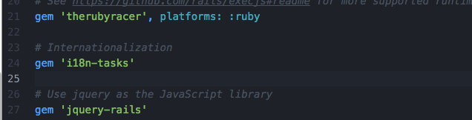
Gemfile is modified
The following line had been added;
gem 'i18n-tasks’
in Gemfile

Slide 16
When the Gemfile is updated,
Please update your gem environment by yourself. Your PC environments cannot be pulled from github.
bundle install
bundle update

Slide 17
Internationalization
Config/environments/development.rb
Config/environments/test.rb
Check that two lines had been added.
config.i18n.load_path += Dir[Rails.root.join('config', 'locales', '*.{rb,yml}').to_s]
config.i18n.default_locale = :en

Slide 18
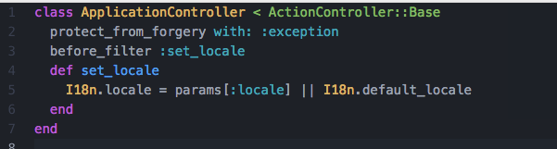
Internationalization (2)
Check that app/controllers/application_controller.rb is modified.
4 lines had been added.
before_filter :set_locale
def set_locale
I18n.locale = params[:locale] || I18n.default_locale
end

Slide 19
Dictionaries
Note that the dictionary files had been added and updated for 4 languages;
En.yml
Ja.yml
Ed.yml
Sw.yml

Slide 20
Entry Messages
Dictionary translations had been added for the “Student Portals” title
En:
app:
entrance: “Student Portals”
Ja:
app:
entrance: “学生ポータル入口”

Slide 21
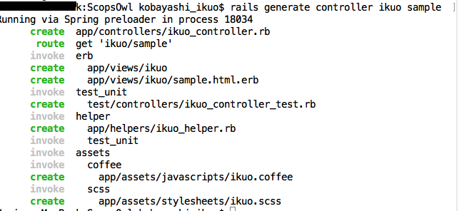
Teachers sample
I had added lecturer’s sample by typing
rails generate controller ikuo sample

Slide 22
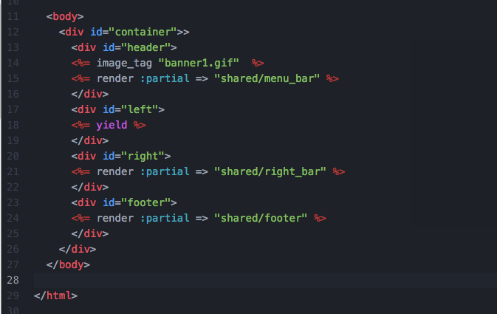
Screen Division
App/views/layouts/application.html.erb had been modified.

Slide 23
Several files had been added.
One directory had been added;
app/views/shared
Check the following files added;
app/assets/images/bannar1.gif
app/views/shared/_right_bar.html.erb
app/views/shared/_footer.html.erb
app/views/shared_menu_bar.html.erb
Check that the following file is modified;
app/helpers/application_helper.rb
app/assets/stylesheets/application.css

