Slide 1
Design
Hitme

Slide 2
Introduction
Traffic Delay for students of Hosei University
Bus near Hosei
Train(Chuo line)
Others
Screen proto-types
Database Schema
Notes:
This is what I implement.
Site of bus and train delay
I show you screen proto-types
Then I tell you structure of database what I thinking.

Slide 3
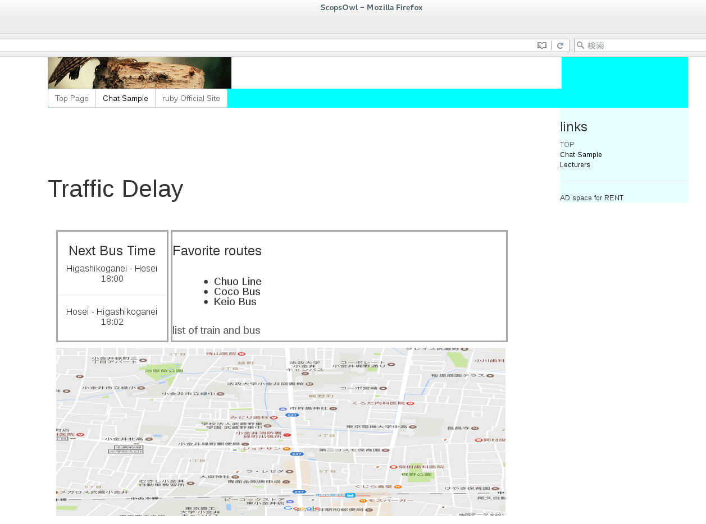
Screen proto-types
Page title
User’s favorite routes
Next bus time
Map of routes
(temporary image)
Notes:
This is screen proto-type
Title,next bus time,Uesr’s favorite routes and map of routes.
This is temporary image, so it has no related to bus routes and I have to change it later.

Slide 4
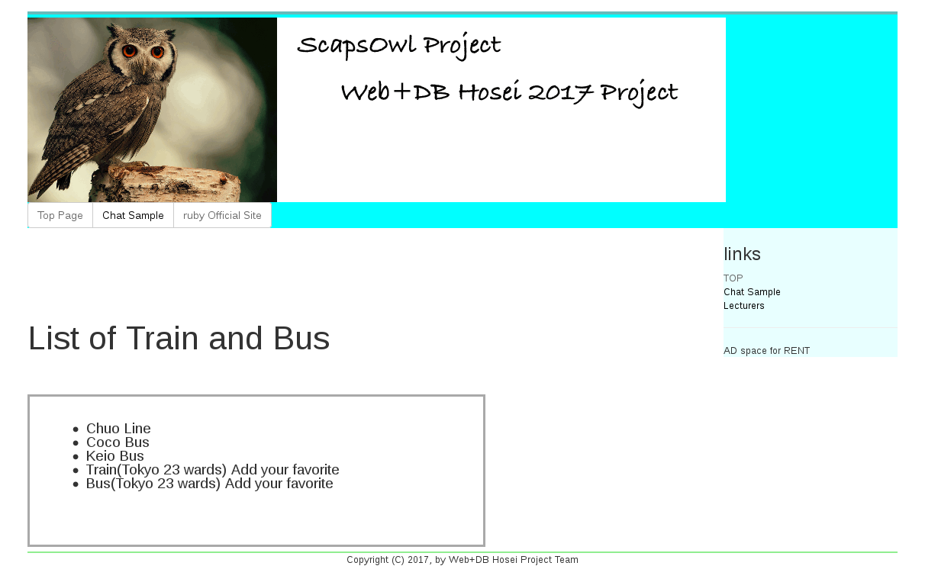
Screen proto-types
Page title
User’s favorite routes
Next bus time
I want to change this lists to table
click
Map of routes
(temporary image)
Notes:
This is a link. When you click it, you move to page of list of train and bus.
Now I am writing the list as bullet , but I want to change it to tables.

Slide 5
Screen proto-types
Page title
User’s favorite routes
Next bus time
Chuo Line
click
Chat
Map of routes
(temporary image)
Notes:
And now It dosen’t be links, but I think that I have to be links and make pages for each links.

Slide 6
Database Schema
Route
name:string
route_detaile:string
link_to_chatroom:string
Favorite
user_id:integer
route_id:integer
Notes:
And this is structure of database what now I thinking.
i think I need 2 database route and favorite.
Route need name and route detaile for display in the list of traffics.
And maybe it need link to chatroom
Then, favorite need 2 id user and route to identify users’ favorite.

