Slide 1
OKANE CHAT SYSTEM

Slide 2
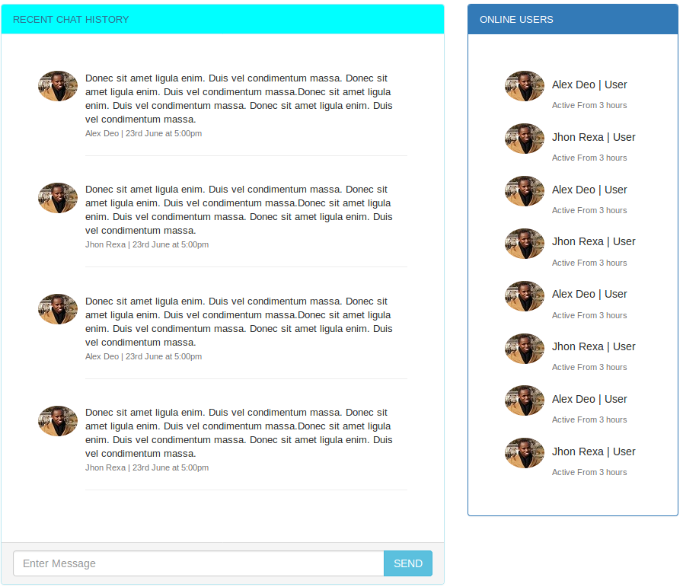
Proposed screens

Slide 3
Data needed by the system
User
Picture. - png
Name. - string
Status.- boolean
Logged in -boolean
Chat
User id. – int
Recipient id – int
Message –Text
Time stamp- date

Slide 4
Entity relationships
User
chat
many
many
m
m
User chat
1
1

Slide 5
THANKS!
Any questions?
You can find me at
@kimmungai

