Slide 1
Mockup
2017/05/18

Slide 2
contents
Bus Delay
Traffic Delay for students of Hosei University
Bus near Hosei
Train(Chuo line)
Others
Arranging for students
Notes:
I’ll make a page of bus delay.
Other pages related students, so I arrange my idea and I’ll make traffic delay,bus near hosei,chuo line and other lines for students of Hosei University

Slide 3
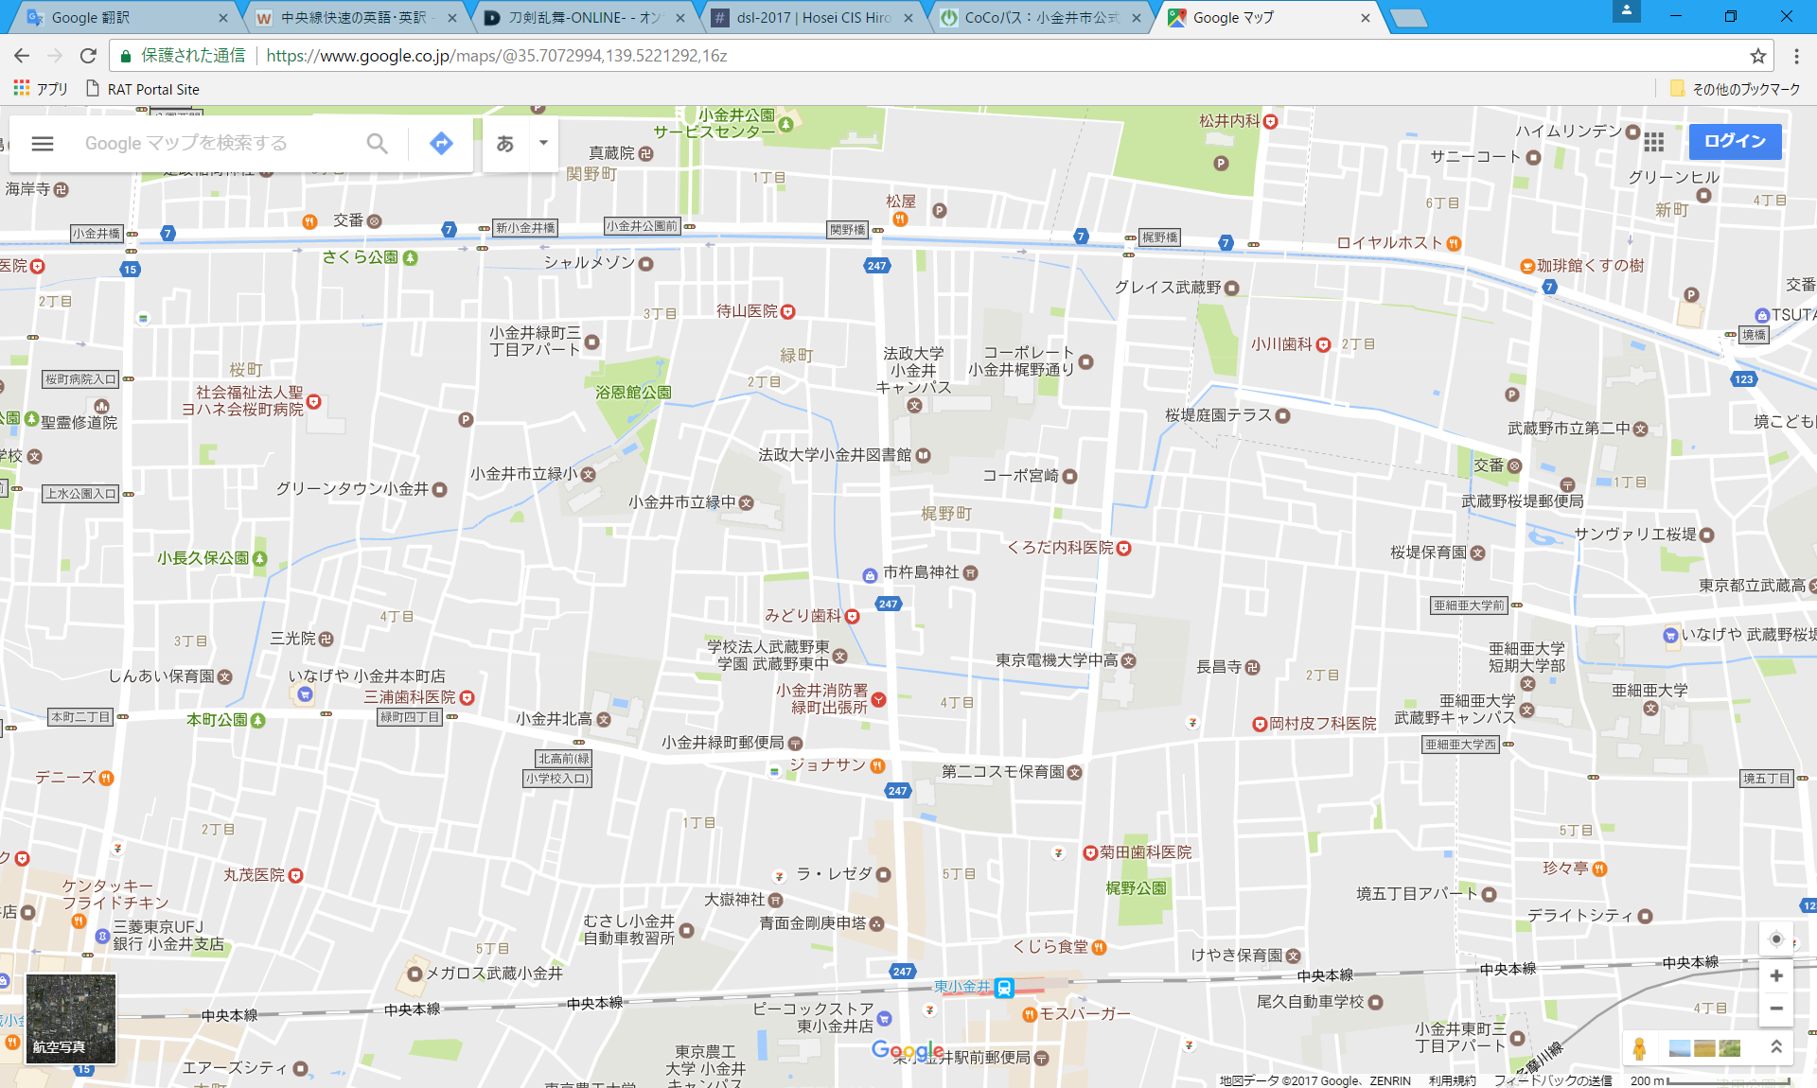
Top Page
favorite
all
Chuo Line
New messages!!
Coco Bus
Keio Bus
Hgashikoganei
↓
Hosei
External linkage
Coco Bus
Keio Bus
JR
Hosei
Other
12:34(00:02)
Keio Bus
6 messages
Coco Bus
2 messages
Hosei
↓
Higashikoganei
Chuo Line
17 messages
12:36(02:02)
Notes:
This is image of Top page
Display your information of traffics in higashikoganei
Here is your favorite traffics. These 3 line is registered by default.
Here is maps near Hosei and higashikoganei station. And default 3 lines’ number of messages are displayed like this.
Here is next bus time higashikoganei station to hosei and hosei to higashikoganei station
And setting external linkage

Slide 4
Top Page
favorite
all
Chuo Line
New messages!!
Coco Bus
Keio Bus
Hgashikoganei
↓
Hosei
External linkage
Coco Bus
Keio Bus
JR
Hosei
Other
Chuo Line
12:34(00:02)
Chat
Keio Bus
6 messages
Coco Bus
2 messages
Hosei
↓
Higashikoganei
Chuo Line
17 messages
12:36(02:02)
Notes:
Click each line, moving chat room.

Slide 5
List of train and bus
favorite
all
Name | info | favorite
Chuo Line | Tokyo-Takao,Toyota…
Coco Bus | Higashikoganei-Hosei
Keio Bus | Higashikoganei-Hosei
Train(Tokyo 23 wards) |  | Add your favorite
Bus(Tokyo 23 wards) |  | Add your favorite
Train(Kanagawa) |  | Add your favorite
Notes:
This is a page of list of all train and bus
Top 3 lines are default settings
If you click add your favorite, these lines are added your favorites.

